Slide 1
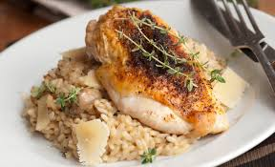
Executive Dining Options in Sunrise, FL: A Coursera Capstone Project

Slide 2

Introduction: Sunrise, FL is an important location for American Express and it is oftentimes a stop for visiting executives of many different business units. Business Problem: Since many New York-based American Express colleagues travel to our Sunrise office for meetings and team building activities, I have been tasked with finding reputable and tasty restaurants nearby for meals after work. In addition, my colleagues have asked me to recommend noteworthy dishes at the restaurant.

Slide 3
By leveraging Foursquare API data, I will pull the following restaurant information in Sunrise:
Venue Names
Venue IDs
Venue Location
Venue Category
Venue Tips

Slide 4
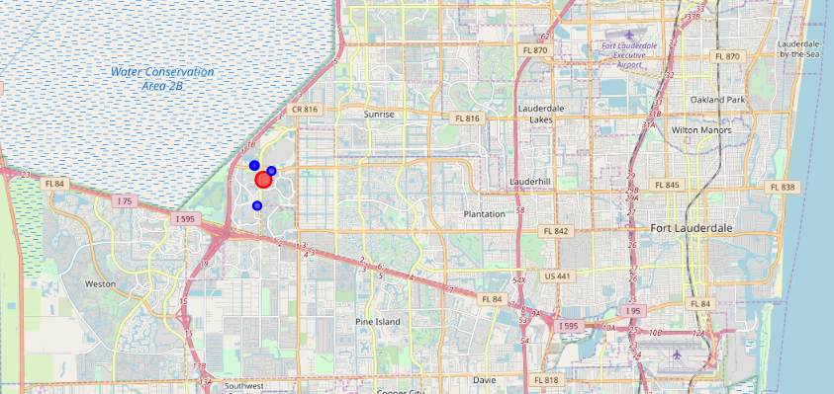
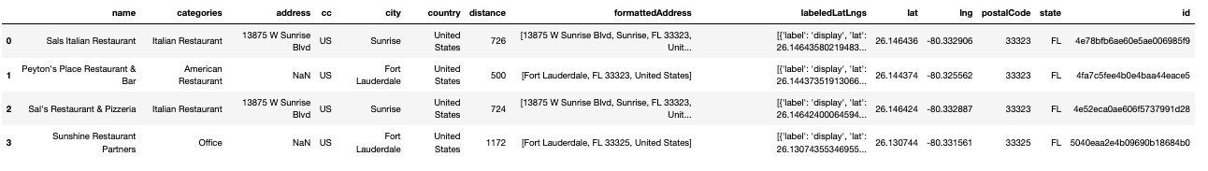
Methodology:
To acquire the above-mentioned details, I will need to do the following:
Get geolocator latitude and longitude coordinates for Sunrise
Foursquare API data to populate a list of venues in Sunrise
Venue names, venue IDs, locations, categories, and tips

Slide 5
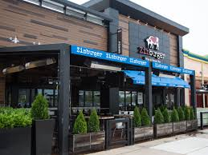
Tips: The double truffle fries and dark chocolate shake at Zinburger!

Slide 6
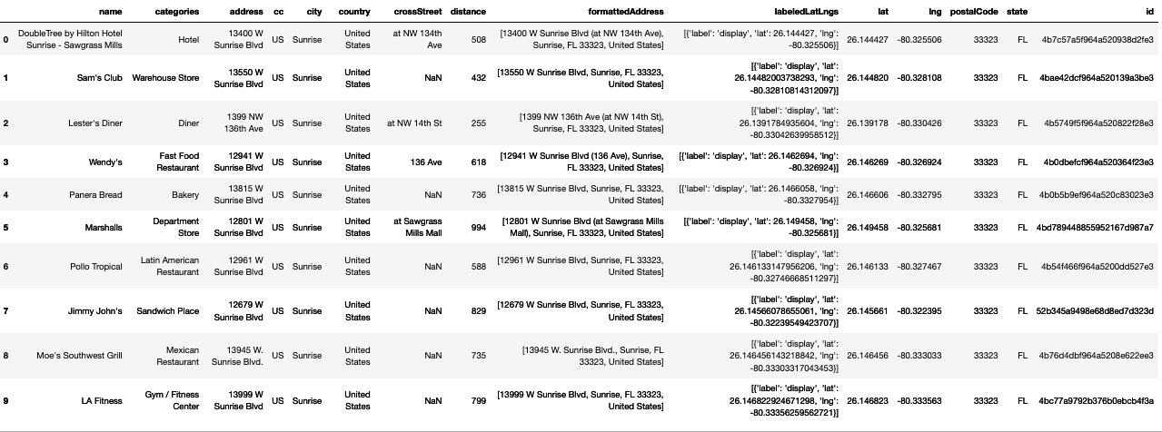
Other nearby places to visit:

Slide 7
