Slide 1
CyberCoach
Ruby on Rails project
Frédérik Ganninger
Thibaud Chardonnens
Notes:
Thibaud

Slide 2
Agenda
Application goals
Project evolution
Project schema
Data Model
DEMO ☺
Improvements
Questions ?

Slide 3


CyberCoach Goals
First presentation
Now
Help people to organize sport tournaments
Create and manage an event
Create a Doodle like tool for finding common dates
Give some points for participating and winning
Friends list
Finding events next to your place
Possibility to login with your CyberCoachServer account
Summary of your performance
User friendly design (Twitter Bootstrap, Jquery)
Notes:
Fred

Slide 4
Project Evolution
Learning Ruby basics and ROR framework
Defining the project features
Building the project and database architecture
Setting up the Github repository and Heroku
Implementing ☺ - feature by feature
Notes:
Thibaud

Slide 5
Project Schema
Notes:
Thibaud

Slide 6
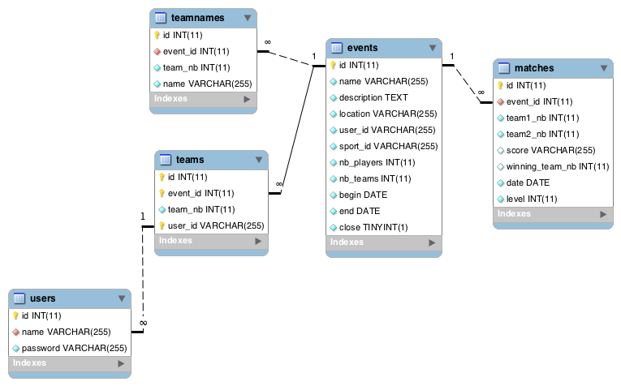
Data Model
Notes:
Fred

Slide 7
DEMO !
Interactive if you go on http://cybercoach.herokuapp.com

Slide 8
Improvements
More interaction with friends
Sending invitation
Comparing scores
Dates management
Help you to plan your event
Doodle like tool
Geolocation and Facebook integration
Latency problems
Create a cache

Slide 9
Questions ?
Thanks for your attention !

