Slide 1
OCTCV Part 2: Physics-Informed
Data Augmentation for Glaucoma Detection
Capstone Three — Final Presentation

Slide 2
Agenda
1. Project Overview & Motivation
2. Data & EDA Findings
3. Augmentation Pipeline Design
4. Model Training & Results
5. Part 1 vs Part 2 Comparison
6. Key Findings & Conclusions
7. Future Directions

Slide 3
Context & Problem
• Glaucoma: irreversible blindness affecting 80M+ globally
• Part 1 trained 3D CNNs on 1,110 OCT volumes (best AUC = 0.94)
• Question: Can data augmentation push performance higher?
• Original paper also tested augmentation (AUC dropped 0.94 → 0.92)
• Our hypothesis: physics-informed augmentation may do better
Reference: Maetschke et al. (2019), PLOS ONE

Slide 4
Dataset
• Source: Zenodo (Ishikawa, 2018)
• 1,110 ONH-centered OCT volume scans (64×128×64 voxels)
• 624 patients, single Cirrus SD-OCT scanner
• 847 Glaucoma (POAG) / 263 Normal (76% / 24%)
• Same train/test split as Part 1 preserved
• Class distribution kept unbalanced (lesson from Part 1)

Slide 5

EDA: Structural Similarity Analysis
• High intra-class SSIM (> 0.8)
• Narrow distribution → conservative
augmentation parameters
• Augmented volumes must stay
within natural data manifold

Slide 6
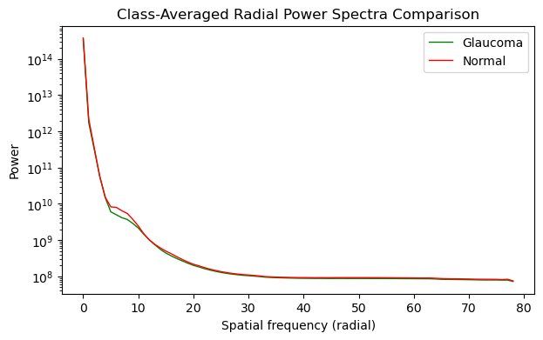
EDA: Frequency-Domain Analysis
• Glaucoma changes: mid-frequency
• Normal vs Glaucoma similar at
low & high frequencies
• Informed LPF radius (r=30)
to preserve diagnostic content

Slide 7
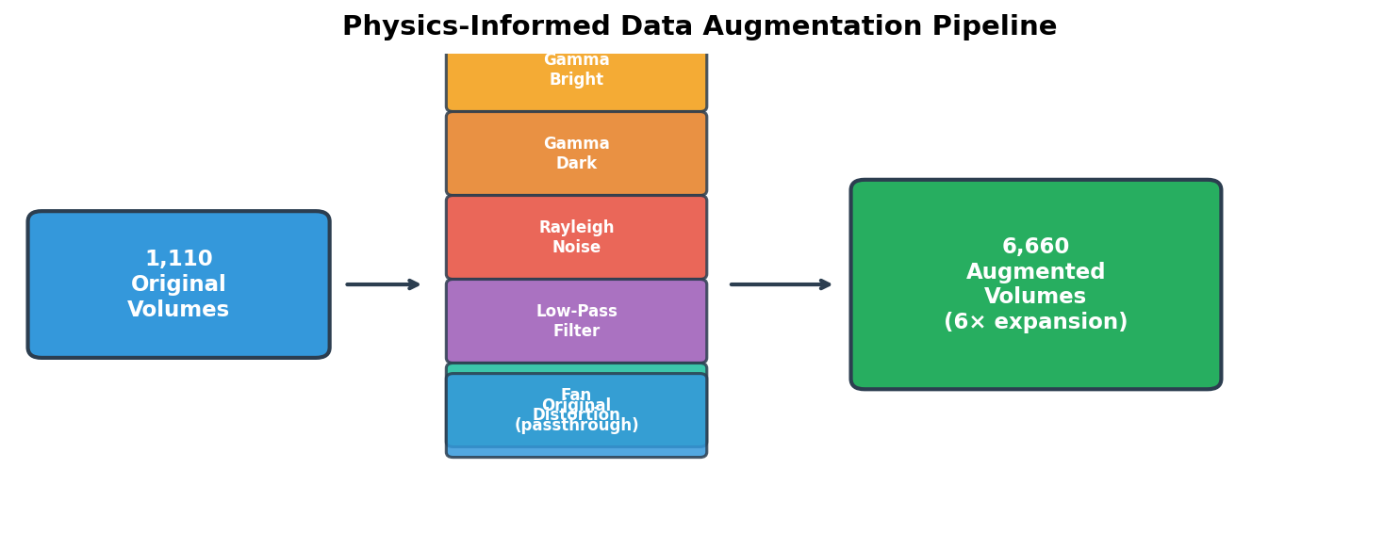
Augmentation Pipeline (1,110 → 6,660)

Slide 8
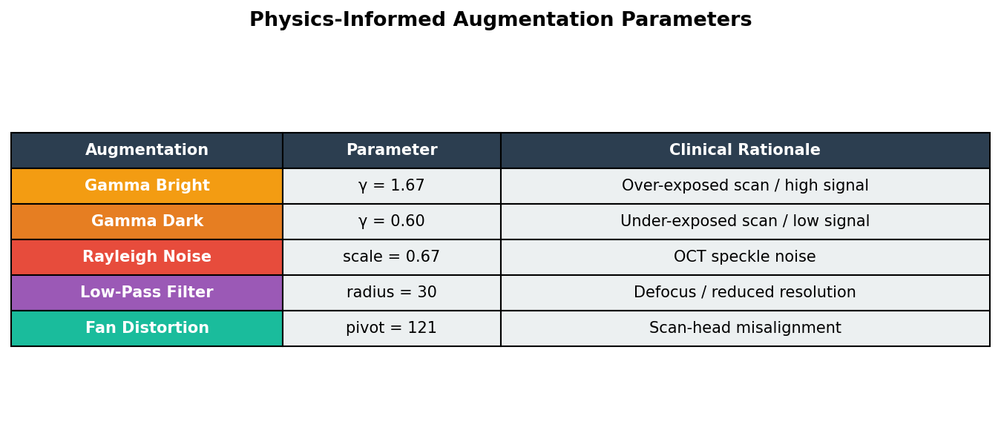
Augmentation Parameters & Rationale

Slide 9
Model Architectures
1. Sequential CNN — 5-layer (replicating Maetschke et al., 2019)
Kernels: 7-5-5-3-3, 32 filters each
2. ResNet-Like — Residual skip connections
Conv3D stem + 3 residual blocks
3. Attention — SE + spatial attention blocks
Channel & spatial feature recalibration
All: GAP3D → Dense(1, sigmoid) | NAdam | Binary CE

Slide 10
Training Configuration
• Optimizer: NAdam (LR = 1e-4, tuned via grid search)
• Batch size: 4
• Early stopping: patience=5, monitor val_auc
• Input normalization: /255 to [0, 1]
• Training data: 5,328 augmented volumes (6× originals)
• Validation: 111 original volumes
• Evaluation: 111 original volumes (fair comparison)
• NO class balancing (Part 1 showed this hurts)
• NO stratification (paper never used it)

Slide 11
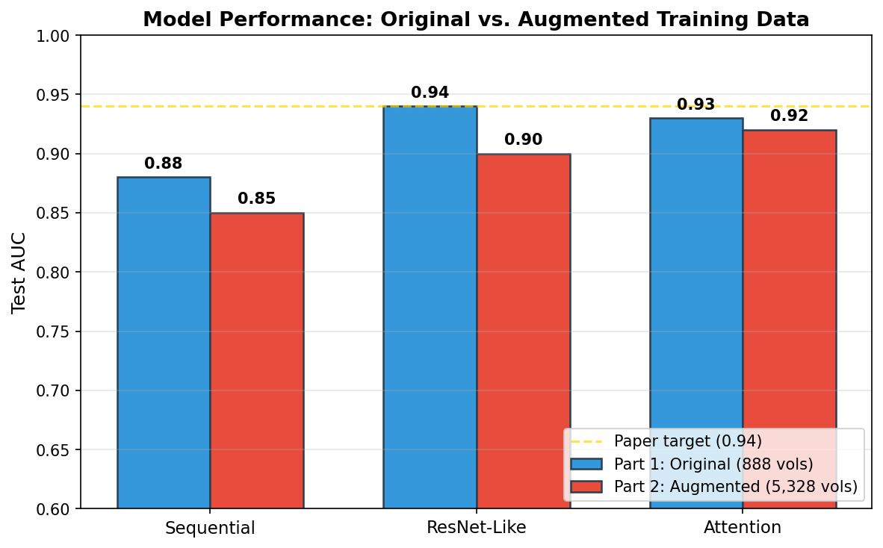
Results: Part 1 vs Part 2

Slide 12
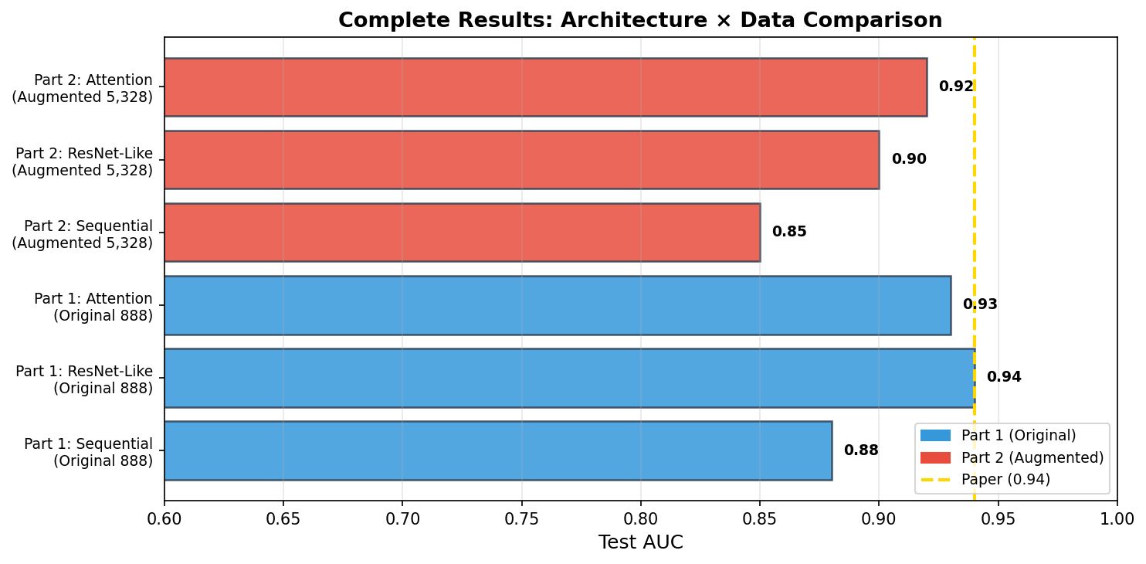
Results: Complete Comparison

Slide 13
Key Findings
1. Augmentation did NOT improve AUC for any architecture
→ Consistent with original paper (their AUC also dropped)
2. ResNet-Like remains best performer (0.94, Part 1)
3. Performance ceiling ≈ 0.94 is DATASET limited
(diversity of patients, not volume of examples)
4. Hyperparameter tuning did not resolve the gap
→ Confirms data diversity is the bottleneck

Slide 14
Why Augmentation Didn't Help
• Data diversity ≠ data volume
Only 624 unique anatomies; augmentation can't create new ones
• Small normal class (263 patients)
Even 6× still only ~1,578 from same 263 anatomies
• Augmentation ≠ new patients
Can't introduce new structural configurations of ONH
• Training dynamics diluted
6× larger epoch → fewer unique gradients per step
• Original paper found the same result
Their augmentation also reduced AUC (0.94 → 0.92)

Slide 15
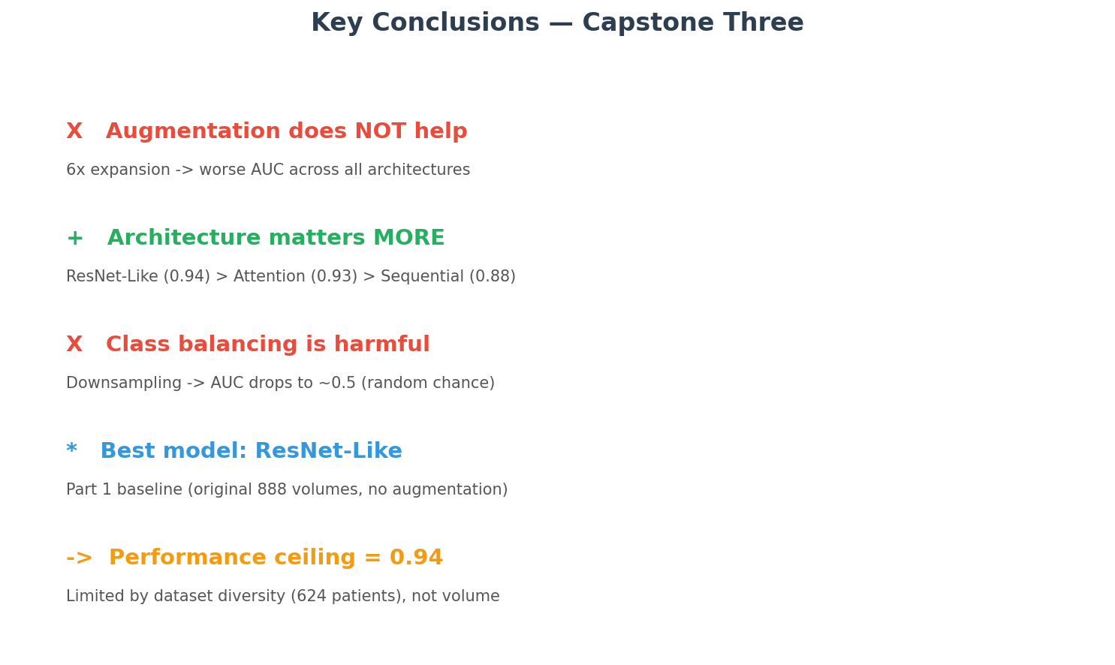
Conclusions

Slide 16
Future Directions
• 5-Fold Cross-Validation for confidence intervals
• Multi-center data from additional institutions/scanners
• Transfer learning / medical imaging foundation models
• Contrastive self-supervised pretraining
• Grad-CAM explainability for clinical trust
• Ensemble methods across architectures
• Web application deployment (Gradio/HuggingFace)

Slide 17
Project Structure
PART_2/
├─ DW-EDA.ipynb Data wrangling & EDA
├─ PPs-Modeling.ipynb Preprocessing + Modeling
├─ model_metrics.json Model metrics file
├─ Final Report (.md)
└─ Presentation (.pptx)
octcv/mdl_lib/
├─ architectures.py 3 CNN architectures
├─ __init__.py XVolSet, train_model(), ModelEvaluator
└─ callbacks.py LivePlot, EpochProgressBar

Slide 18
References
[1] Ishikawa (2018). OCT volumes for glaucoma detection. Zenodo.
[2] Maetschke et al. (2019). A feature agnostic approach for
glaucoma detection in OCT volumes. PLOS ONE.
[3] He et al. (2016). Deep residual learning. CVPR.
[4] Hu et al. (2018). Squeeze-and-excitation networks. CVPR.

Slide 19
Thank You
Questions?

