Slide 1
Lookup Tool Using Hash Tables Using Google Books N-Gram Dataset
Developing efficient word searches using hashing methods
By: Taner Bulbul

Slide 2
Project Overiew
Custom Hash Table Implementation
The project uses a custom-built hash table for fast data lookup, avoiding built-in dictionaries.
Google Ngram Dataset Usage
Raw Ngram data files are processed and cleaned from special characters and speech tags. Used 1-Ngram dataset with a subset of 200,000 words starting with ‘a’.
User Interaction and Autocomplete
The command-line interface allows word lookup and provides intelligent autocomplete suggestions based on frequency.
Algorithm-Centered Design
The design highlights algorithmic rigor by focusing on hashing applied to noisy, large-scale data.

Slide 3
Custom Hash Table with Linear Probing
Hash Table Structure
The hash table uses open addressing with linear probing to resolve collisions effectively.
Collision Handling Importance
Proper collision handling ensures correctness and maintains performance in insert and search operations.
Dynamic Resizing
Initial hash table size is doubled and is adjusted to a prime value if the load factor reaches 0.7.

Slide 4
Handling Noise in Real-World Ngram Data
Normalization of Tokens
Convert all words to lowercase and remove non-alphabetic characters to ensure consistency in token representation.
Structured Data Parsing
Parse each line as a tab-separated record with exactly four fields for validity and consistent extraction.
Suffix Noise Reduction
Split tokens at underscores and retain only the base word to reduce noisy suffixes and annotations.
Cleaner Dataset for Algorithms
Preprocessing transforms raw noisy data into clean, consistent keys suitable for reliable algorithmic processing.

Slide 5
Storing and Aggregating Multiple Metadata Fields
Raw Data
1-Ngram data looks as below in the raw format:
Word Year Match Count Volume Count
ANTlBlOTlC_NOUN \t 1975 \t8 \t 3
ANTlBlOTlC_NOUN 1977 1 1
ANTlBlOTlC_NOUN 1978 2 1
ANTlBlOTlC_NOUN 1979 3 3
Rich Metadata Storage
The hash table stores the word as keys, match count, and volume count as metadata. It adds all the counts for all of the years for a word.
Aggregation of Data Fields
Match_count and volume_count fields are aggregated to reflect total occurrences and distribution across books.

Slide 6
Efficient Processing at Scale
Dataset Processing
The system processes the 200,000 entries from the 1-Ngram file.
Automatic Hash Table Resizing
Automatic resizing occurs when the load factor reaches 0.7, maintaining efficient hash table operations.
Prime Number Table Expansion
Resizing expands the hash table to the next prime number to improve key distribution and reduce clustering.

Slide 7
DJB2-Style String Hashing
Sequential Character Processing
The hash function processes each string character sequentially to combine values for a robust hash output.
Mixing and Modulo Operation
Character mixing and division hashing to ensure well-distributed hash values and proper indexing.
Collision Reduction Importance
Using a strong hash function reduces collisions, improving search and insertion efficiency in hash tables.
Algorithmic Design Choice
The deliberate selection of DJB2-style hashing highlights the importance of algorithmic decisions on performance.

Slide 8
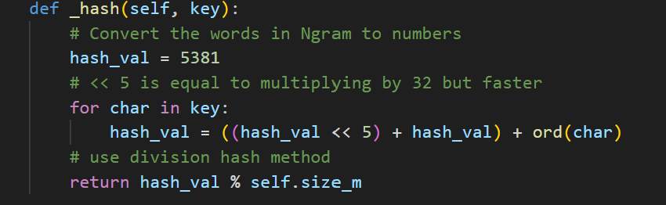
DJB2-Style String Hashing
Each character in the word is converted to a number using the DJB2 algorithm. Then use the division hash.

Slide 9
CLI Search and Autocomplete
User Interaction with CLI
The command-line interface allows users to input words and interact with the search algorithm simply and effectively.
Direct Lookup Using Hashmap
Users perform direct word lookups via hashmap search, enabling quick access to stored data entries.
Autocomplete Suggestion Logic
If a word is not found, the system generates autocomplete-style suggestions ranked by frequency for user convenience.
Concept Visualization
This CLI feature visually demonstrates hashing, collision handling, and metadata aggregation in an intuitive way.
Performance Measurement
Performance is measured via probe tracking and runtime timing to provide evidence of algorithm efficiency.

Slide 10
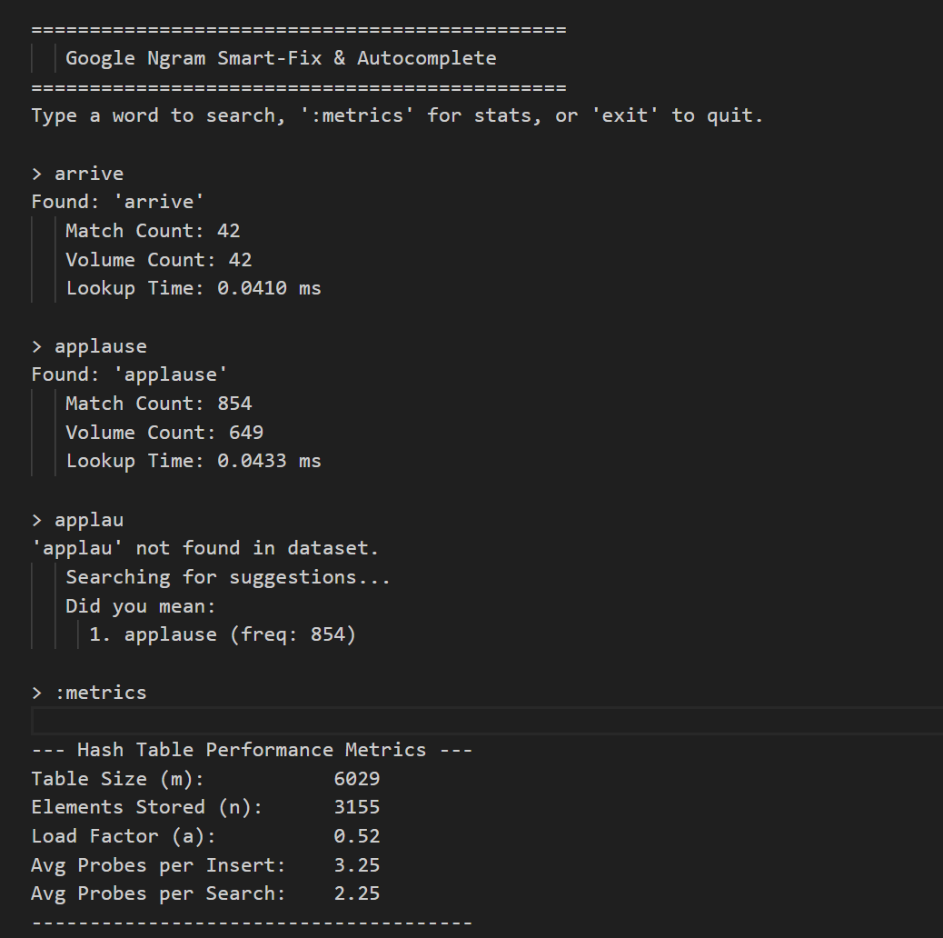
CLI Example

