Slide 1
Notes:
Thank you
Introduce self
Intro ESRI Canada - Subsidiary of ESRI International
ESRI is a software company specializing in Geographic Information System software
In addition to duties as ESRI’s Schools and Libraries program manager, I am also a part time instructor at Sir Sandford Fleming college in Lindsay, Ontario where I teach computer programming
I was pleased to be invited to give this address to you today, and I do so as much a fellow educator as a facilitator of technology in the school system. I’m thrilled to see the level of enthusiasm for introducing technology into all levels of education that today's session demonstrates

Slide 2
ESRI Canada
ArcView GIS for Schools and Libraries
November 7, 2026
ArcView Basics

Slide 3
The ArcView GUI
Menus, Buttons, Tools
Document Types
Active vs. Visible Themes

Slide 4


Menus, Buttons, Tools
Menu Bar: Contains ArcView pull-down menus grouped by function type.
Window Title Bar: Use to select a window and move windows around the screen
Tool Bar: Click a tool and it becomes active (pushed in). Apply the tool inside a document to execute the function.
Button Bar: Contains ArcView command buttons. Click a button once to execute a function.
Tool Tips: Hold the mouse pointer over a Button or Tool to get its name. Also look in the Status Bar

Slide 5
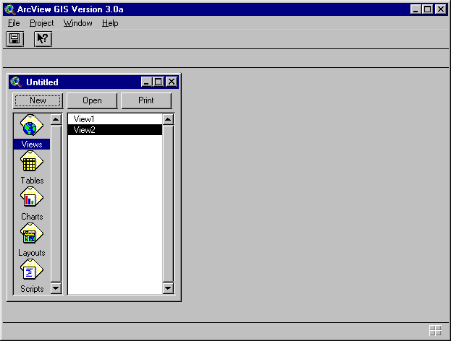
ArcView Project Window
A Project is a file that organizes all the information you need to do your work.
It lists the icons for ArcView’s five main documents.
You open, print or create documents using these buttons.
Your documents are listed here.
Choose a document type from these icons.

Slide 6
ArcView Documents
Views - Contain the map data or Themes.
Tables - Tables show the attribute data attached to your map data.
Charts - These are Chart and Graph displays of your data.
Layouts - Layouts are where you assemble your map for printing - it’s your final printed page.
Scripts - These are used to enter Avenue code to customize ArcView.

Slide 7
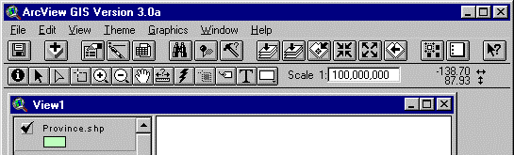
The View Document
Document where your working map is displayed.
You can:
  pan and zoom
  create and edit features
  perform queries
  and more…

Slide 8
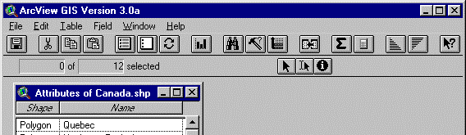
The Table Document
Contains all the table manipulation controls.
Manipulate, edit or create attribute data.
You can:
  join tables
  perform queries
  summarize statistics
  and more…

Slide 9
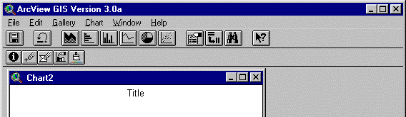
The Chart Document
This document displays tabular data graphically.
Charts are dynamically linked to tables and views.

Slide 10
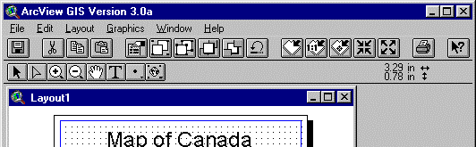
The Layout Document
Assemble all components of your project for printing.
You can:
  insert frames for views, tables, charts
  add a scale bar and north arrow

Slide 11
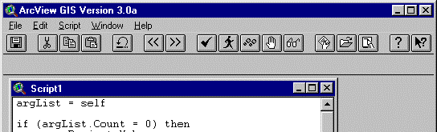
The Script Document
This where you can write Avenue scripts that will allow you to customize ArcView.
Some functions in ArcView are accessible through the script document.
Mostly for advanced users.

Slide 12
ArcView - The “Active” GIS
The “Active” Document:
  Document window that you are currently working with (View, Table…)
  The menus, buttons, and tools will look different with each document.
Make documents “active” by:
  Single-click on the document window
  Choose document name from Window menu

Slide 13
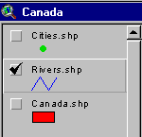
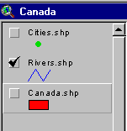


ArcView - The “Active” GIS
The “Active” Theme:
  Not to be confused with “Visible”
  Before you work with a theme, it needs to be “active”.
  Some tools only work with “active” themes (e.g.. Identify tool).
Active
Not Active
Visible
Not Visible

Slide 14
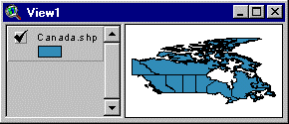
Setting Theme Status
Setting Visible or Active Status:
  To make a theme “Visible”, single-click on the Visibility Selector
  To make a theme “Active”, single-click on the Theme Name
Window Title Bar
Visibility Selector
Theme Name
View Area (map)
Table of Contents

Slide 15
ArcView Functions
Data Manipulation
Data Analysis
Data Presentation
Customization

Slide 16
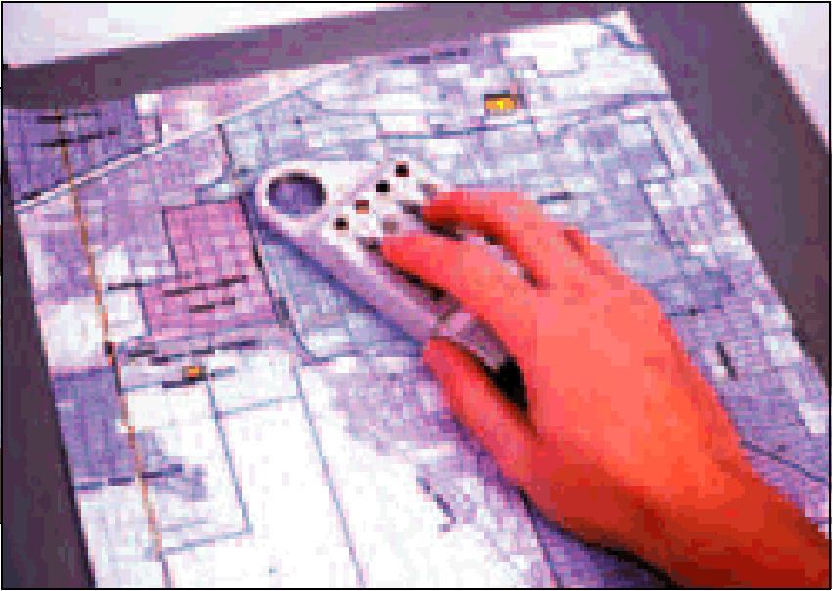
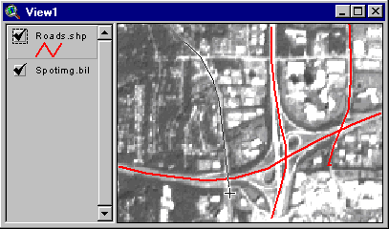
Data Creation
Manipulation
Analysis
Presentation
Table Digitizing traces objects on a paper map
  Uses a digitizing tablet
Heads-up Digitizing traces objects on the screen
  Scanned map, air photo or satellite image

Slide 17
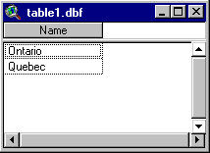
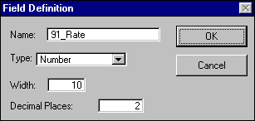
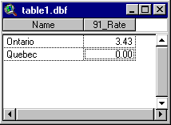
Data Editing
Manipulation
Analysis
Presentation
Data stored in tables (spreadsheets)
  Tables composed of Records
  Records composed of Fields
New tables can be created, and data added and changed...

Slide 18
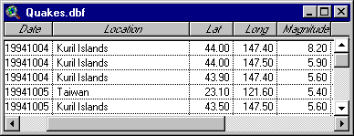
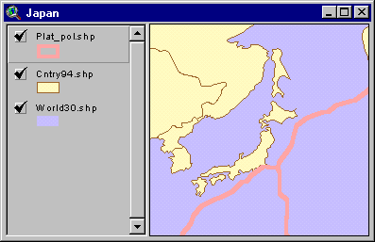
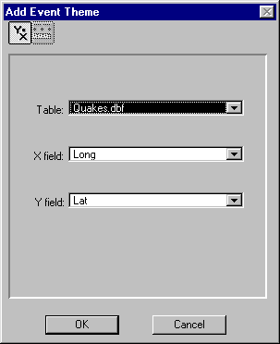
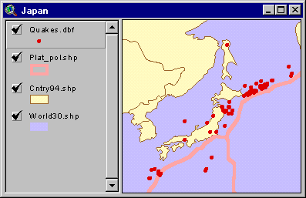
Event Mapping
Manipulation
Analysis
Presentation
Tables often contain location information. This can be converted to points.

Slide 19
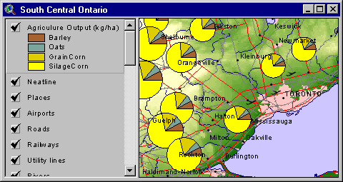
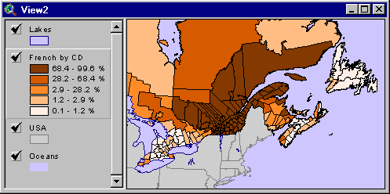
Thematic Maps
Manipulation
Analysis
Presentation
ArcView supports thematic mapping...
Graduated Colour
Chart Maps

Slide 20
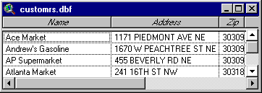
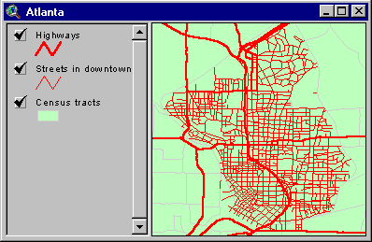
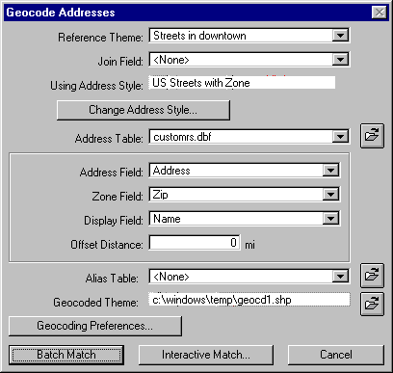
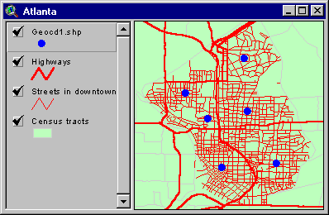
Address Matching
Manipulation
Analysis
Presentation
Matches address data to streets to create points.

Slide 21
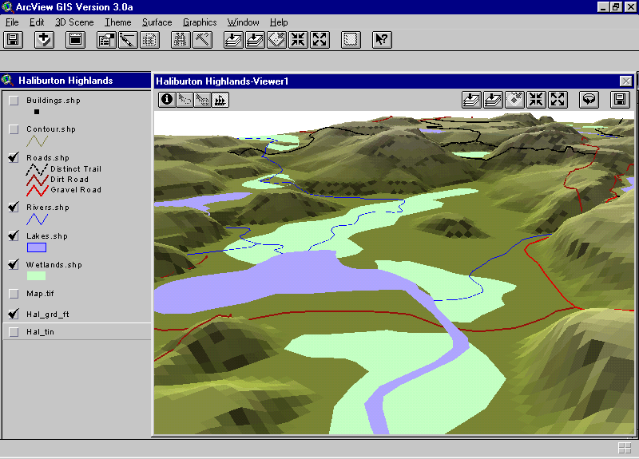
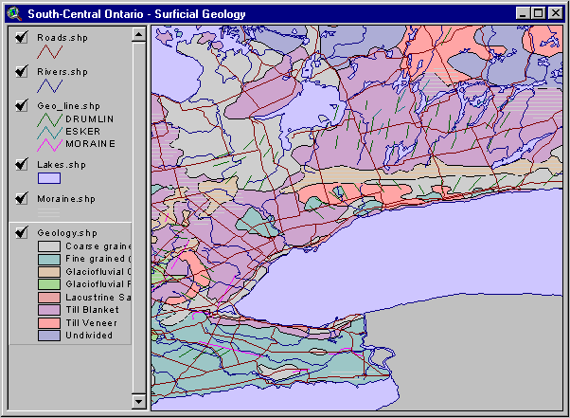
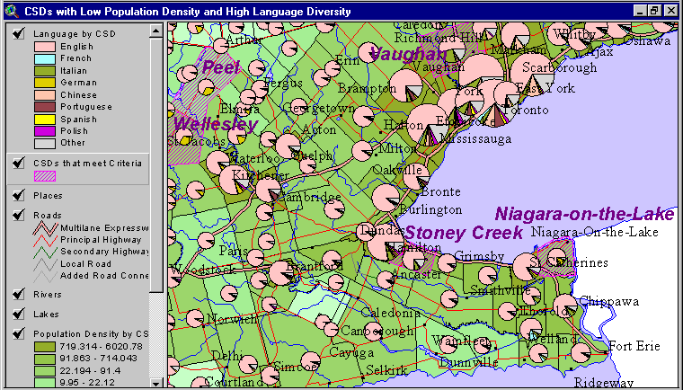
Data analysis
A variety of analytical methods

Slide 22
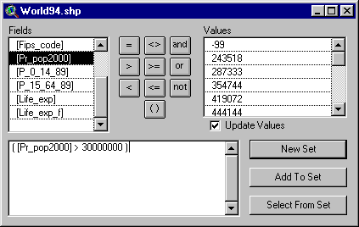
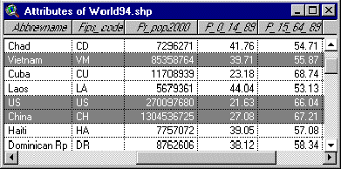
Table Query
Manipulation
Analysis
Presentation
ArcView can answer questions about the attribute data...
  How many countries will have a population of more than 30 million in the year 2000?

Slide 23
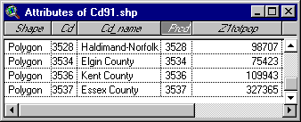
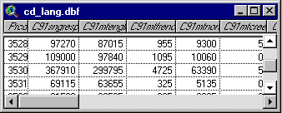
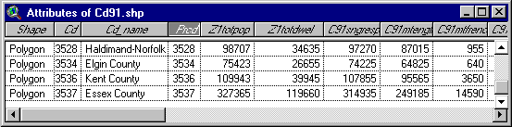
Joining Tables
Manipulation
Analysis
Presentation
Some data is stored external databases
To be used by a GIS, these tables must be joined to a map.

Slide 24
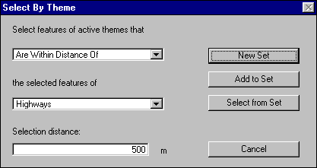
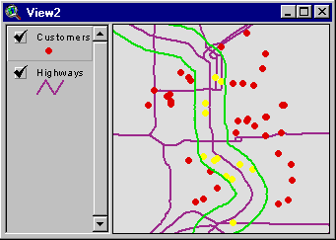
Spatial Query
Manipulation
Analysis
Presentation
ArcView can answer questions about the location of entities...
  How many customers live within 500m of a highway?

Slide 25
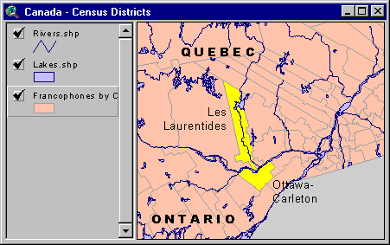
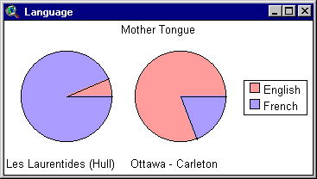
Graphs / Charts
Manipulation
Analysis
Presentation
ArcView can also produce traditional charts and graphs based on map data...
Pie Chart

Slide 26
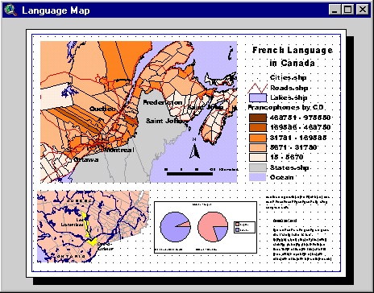
Map Design
Manipulation
Analysis
Presentation
Bring everything together in a Layout...
Map Views
Legend
North
Arrow
Text
Scale Bar
Graphs

Slide 27
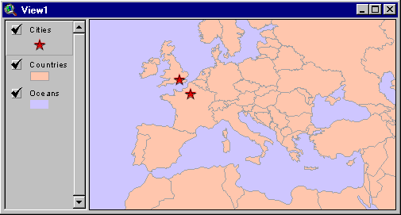
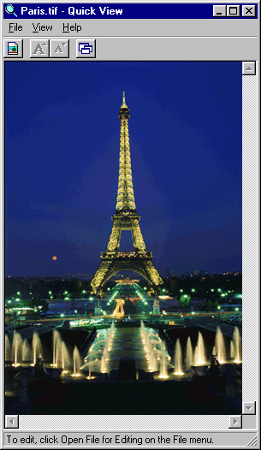
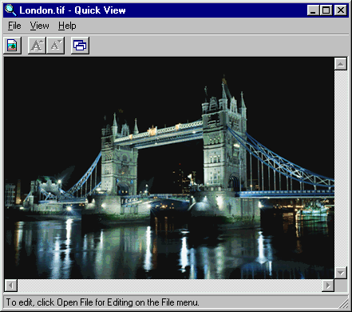
Hot-Linking
Manipulation
Analysis
Presentation
Objects on map can be “Hot-Linked” to other applications...

Slide 28

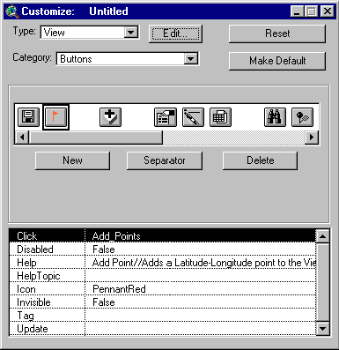
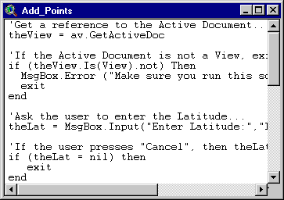
Customization
ArcView GIS includes Avenue™
  Avenue is a true Object-Oriented Programming language
  ArcView’s Graphical User Interface (GUI) can be fully customized

Slide 29
Notes:
Thank you
Introduce self
Intro ESRI Canada - Subsidiary of ESRI International
ESRI is a software company specializing in Geographic Information System software
In addition to duties as ESRI’s Schools and Libraries program manager, I am also a part time instructor at Sir Sandford Fleming college in Lindsay, Ontario where I teach computer programming
I was pleased to be invited to give this address to you today, and I do so as much a fellow educator as a facilitator of technology in the school system. I’m thrilled to see the level of enthusiasm for introducing technology into all levels of education that today's session demonstrates

