Slide 1
Geography Matters

Slide 2
Geography and Technology
Geography affects us in many ways
  Our natural environment
  Our human environment
Geography is a Hi-Tech discipline
  Earth Observation
  Global Positioning Systems (GPS)
  Geographic Information Systems (GIS)
Notes:
Traditionally, geography has been seen as affection our natural environment (physical geography) and our human environment (human geography).
However, more recently, geography has been viewed as an emerging hi-tech discipline, with such systems as Earth Observation, GPS and GIS. We will examine each of these more closely.

Slide 3






Earth Observation
SPOT
Landsat (TM)
SPOT
RadarSAT
NOAA
LANDSAT
ERS
RADARSAT
ERS
NOAA
Notes:
There are several satellites orbiting the earth and taking pictures of various landforms and surfaces on the earth. Some of these satellites are:
SPOT - The French satellite – Système Pour l’Observation de la Terre - there is data available from this satellite on ArcCanada.
LandSAT - The first satellite ever put in orbit, by the US. It was used for spy operations during the Cold War. Some of this data is available from NASA.
RADARSAT - Canadian made satellite system. Originally built to monitor ice flow in the Arctic because radar waves can penetrate weather systems and ice (for example cloud cover).
NOAA - National Oceanic and Atmospheric Association… If you ever watch the weather channel, and see cloud cover/movement images, you are probably looking at a NOAA image.
ERS - European satellite

Slide 4
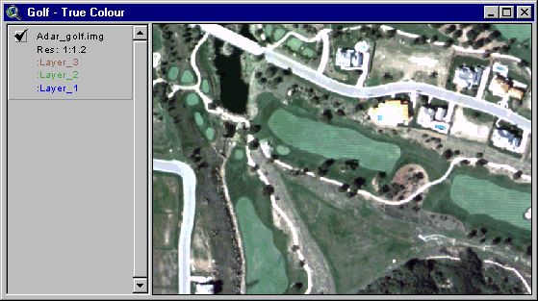
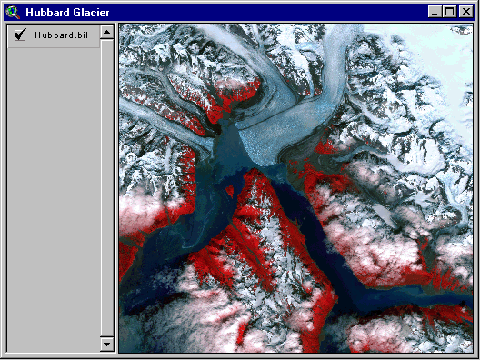
Earth Observation
Notes:
These satellites can take pictures at various scales:
From a golf course…
To a glacier - satellites are able to detect the breakup of ice below the surface before the human eye, so these images are often used in planning Arctic exploration routes.

Slide 5
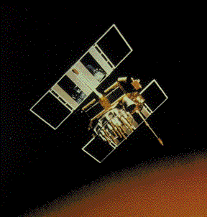
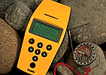
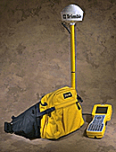
Global Positioning Systems
GPS is a revolutionary navigation System
  24 satellites orbiting the earth
  Provide location within metres anywhere on the globe.
  Now available in many cars as an option
Notes:
Unlike the satellites orbiting the earth and taking pictures of the surface, these GPS satellites provide location information to a GPS receiver anywhere on the globe.
GPS systems are now available as an option in many cars - Cadillac's, BMWs and Mercedes - ONStar Navigation system, etc.

Slide 6


Geographic Information Systems
Describing Our World
We can describe any element of our world in two ways:
Attribute Information:
What is it?
Location Information: Where is it?
Species: Oak
Height: 15m
Age: 75 Yrs
51°N, 112°W
Notes:
Finally, GIS…
Every element of our world, can be described in two ways.
Let’s take this tree for example...
This tree has a location - described with a latitude and longitude - it is located at 51oN and 112oW. This is its "location information".
This same tree also has additional “attribute information”. This is an oak tree, it is 15m high and it is 75 years old.

Slide 7
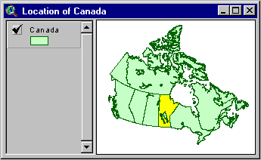

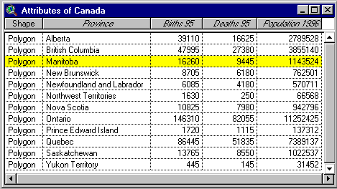
GIS - Links Data Sets
GIS software links the location data and the attribute data:
Notes:
The location and attribute information is stored inside your computer and a GIS links the two types of information together. It uses a map to display the location information and a table to display the attribute information.
There is a constant link between the location and attribute information - when Manitoba is highlighted on the map, it is also highlighted in the table.

Slide 8
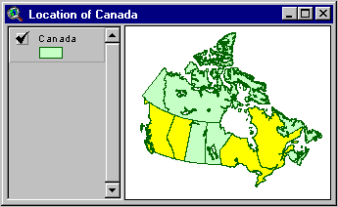
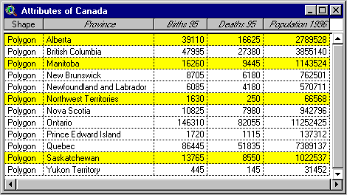
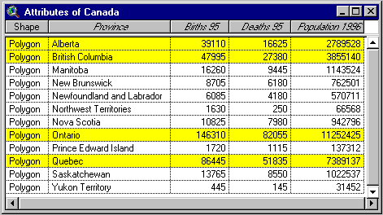
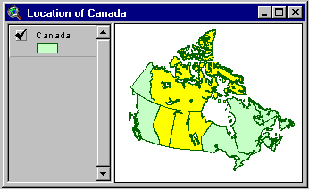
GIS - Analysis
GIS software can answer questions about our world:
Attribute Questions:
What provinces have more than 1.5 million people?
Spatial Questions:
What provinces border Saskatchewan?
Notes:
Using GIS you can ask questions related to either the location or the attribute information. The power behind a GIS is the ability you now have to ask questions using the two types of information that are housed in a GIS.
We can ask a spatial question such as "Which provinces border on Saskatchewan?" In this case, we are asking a question relating to the location information so the GIS is going to go the map to answer this question. It will highlight all those provinces that answer the question. However, it is important to remember that those same provinces will also be highlighted in the table, thus demonstrating the link between the two types of information.
On the other hand we can ask a question that relates to the attribute information such as "How many provinces have more than 1.5 million people?" In this case, the GIS will go to the table, where the attribute information is stored, and highlight those provinces that meet these criteria. Keep in mind that the same provinces will also be highlighted on the map.

Slide 9
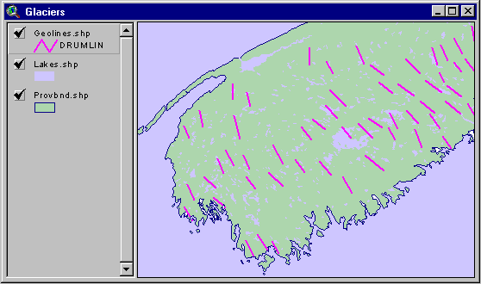
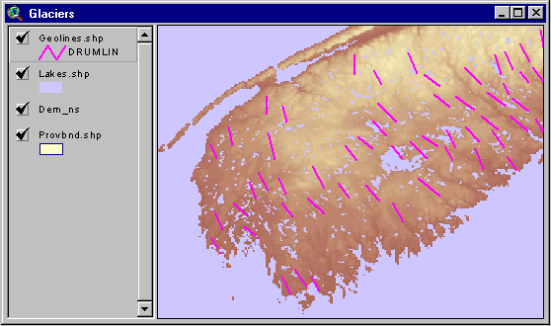
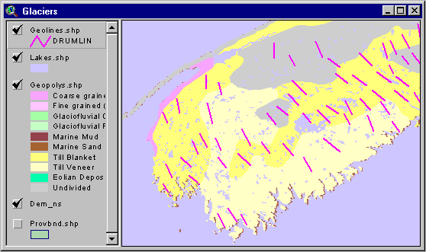
GIS - Layers
GIS contains many layers of information:
These are just a few of the kinds of layers a GIS can contain:
Base Map Data
Elevation
Surface Geology
Notes:
GIS works in layers:
You can begin with Base map data…
And add elevation data…
And then add the surface geology for the same area…
With these layers you can begin to ask question about the area and discover relationships among the features.

Slide 10
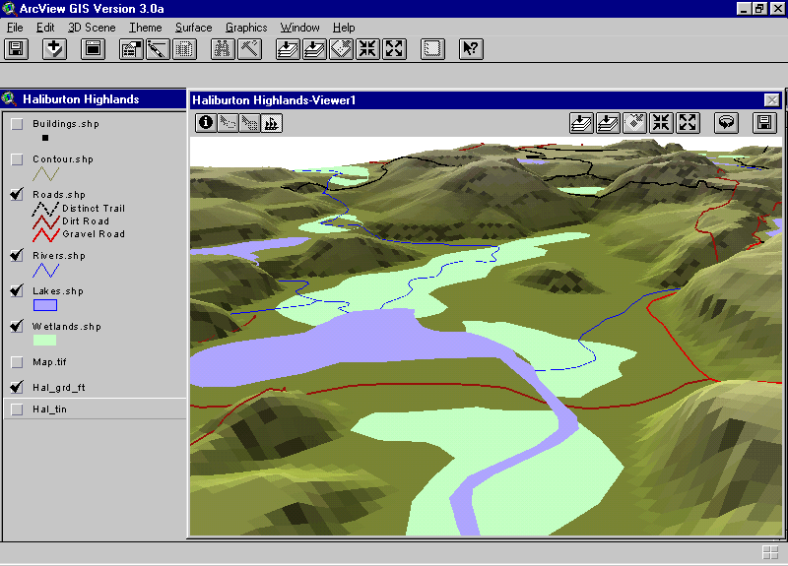
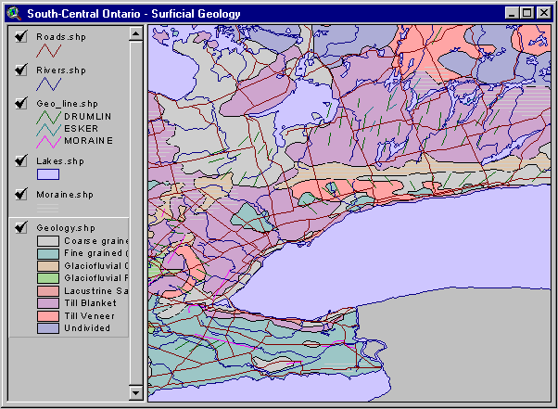
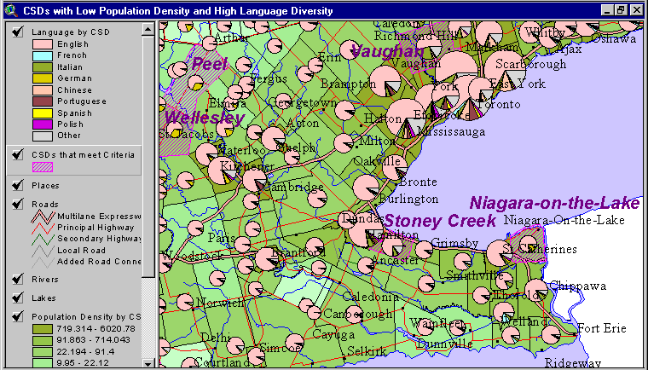
GIS - Analysis
GIS can analyze data in many ways:
Notes:
GIS can analyze data in many ways:
Population and demographic data (language distribution in southern Ontario)
Physical features for the same area (surface geology)
GIS also allows us to view data in a 3D perspective (fly-throughs, etc)

Slide 11
GIS Technology
GIS borrows from other software technology:
GIS
  Relational Database Management Systems
Relational
Database
CAD
Graphics
  Computer Assisted Design and Graphics Software
Statistical Analysis
  Statistical Analysis and Reporting Packages
Notes:
One more thing that we should discuss in relation to the power of GIS is about the actual technology that makes up the software. Once you start working with the software you will realize that most of it is not all that unfamiliar to you. In essence, there are three components that are part of GIS technology.
1.Relational database - A database is a set of data that can share between different applications systems. An example of a relational database is Microsoft Access. This portion of the technology relates to how the location and attribute data are linked together and shared inside a GIS.
2.CAD Graphics - The second component that makes up a GIS is the graphics component. In a GIS you can move features around, change colors and modify the map layout. These are all tasks that are commonly performed in a graphics program such a CorelDraw or Microsoft Paint.
3.Statistical analysis - GIS also has an analysis component included in its technology. You can perform a variety of analytical tasks on the data included in the attribute table such as standard deviation, mean calculations, data summaries and so on. Statistical analysis performed in a GIS is similar to that done is programs such as Microsoft Excel or Corel QuatroPro.

Slide 12
Summary - What is GIS?
GIS is about using data to describe our world in two ways:
  Location Data - Where is it?
  Attribute Data - What is it?
GIS software maintains a link between layers of location and attribute data
  With the Link, we can ask questions about our world…

Slide 13
Real World Applications
Environmental
Park Management
Agriculture
Public Utilities
Health Care
Emergency 911
Real Estate
Marketing
Notes:
GIS is used in many different organizations for a whole variety of purposes. The following is an outline of some of the different ways that people use GIS to solve complicated spatial related problems. There are obviously hundreds of other uses but we are only going to look at some of the more popular ones.

Slide 14
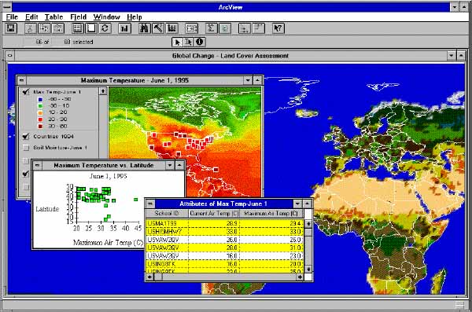
Environmental
What are the effects of Global Warming?
Land cover and temperature relationships are made clear when the data are seen at once using Geotechnology.
Notes:
Environmental scientists can use GIS to assess the impact of global warming in areas of concern.
Data collected on the vegetation of an area as well as data collected on the change in temperature over time in the same area can be overlaid and analyzed to determine whether or not an increase in temperature has affected vegetation growth.

Slide 15
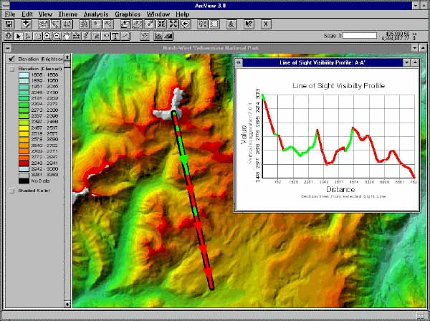
Park Management
Will the new building spoil the Park Scenery?
Park planners use Geotechnology to determine if a new Visitor Centre can be seen from the peak.
Notes:
Let's say, for example, you are the manager of a park where people tend to come and do a lot of hiking. As your park becomes more popular and more people are frequenting it, you realize that there is a need to build a new visitors center. However, you want to make sure that the new building isn't visible from the peak of your mountain so as not to spoil the scenery. Using a GIS, you can input the change in elevation across the mountain that hikers are climbing. You can then take a cross section of the mountain and, using what is called a "line of sight" function, you can determine which areas of the mountain are not visible from the peek and thus establish the best place to build your new visitors center.

Slide 16
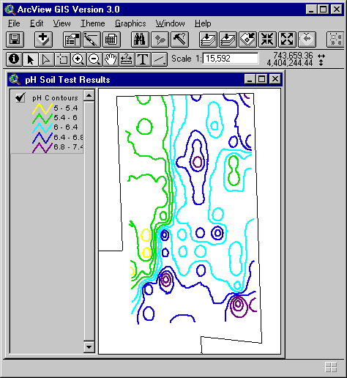
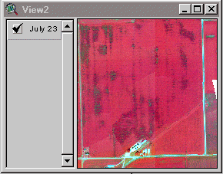
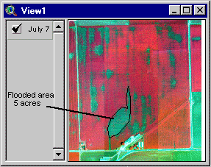
Agriculture
How can I improve food production?
Geotechnology is used in making crop management decisions to maximize yields and minimize fertilizer input.
Notes:
Precision farming is becoming more and more significant as farmers are working on smaller areas of land while having to increase crop production. GIS and remote sensing technology is becoming more widespread within this sector. A farmer can use GIS to map out the pH levels across his fields as well as the nitrogen levels and soil types. He may also use it to keep track of which seeds were planted in what location and when they need to be harvested. Advances in remote sensing technology (satellite imagery) allow a farmer to detect the onset of an insect infestation or disease in its early stages - before the human eye is able to notice such a thing. Satellite imagery allows farmers to pinpoint the exact location of a disease so he may localize his pesticide spraying and manage his crops more effectively.

Slide 17
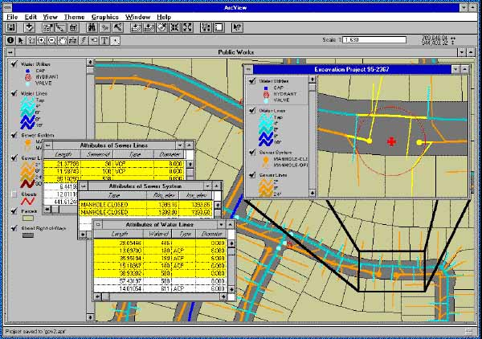
Public Utilities
Is it safe to dig here?
A proposed excavation, identified by address, is compared to pipelines in the area using Geotechnology.
Notes:
You have surely seen the sign on the back of phone company trucks or gas company trucks that says "Call before you dig!" Let's say you were going to be building a new fence around your property. You first have to call all the utilities companies and find out where the utility cross your property. In the past, workers from these companies would come out to your house and spray paint your lawn where the utility lines are located.
These days, chances are when you call that number, the person on the other end of the phone is sitting in front of a GIS. When you give them your address, they can easily pull up your land parcel, and overlay all of the utility lines. They can then easily fax or mail you a map and you don’t have to wait for someone to come out and spray your lawn before you can begin building your fence.

Slide 18
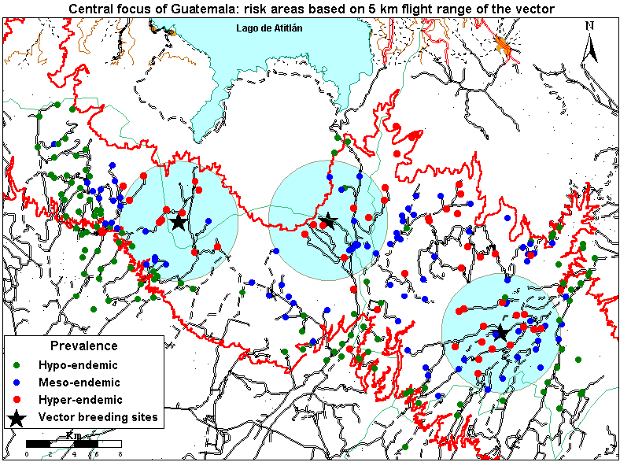
Health Care
What Communities are at risk from Disease?
Geotechnology identifies communities at risk of River Blindness and helps determine the impact of treatment.
Notes:
A good example of how GIS is used in health care is illustrated by a project done in Guatemala. In parts of the country, an epidemic of River Blindness disease was occurring. It was discovered that mosquitoes are the carriers of this disease. Therefore, health officials used a GIS to map out the area and they plotted the location of mosquito breeding sites. They were then able to accurately assess which communities surrounding these sites were going to be affected by this disease. As a result, they were able to manage their health care treatment facilities much more effectively.

Slide 19
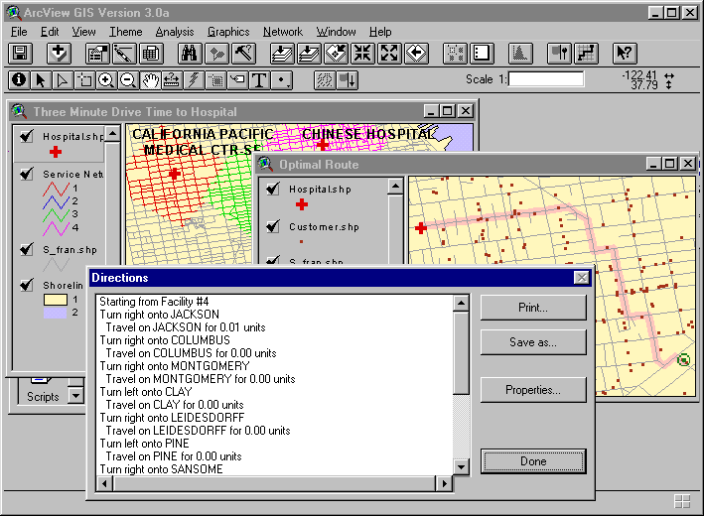
Emergency 911
What is the fastest route to the Hospital?
Geotechnology can choose the fastest route to a hospital. The GIS can take into account traffic and other impediments.
Notes:
This falls under the same concept of health care but with a different application. When you call an ambulance, you want to know that the ambulance will get to your house as fast as possible and then get you to the nearest hospital as fast as possible. Using a street network file as well as GPS (Global Positioning System) technology, ambulance dispatchers use a GIS to pinpoint the location of the ambulance in relation to your home and establish the quickest route to be taken. A GIS can take into account time of day, traffic volume, one way streets, speed limits and stop signs in order to make sure that the optimal route is taken. Directions can then be printed out or sent via satellite to the ambulance itself. All this can take place within a matter of seconds! Similarly, a delivery service such as UPS or Pizza Pizza would implement the same technology.

Slide 20
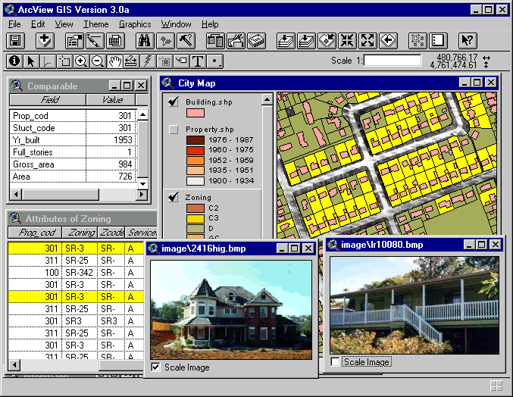
Real Estate
Where is my Dream Home?
With Geotechnology, an agent can show a map of a neighborhood and a picture or video of the actual properties.
Notes:
This is a really interesting application in using GIS. Traditionally, looking for a house has been a rather long (and sometimes frustrating!) procedure involving you and a real estate agent travelling around a neighborhood in search of your dream home. Obviously, before you begin your search you have established certain criteria that are important to you such as type (house, apartment…), cost, location, proximity to schools, age group of others in the neighborhood and so on. Using a GIS that has all this information stored in its database, you can ask the GIS to show you all the homes for sale that meet your criteria. The GIS will be able to bring up all the listings that fit your criteria. What a GIS allows for is the spatial component that was not there before. You can now narrow down your selection by establishing limits to distances away from schools, parks, shopping centre and so on. More and more we are going to begin seeing GIS used is this type of application.

Slide 21
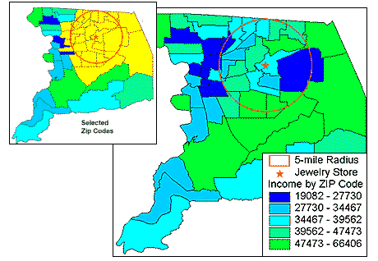
Marketing
How can I optimize my Marketing Campaign?
Geotechnology can query a database and identify only those areas with the highest household income within a specified distance of a store.
Notes:
This is probably one of the fastest growing fields that makes use of GIS. The term Business Geographic's is commonly used to describe this type of application. Several colleges specializing in GIS education have implemented a program that is geared specifically towards teaching business applications using GIS. To illustrate one of the uses of GIS in marketing, let's say that you are a jewelry store in a mid-sized town of about 50,000 people and you are going to have a sale. You print up 50,000 flyers and distribute them to everyone in town and you get approximately 500 people to your sale. However, you realize that this is a very expensive way of advertising and you decide to do some research about who your customers are. For several months, as customers come into your store, you ask them what their postal code is. Using a GIS, you begin to plot where all your customers live. Now you can relate that information to demographic information such as age and income to build a database on your customers. Now you can start to do some analysis. Using a GIS, you are able to determine that most of your customers live within a five-kilometre radius of your store and live in areas of above average income. You realize that there are only about 5000 people in your community who meet your customer profile. When you are ready for your next sale, you now only have to print out 5000 flyers and you will get the same 500 people at your sale. Similarly, the information gathered can help you to determine where you should build a new store to better service your customer base.
Many companies use this information to send out junk mail. If you notice, areas where there is a high concentration of students will likely receive a great deal of flyers relating to pizza delivery whereas suburban community dwellers may receive flyers about furniture sales and so on.

Slide 22
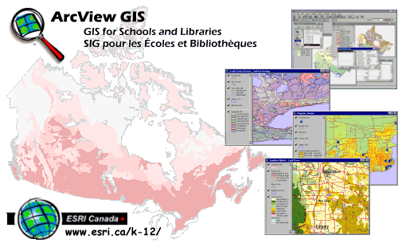
ESRI Schools and Libraries Program
ArcView GIS
Data
Lesson Packs
Training
World Wide Web
http://www.esricanada.com/k-12/

Slide 23


