Slide 1
Depth Penetration of Earthquake Rupture
Progress on Two Numerical Methods
Seismology and Geomechanics Group Meeting
17 December 2013
T. Ben Thompson

Slide 2
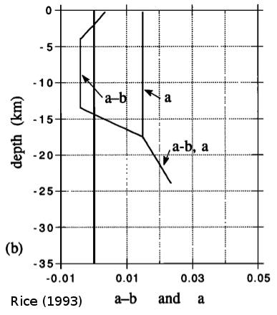
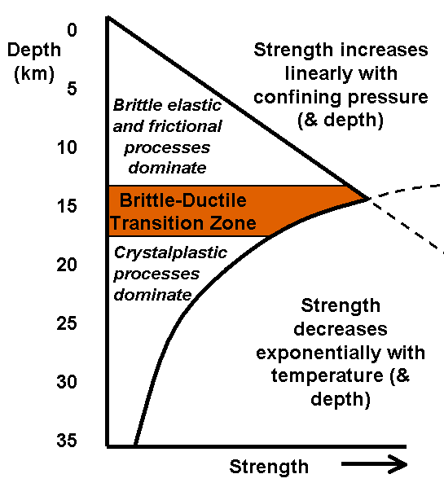
Rupture Depth Penetration
Two simple paradigms for the depth termination of rupture:
  Changes in frictional properties – velocity strengthening
  Brittle-ductile transition – viscoplasticity, ductile shear zones

Slide 3
Computational Problems
Near fault physics are very important
  Temperature anomaly, ductile shear zones (many more!)
  Requires very fine spatial resolution for rupture – meters.
For wave propagation, the Courant-Friedrich-Lewy (CFL) condition causes big problems!
Normally, CFL is a global stability condition.
Idea: Larger elements take longer time steps (less compute time!)
  Reduces the CFL condition to a local stability condition

Slide 4
Wave Equation
Idea: Seismic waves are a coupled system of first order advection equations.
In velocity-stress formulation:
1st Time derivative = 1st space derivative

Slide 5
Finite Volume Methods
Integrate over one “cell” and one time step
  Use divergence theorem to consider flux at the boundaries.
  Consider cell average, , in semi-discrete update:
Need a method for computing

Slide 6
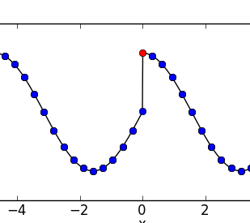
WENO Reconstruction
Compute as a shock-preserving local interpolation of grid averages, .
  Preferentially weight smooth parts of the solution
Example of WENO reconstruction, note the preserved shock!

Slide 7
ADER Scheme
Taylor expand in time around :
Use governing equation to replace time derivatives with space derivatives.
We know from the polynomial reconstruction.
Works for arbitrary number of Taylor series terms.
Titarev and Toro (2002), Pelties and others (2012)

Slide 8
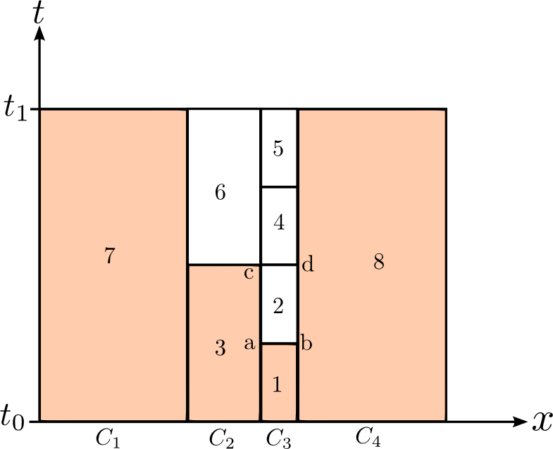
Local Time Stepping

Slide 9
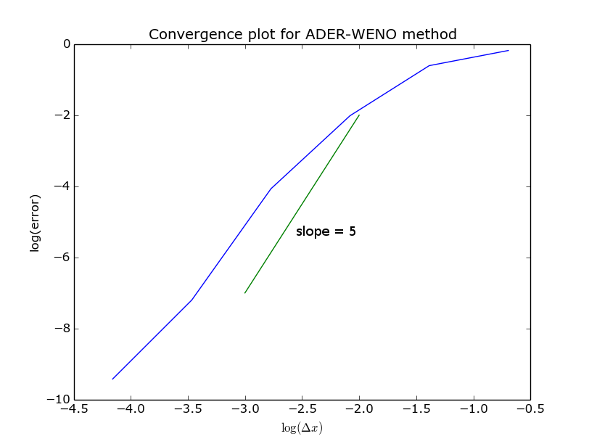
Basic code is working

Slide 10
Interseismic Deformation
Just to be clear: Different problem!
Initial rupture stresses are driven/affected by:
  Tectonic loading
  Stable sliding on the fault
  Deep, viscoplastic creep – especially ductile shear zones
Time evolution depends on specific viscosity function.
Goal: efficiently compute creep and temperature over many earthquake cycles for arbitrary viscosity functions.

Slide 11
Quasistatic Viscoplasticity
Governing equations:

Slide 12
Simplified Equations
Antiplane geometry. No loss of generality!
Infinite strike-slip fault.

Slide 13
Numerical Difficulties
Velocity evolution, but no time derivative of velocity!
In general, nonlinear viscosity.
  Requires Newton's method iterations.
Non-symmetric linearized operator.
  Rules out fast matrix solver methods like the conjugate gradient method.

Slide 14
Projection Method
Idea: Expand velocity as a Taylor Series.
Split-step update:
  Step 1: Update the stress ignoring changes in the velocity.
  Step 2: Evolve the velocity and force a divergence free stress.
“Projection” – stress is explicitly projected onto a divergence free function space.

Slide 15
2nd Order Projection

Slide 16
Projection Method – Benefits
Both steps are provably
ODE is easy to solve.
Poisson is easy to solve very quickly – FFT, Multigrid
  Note: Boundary Conditions are applied in the Poisson step.
Nonlinearity is restricted to the ODE.
Improves on Zienkiewicz and Cormeau (1974) and Hughes and Taylor (1978)

Slide 17
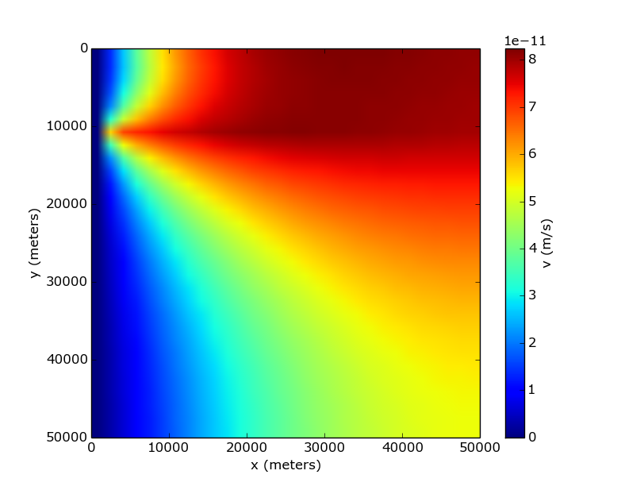
Example
100 years after a 2 meter slip, plate rate far field in upper layer. 10km elastic layer over viscoelastic half space, fault is locked.
I need to do much more verification and convergence testing

Slide 18
Conclusions
Very efficient elastic wave propagation is possible with existing techniques
  Local time stepping (ADER)
Projection method gives a much easier quasistatic viscoplasticity problem
  ODE + Poisson vs. Nonlinear, asymmetric elliptic
I have a lot of work to do.
  Convergence tests!

