Slide 1
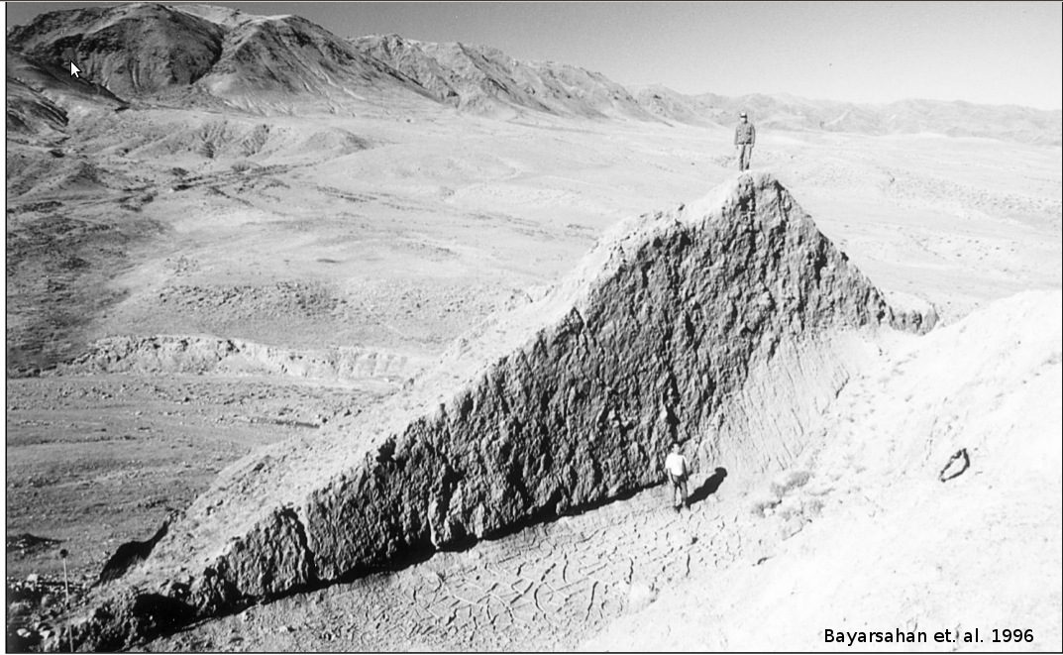
Crustal Kinematics of the Shargyn Basin, western Mongolia
Thomas Ben Thompson

Slide 2
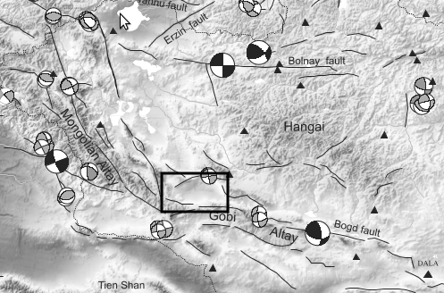
            Calais 2003
Intersection of two major strike-slip systems
+
Transpressional slip on both systems
=Complex kinematics (Shargyn Basin)

Slide 3
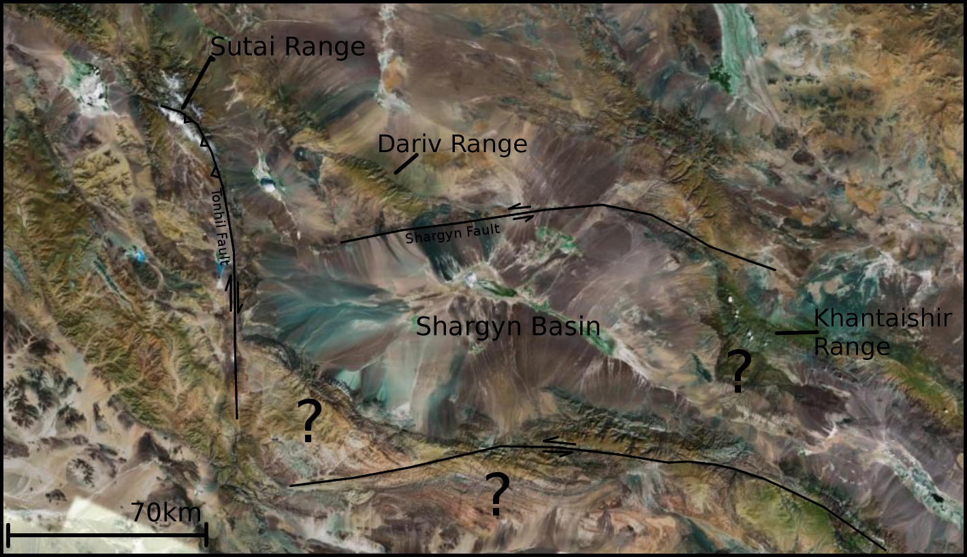
Why is there a big basin here (hole)?

Slide 4
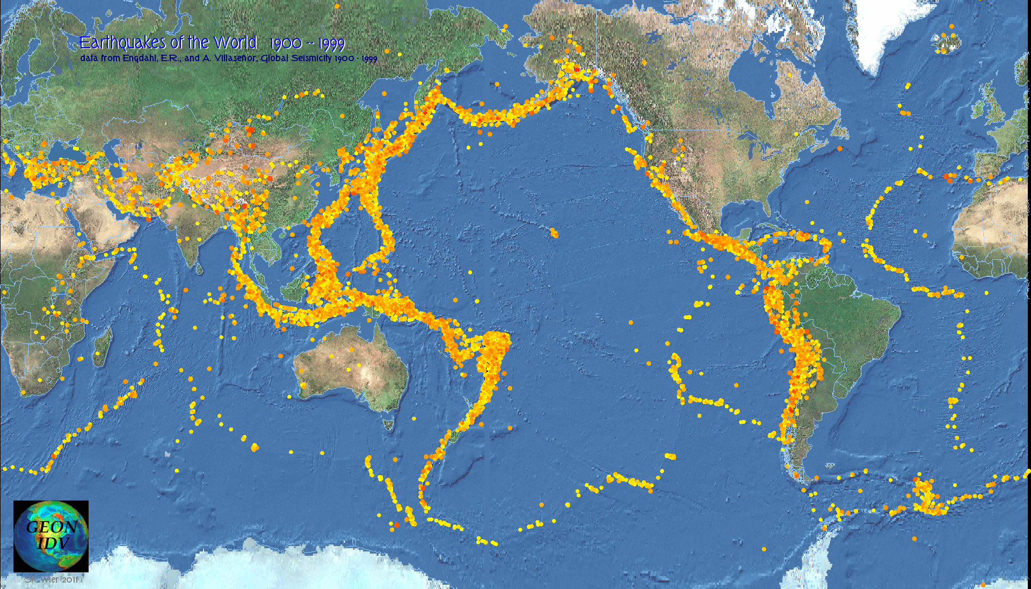
Normally: Deformation at plate boundary zones

Slide 5
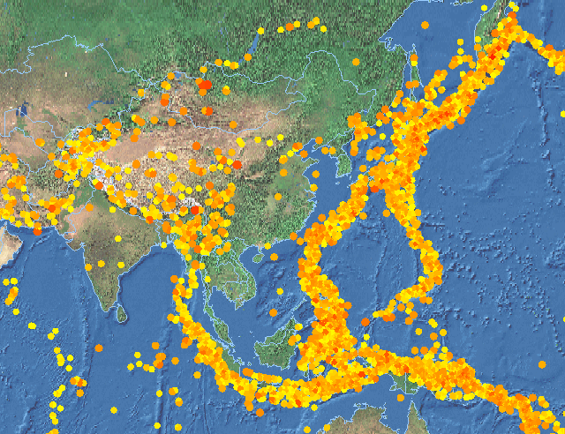
Mongolia: Lots of deformation. Plate boundary very distant!

Slide 6
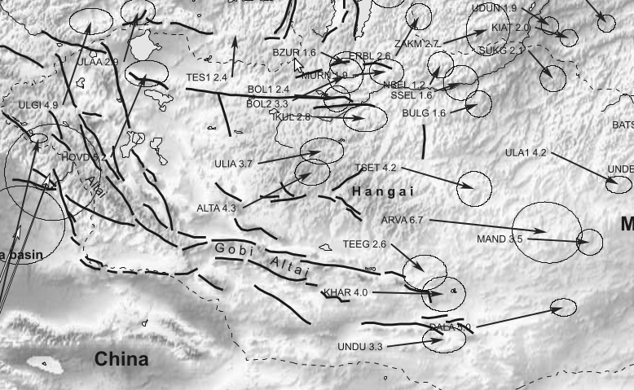
Calais 2003
GPS data show:
Northwards motion in the west
Eastwards motion in the east
~5mm/yr average

Slide 7
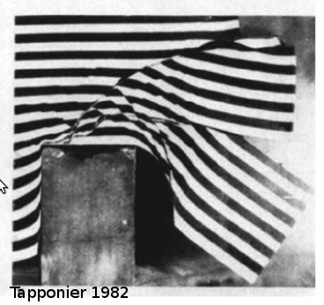
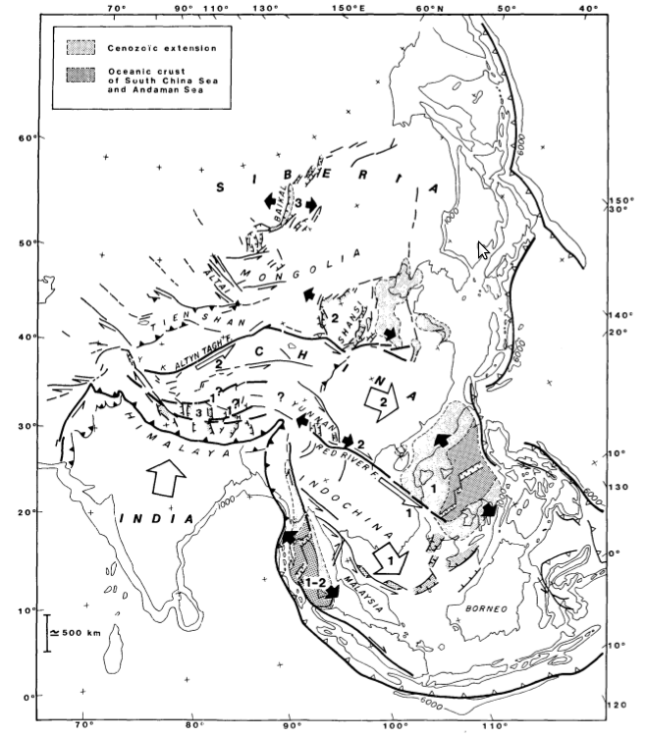
Q: What drives Mongolian deformation?
A: India
Tapponier 1982

Slide 8
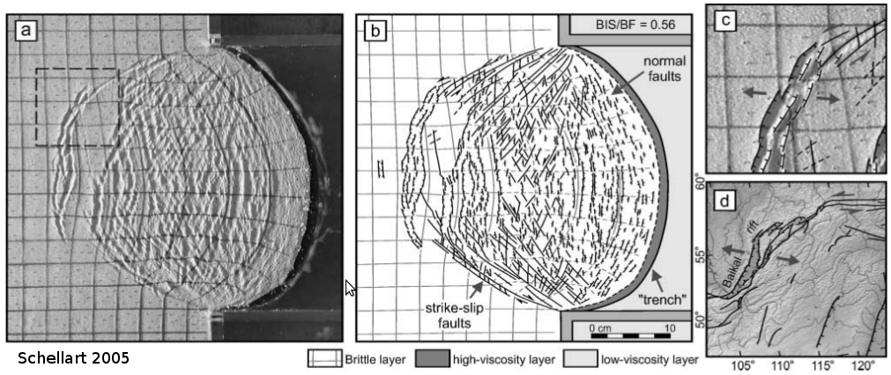
Q: What drives Mongolian deformation?
A: East Asian Subduction Zone rollback
– Eastward trench retreat pulls the continent along with it.

Slide 9
Why is there a big basin here (hole)?

Slide 10
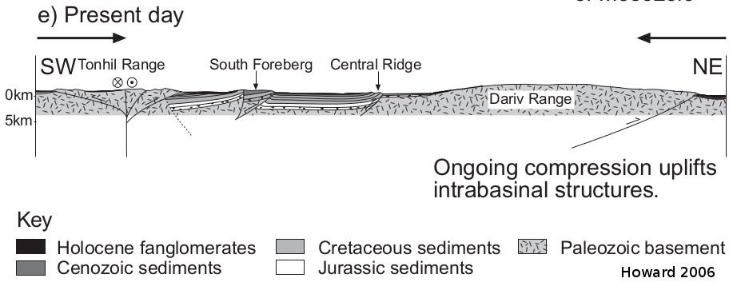
Maybe the Dariv Basin could be a useful model for Shargyn Basin Kinematics?
– piggyback basins
– transpressional basins

Slide 11
What are the kinematics of the Shargyn Basin?
Could the answer provide some insight into the debate on Asian stresses?

Slide 12
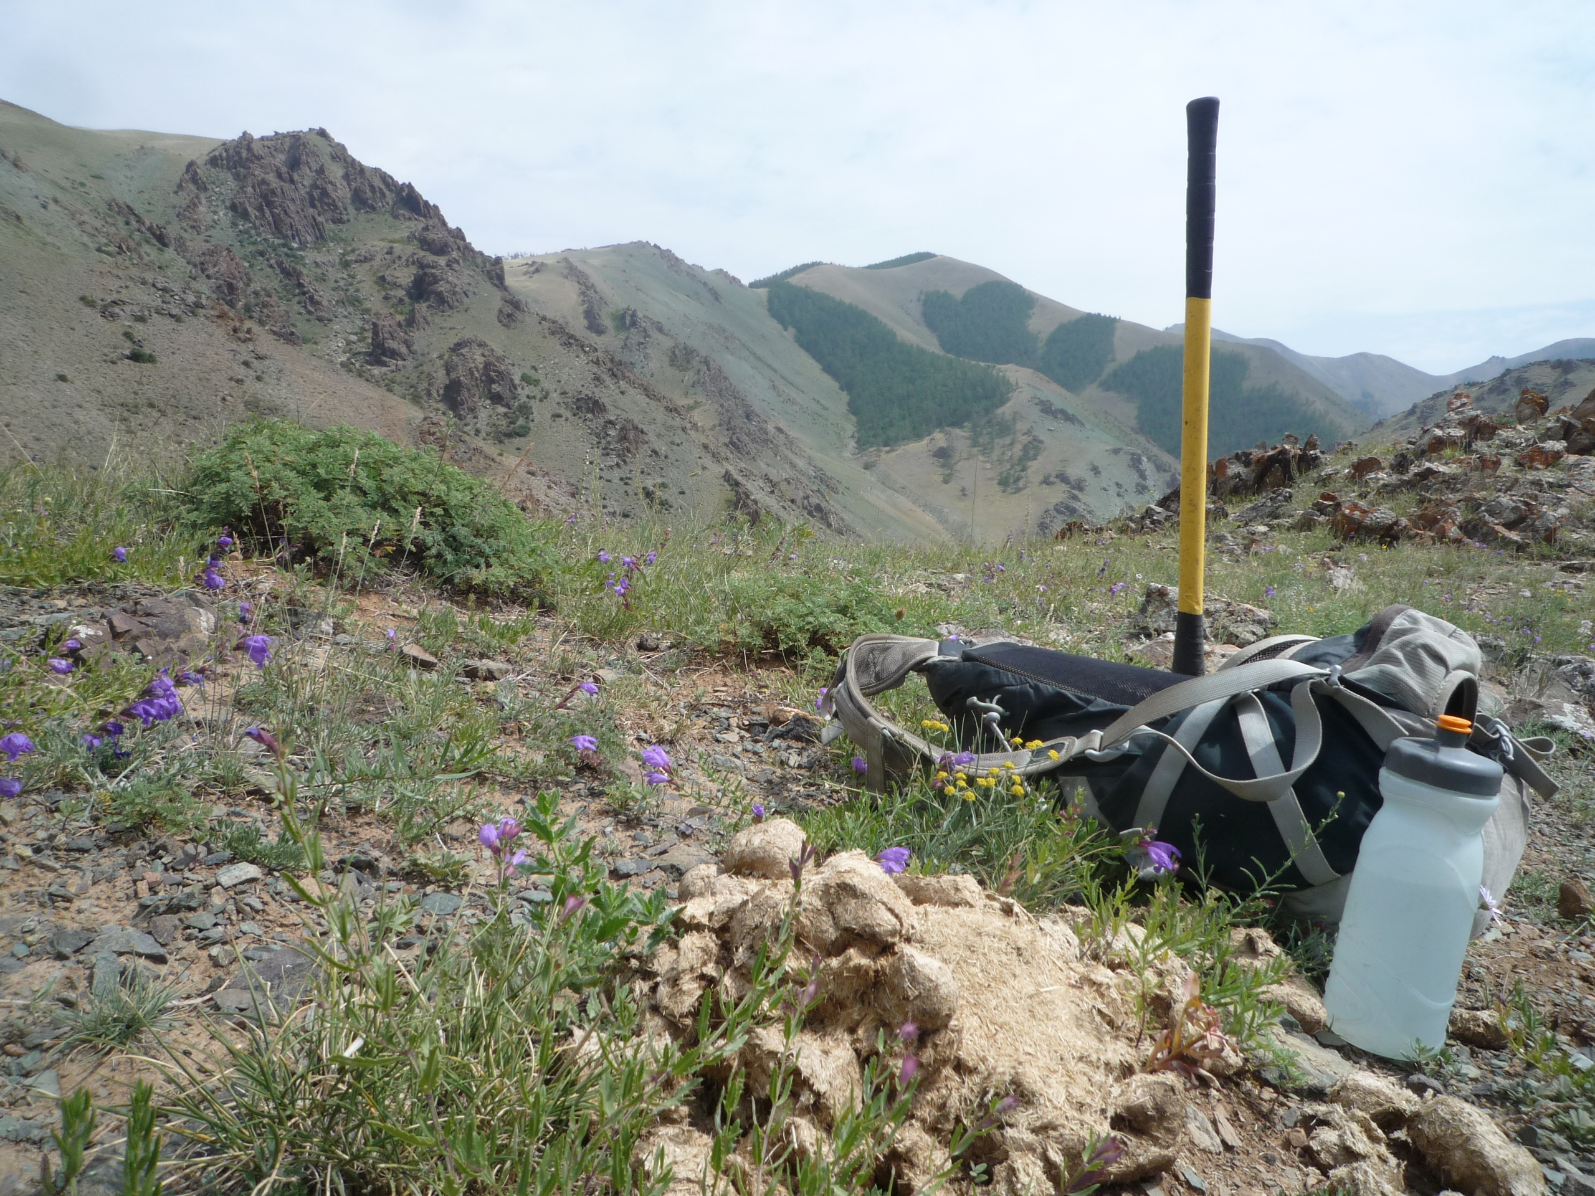
Completed Work – Field Season!

Slide 13
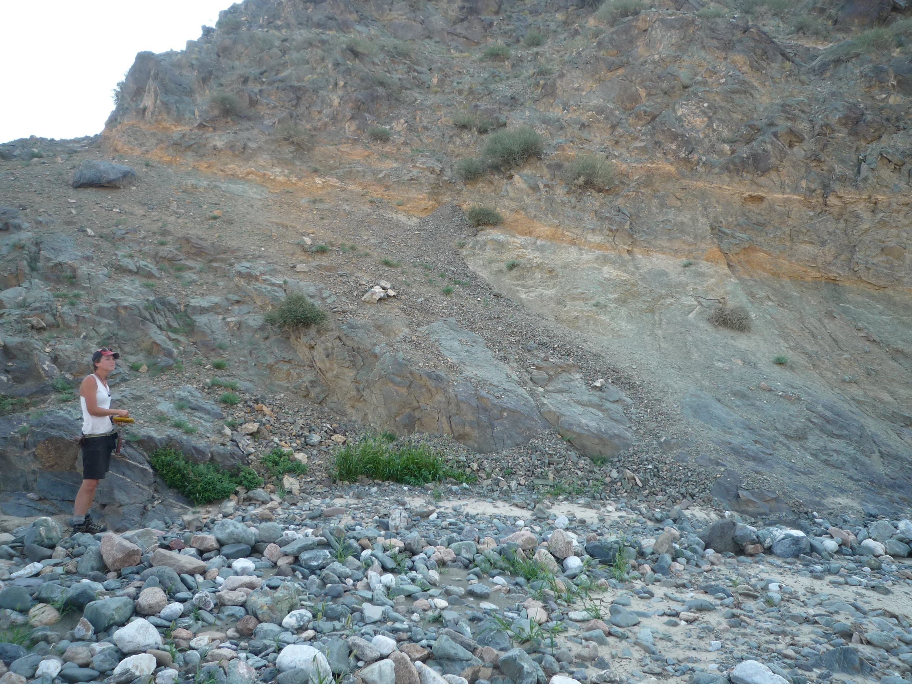
Completed Work – Direct Fault Observations

Slide 14
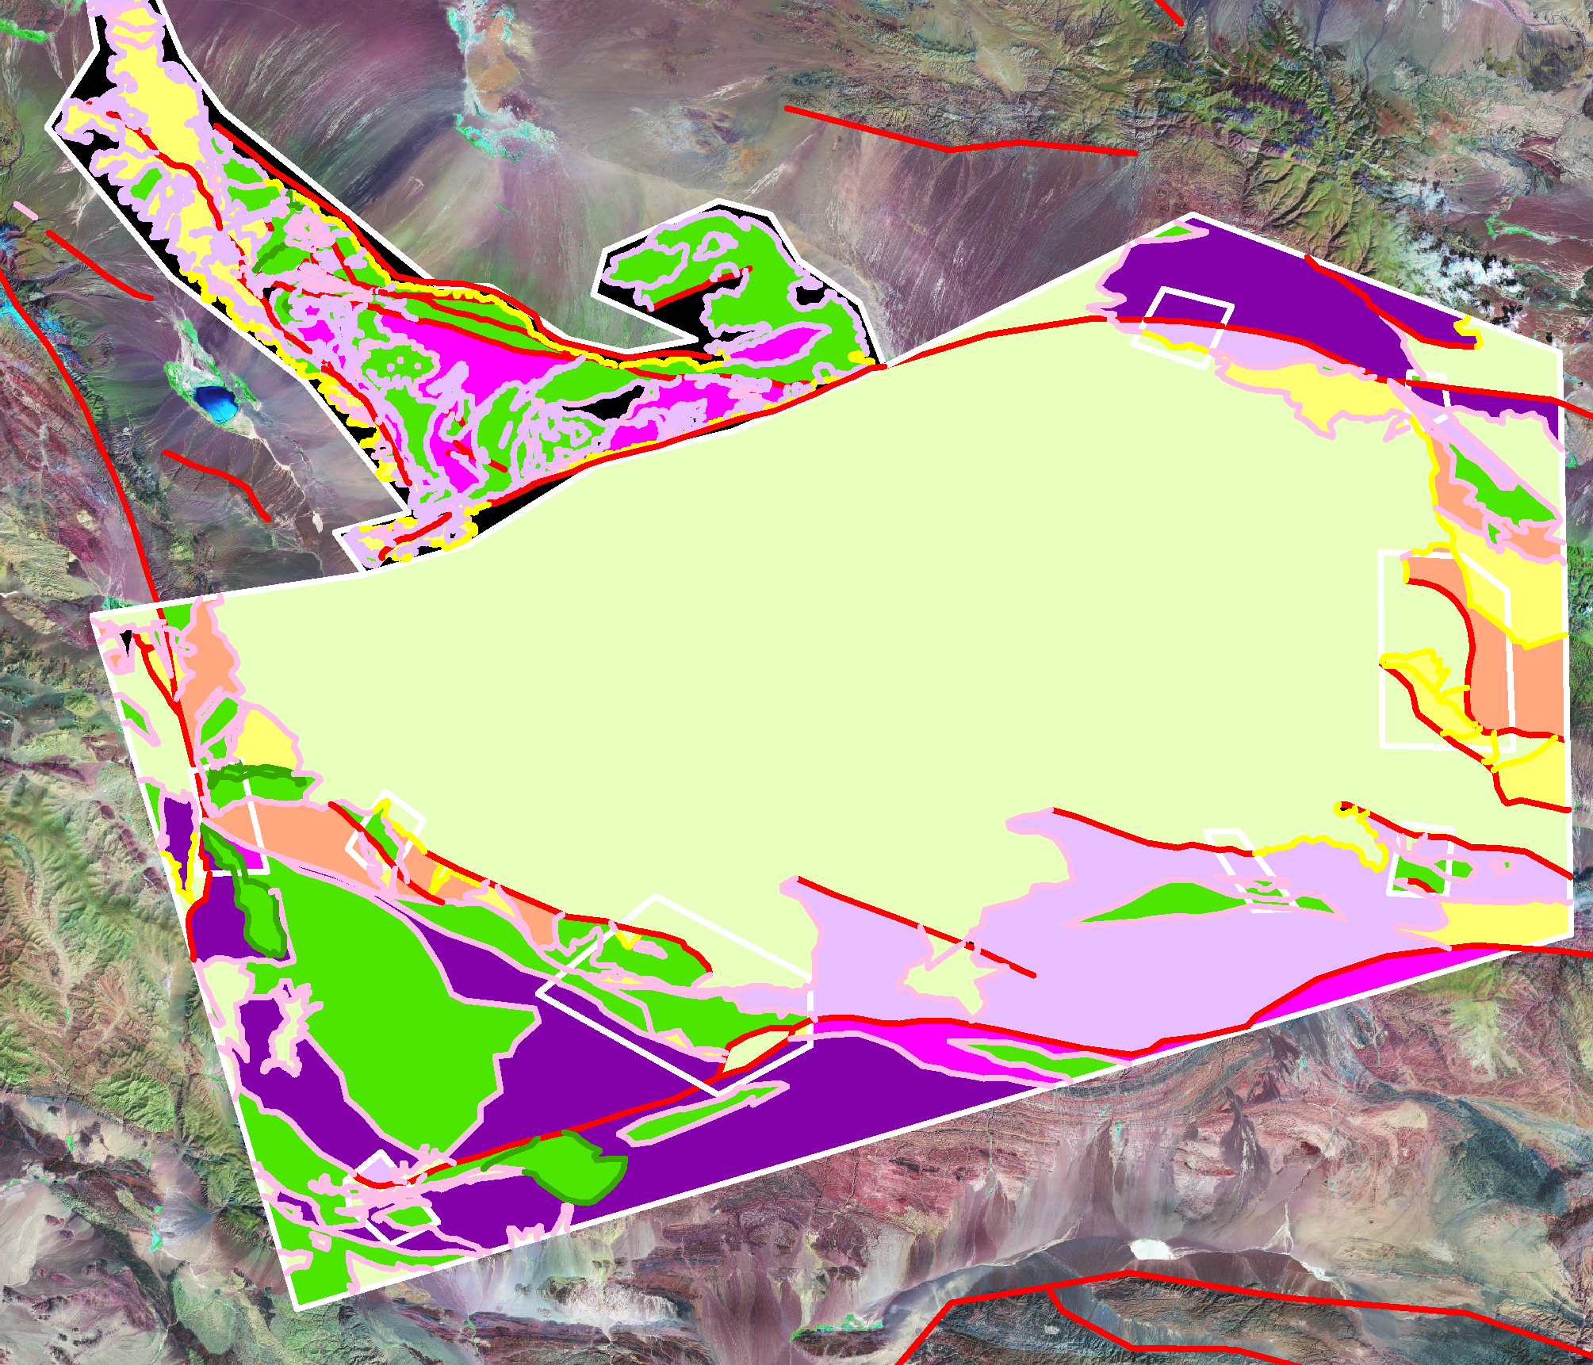
Partially Completed Work
Map and Cross-sections

Slide 15
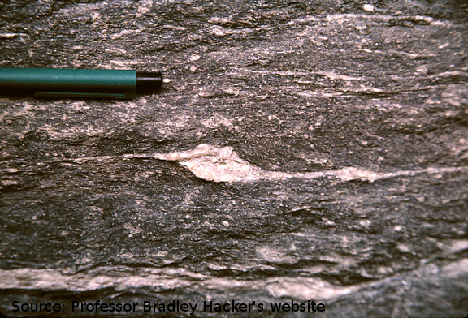
Todo: Kinematic Indicators
Ductile clast rotations – visible in thin section
Collect brittle deformation fabric measurements

Slide 16
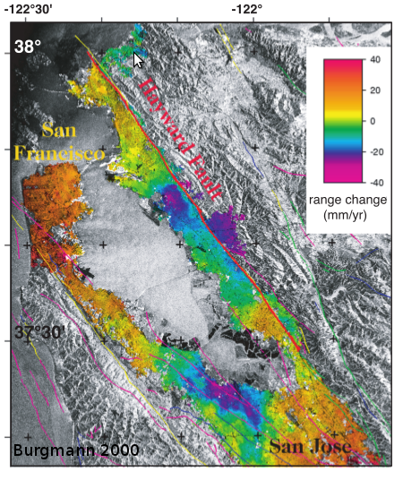
Todo: inSAR of active deformation
Provides local measurement of active motion rates

Slide 17
Timeline
Now – March:
–Continue updating the map
–Create cross-sections through the important areas
–Kinematic indicators in samples and field data
–Further literature review on basin formation
–Active deformation rates using inSAR?
–Write while I go
–Develop coherent basin formation kinematics
–Could any of this data help extrapolate backwards in time?
April:
–Write remainder of thesis paper
May:
–Final touches and edits
–Presentation!

Slide 18
Complications
Extrapolating into the past is difficult!
But, the present-day kinematics of the Shargyn Basin are still worthwhile
Times up in April/May.
Regardless of what happens, the map is still valuable.

Slide 19
Why?
A better understanding of active crustal deformations helps with:
– disaster management (earthquakes)
– resource development (oil, gas, coal)
– helps understand past crustal deformation

