Slide 1
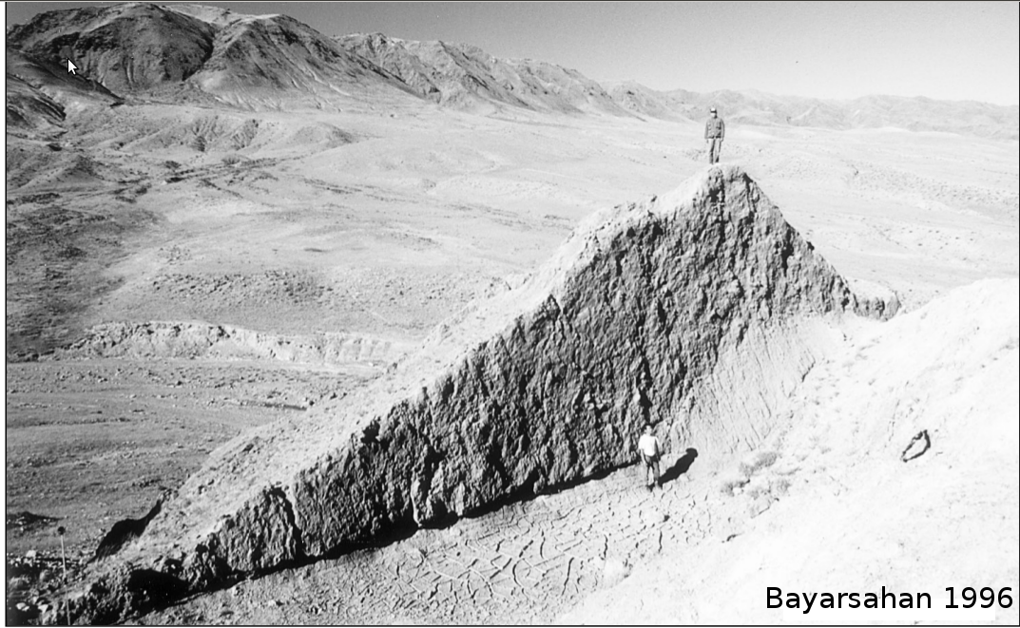
Active deformation of the
Shargyn Basin, western Mongolia
By: Ben Thompson
Advisors: Prof. Oliver Jagoutz, Claire Bucholz (PhD Candidate)

Slide 2
Outline
Background on Mongolian Tectonics
Field and satellite data
Active structure of the Shargyn Basin
Paleozoic structural grain as a control on active faults.

Slide 3
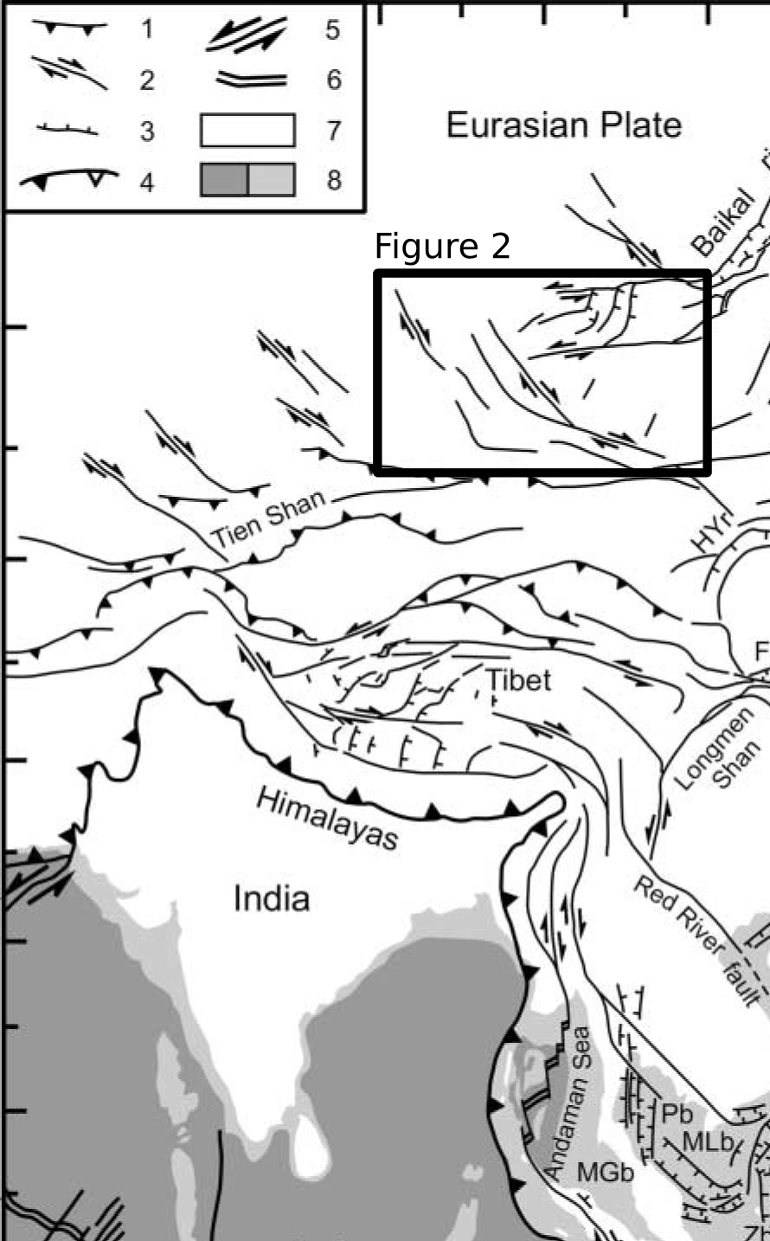
Mongolian deformation in context
Indo-Eurasian orogeny
Mongolia is the northern extent of Eurasian deformation

Slide 4
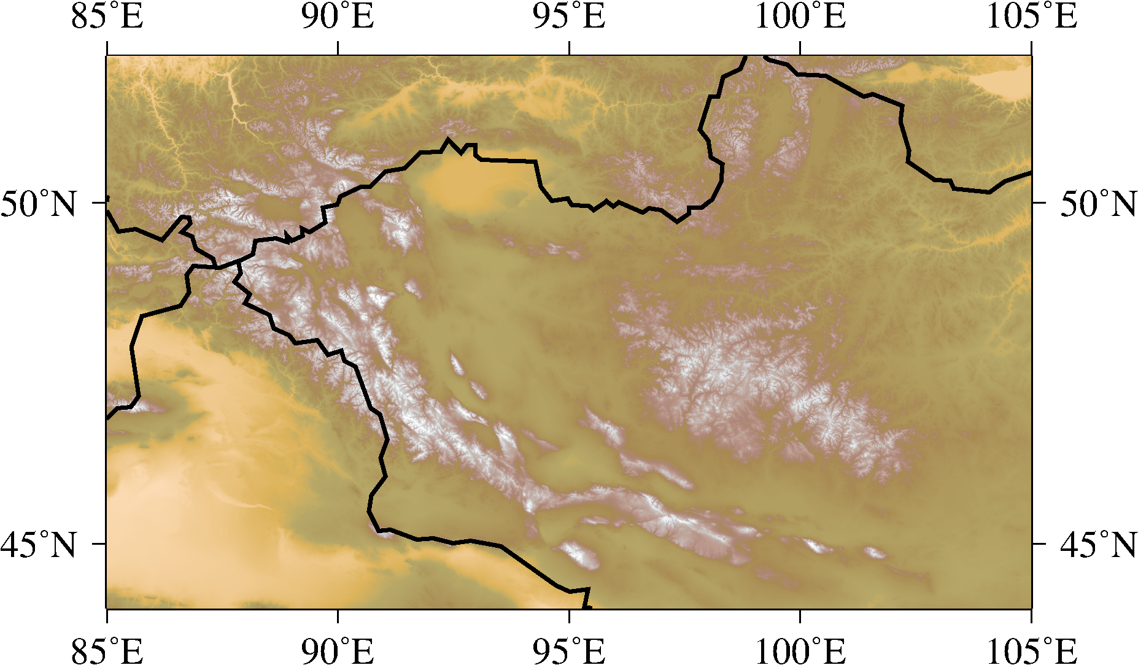
Mongolia: Plateau with basin and range topography

Slide 5
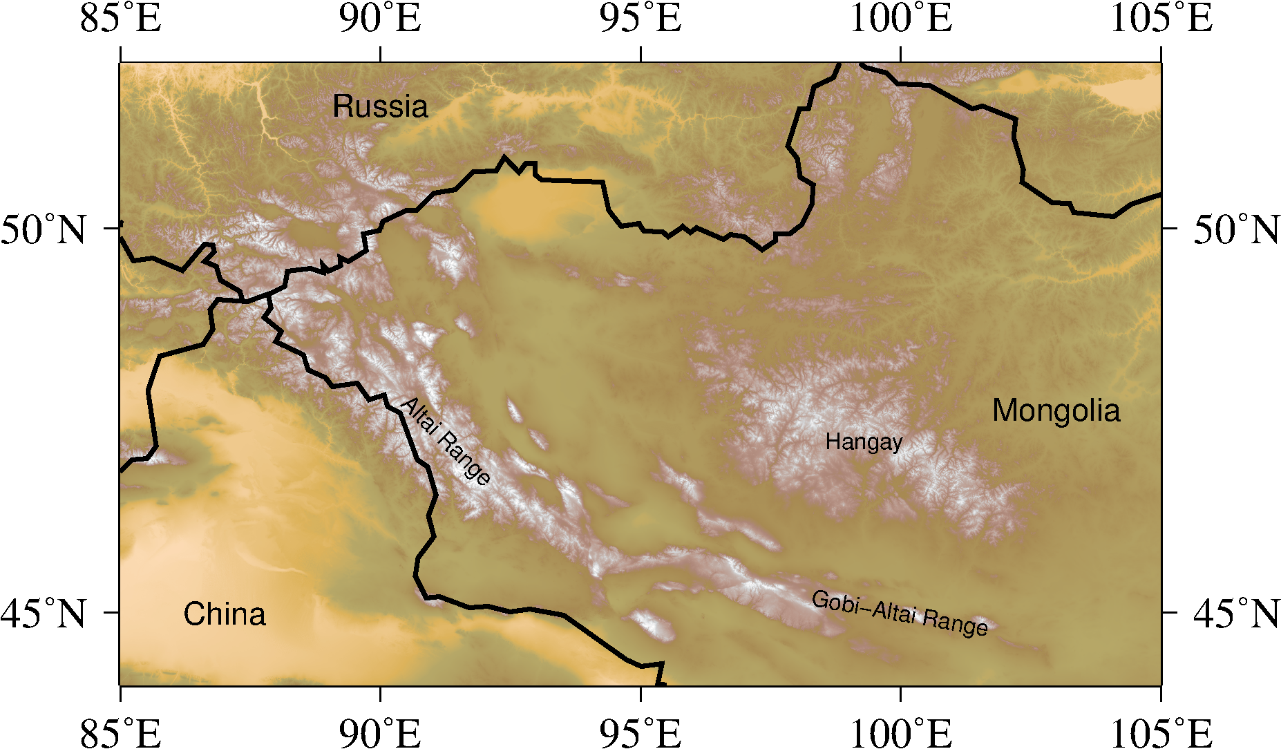
Mongolia: Three major mountain ranges

Slide 6
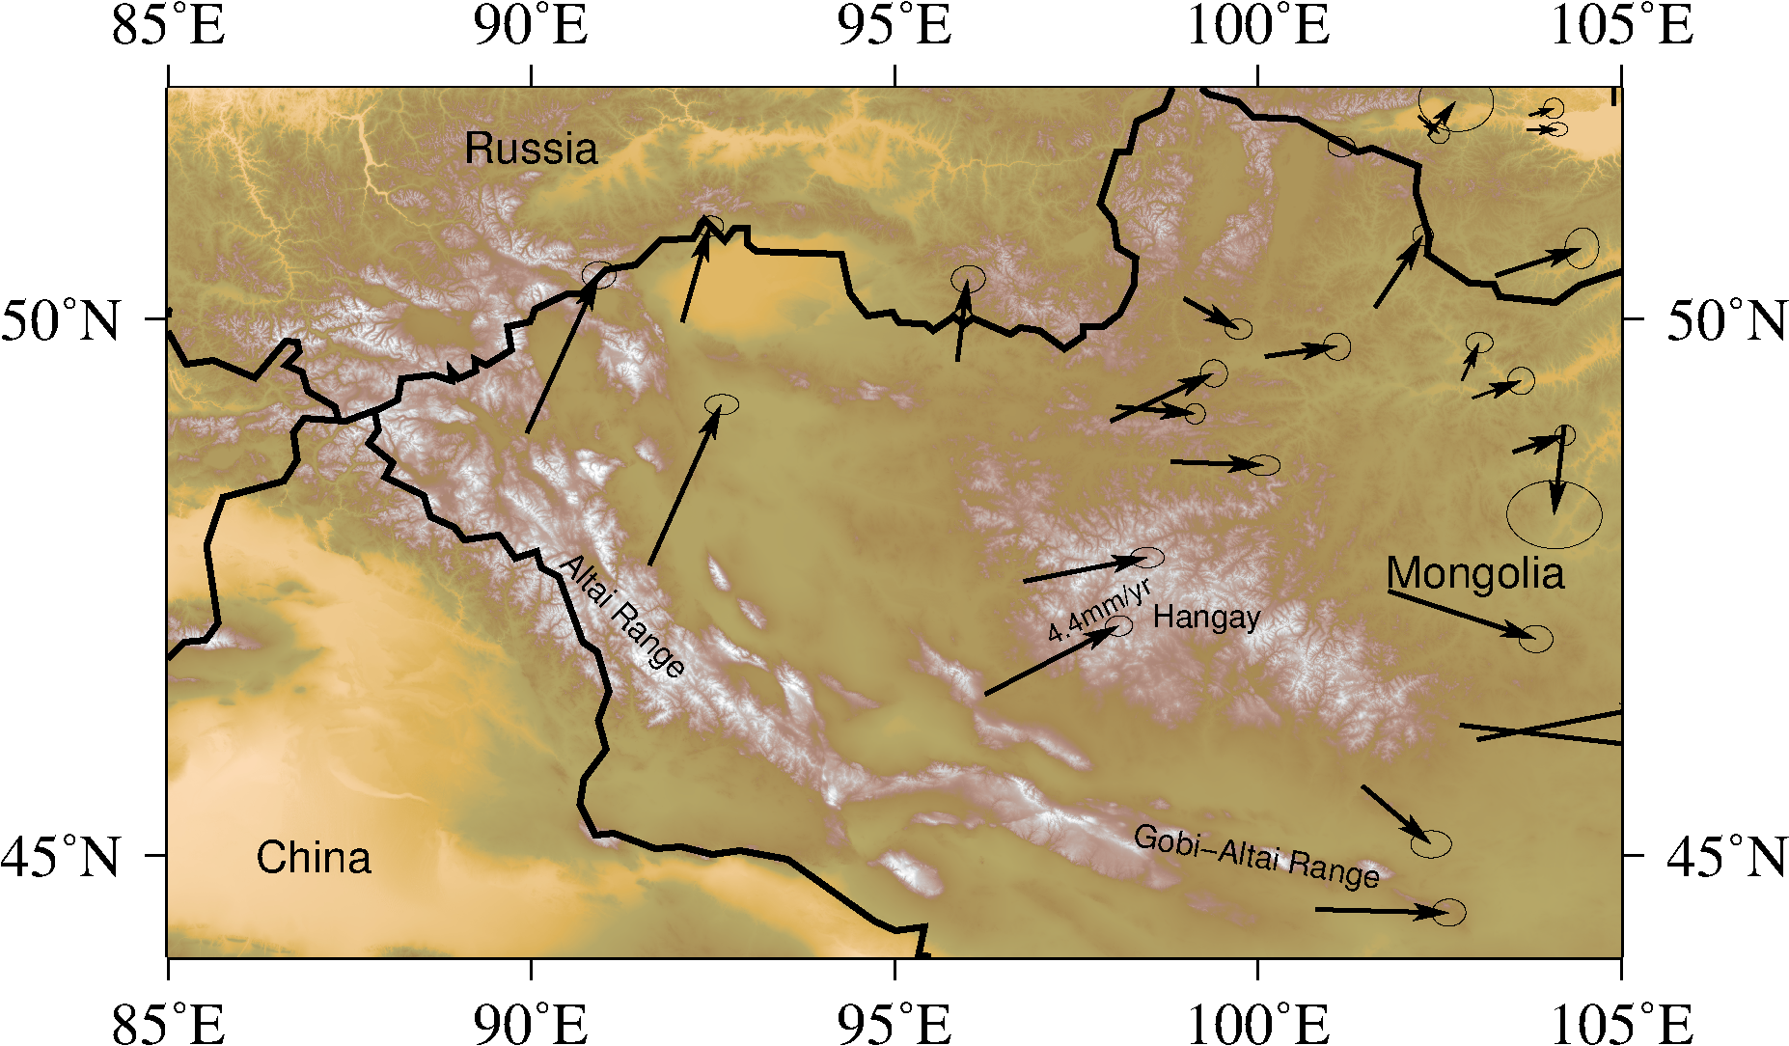
Mongolia: northwards and eastwards motion

Slide 7
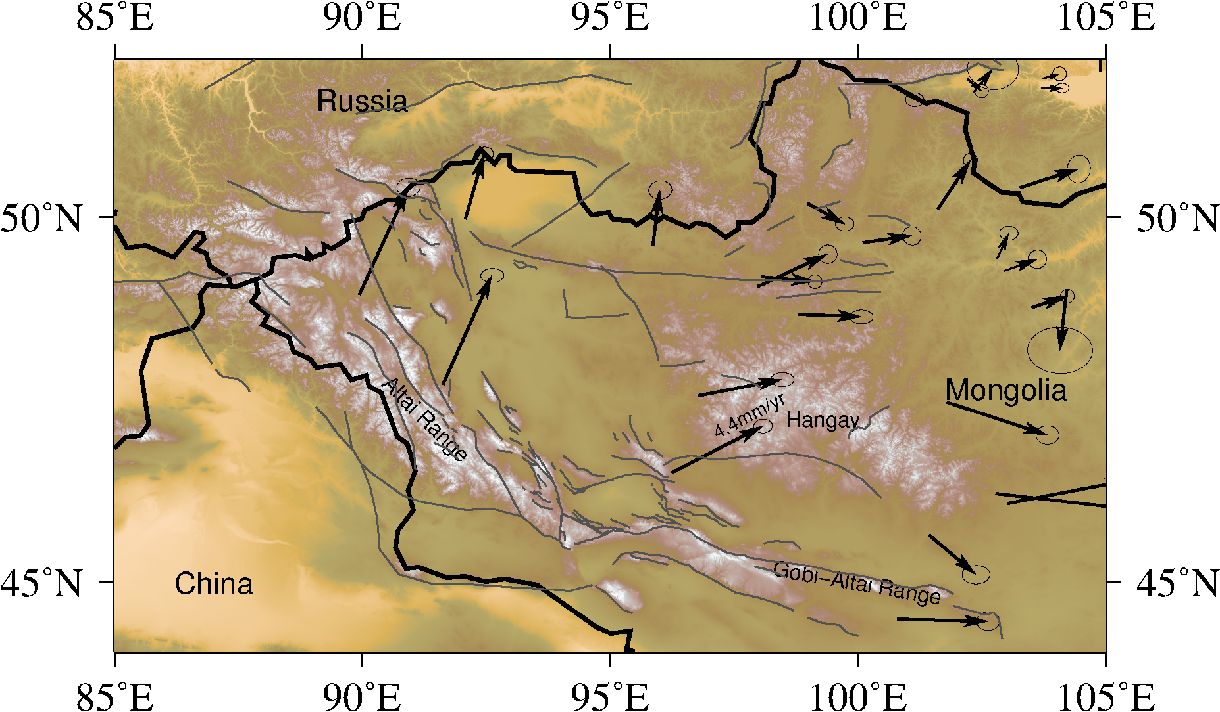
Mongolia: widespread active faulting

Slide 8
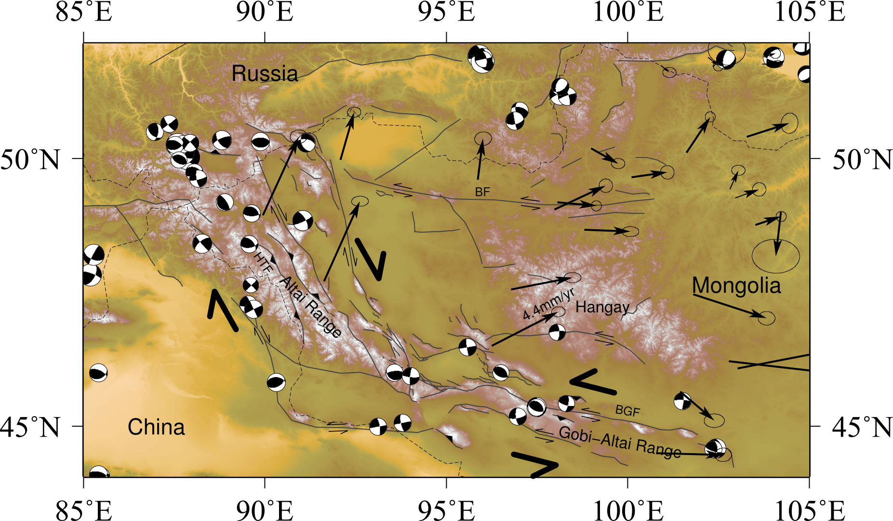
Mongolia: transpressional conjugate strike-slip pair

Slide 9

Mongolia: transpressional conjugate strike-slip pair
Shargyn Basin = the intersection!

Slide 10
Outline
Background on Mongolian Tectonics
Field and satellite data
Active structure of the Shargyn Basin
Paleozoic structural grain as a control on active faults.

Slide 11
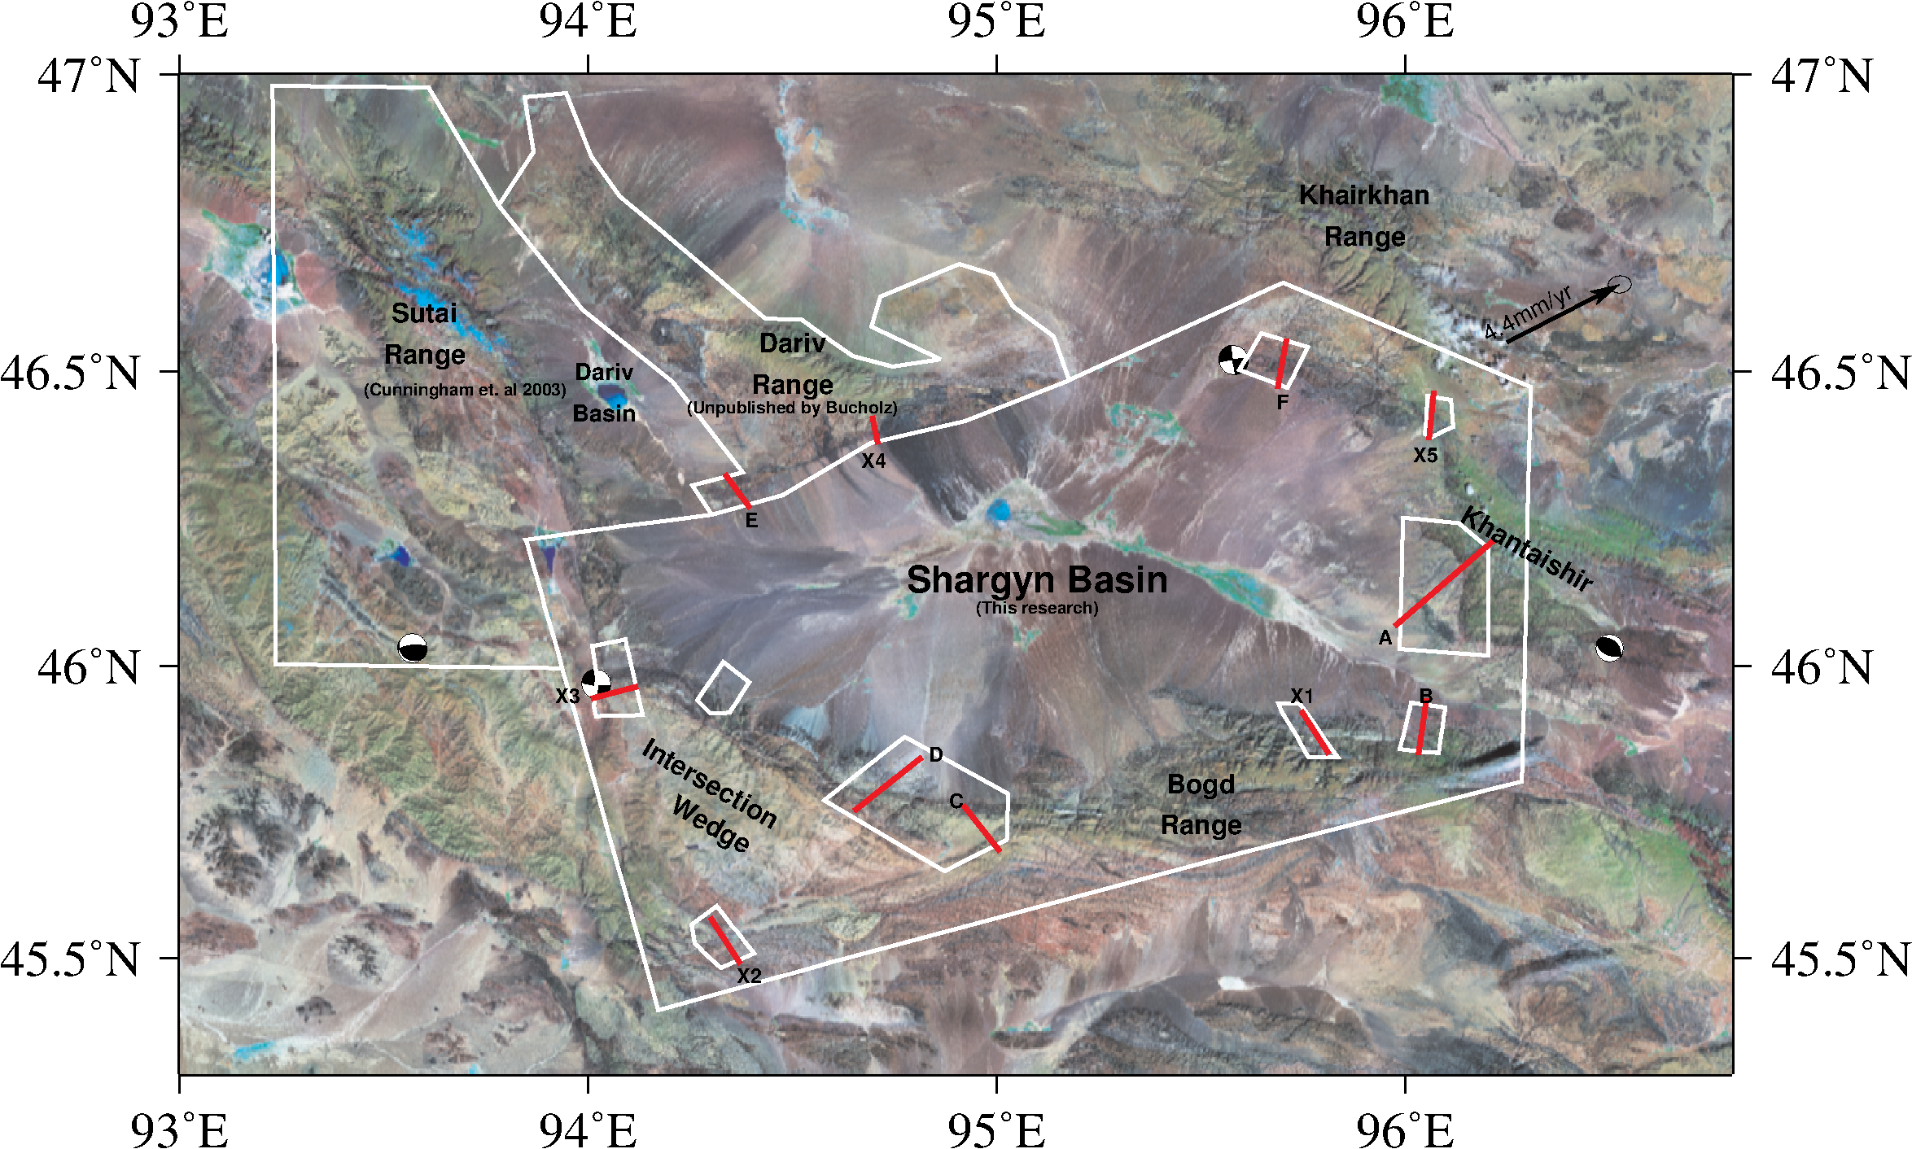
Some faults are visible on satellite imagery.
~150 km

Slide 12
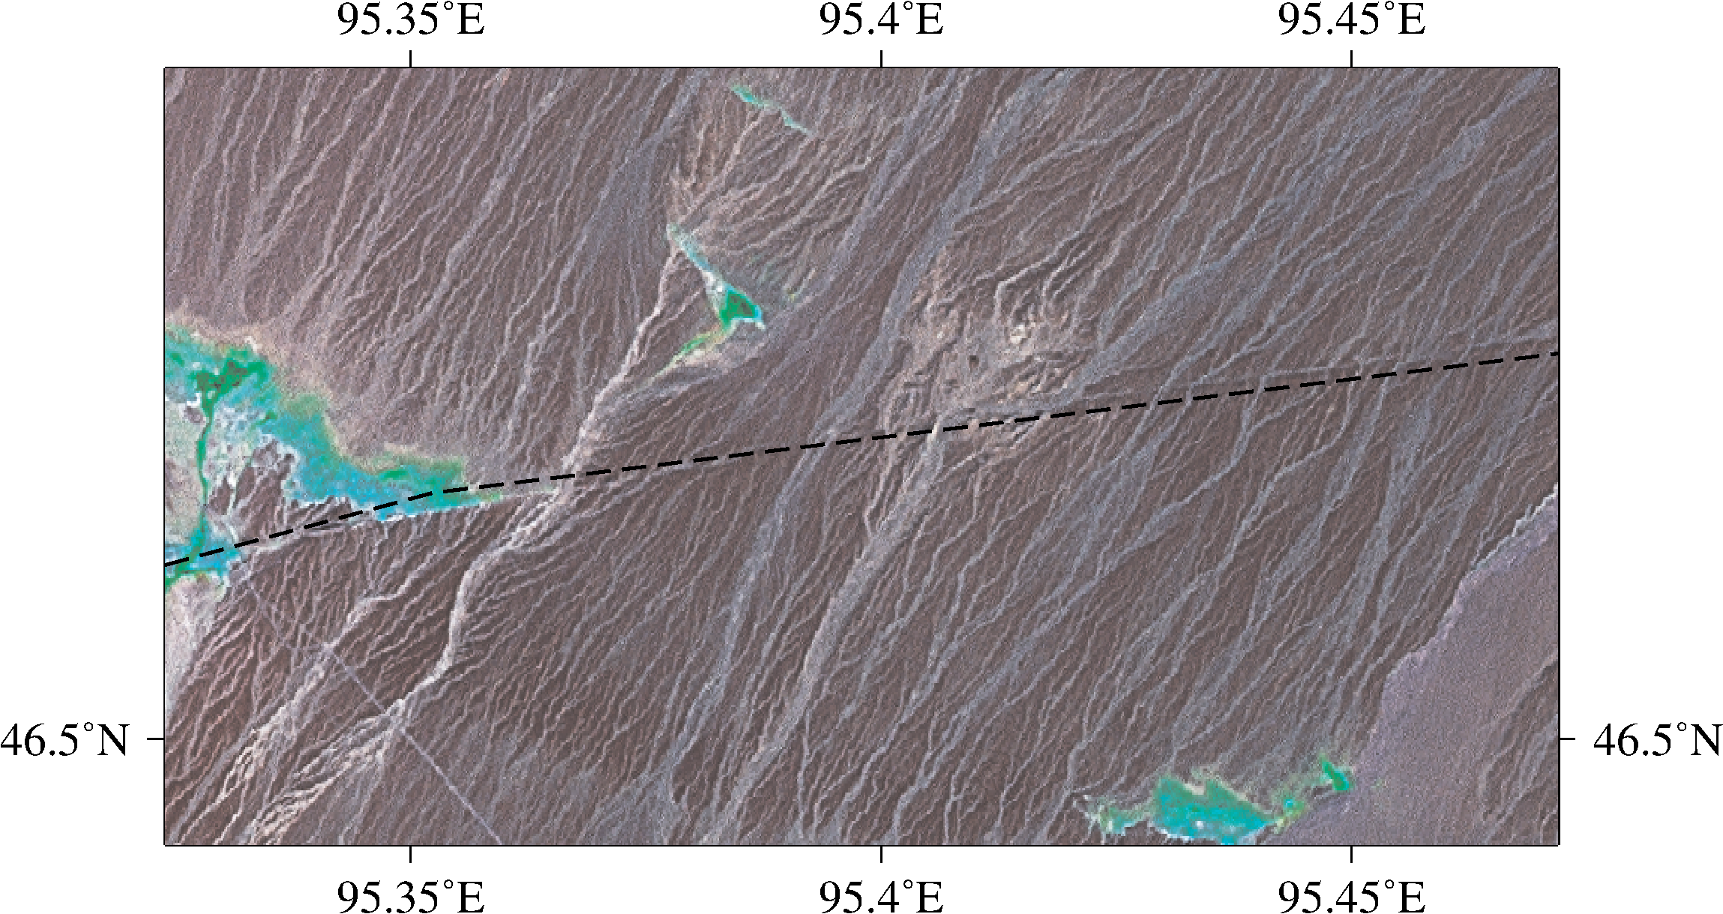
Some faults are visible on satellite imagery.
In this image, the Shargyn fault is offsetting stream beds.

Slide 13
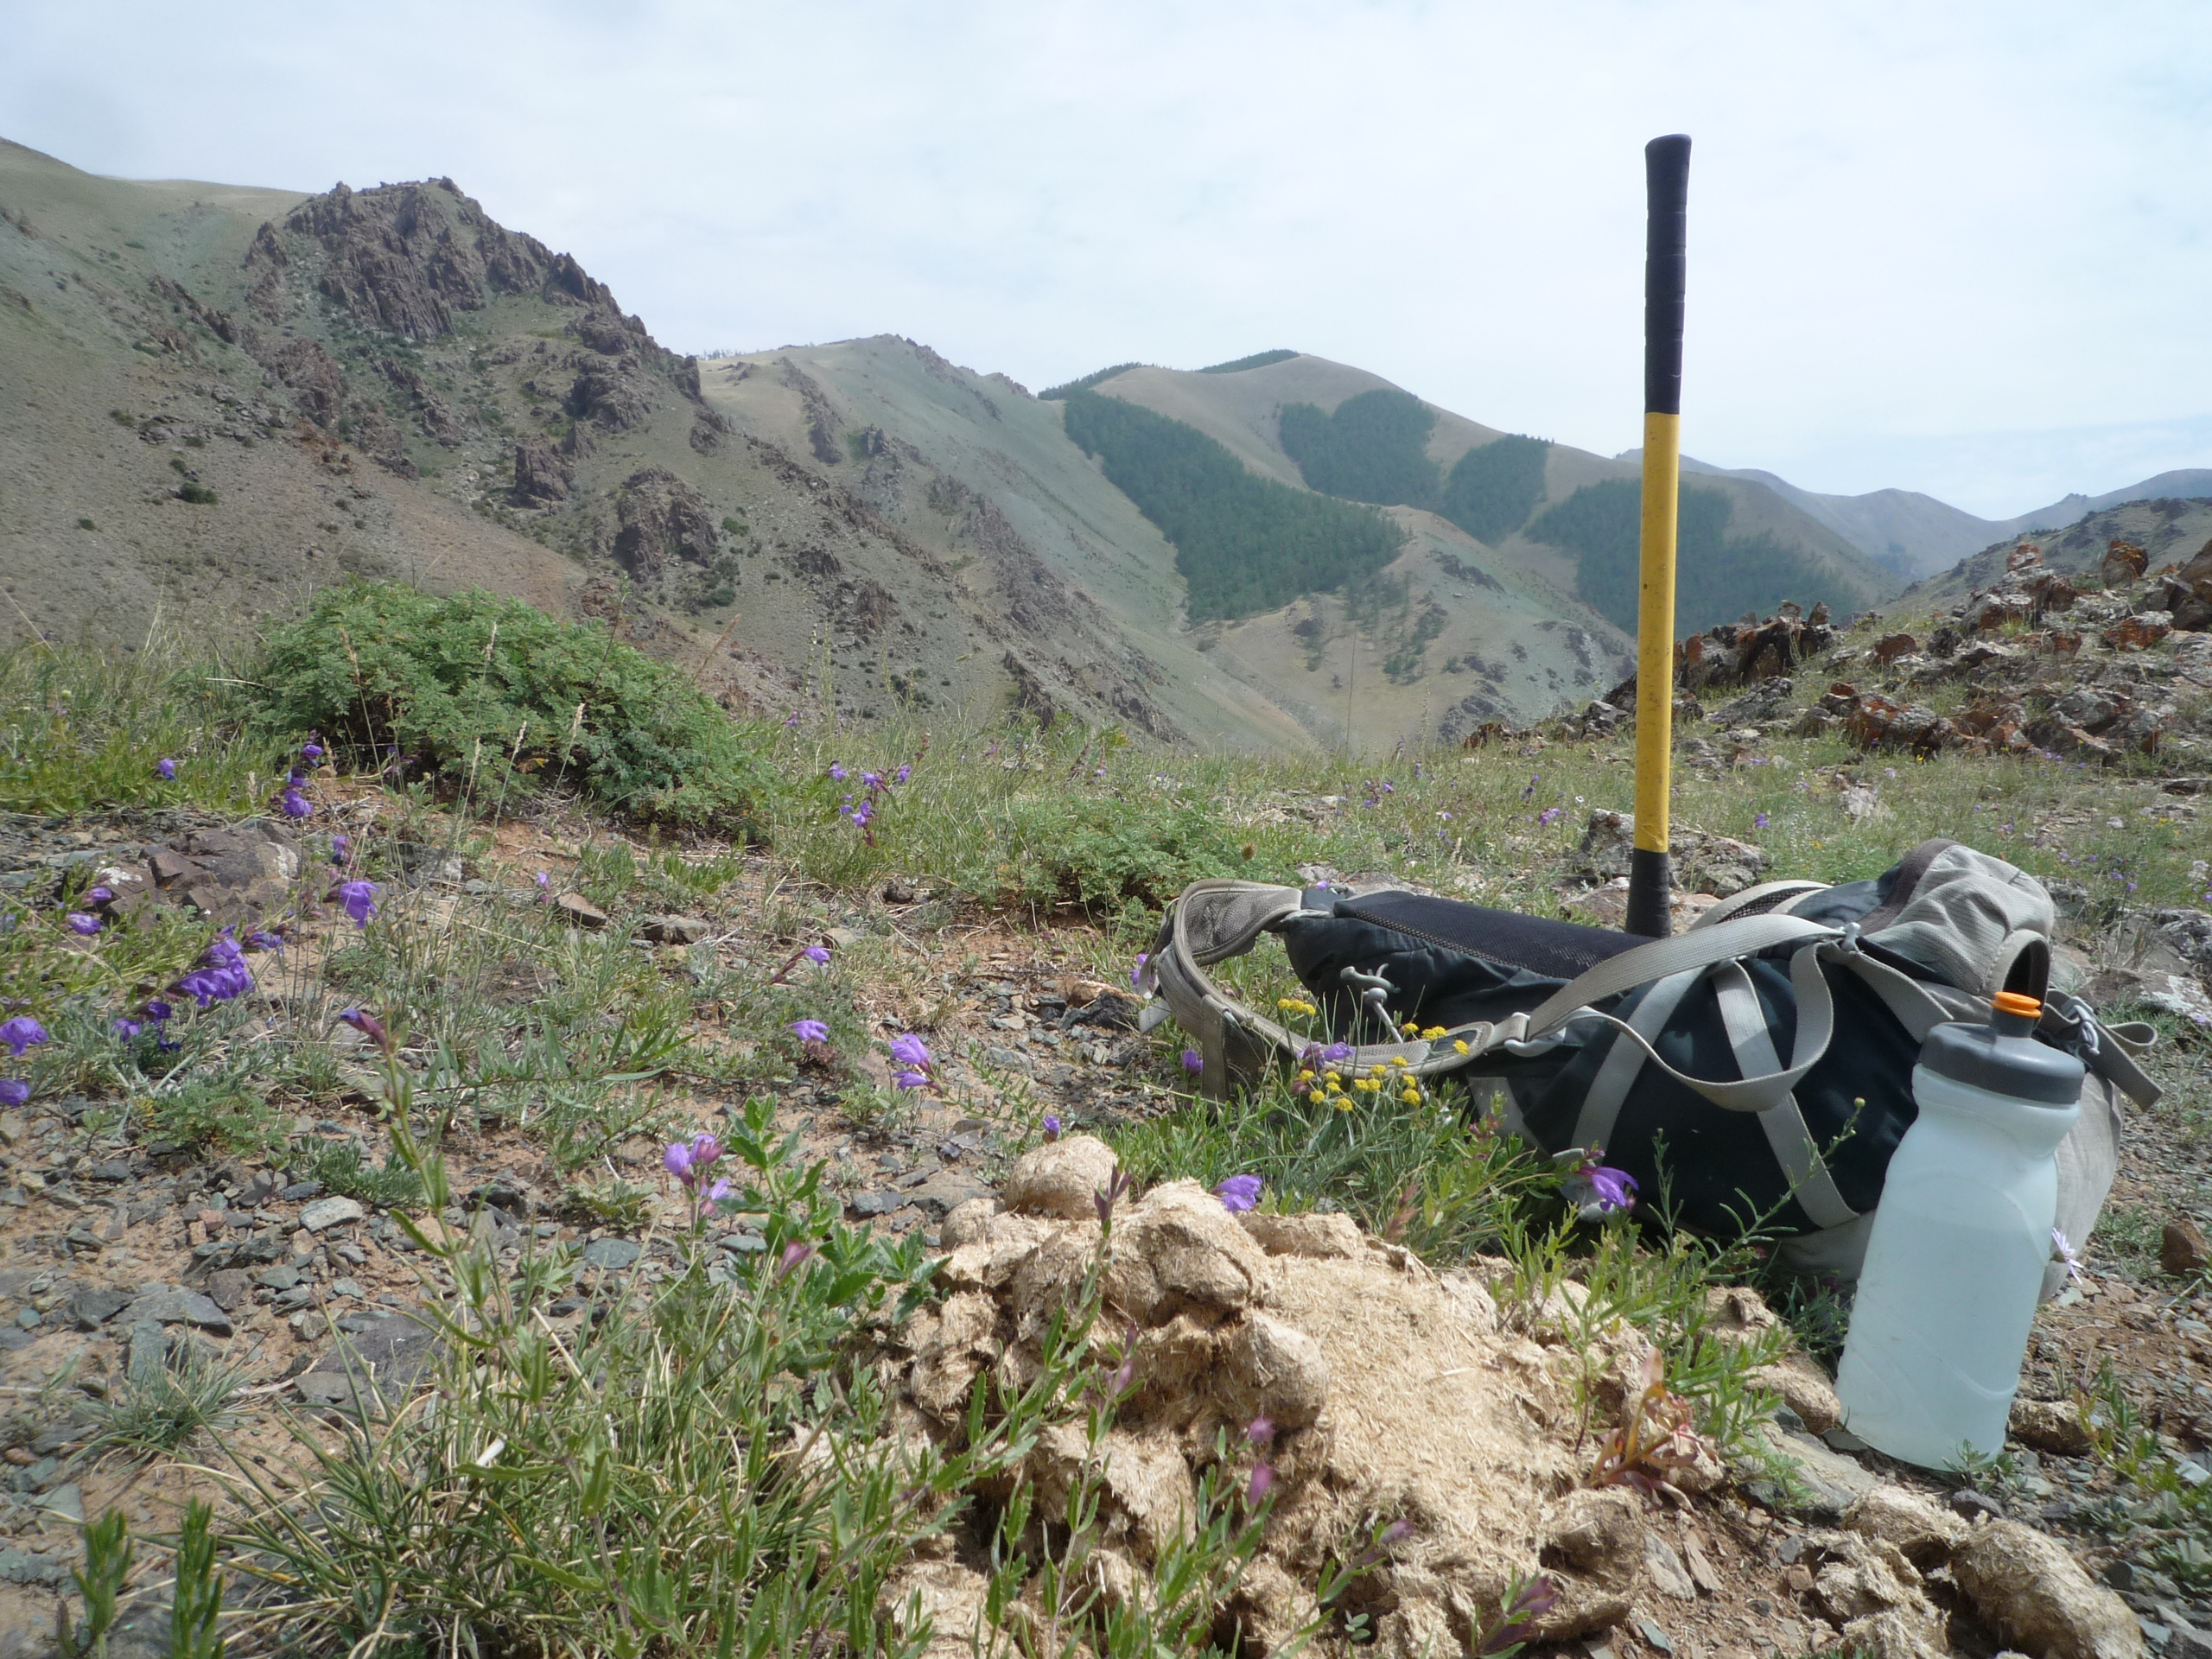
Some other faults we examined in the field

Slide 14
Some faults were directly visible in exposure
Upper Khantaishir Thrust

Slide 15
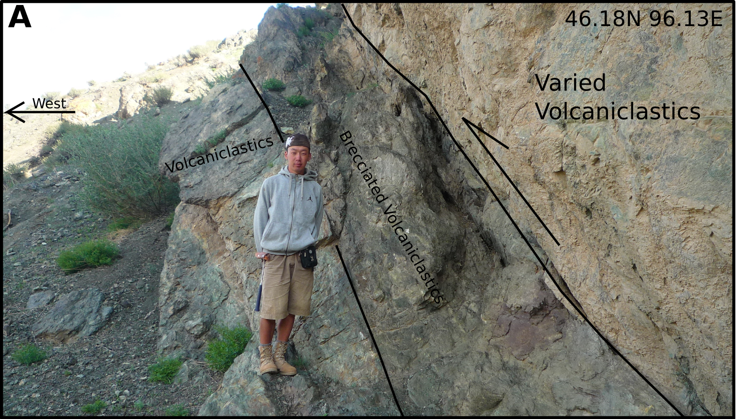
Khantaishir fault exposure

Slide 16
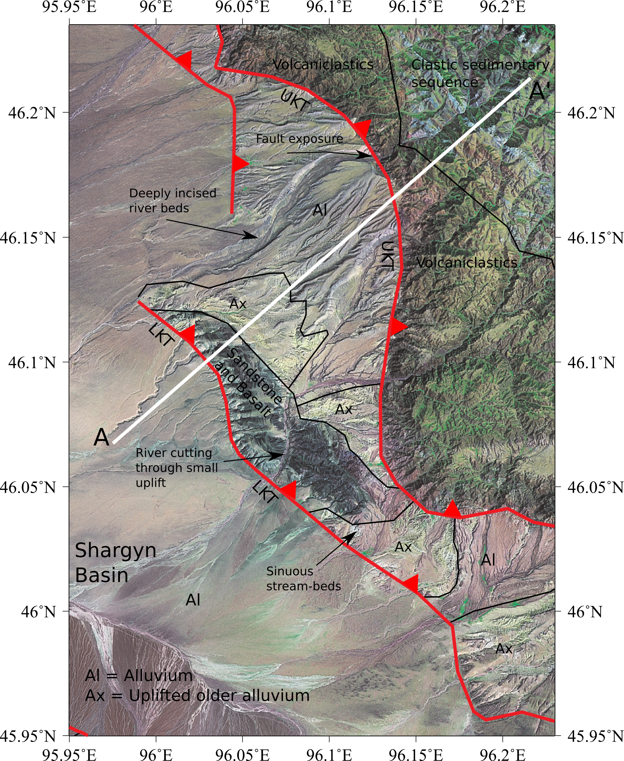

Slide 17
We performed transects through interesting areas
Khantaishir: Two thrusts of different ages

Slide 18
Outline
Background on Mongolian Tectonics
Field and satellite data
Active structure of the Shargyn Basin
Paleozoic structural grain as a control on active faults.

Slide 19
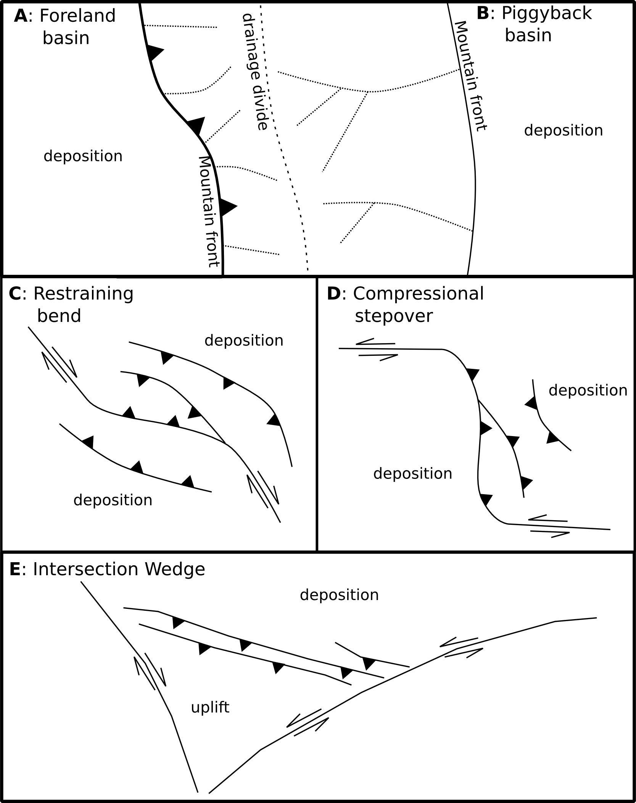
Transpressional strike slip can create a variety of features
  All of these features are visible around the Shargyn Basin
  The Shargyn Basin is formed by a combination of an intersection wedge, a compressional stepover and other minor features.

Slide 20
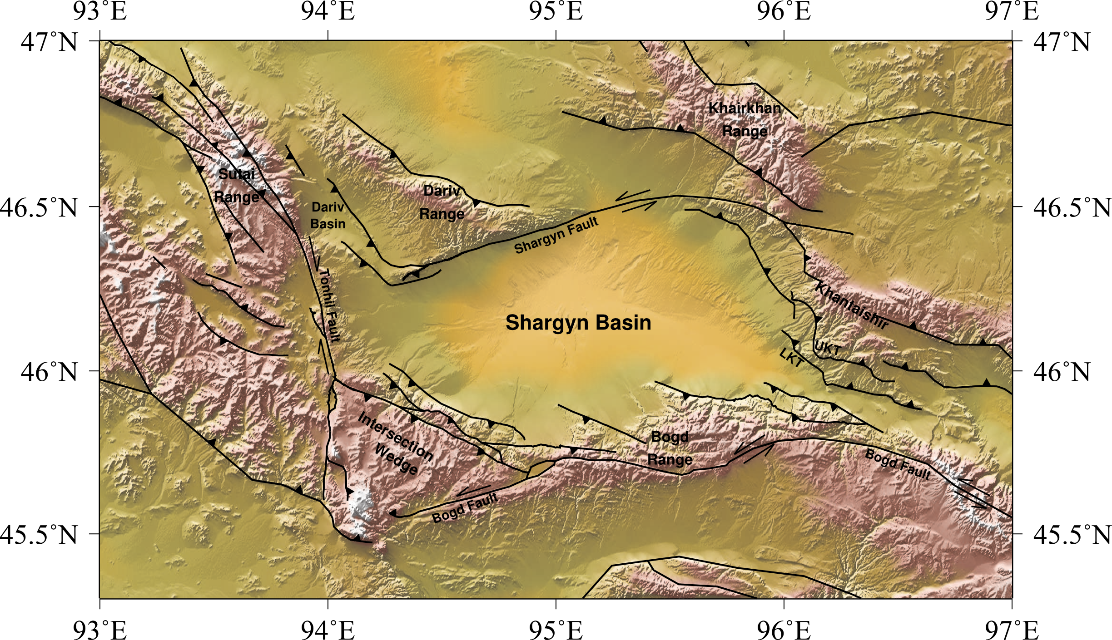
Transpressional strike slip can create a variety of features
Dariv Basin = piggyback basin Sutai Range = restraining bend

Slide 21
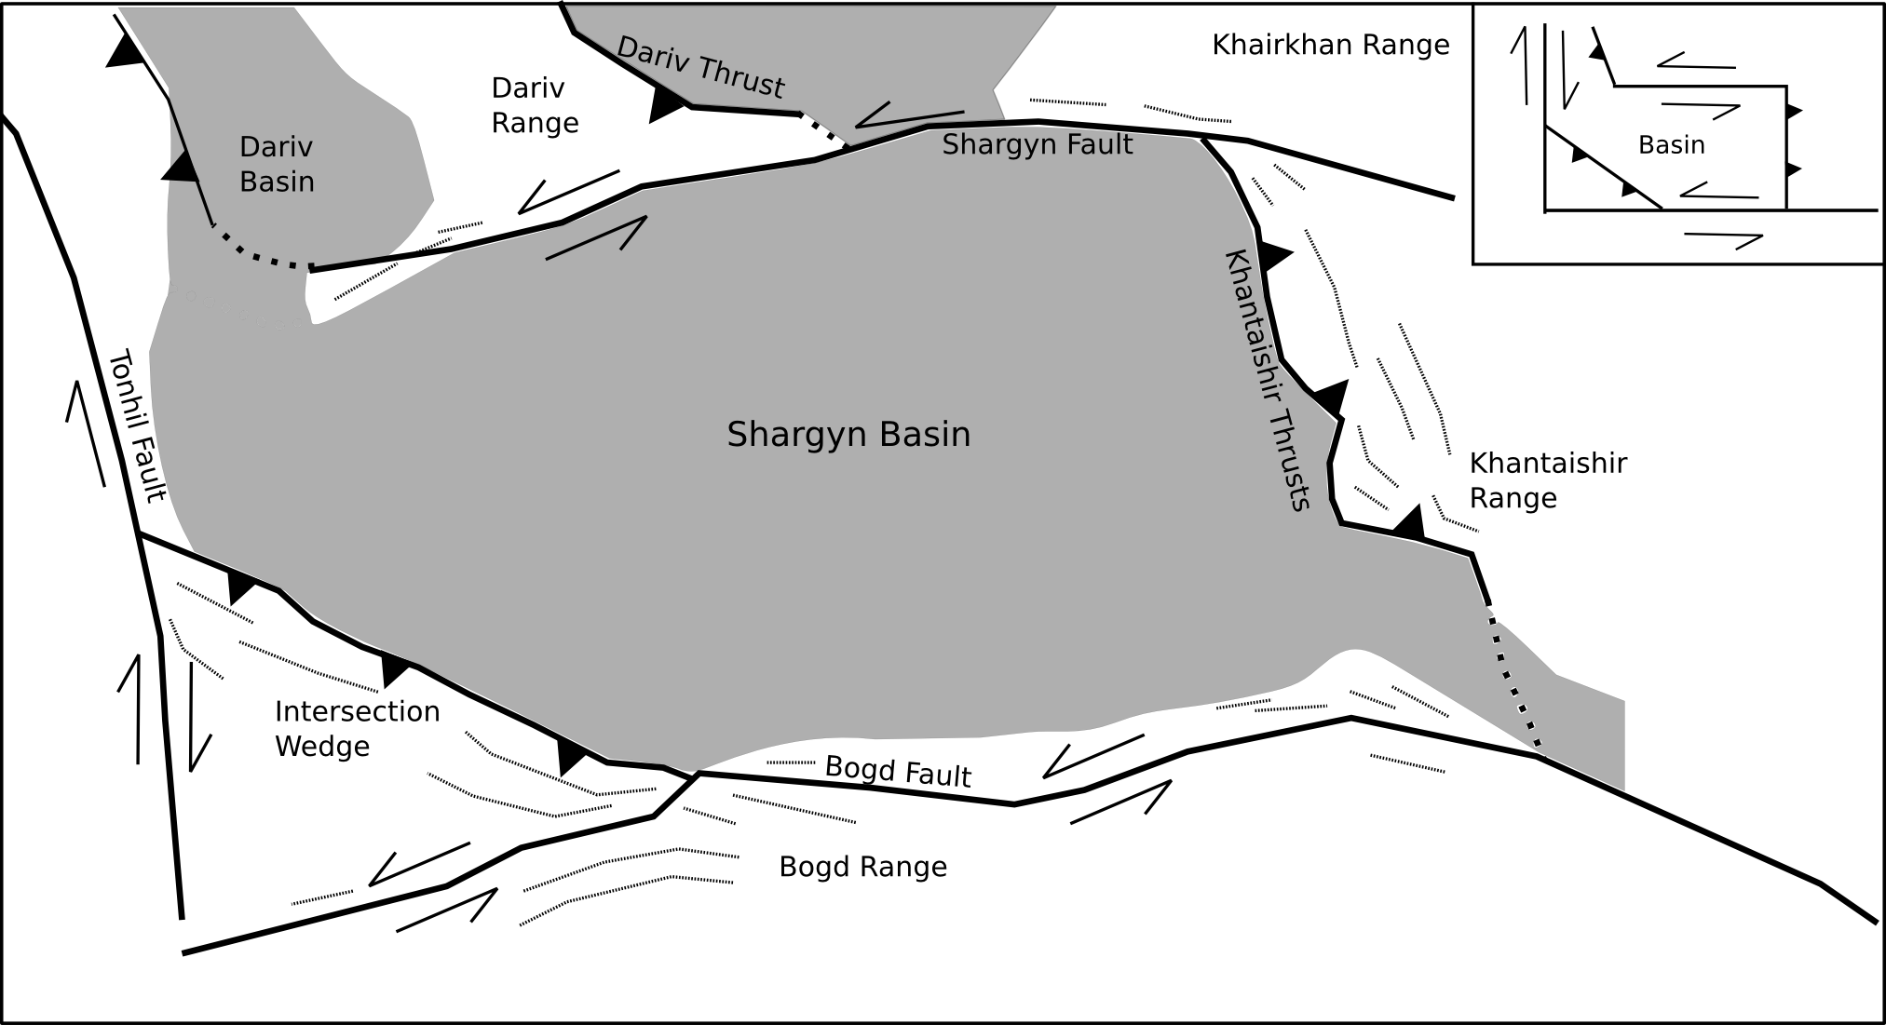
The Shargyn Basin
Compressional stepover and intersection wedge

Slide 22
Outline
Background on Mongolian Tectonics
Field and satellite data
Active structure of the Shargyn Basin
Paleozoic structural grain as a control on active faults.

Slide 23
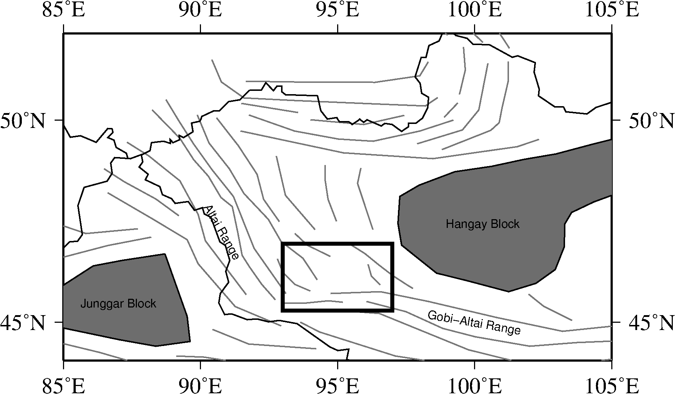
A complex tectonic history controls the location of active faults

Slide 24
A complex tectonic history controls the location of active faults
Regionally: Active faults follow pre-existing weaknesses

Slide 25
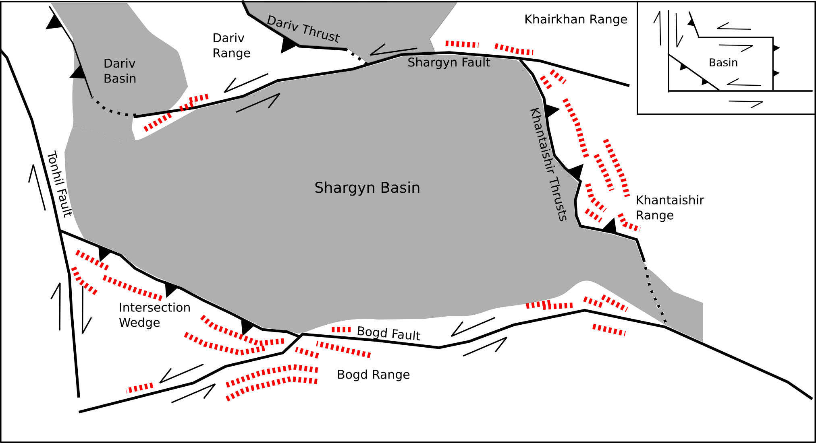
A complex tectonic history controls the location of active faults
Locally, active faults follow foliation (red) and bedding.

Slide 26
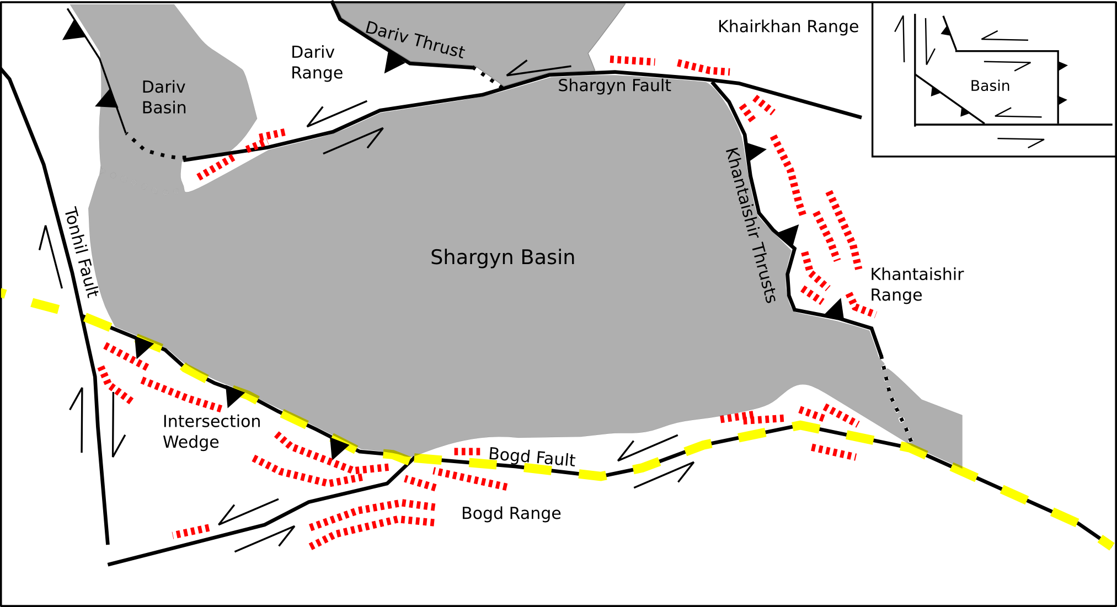
A complex tectonic history controls the location of active faults
The Main Mongolian Lineament, in yellow, is a major
Carboniferous Suture Zone

Slide 27
Conclusions
Faulting around the Shargyn Basin creates:
  Compressional stepover with motion stepping north from the Bogd Fault to the Khantaishir Thrusts and the Shargyn Fault.
  Intersection wedge between Bogd and Tonhil Faults in the western part.
  Strike slip faults terminate in thrust splays.
Faulting is controlled by pre-existing Paleozoic structures.
  Foliation parallel to the basin margins and active faults

