Slide 1
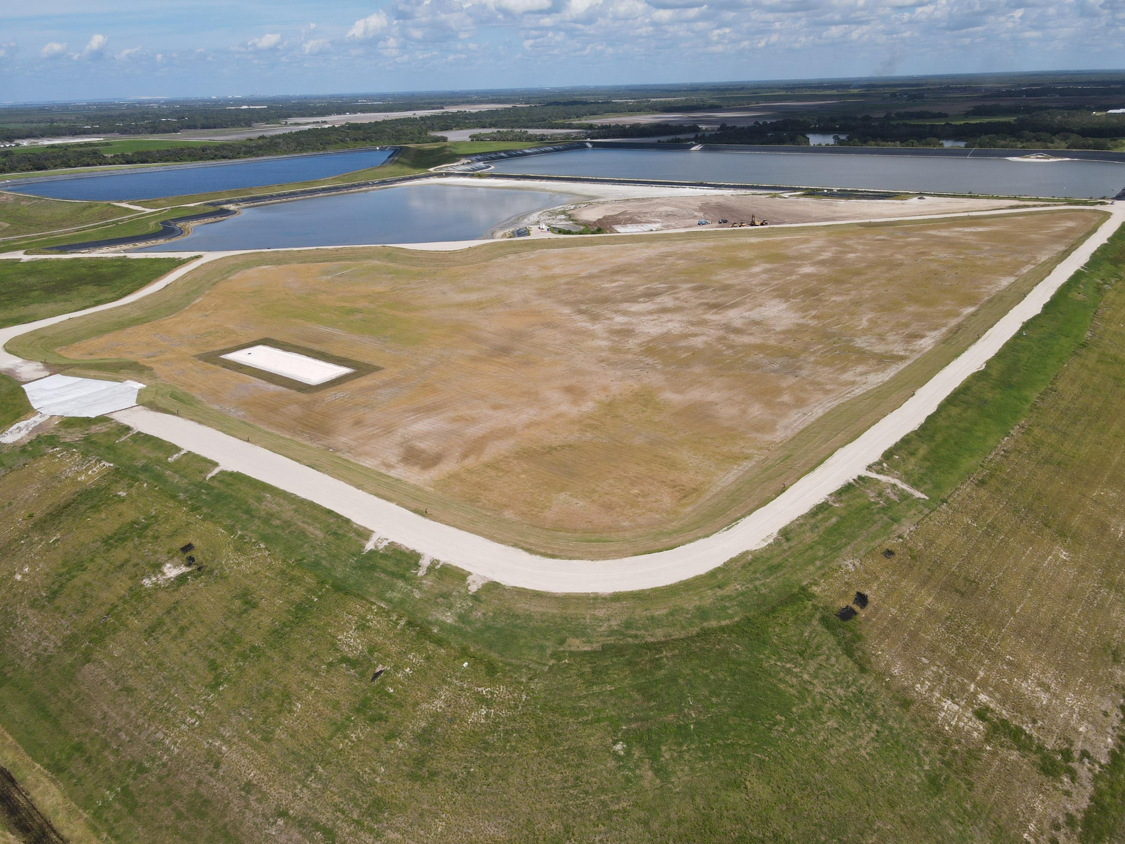
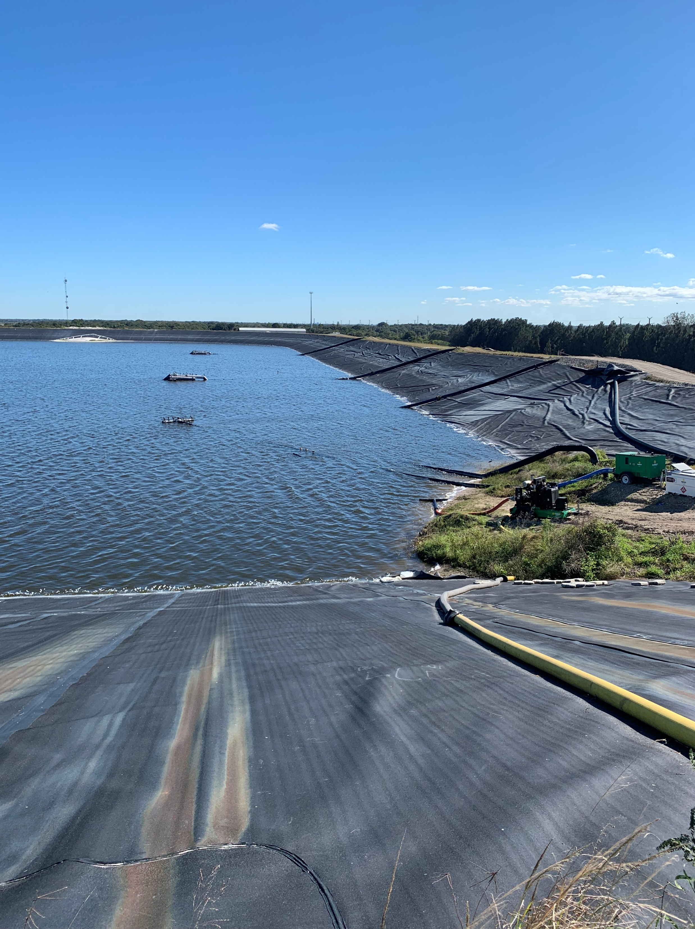
(a) Piney Point looking northeast
(b) NGS-S holding pond

Slide 2
