Slide 1
Evolutionary Approach
Eleftherios Christopouros
Martin Schnöll
Thomas Bergmüller

Slide 2
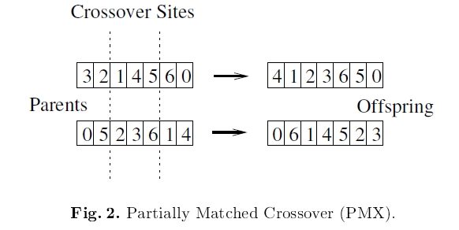
Quick Synch: Evolutionary
Each FV has genetic information
A subset of the N first elements of the genetic information => Feature-Subset
Rate the fitness of a DNS and generate offspring

Slide 3
JEvolution
Java library, 2001
Functionality (among other)
Chromosome class
Evolutionary Algorithm (EA) class
Sample code
Sorting-Phenotype
other demo-phenotype
Phenotype interface

Slide 4
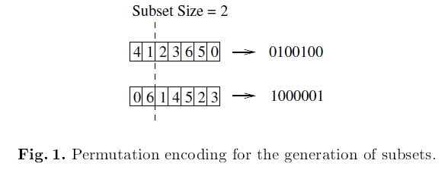
Chromosome
Encodes the genetic information
Permutation encoding
Configurable
mutation rate,
Crossover sites
…

Slide 5
Phenotype
Implements fitness function J(.)
Allows to rate the quality of a subset of selected features
(The first N bytes of a particular chromosome)

Slide 6
KnnPhenotype
Implements phenotype
Own KNN-Classifier
Hashmaps
Euclidean distance
Leave-one-out-Evaluation

Slide 7
KnnPhenotype & Results
Look at the code
Live Demo

