Slide 1

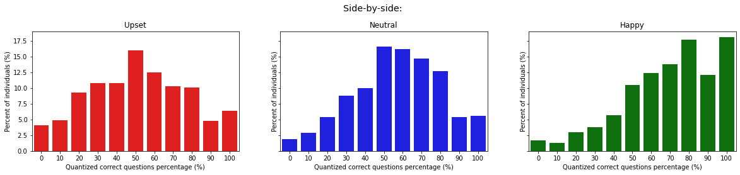
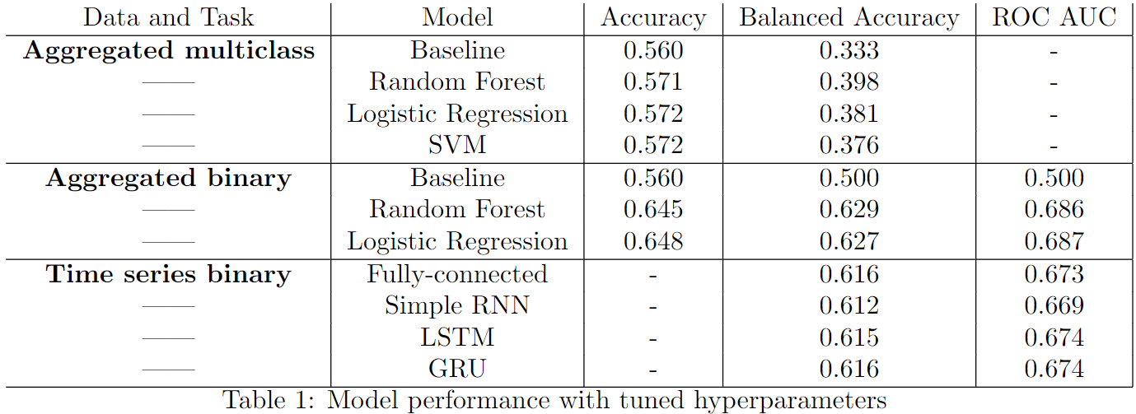

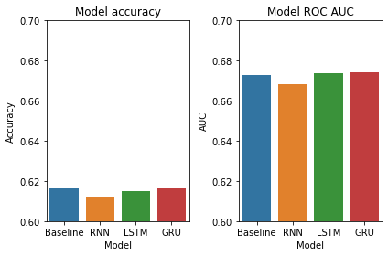

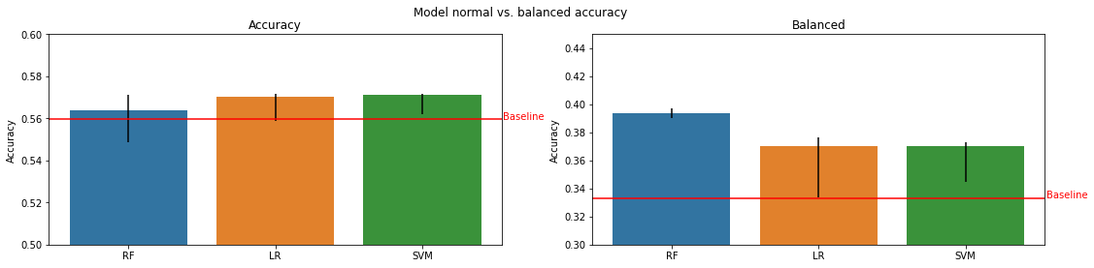
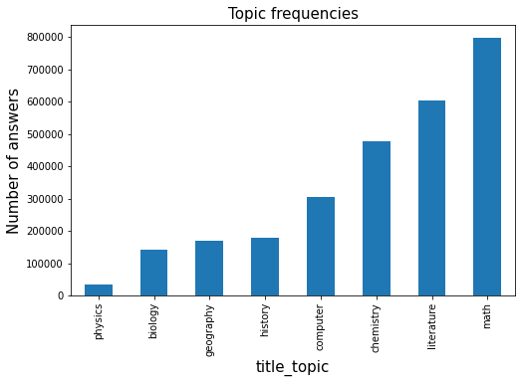
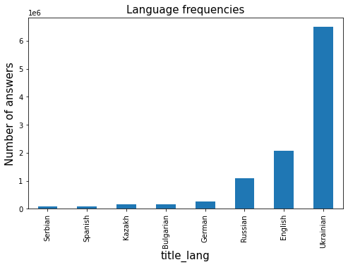
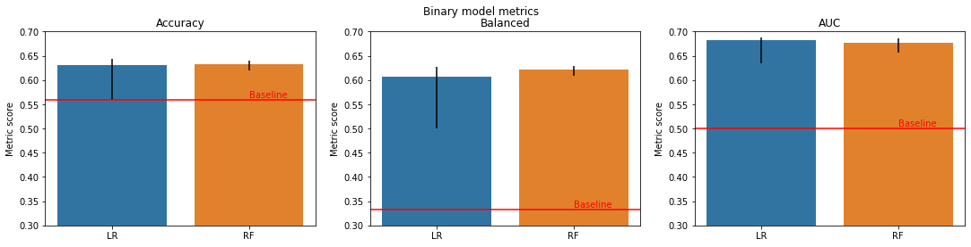
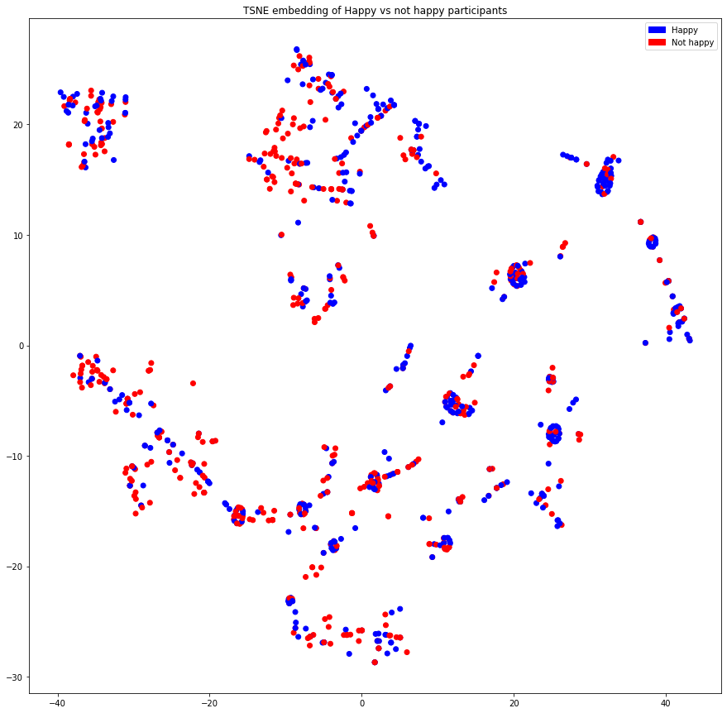


Predicting feeling of learning based on session interactions and characteristics.
Classtime
Team 🦖 - Berkane Thomas, Blackwell Julian, Ezzo Ahmed
Machine Learning for Behavioral Data (MLBD) Course, EPFL, 2022
1 INTRODUCTION
3 RESULTS
Motivation: Students with the best results feel better about learning.
Research question: Can we predict reflection responses to the ”How do you feel about your learning progress” question based on the students’ session interactions and the characteristics of the session?
Two approaches:
Aggregated features with classification ML models
Time Series data with RNNs
Key insights: - Classification models improve the balanced accuracy more so than regular accuracy. Models best suited for binary classification (notably RFs). - Significant performance improvement compared to baseline. - Fully-connected network gives similar performance to RNN architectures. GRU seem to slightly outperform the alternatives
2 METHODOLOGY
Figure 3. Time Series – Binary classification
Dataset - Classtime
From the original answers dataset, we compute 13 features to make our predictions:
We first impute missing data and normalize the features. Additionally, we limit the number of time steps (between 10 to 30) and add padding if needed.
Note: the class labels are unbalanced so we generate a balanced dataset to remove bias towards a specific label. (Unbalanced: ~50% happy, ~35% neutral, ~15% upset)
Model Architecture
Aggregated: 3 different models were tested: multi-class Logistic Regression, SVM, and Random Forests. We compare these to a most-frequent class baseline predictor.
80/20 train-test split along with 5-fold cross validation to select the best model and hyperparameters. Trained with balanced binary accuracy.
Multi-class classification {happy, neutral, upset} compared to binary prediction {happy, not}.
Time Series: 3 different RNN architectures (Simple RNN, LSTM, GRU) compared to a fully-connected baseline.
10% test data, remaining data split 80/20 for training-validation. Networks trained with binary cross-entropy loss.
Participant | Session | Question
Answer time Answer correctness Number of answers | Mode Feedback mode Forced reflection Timer Is solo? Title length, language, topic | Video Image Weight
Figure 3. Aggregated multi-class classification
Figure 1. Frequencies of topic titles and languages
Figure 4. Aggregated binary classification
Math | Computer | Literature | Chemistry | History | Physics | Geography
Mathematics | Computer | Reading | Equations | History | Processes | Geography
Multiplication | Systems | Literature | Chemistry | History | Force | Culture
Science | Programming | Writing | Physics | Mythology | Mechanics | Map
Geometry | Technology | Reading | Biology | Reformation | Gravity | Region
Algebra | Spreadsheet | Text | Organisms | Chronicle | Apparatus | Country
4 EXTENSION WORK
Participant clustering to suggest patterns in happy vs not-happy
Session happiness prediction: Based on participant data, can we predict happiness percentage?
Figure 2. Top 5 most frequent words for each topic
Model | MSE | MAE
Deep | 0.1003 | 0.2575
LR | 0.1017 | 0.2598
4 CONCLUSION
Figure 5. TSNE participant embedding
Considered models perform better than baseline predictors but have room for improvement.
Future improvements: consider users across sessions to model behavior with session type/topic instead of single session.

