Slide 1
Efficient Parameterization of Modelica Models
Thomas Beutlich and Dietmar Winkler 14. International Modelica Conference – Session 2A
2021-09-21

Slide 2
Outline
Motivation, use cases and history
Modelica library ExternData
Missing data
Structural parameters
Modelica library ModelicaTableAdditions
Conclusions and outlook

Slide 3
INTRODUCTION

Slide 4
Motivation
Separation of the behavioral implementation from its actual design parameters
Improvement of the overall quality, testability and reusability of application models - both on component and system level
Coordinated and centralized data management
Definition of parameterization responsibility by pull vs. push principle
Notes:
Like “clean code” in SW engineering
Data management in data bases where parameterization variants can be derived

Slide 5
Use cases
Property parameters – (usually) constant
Geometry dimensions
Material constants
Ambient conditions
Look-up tables
Stimulation parameters – time series
Environmental conditions
Open-loop driver maneuver
Structural vs. non-structural parameters
Notes:
Property parameters – (usually) constant
Geometry dimensions, e.g., tire diameter
Material constants, e.g., electrical resistance
Ambient conditions, e.g., ambient pressure
Look-up tables, e.g., consumption map
Stimulation parameters – time series
Environmental conditions, e.g., weather over one year
Open-loop driver maneuver, e.g., acceleration profile over one hour
Structural vs. non-structural parameters

Slide 6
Short history
2005: Tiller implements a generic data retrieval API for XML @Ford
2005/6: Parameterization of transmission models by ASCII text files @ZF
2006: AIT proposes XML based parameterization – if we only had used XML
2008: Haumer raises the core issue by requiring a general standardized implementation for usage within MSL
2013: ITI implements Modelica Standard Tables for MSL v3.2.1
2014: MA initiates SSP project - but for connected FMUs
2019: MA releases SSP standard v1.0
2021: Release of ExternData v3.0.1 and ModelicaTableAdditions v2.2.0
Notes:
Tiller not only introduces … but also proposes a generic data retrieval API for Modelica
By Xpath query language

Slide 7
LIBRARY IMPLEMENTATION
Handling of external data resources in Modelica

Slide 8
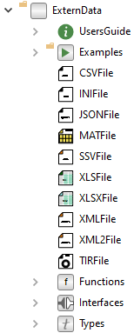
EXTERN DATA
BSD-2-Clause License
Available @GitHub or impact
Version 3.0.1 from 2021-09-19
CI build pipelines
Reads CSV, INI, JSON, MATLAB MAT (incl. HDF5), SSV, Excel XLS/XLSX, TIR and XML
Tested in Dymola, OpenModelica and SimulationX
Notes:
Utility library that keeps all things like file I/O, locale dependency, OS portability​ or thread-safety away from you.

Slide 9
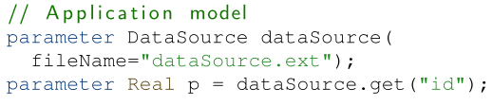
FEATURES
External code in pure C
Two implementation layers
Function layer
Record layer
Inner/outer concept
Reads CSV, INI, JSON, MATLAB MAT (incl. HDF5), SSV, Excel XLS/XLSX, TIR and XML
Compatible with MSL v4.0.0
Tested in Dymola (Linux/Win), OpenModelica (Linux/Win) and SimulationX
Notes:
Function layer works directly on external objects
Record layer:
Clean interfaces for records and accessor function enables inheritance and function redeclaration
Hides the external object as implementation detail
Enables inner/outer concept for the data record instance

Slide 10
FEATURES: MISSING DATA
Configuration setting how to react on missing data, e.g., empty cell of an Excel sheet
Return default value
Return default value and print message
Return default value and raise warning
Stop the simulation with an error
Function layer: Can be set per external function call
Record layer: Can be set per external data resource

Slide 11
FEATURES: STRUCTURAL PARAMETERS
Structural parameters from external data resources may cause issues
Whenever a structural parameter changes, the system of equations (in flat Modelica) changes, particularly if used as an array dimension
No general support available
Workaround for Dymola and OpenModelica, but redundant I/O (if not cached)
Notes:
Open Modelica Language issue

Slide 12
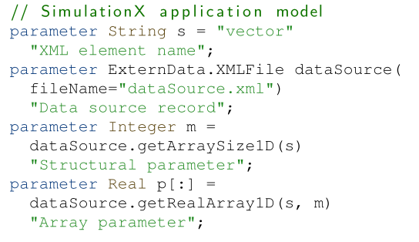
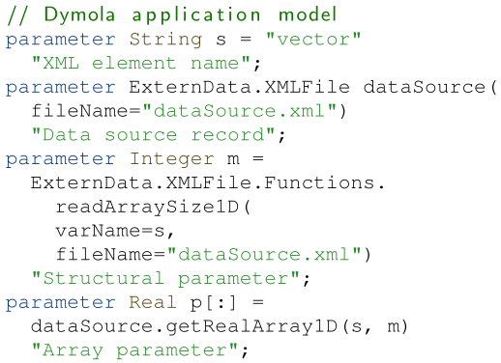
FEATURES: STRUCTURAL PARAMETERS
SimulationX
DYMOLA

Slide 13
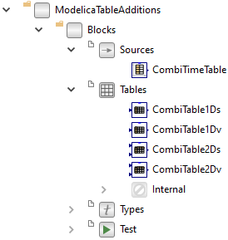
Modelica Table Additions
BSD-2-Clause License
Available @GitHub or impact
Version 2.2.0 from 2021-04-21
Reads CSV, EPW, JSON, MATLAB MAT and MOS
Tested in Dymola and OpenModelica
Notes:
Extension of Modelica Standard Tables

Slide 14
FEATURES
External code in pure C
Reads CSV, EPW, JSON besides MATLAB MAT and MOS
Compatible with MSL v4.0.0
Compatible with ExternData (by reusing the same dependencies for e.g., JSON)
Tested in Dymola (Linux/Win) and OpenModelica (Linux)
Notes:
CSV already ported to MSL master
EPW especially for Buildings lib
EPW with leap year support

Slide 15
FINALE

Slide 16
CONCLUSIONS
No Modelica Association standard for Modelica model parameterization
Open-source Modelica libraries fill the gap
Model developers deal with parameterization effort

Slide 17
Outlook
Support of unit conversion
Support of encryption of external data resources
Clarification of Modelica Language issues regarding external objects

Slide 18
Questions?
Ask here or on wonder.me afterwards

