Slide 1


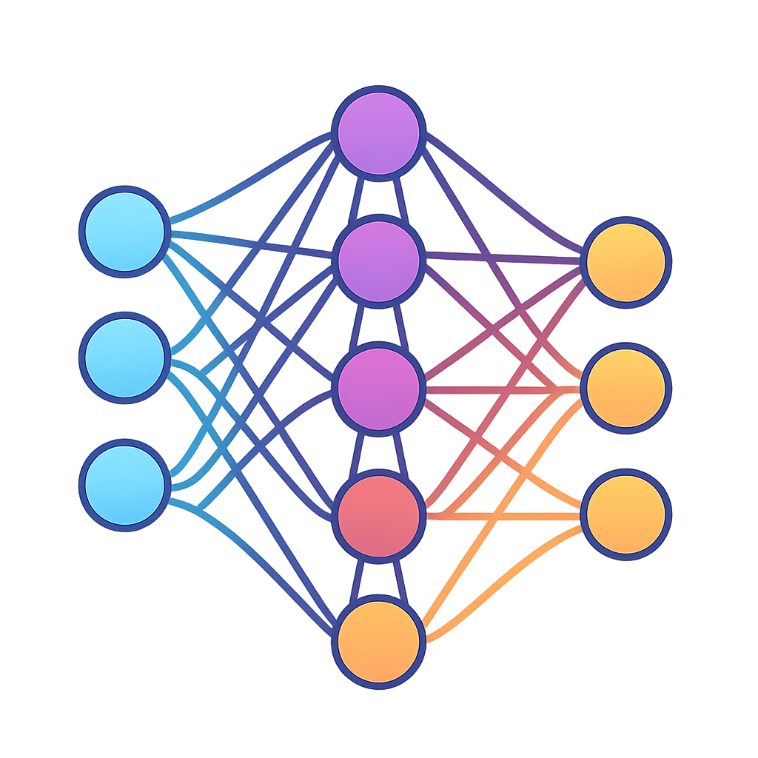
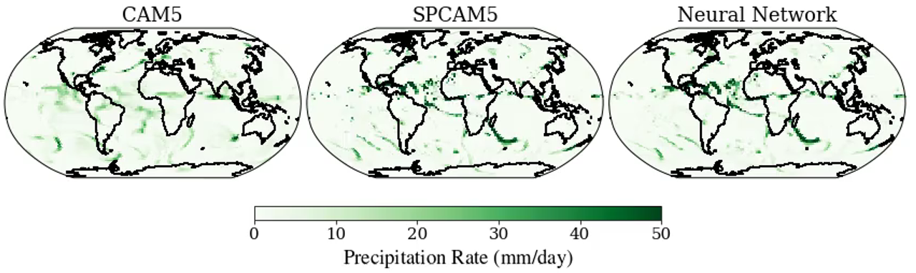
ML for Earth & Env Sci (Ch. 5, SA2026)
Traditional Model (too smooth!)
High-fidelity model (too expensive!)
Neural Network
Precipitation rate (mm/day)
How can we emulate complex, nonlinear, high-dimensional
environmental processes with machine learning?
Source: Mooers et al. (2021)
Notes:
CAM runs in a couple of hours on a couple of cores; SPCAM takes days on thousands of computer cores. The neural network on the right makes it 10x less expensive.

Slide 2
Min 15-50: Neural Networks for
High-Dimensional, Nonlinear Processes
Learning Objectives (Géron Ch9 & Ch10):
Define an artificial neural network
Understand the steps & best practices to build an artificial neural network
Understand activation functions
Know the main hyperparameters defining a neural network’s architecture
Know the main hyperparameters controlling the training of a neural network

Slide 3
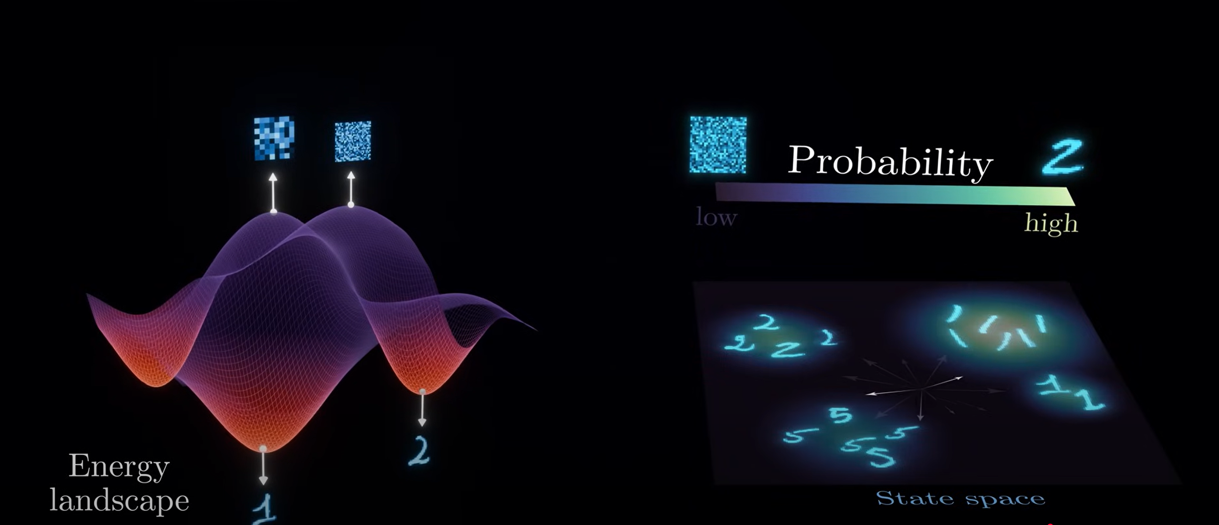
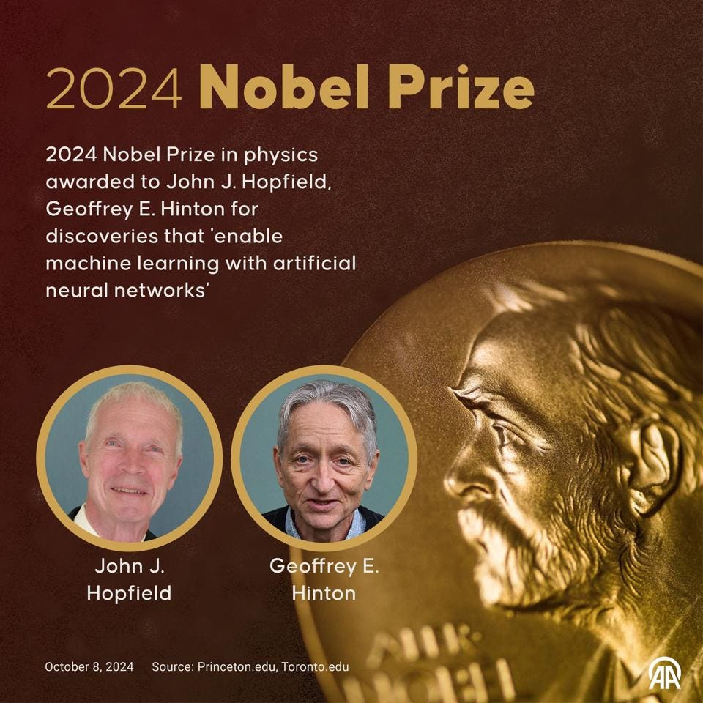
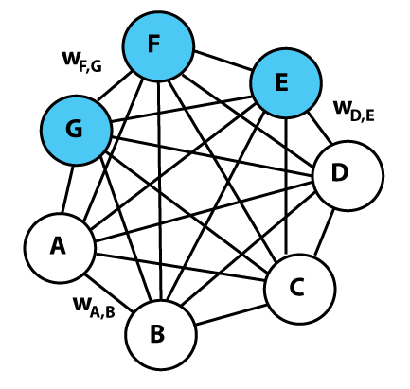
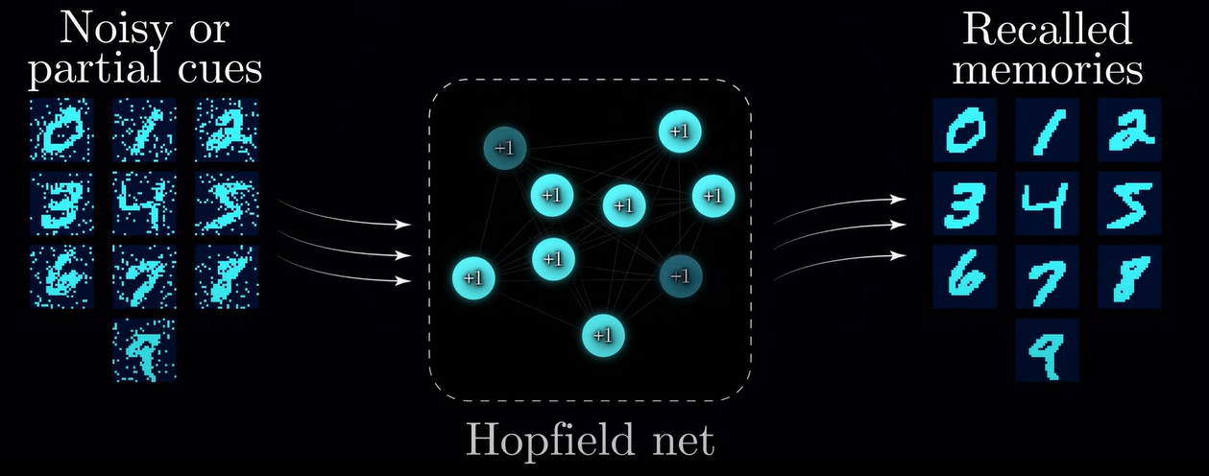
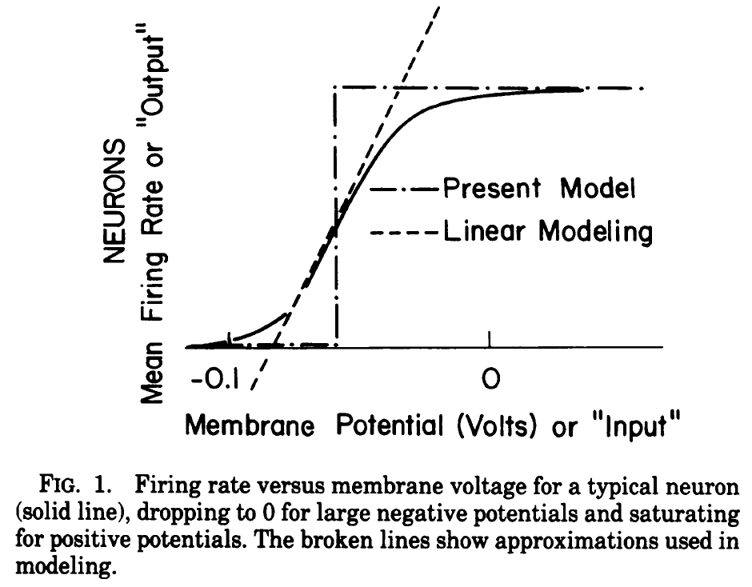
Sources: Forbes, Wikipedia, Hopfield (1982), Artem Kirsanov
Boltzmann machine
(1983-1985)
Hopfield network (1982)
Notes:
“for foundational discoveries and inventions that enable machine learningwith artificial neural networks”
Hopfield network = recurrent neural network that can store and recall patterns

Slide 4
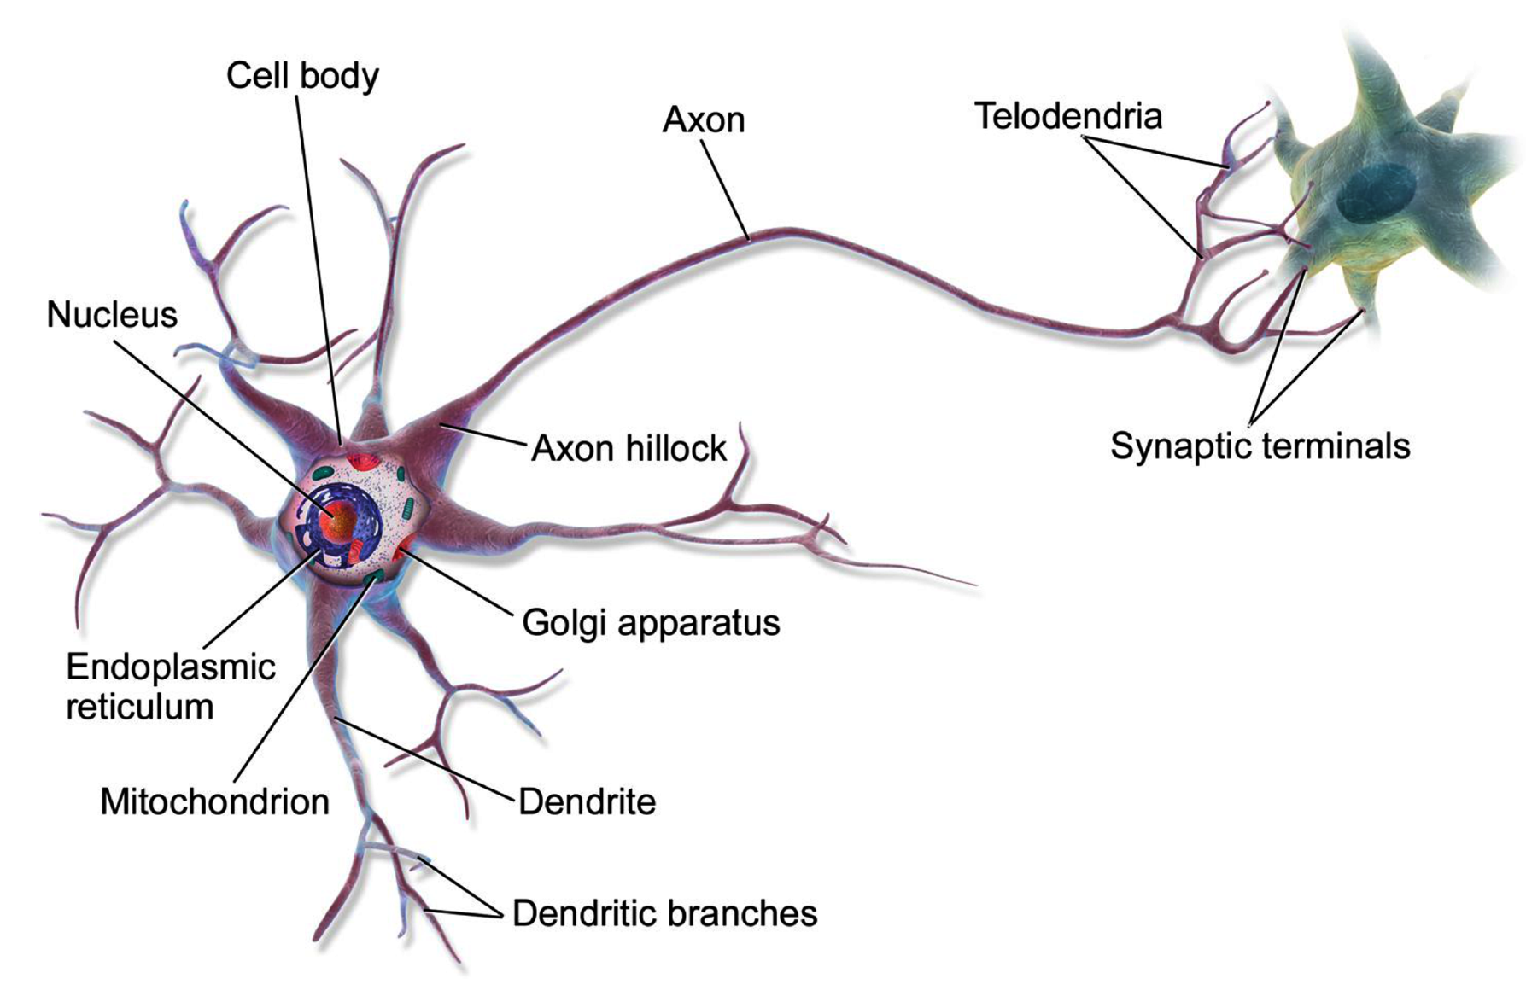
From biological to artificial neural networks
Action Potential
Source: Wikimedia Commons
Notes:
Biological neurons produce short
electrical impulses called action potentials (APs, or just signals), which travel along
the axons and make the synapses release chemical signals called neurotransmitters.
When a neuron receives a sufficient amount of these neurotransmitters within a
few milliseconds, it fires its own electrical impulses

Slide 5
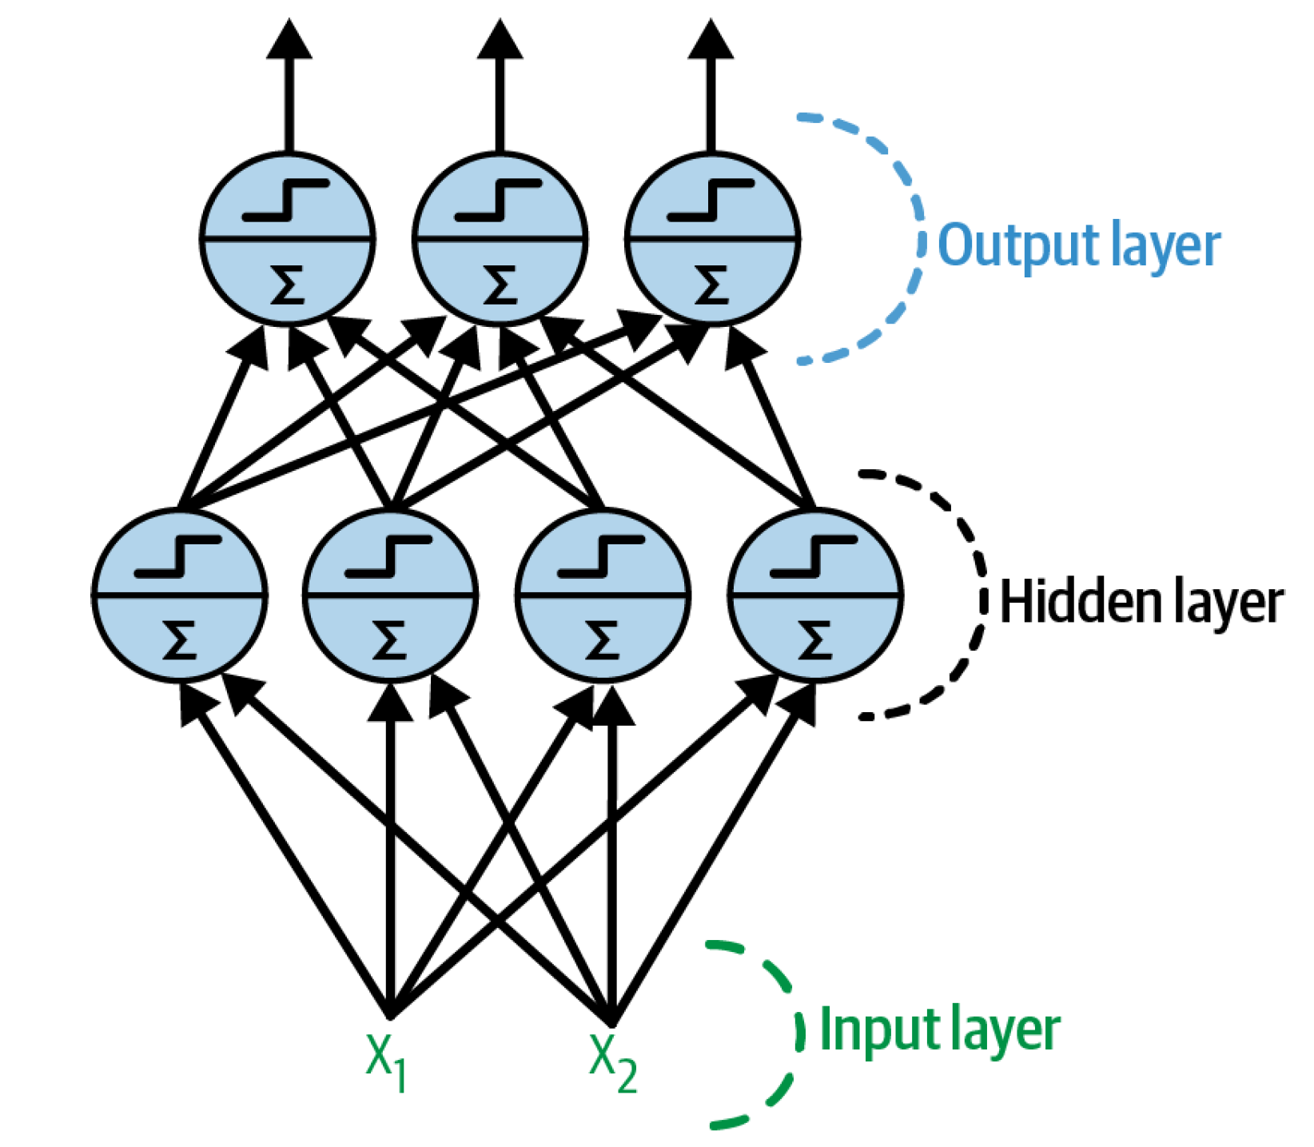
From biological to artificial neural networks
Action Potential
Source: Wikimedia Commons, Géron (Ch. 10)
Notes:
Biological neurons produce short electrical impulses called action potentials (APs, or just signals), which travel along the axons and make the synapses release chemical signals called neurotransmitters. When a neuron receives a sufficient amount of these neurotransmitters within a few milliseconds, it fires its own electrical impulses

Slide 6
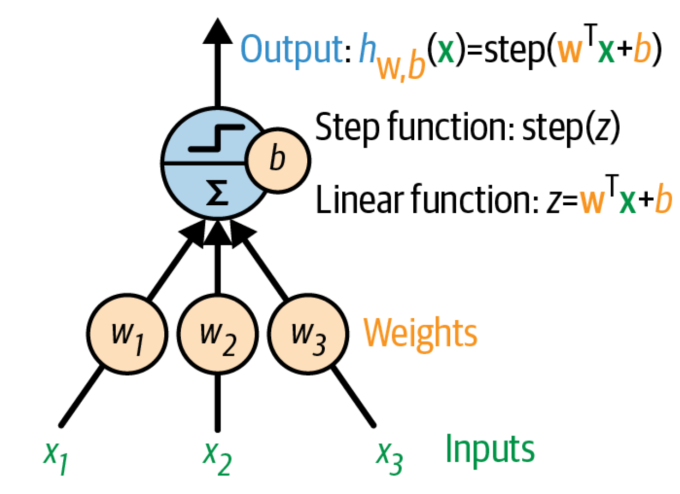
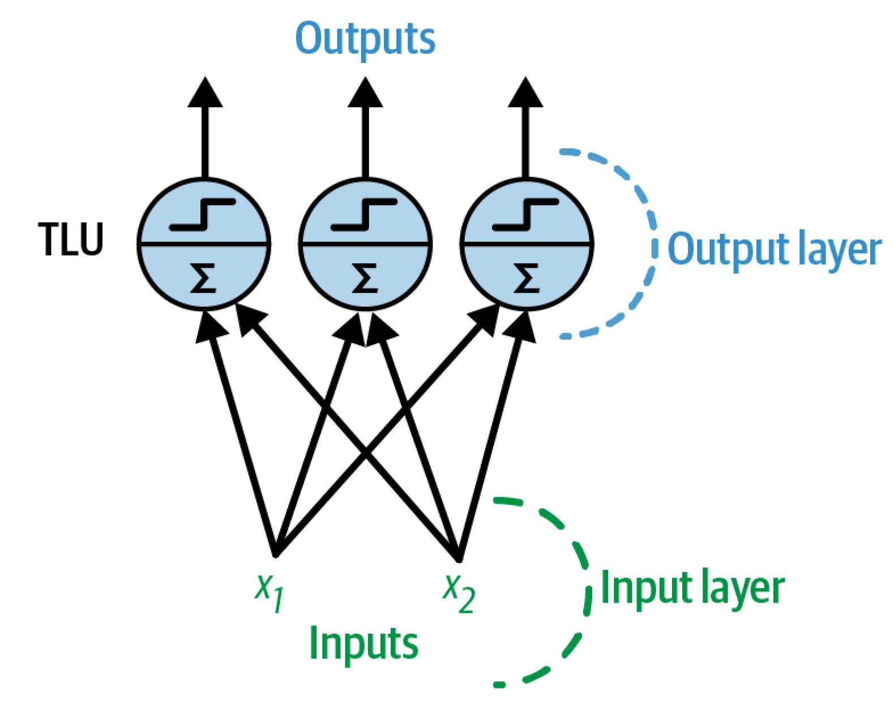
From the perceptron to a fully connected layer
3 inputs, 1 output
2 inputs, 3 outputs
Notes:
TLU = Threshold logic unit

Slide 7


From the perceptron to a fully connected layer
Input Vector
Weight Matrix
Activation Function
Bias Vector (Intercept)
2 inputs, 3 outputs

Slide 8

From fully connected layer to Multilayer Perceptron
Notes:
1 layer = similar to logistic regression
2 layers = shallow neural network
Deep learning = 3 layers and above

Slide 9
Feedforward neural net

Slide 10
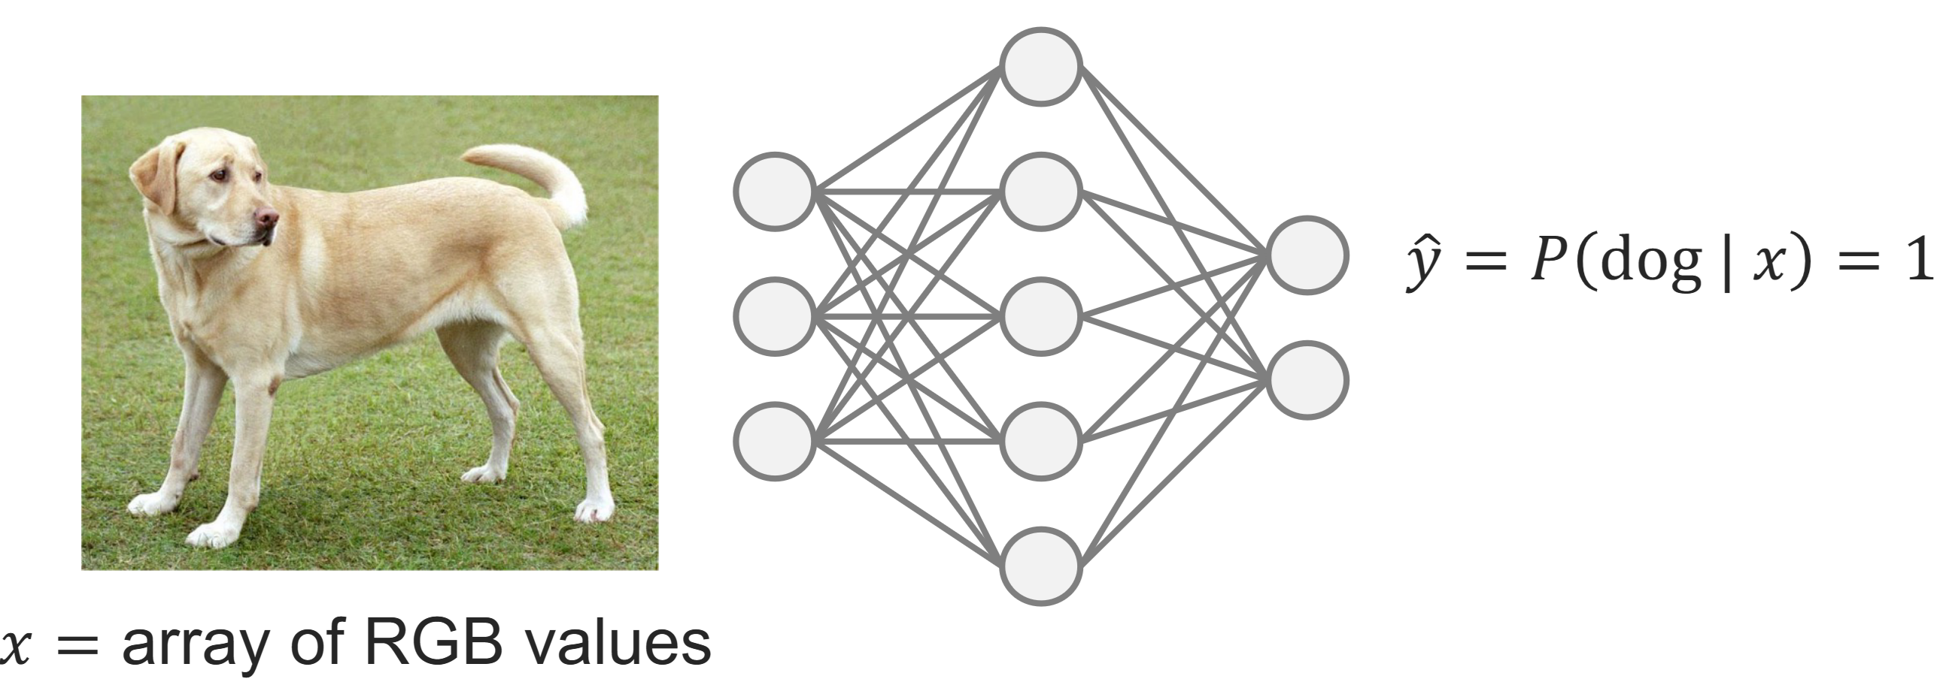
Universal Approximation Theorem:
By making an artificial neural network wide enough (large W)
or by making an artificial neural network deep enough (many combined ϕ)
A neural network can represent any continuous functions
Sources: Cybenko & Hornik (1989),
Leshno et al. (1993), Zhou et al. (2017)
Image source: ETHZ Deep Learning for scientific comp.
Notes:
And this is what makes deep learning so successful: Works best in the large data regime
Question 1: Can you think of an example where this useful?

Slide 11

Universal Approximation Theorem:
By making an artificial neural network wide enough (large W)
or by making an artificial neural network deep enough (many ϕ)
A neural network can represent any continuous functions
and even any nonlinear continuous operator
Source: Lu et al. (2021)
Image source: Midjourney

Slide 12
?
?
?
?
How to train so many weights and biases?

Slide 13
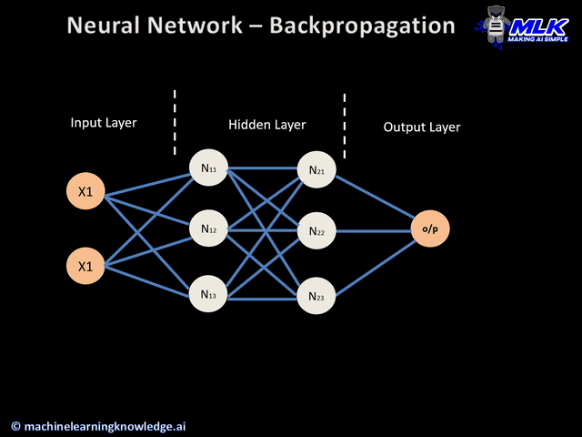



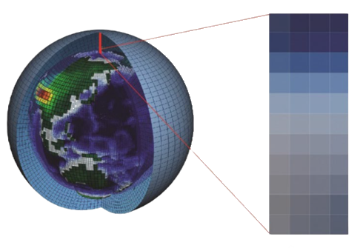
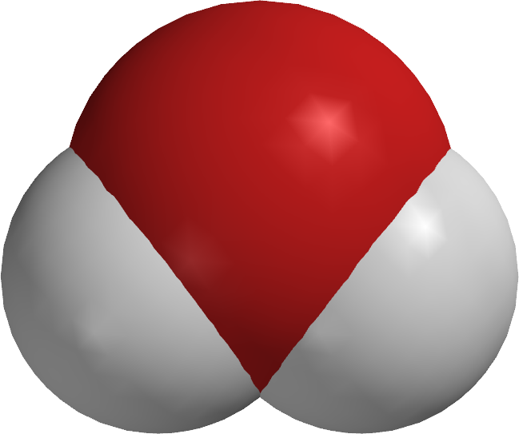
☹️

Slide 14

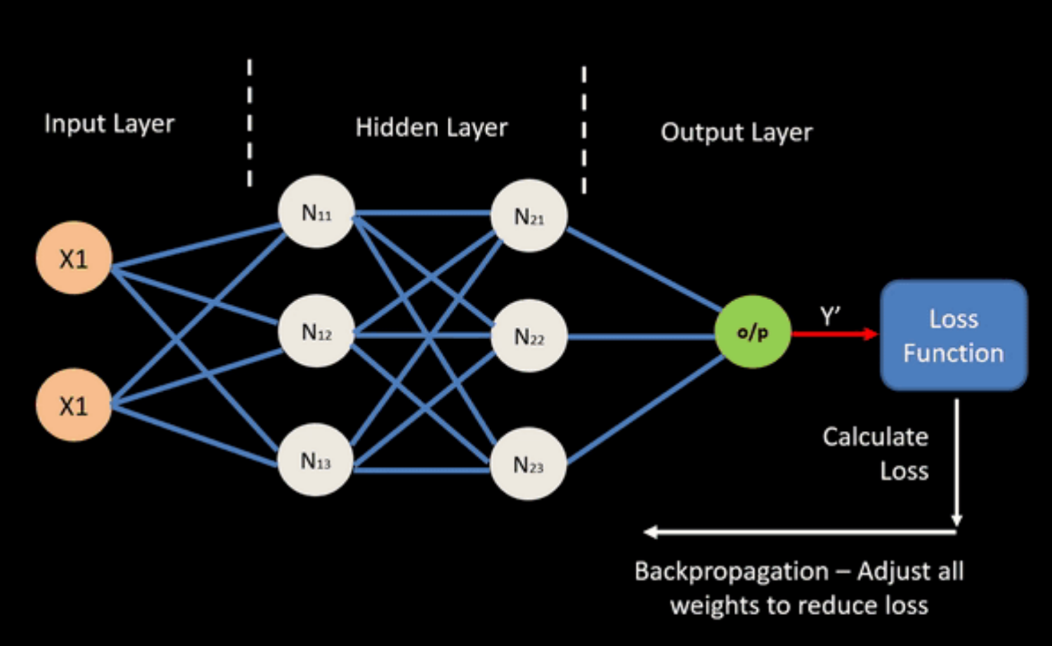

Automatic differentiation:
🙂‍↔️
Notes:
Vanishing gradient = Graident

Slide 15
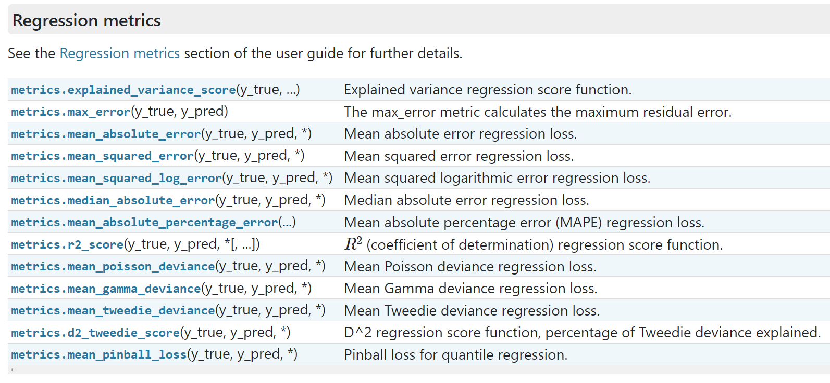
How to build a neural network in practice?
Define your problem (classification versus regression, loss function)

Slide 16
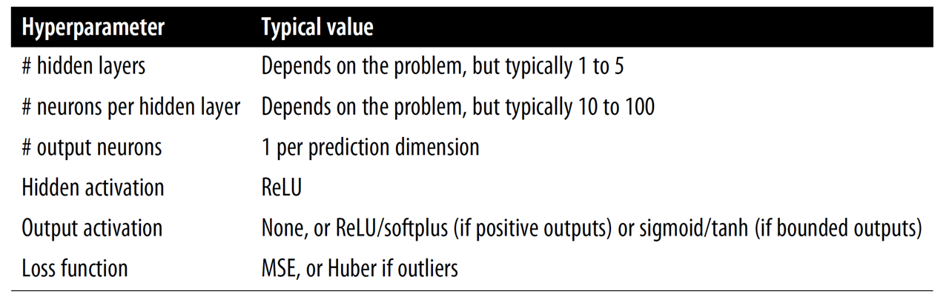
How to build a neural network in practice?
Define your problem (classification versus regression, loss function)
Pre-process the data (training/validation/test split, normalization/scaling)
Choose your architecture:

Slide 17
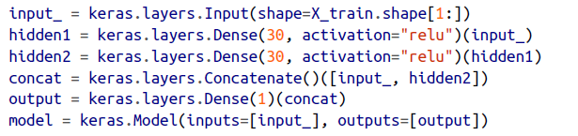

How to build a neural network in practice?
Define your problem (classification versus regression, loss function)
Pre-process the data (training/validation/test split, normalization/scaling)
Choose your architecture & implement it using sequential/functional API
Sequential API
Functional API
model =
torch.nn.
Sequential(
…
)
Torch has a functional API:
https://docs.pytorch.org/cppdocs/api/nn/functional.html

Slide 18
How to build a neural network in practice?
Define your problem (classification versus regression, loss function)
Pre-process the data (training/validation/test split, normalization/scaling)
Choose your architecture & implement it using sequential/functional API
Choose your training hyperparameters (layer width, # of layers, etc.)
Train your neural network on the training set
Use the validation set to optimize hyperparameters & for callbacks

Slide 19
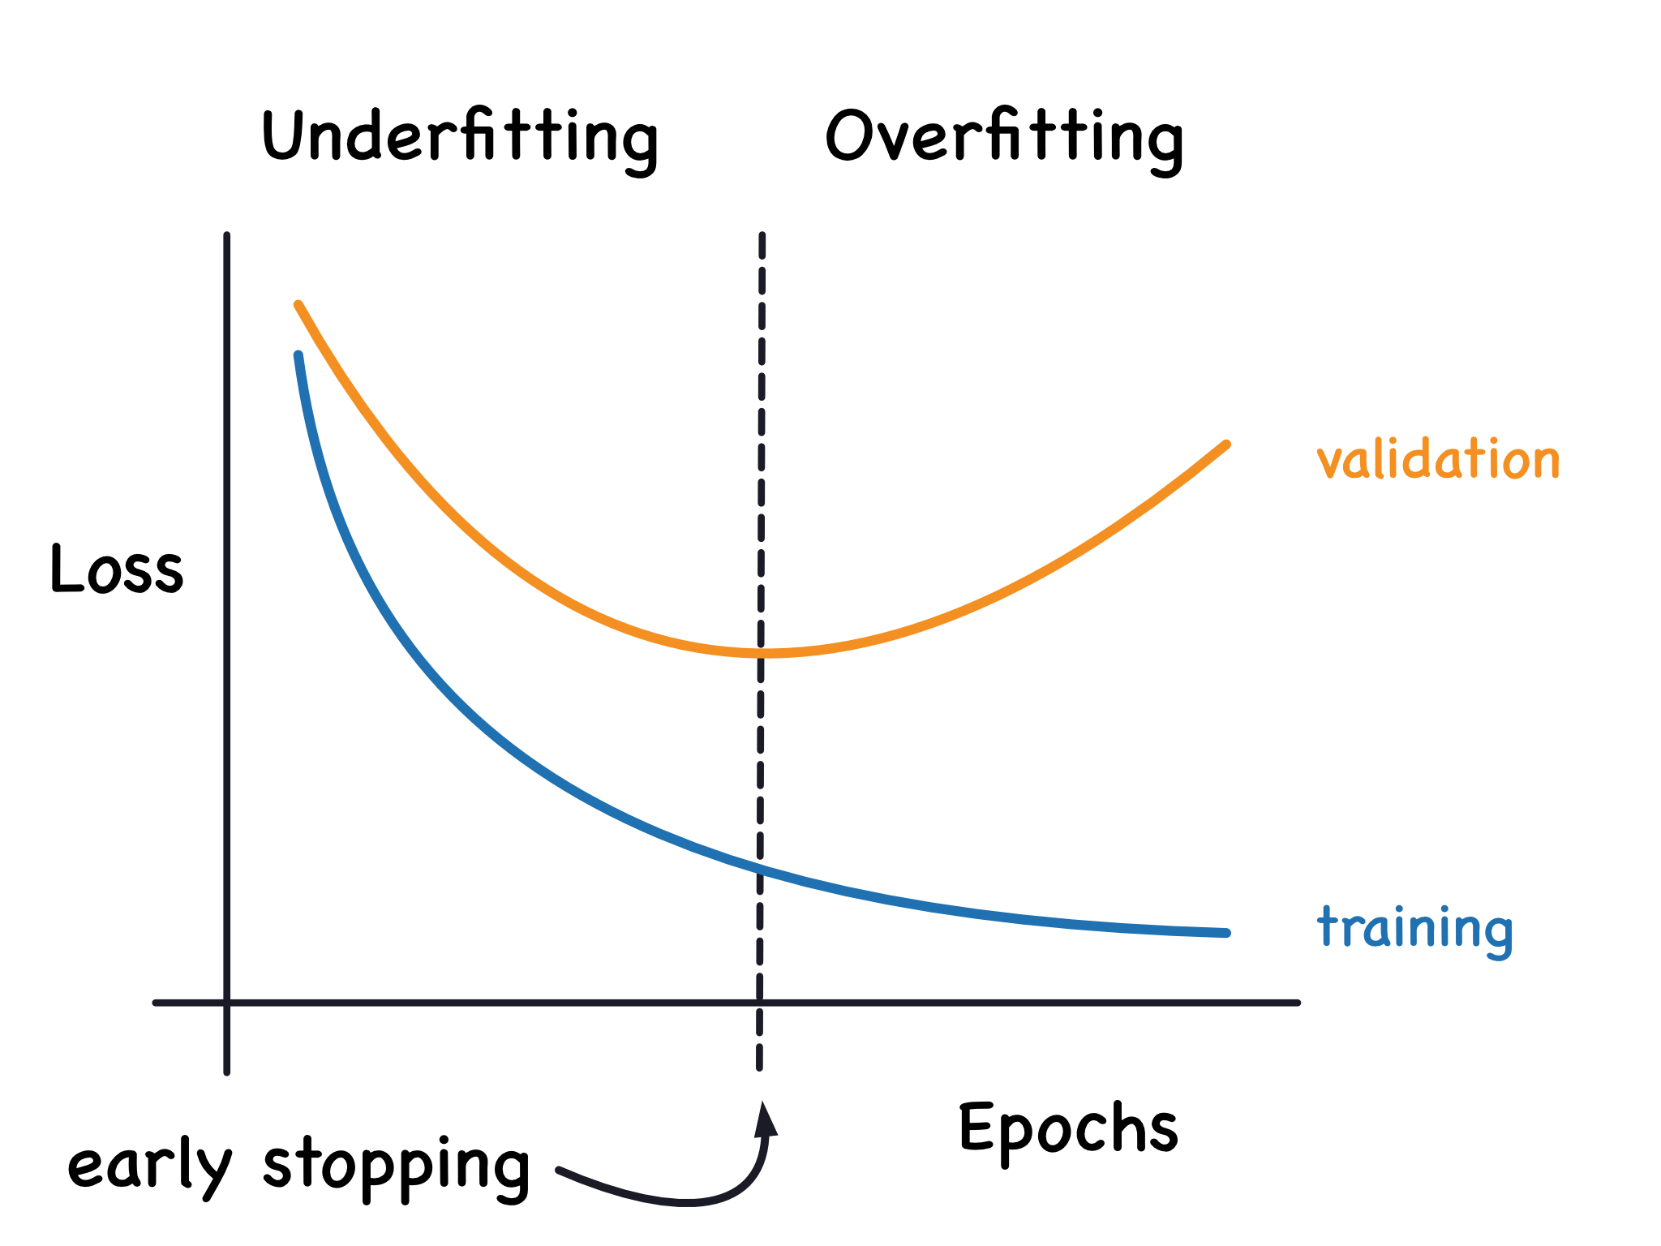
How to build a neural network in practice?
Define your problem (classification versus regression, loss function)
Pre-process the data (training/validation/test split, normalization/scaling)
Choose your architecture & implement it using sequential/functional API
Choose your training hyperparameters (learning rate, batch size)
Train your neural network on the training set
Use the validation set to optimize hyperparameters & for callbacks
(callback)
#Epoch = Going through the entire training set once
Source: Kaggle
Notes:
Question: Where would you stop the training?

Slide 20
How to build a neural network in practice?
🍽️
🍽️
Define your problem (classification versus regression, loss function)
Pre-process the data (training/validation/test split, normalization/scaling)
Choose your architecture & implement it using sequential/functional API
Choose your training hyperparameters (learning rate, batch size, etc.)
Train your neural network on the training set
Use the validation set to optimize hyperparameters & for callbacks
(Hyperparameter optimization libraries = Hyperopt, Optuna, Keras Tuner)
Your network is ready ☺ Evaluate it on the test set and you’re done!

Slide 21
Neural Networks for
High-Dimensional, Nonlinear Processes
Learning Objectives (Géron Ch10 & Ch11):
Define an artificial neural network
Understand the steps & best practices to build an artificial neural network
Understand activation functions
Know the main hyperparameters defining a neural network’s architecture
Know the main hyperparameters controlling the training of a neural network

Slide 22
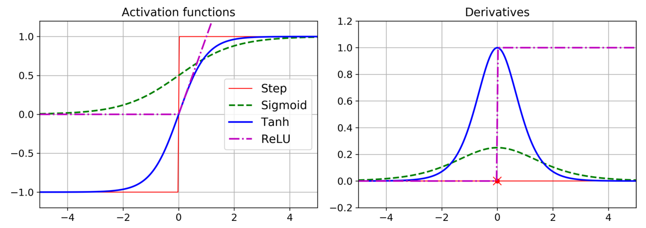

Slide 23
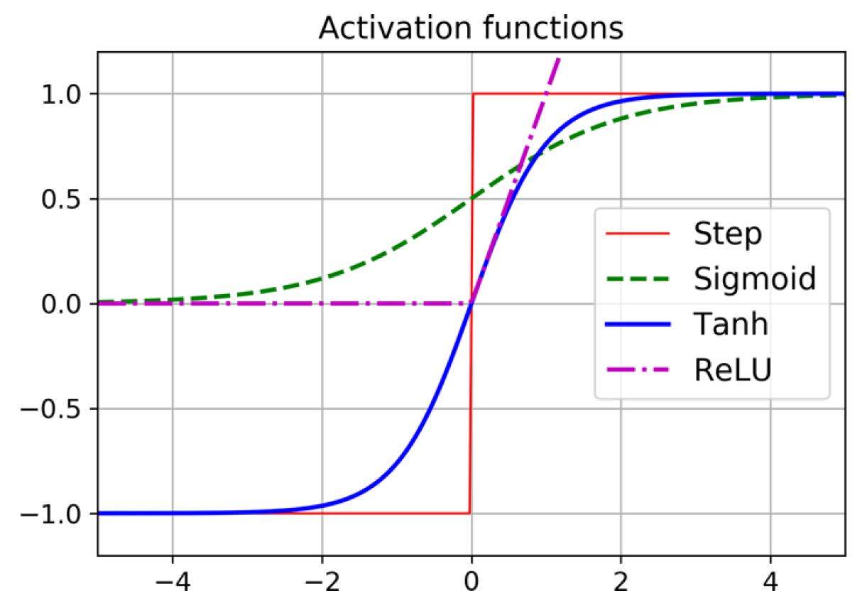
Choose activation function:
Tanh > Sigmoid (Logistic)
Source: Géron (Ch. 10)

Slide 24
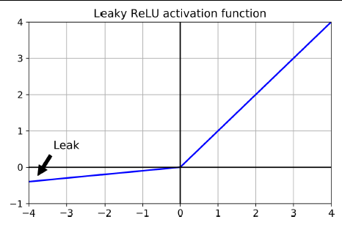
Choose activation function:
Leaky ReLU > ReLU > Tanh > Sigmoid
Source: Géron (Ch. 10)

Slide 25
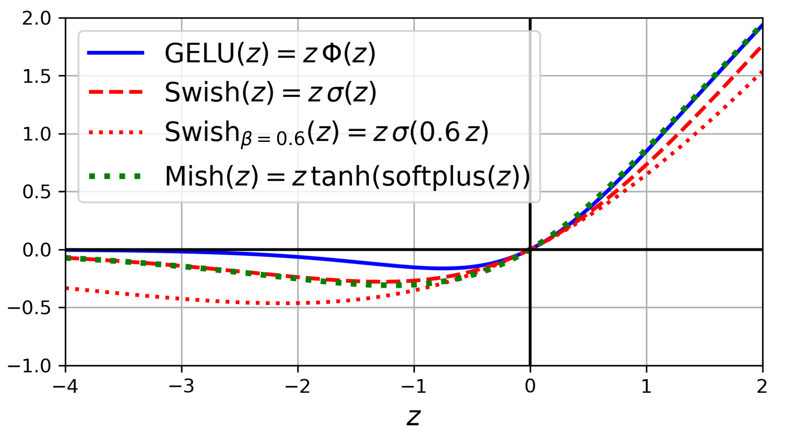
Choose activation function:
Swish > SELU > Leaky ReLU > ReLU > Tanh > Sigmoid
Source: Géron (Ch. 10)
Notes:
Question 2: To predict an environmental variable, e.g., a flux, that’s always between -1 and 1, which activation function(s) would you choose?

Slide 26
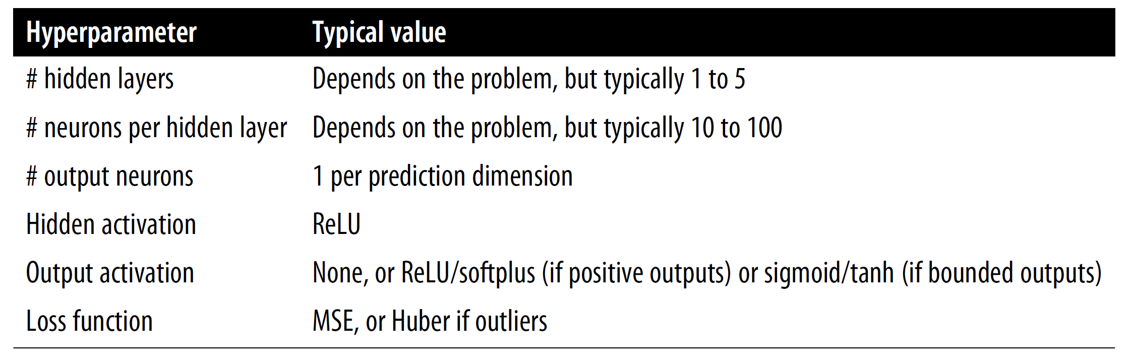
Hyperparameters related to the architecture
Source: Géron (Ch. 10)

Slide 27
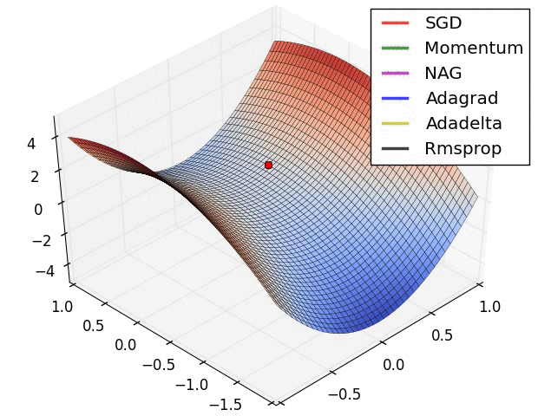
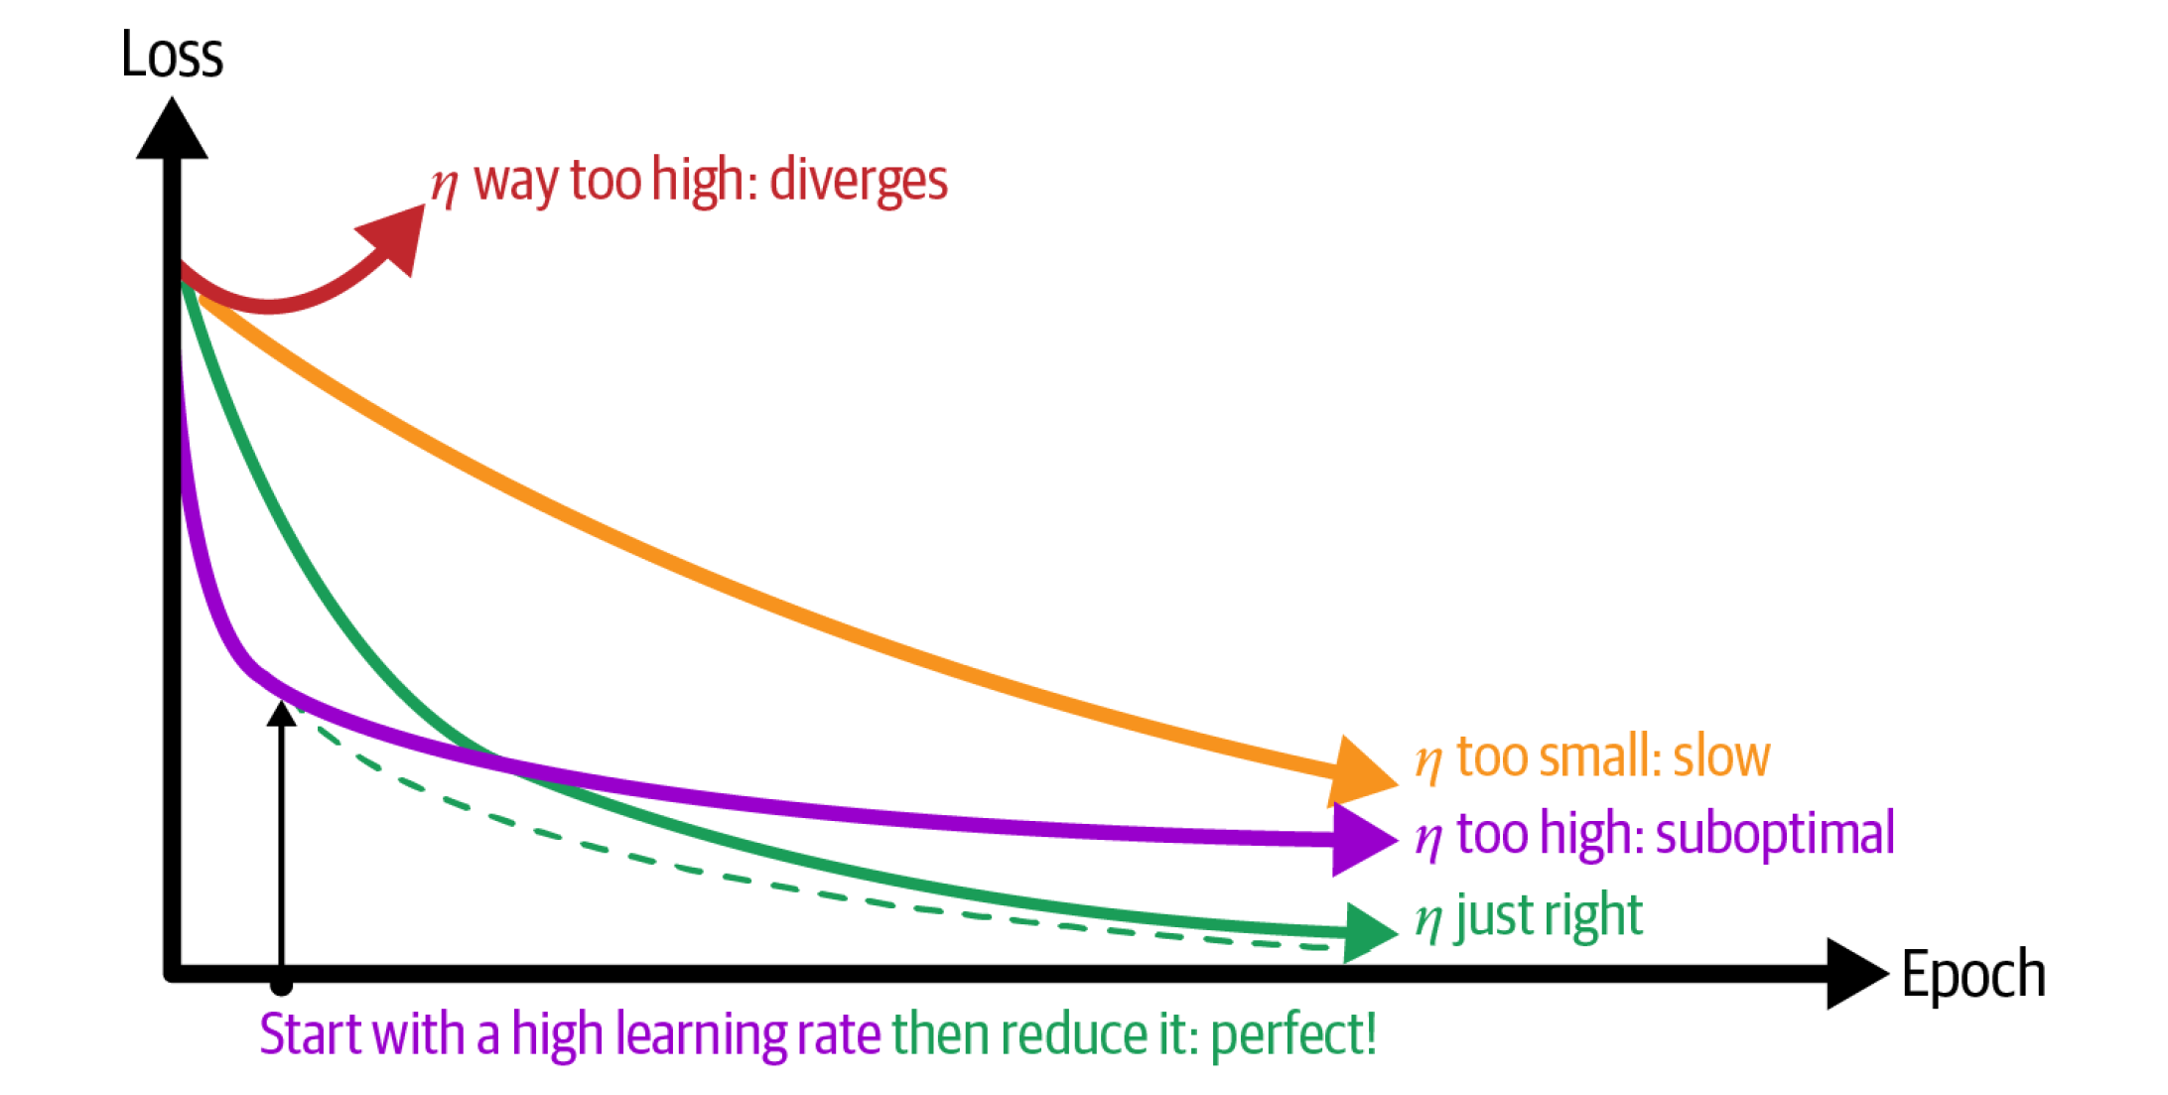
Hyperparameters related to the training
Loss function:
MSE, MAE, Huber for regression
Cross-entropy for classification
Batch size, Initialization of weights
Optimizer
Learning Rate
Source: towardsdatascience.com
Notes:
Question 3: Which optimizer would *you* choose?

Slide 28
Overfitting? Regularize ☺
L1/L2 regularization: Loss += |Weights,Biases| + (Weights,Biases)²
Batch normalization:
Automatically scale inputs using
(mean , standard deviation)
calculated over the batch

Slide 29
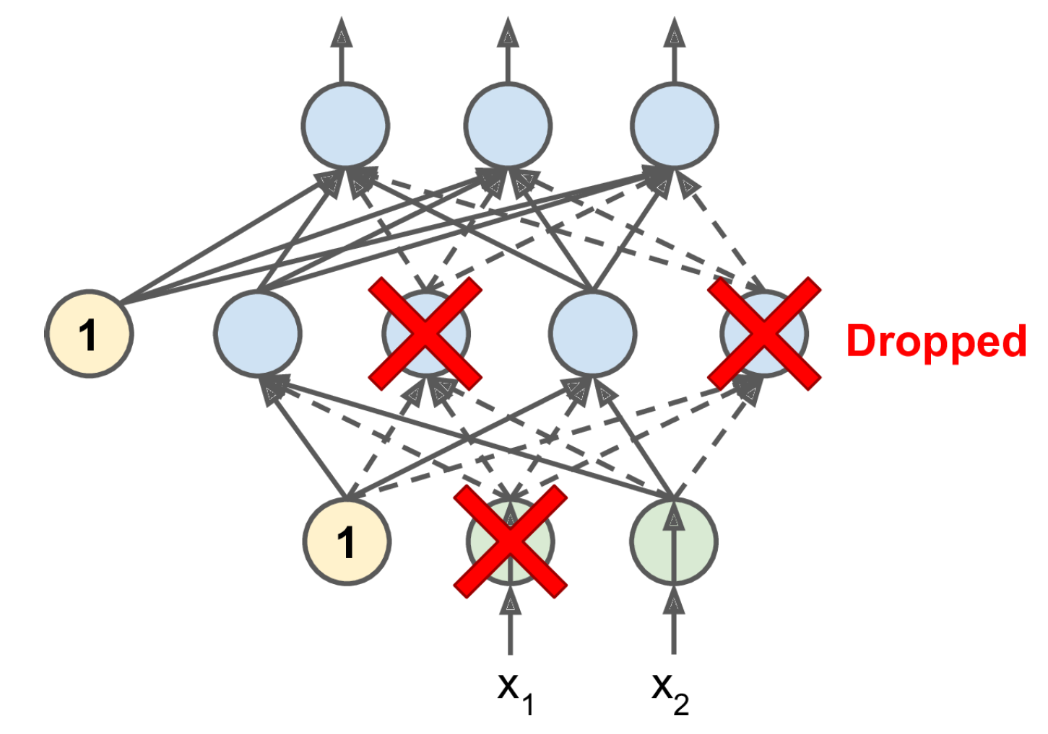
Overfitting? Regularize ☺
L1/L2 regularization: Loss += |Weights,Biases| + (Weights,Biases)²
Batch normalization:
Automatically scale inputs using
(mean , standard deviation)
calculated over the batch
Dropout (can add uncertainty)

Slide 30

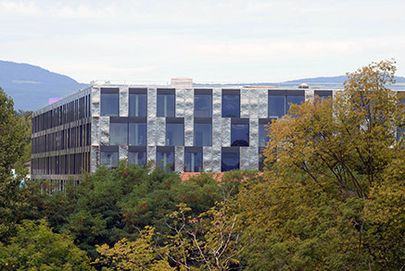
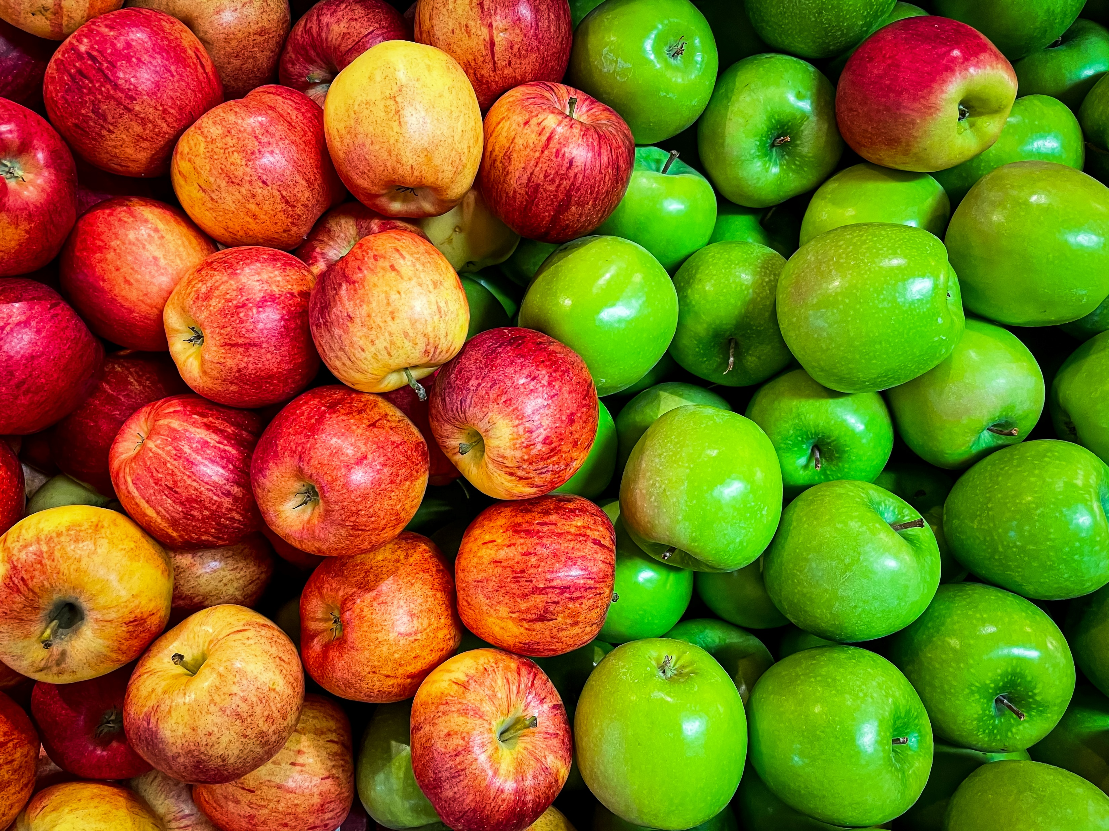
Min 60-75: Break

Slide 31
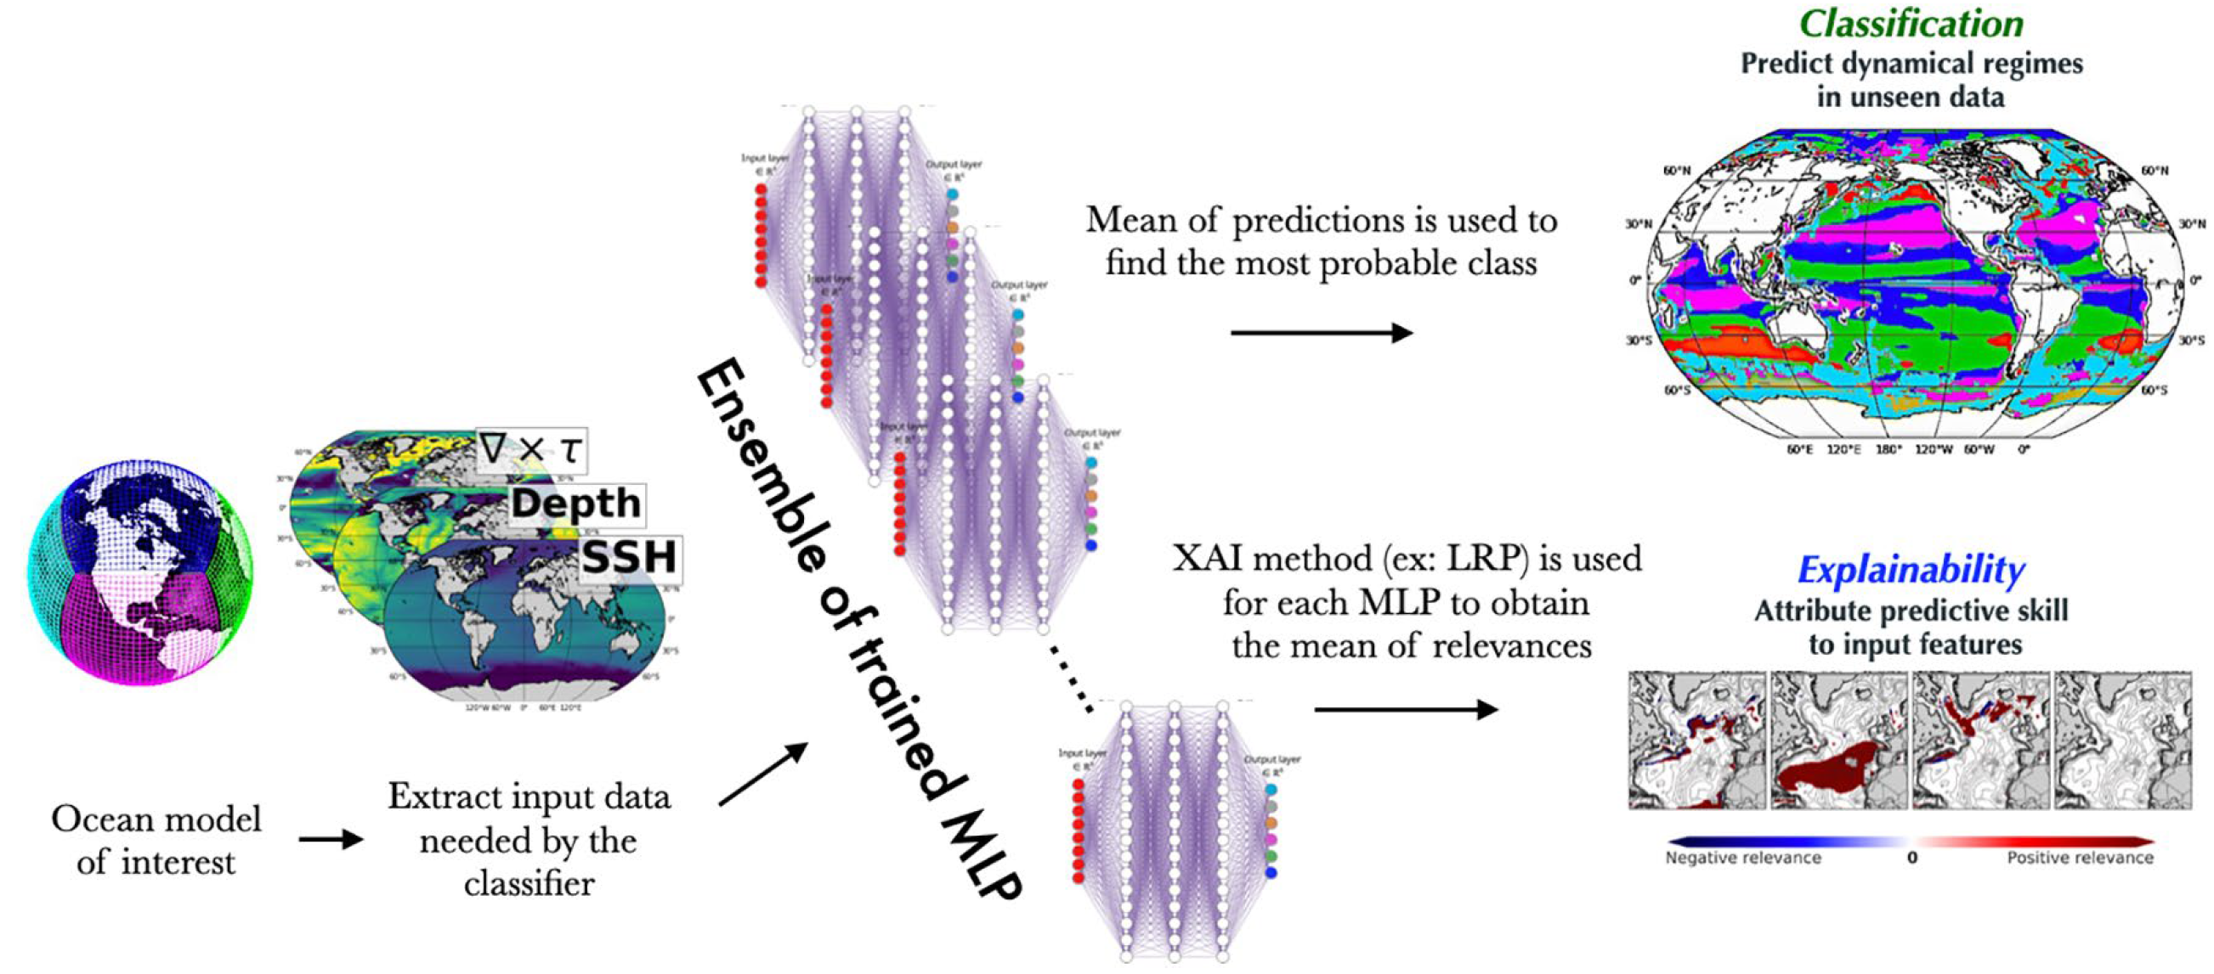
Min 75-110: Unsupervised Learning to Elucidate Environmental Complexity

