Slide 1
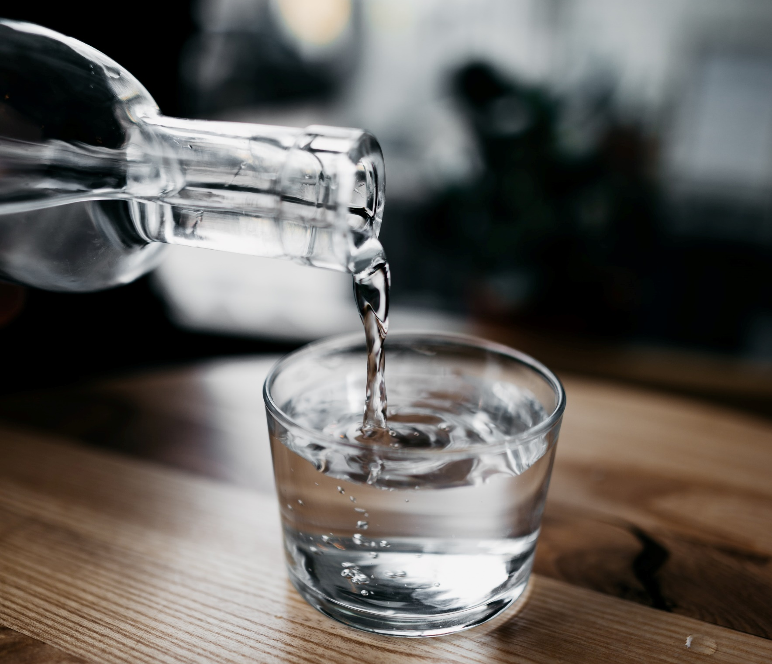
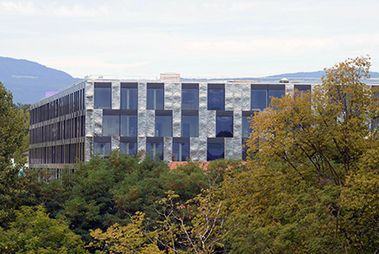
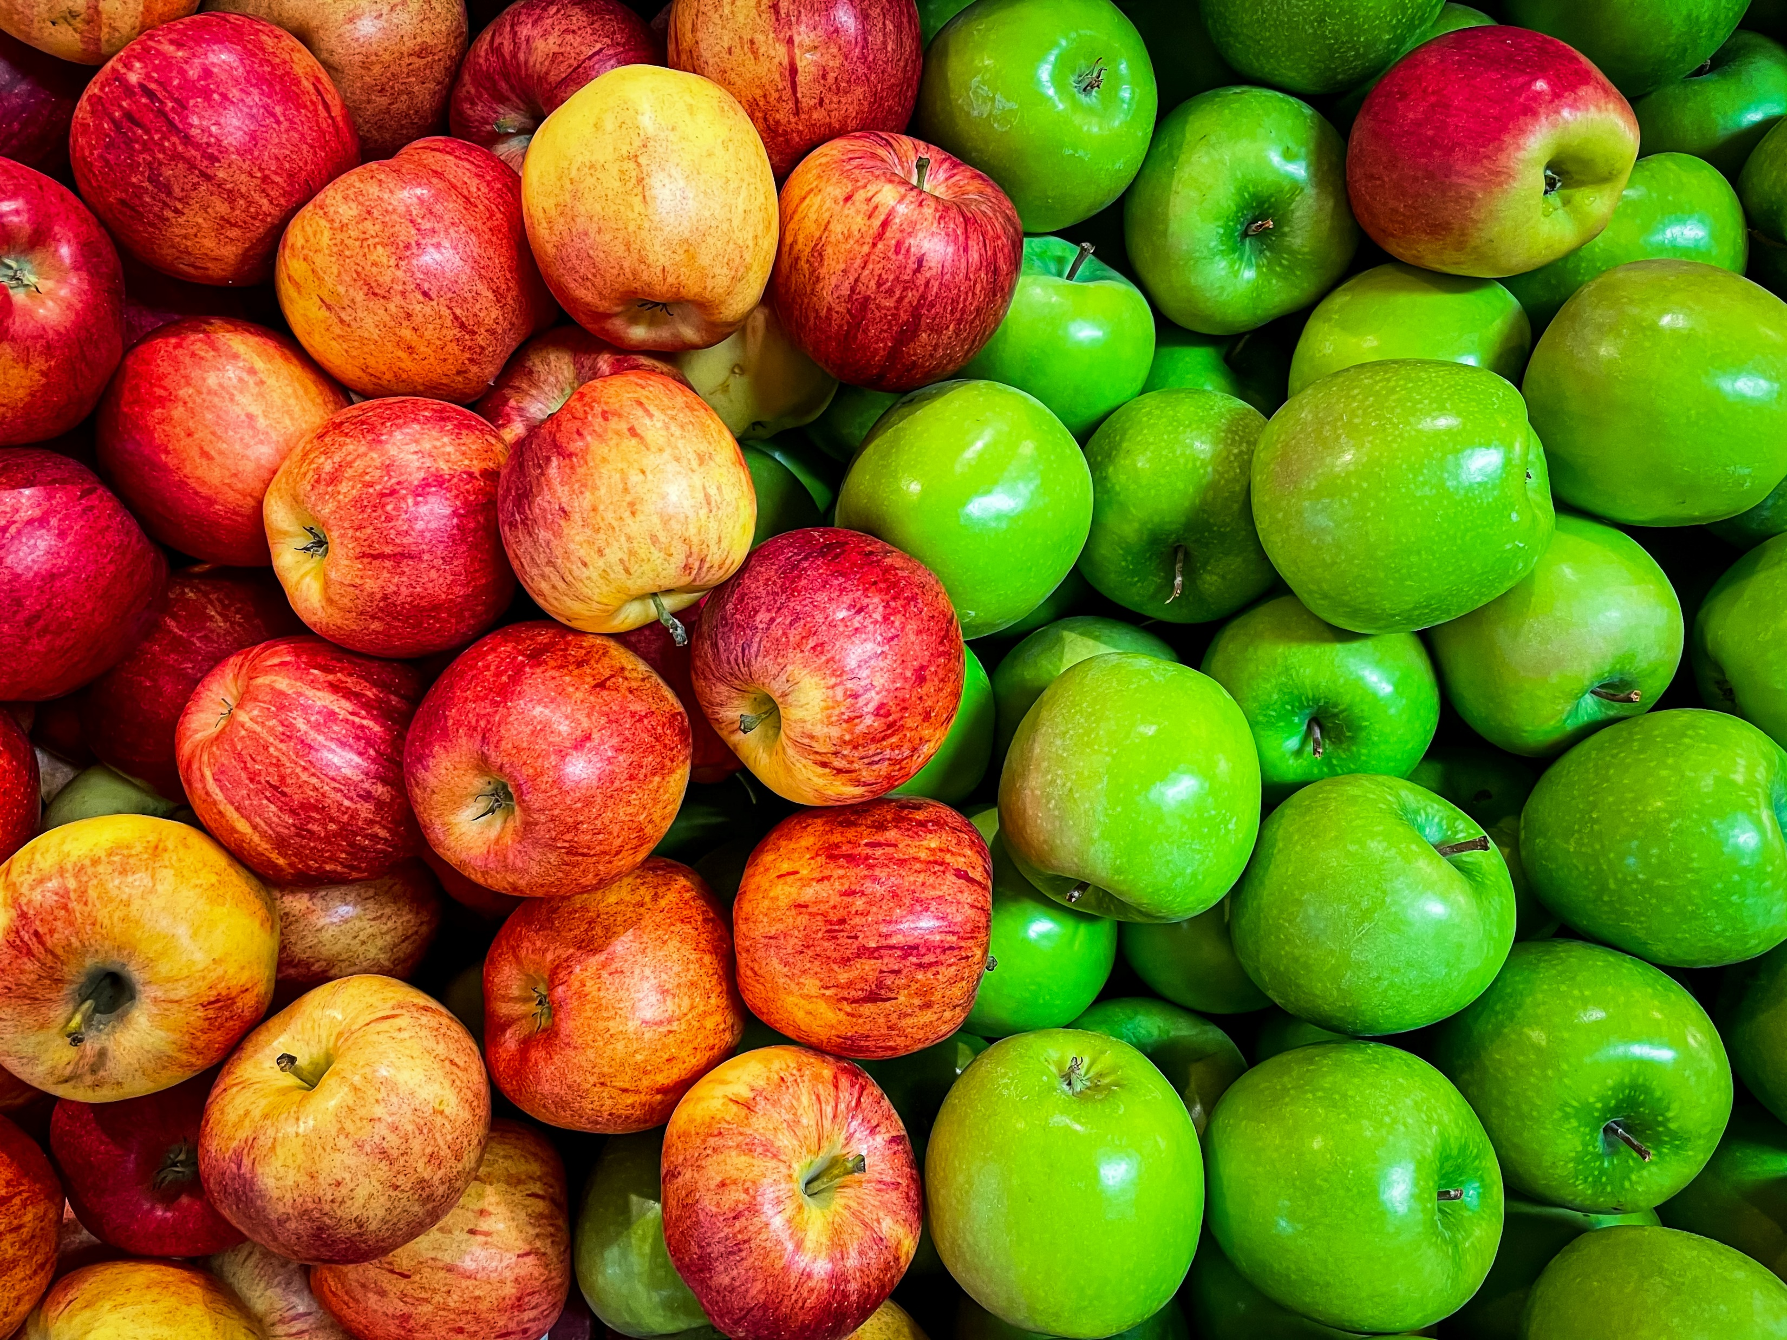
Min 60-75: Break

Slide 2


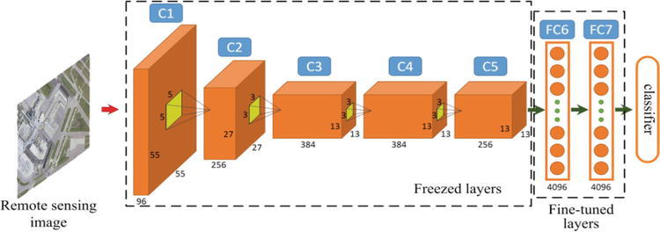
ML for Earth & Env Sci (Ch. 6, SA2026)
How can we extract information from images/videos using deep learning?
Source: Luo et al. (2018)
Notes:
COSERO hydrological model

Slide 3
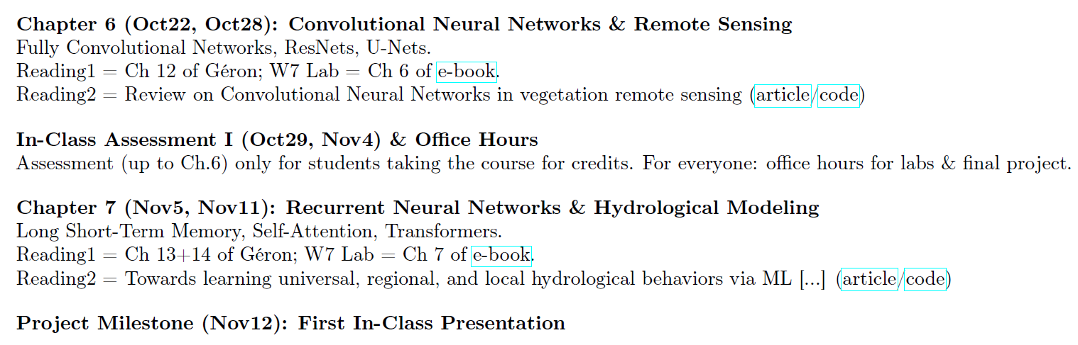
Mid-term Presentations: Thursday, Nov 12 in GEO 2145
Office hours to prepare presentations: Oct 29th

Slide 4
Mid-term Presentations: Thursday, Nov 12 in GEO 2145
Office hours to prepare presentations: Oct 29th
4min presentations + 6min Q&A/feedback
Tip = 1 slide/minute
Scientific question: What’s our goal and why do we care?
Dataset: Characteristics, challenges, training/validation/test split, etc.
Methodology: Which ML algorithm(s) are you planning to use and why?
Results: What are your initial results & what do you plan to do next?

Slide 5
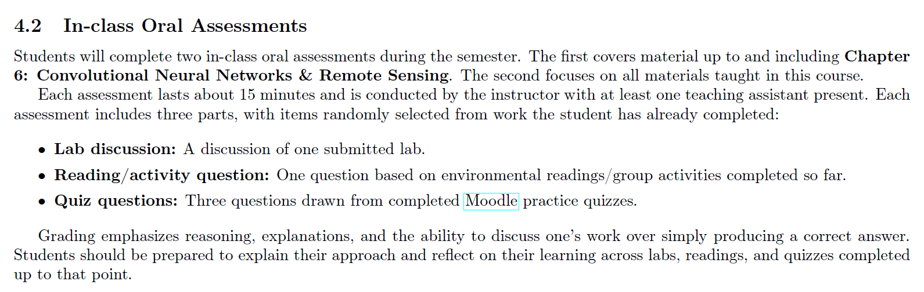
Oral Assessment I: Nov 4th in GEO 2138

Slide 6
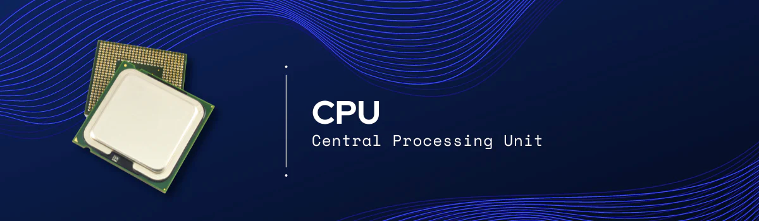
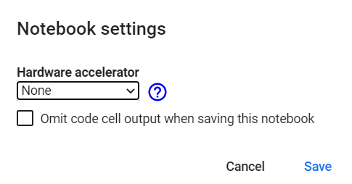

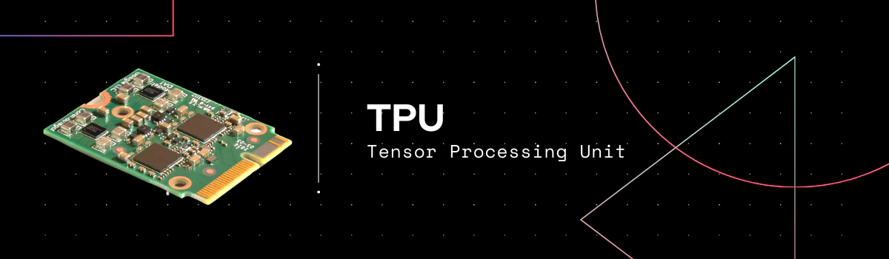
Only several cores but very precise
Executes instructions serially
Good for large models (large RAM), small batch sizes, custom calcs.
Has thousands of cores
Specialized for parallel processing
Good for larger batch sizes and deep learning in general
Specialized for matrix processing
Good for large batch sizes & CNN
(Edit menu)
Source: https://premioinc.com/blogs/blog/what-is-the-difference-between-cpu-vs-gpu-vs-tpu-complete-overview
Notes:
We talked about computational time, let’s briefly introduce hardware

Slide 7
Min 80-105: Convolutional Neural Networks to Process Images
Learning Objectives (Géron Ch14):
Define a convolutional neural network
Discuss the main applications of convolutional neural networks
Know the steps to design and train a convolutional neural network
Define transfer learning and understand how to re-use pre-trained models

Slide 8
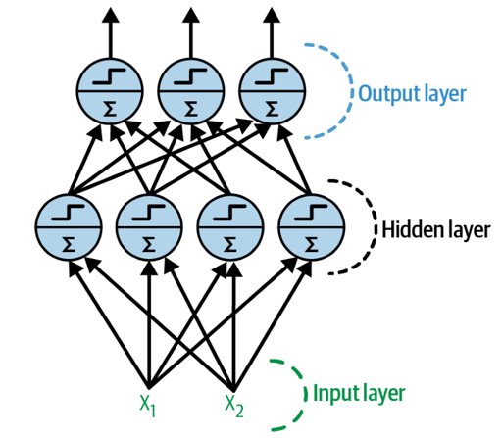
Last week = general case: Artificial Neural Networks
Notes:
1 layer = similar to logistic regression
2 layers = shallow neural network
Deep learning = 3 layers and above
VOTE 1: How many trainable parameters (weights and biases) in the input layer?
VOTE 2: If the input layer was a 10x10 image, how many trainable parameters?

Slide 9
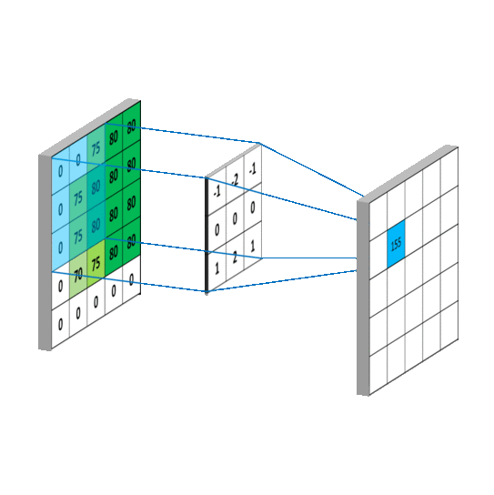
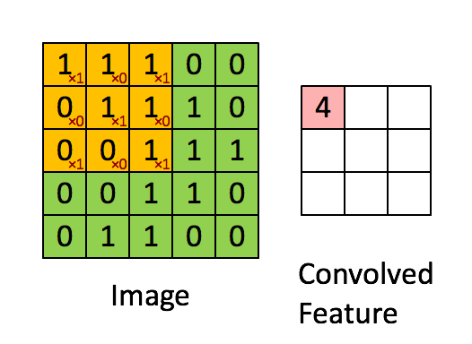
This week: Convolutional Neural Networks (CNNs)
Regularized versions of Artificial Neural Networks used to process images
Source: Giphy, Analytics India Magazine (K. Maladkar)

Slide 10
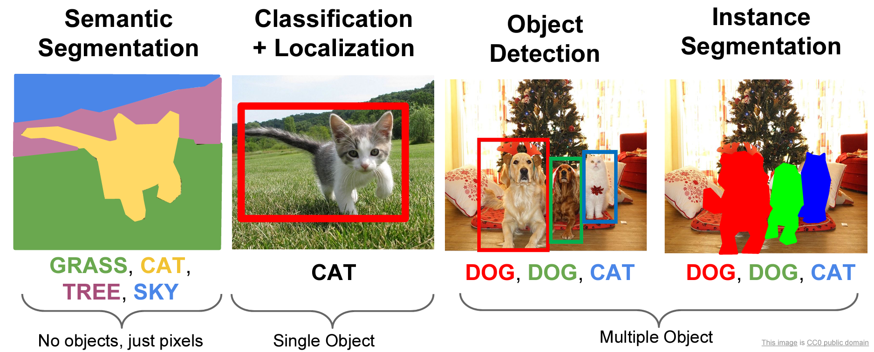
CNNs used for computer vision (analyzing images, videos)
Source: Stanford (CS231)

Slide 11
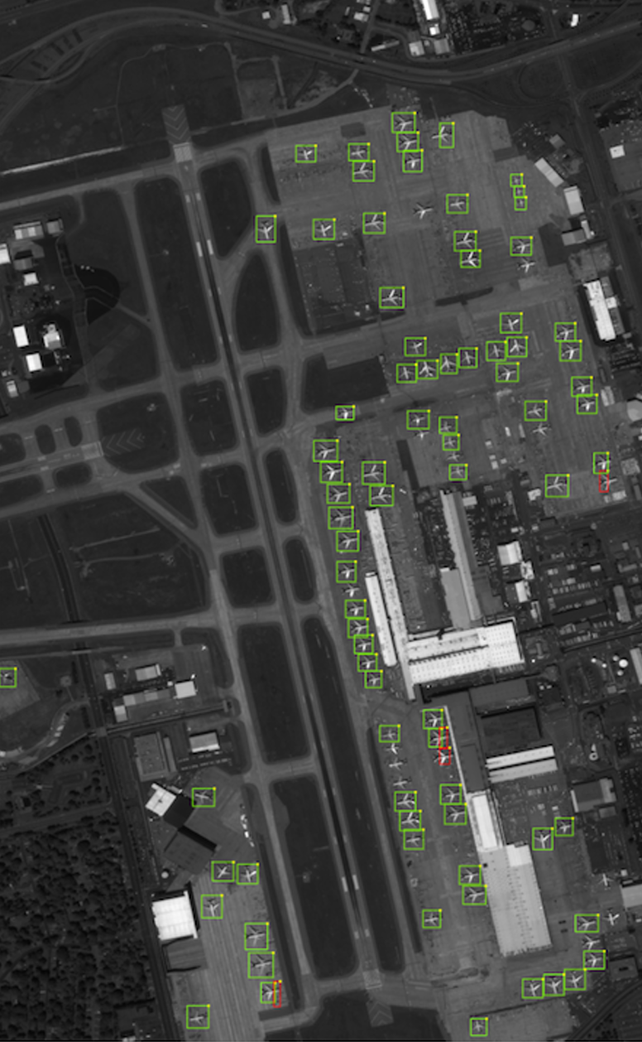
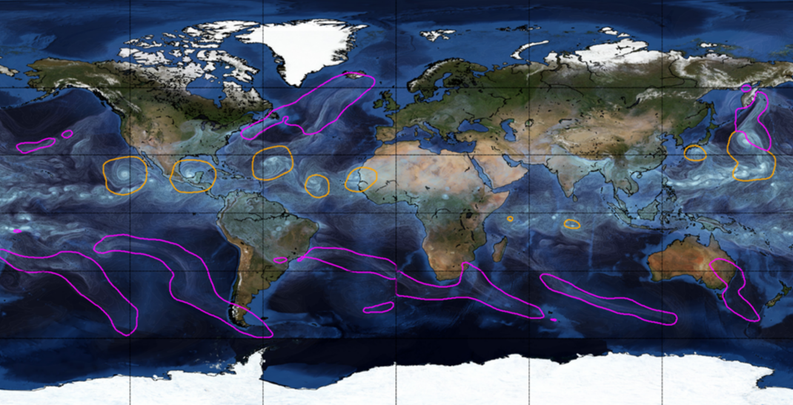
Object Detection for Remote Sensing
Instance Segmentation for Storm Detection
Source: Zhu et al. (2017), Prabhat et al. (2020)
Notes:
VOTE: Which output contains the most information?

Slide 12
Environmental Applications
Object Detection
Semantic Segmentation
catchment was flooded
classify parts of a catchment as being flooded or not.
In forestry, it could be classifying a remote sensing image into forest and non-forest
identifying every single tree in an image
"draw" the boundary of each rock glacier, individually
you will know for each pixel if this pixel "is in" a rock glacier, but you will not be able to know how many there is, just where there are rock glaciers on the picture

Slide 13
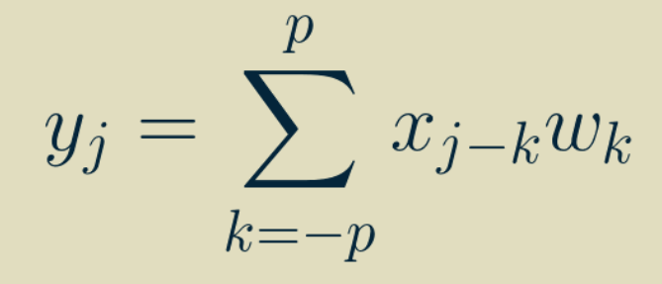
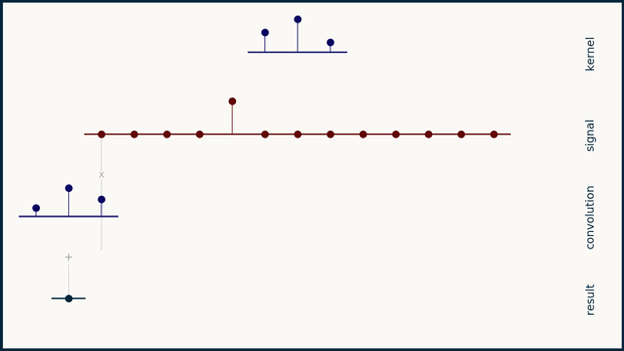
One-dimensional Convolution
Output
Input
Weights
Simple & inexpensive
Source: Brandon Rohrer
Notes:
VOTE: How many trainable parameters (weights and biases) for this operation?

Slide 14
Two-dimensional Convolution
↓
Two-dimensional weights
(Kernel, Filter)
3 x 3 receptive field
Notes:
VOTE: How many trainable parameters for this operation ?

Slide 15
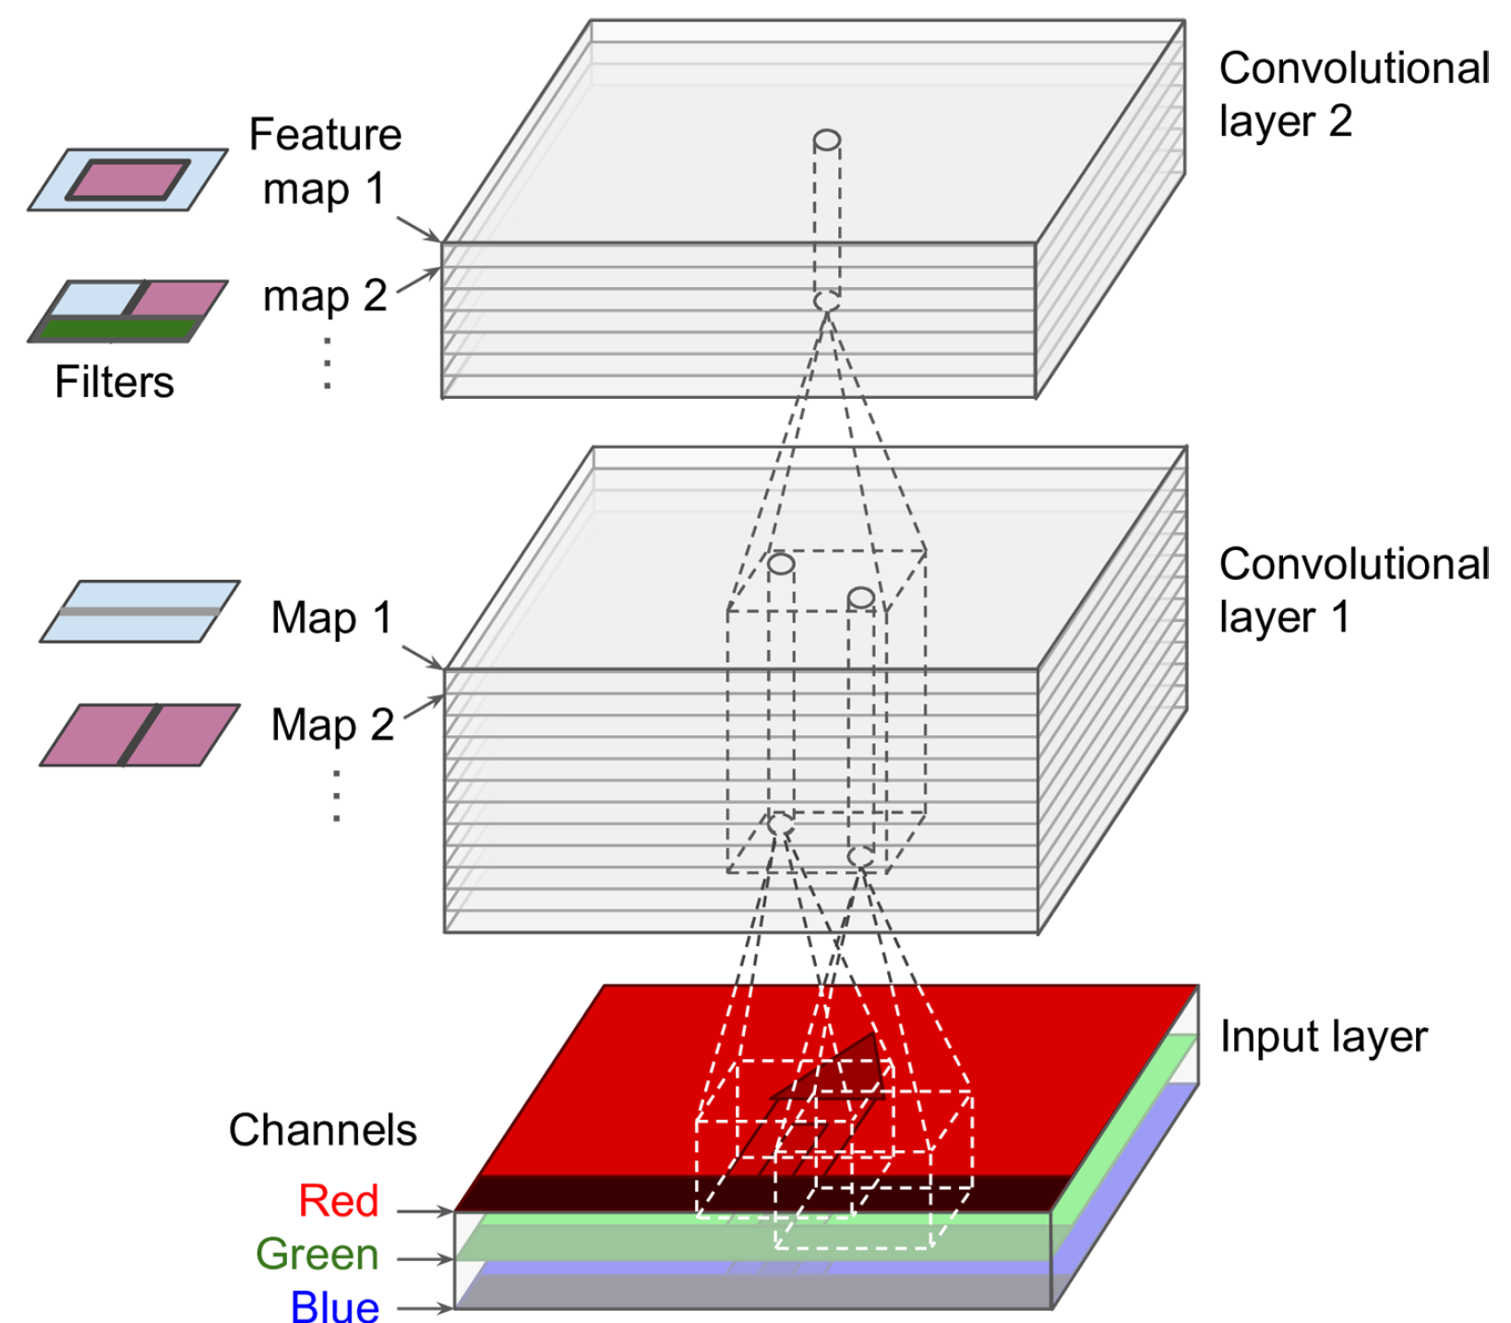
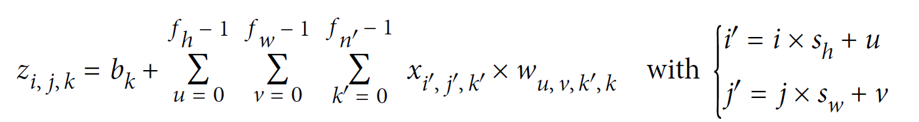
Two-dimensional Convolution with Multiple Features
Output
Input
Weights
Stride
Sum over height
Sum over width
Sum over features

Slide 16
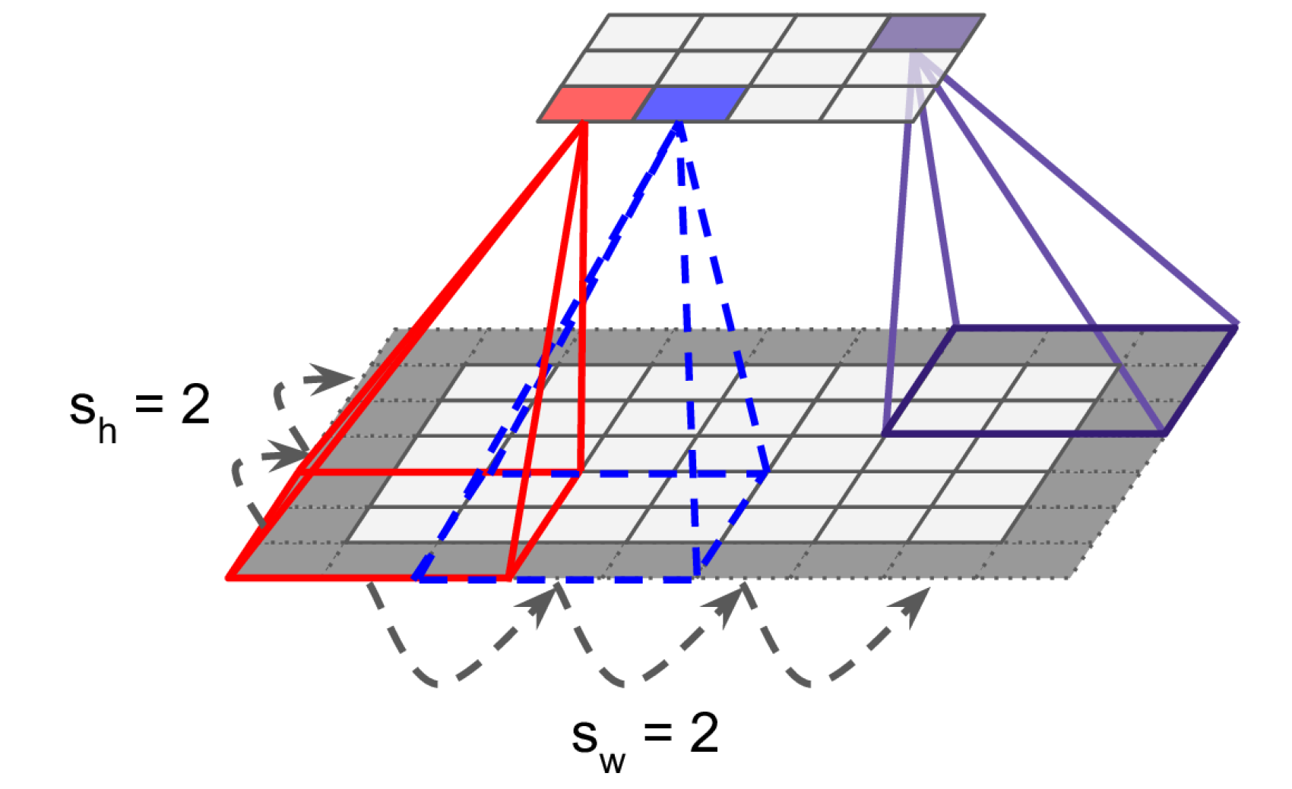
Reducing dimensionality using strides
Stride = “How much you move the filter by in each direction”
“Stride is one of the features used in defining the movement of the filter layer, which defines the amount of movement of the filter on the image. Each movement of the filter on the input image will produce one value, contributing to the output image. Now, if the stride is large, it means that the filter takes a big step at each step and, therefore, will produce fewer values and a smaller output compared with the original input.” 2022 student

Slide 17

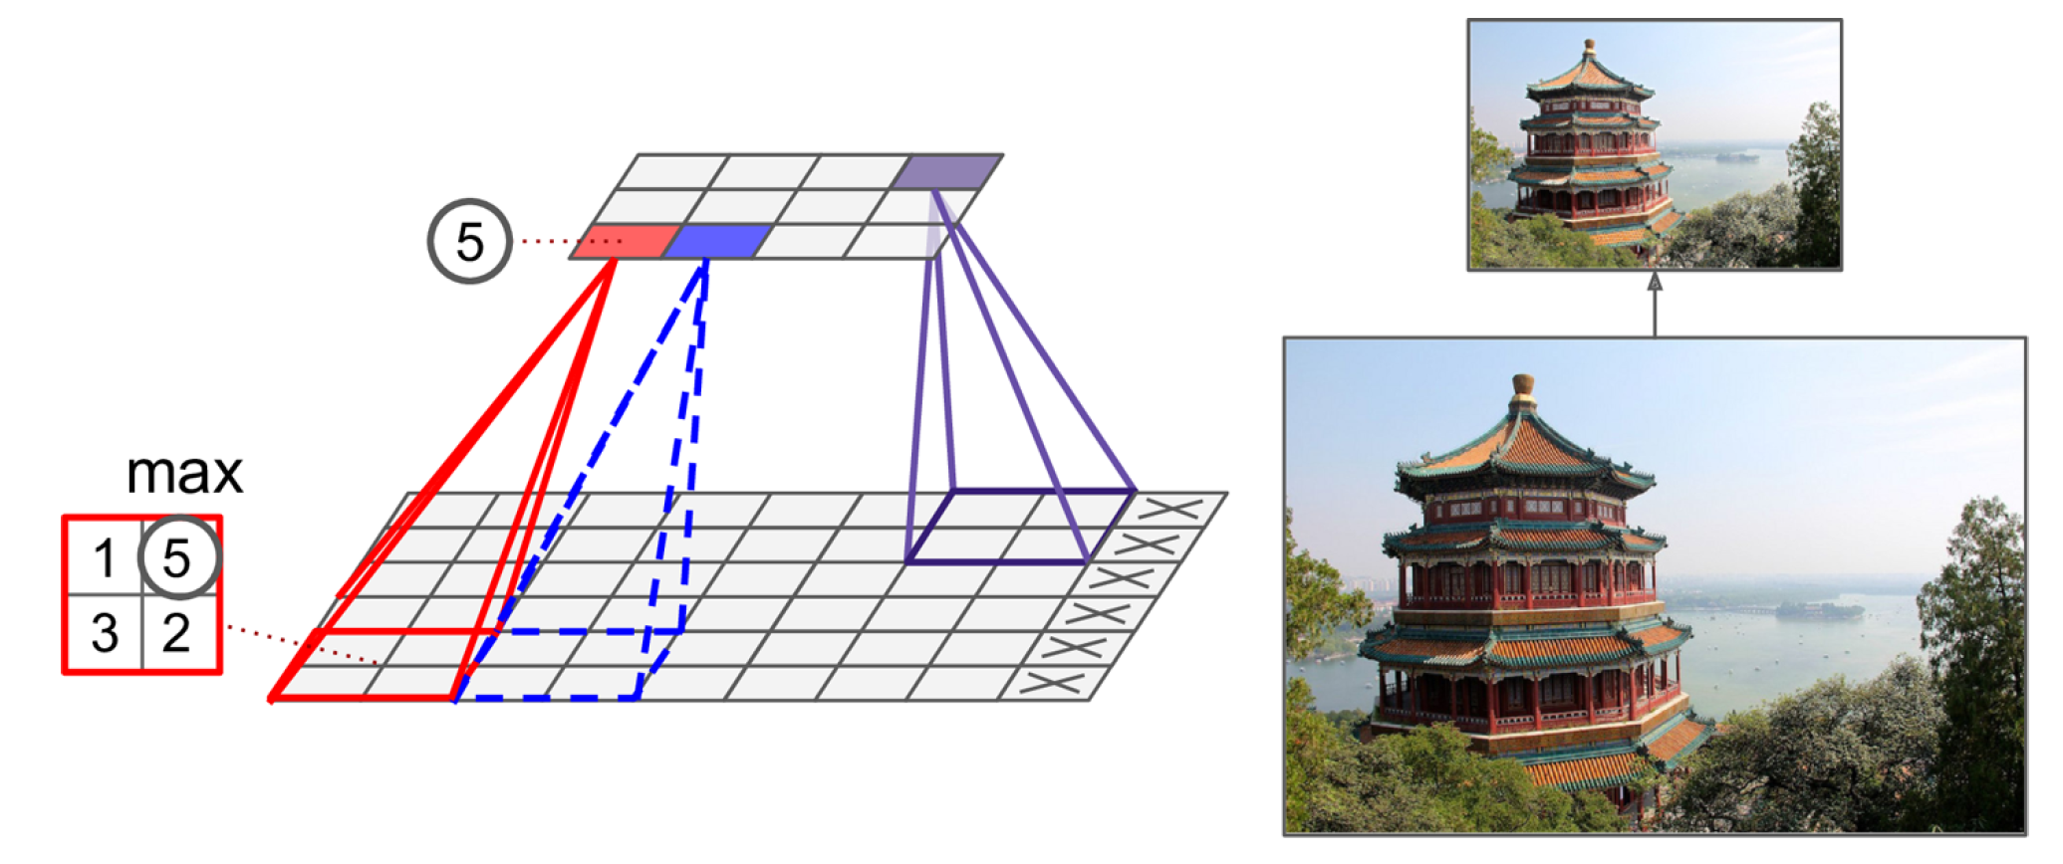
Shrinking the Input Image using Pooling Layers
Alternative: Mean/Average pooling
Notes:
Explain Difference between pooling and convolutional layer

Slide 18
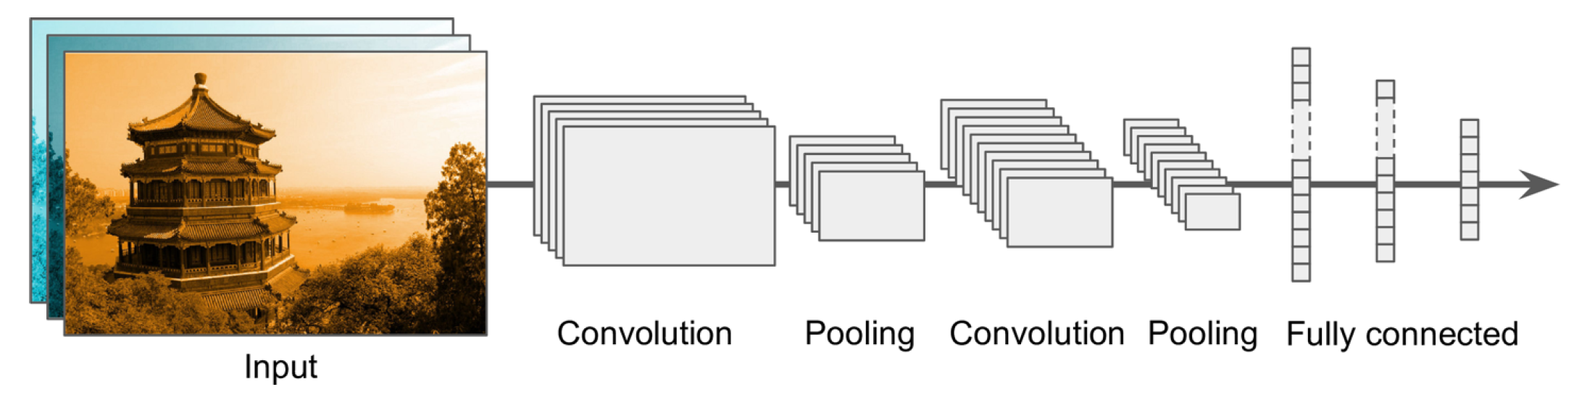

Building a Convolutional Neural Network
Prepare and load
image dataset
Not enough data!

Slide 19
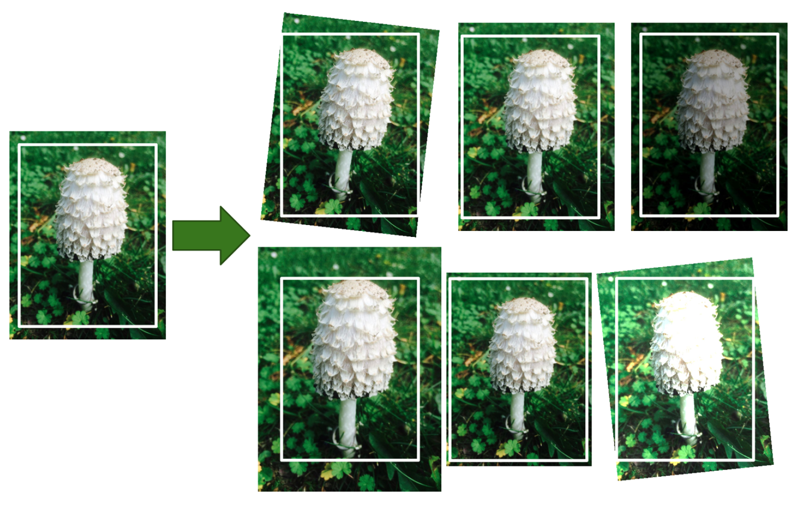
Data Augmentation = Generate realistic variances of each training instance (rotation, translation, resizing…)
Bonus: Regularizes the model

Slide 20
Building a Convolutional Neural Network
Prepare and load
image dataset
First Convolution Operation
Image shrinks

Slide 21
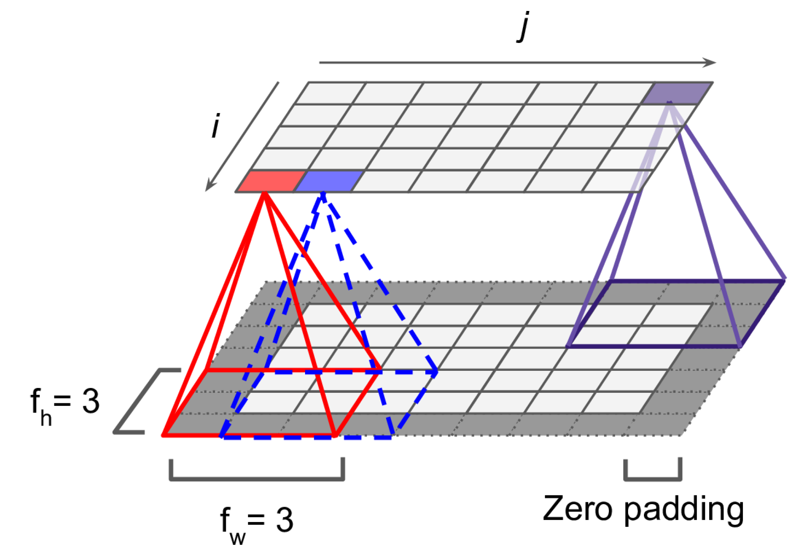
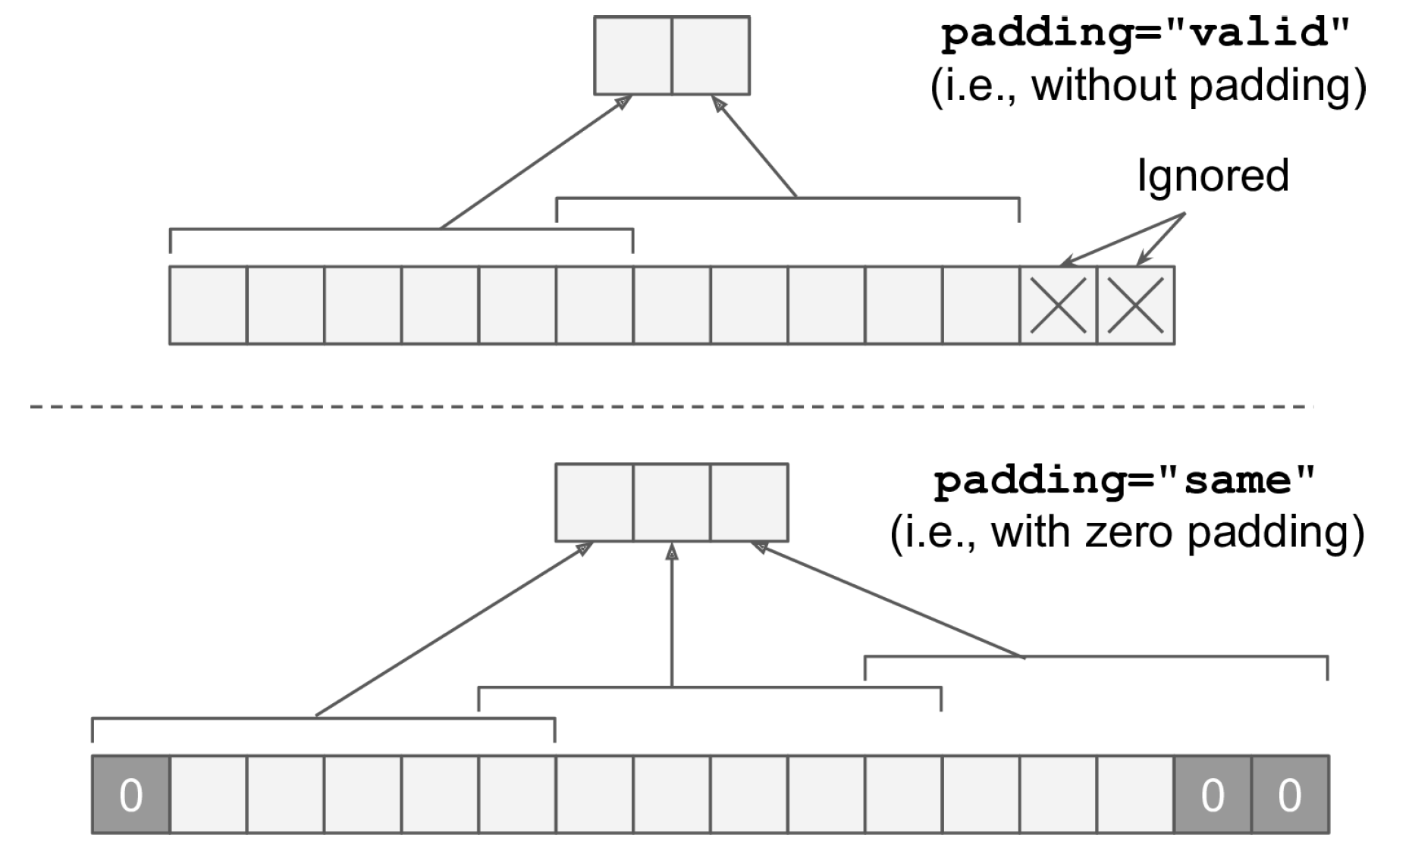
(Zero) padding to preserve the dimension of the input

Slide 22
Building a Convolutional Neural Network
Prepare and load
image dataset
First Convolution Operation
Series of convolution+pooling
Dense layers

Slide 23
Train using appropriate loss (↓RAM use: ↓batch size, ↓layers, ↑strides, etc.)
Prepare and load
image dataset
First Convolution Operation
Series of convolution+pooling
Dense layers

Slide 24

Building a Convolutional Neural Network
Prepare and load
image dataset
Still not enough data!

Slide 25
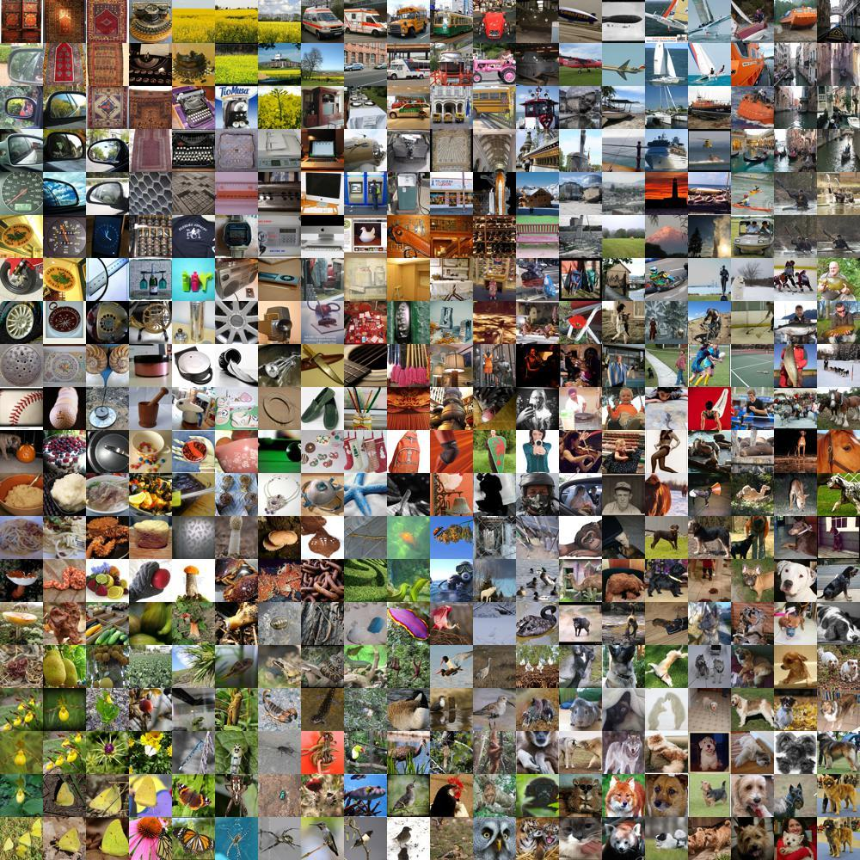
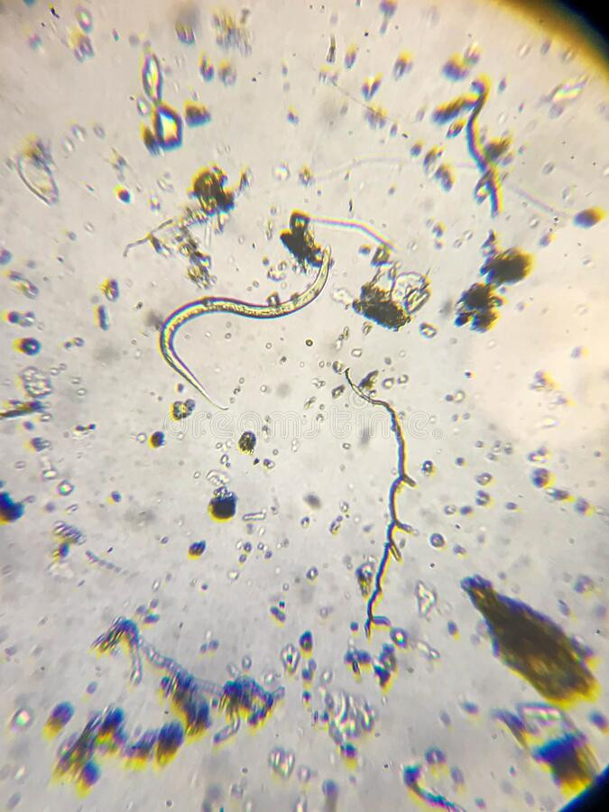
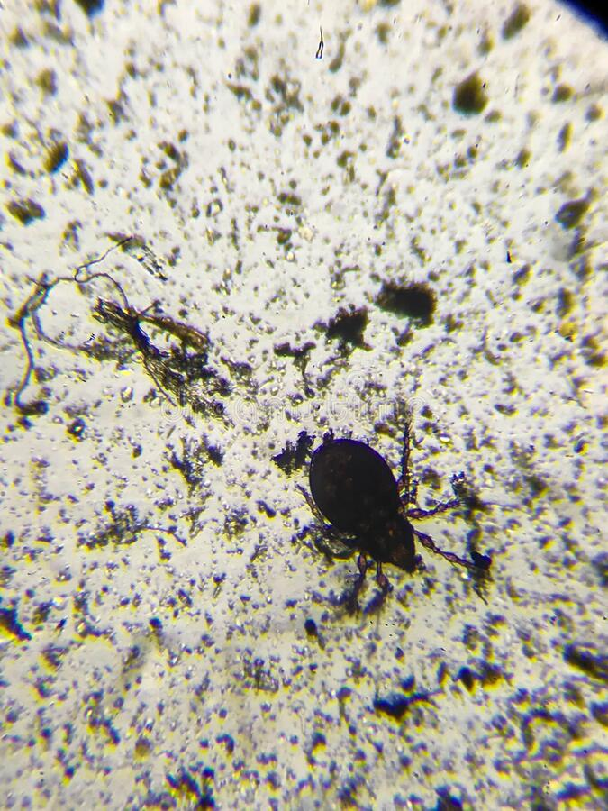
Transfer Learning = Reusing trained model for a different problem
?
↔
Source: ImageNet, Dreamstime.com
Notes:
VOTE: Who thinks it’s a good idea? Ask people who think it’s a good idea why?

Slide 26
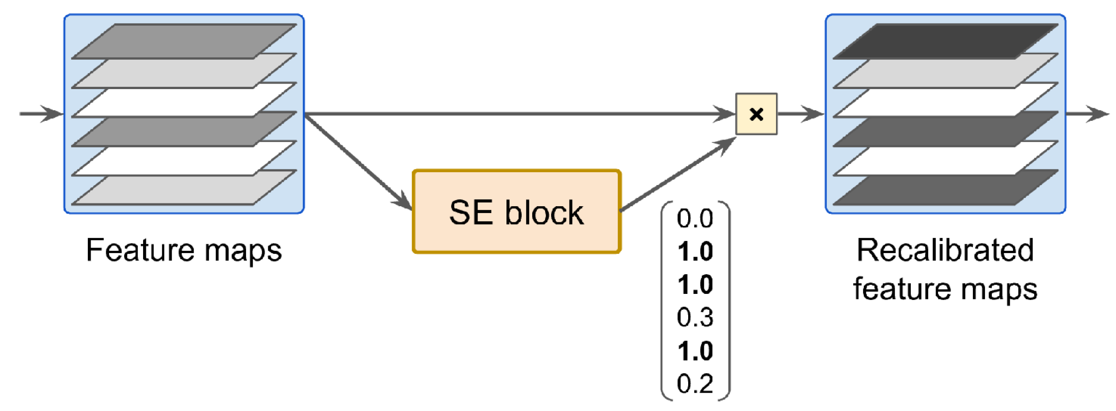
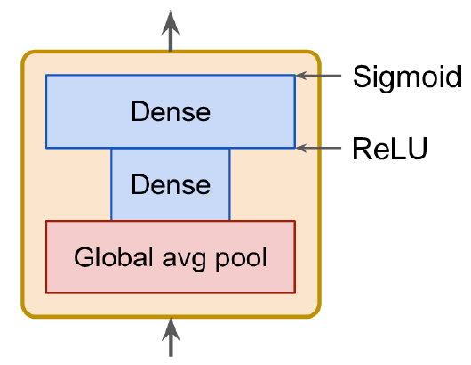
Which model to choose?
See Géron Ch14 for list of high-performance models (winners on ImageNet):
AlexNet (Stacked convolutions + local response normalization)
SENet (Adds small neural networks to recalibrate feature maps)
Fully-convolutional architectures (process images of various sizes)
Notes:
SENet =

Slide 27
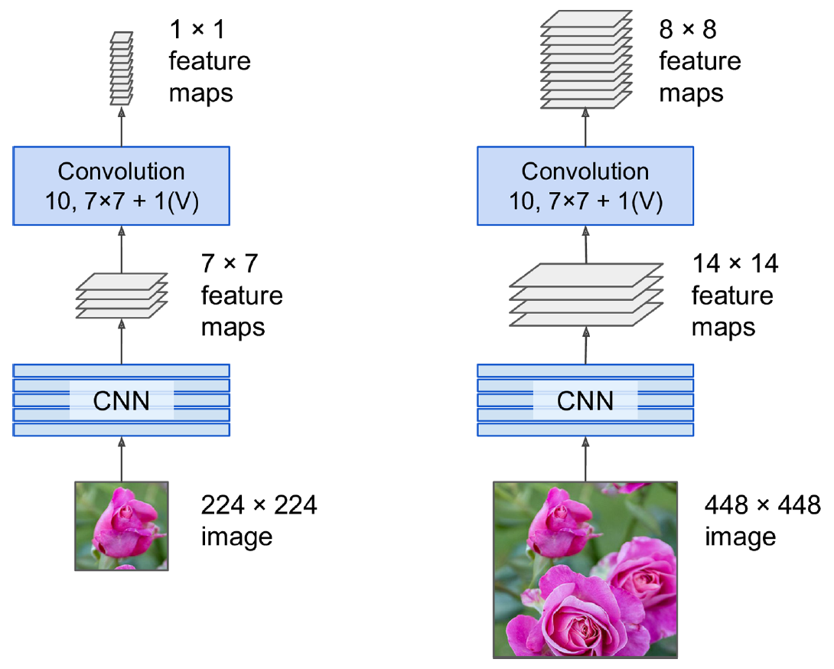
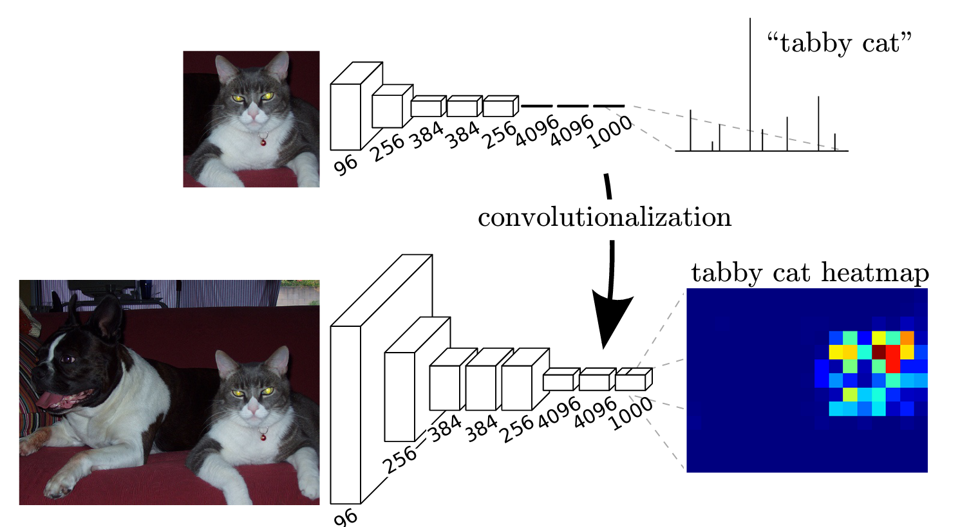
Fully-Convolutional Network = No dense layers
Can process image of any size for semantic segmentation
Source: Long et al. (2015)

Slide 28
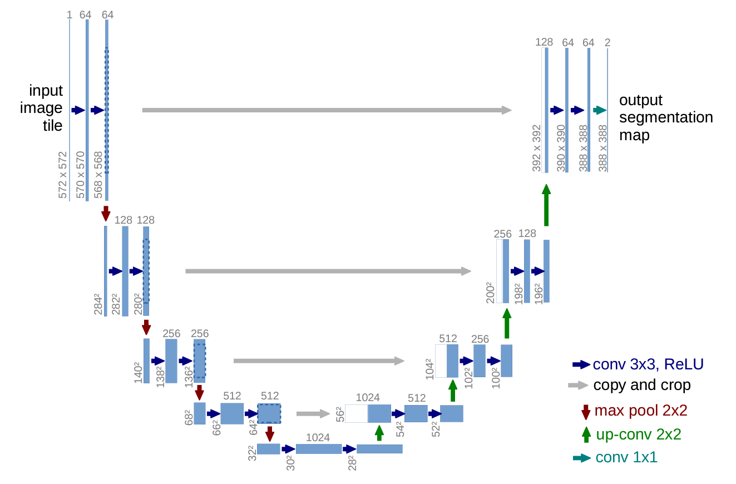
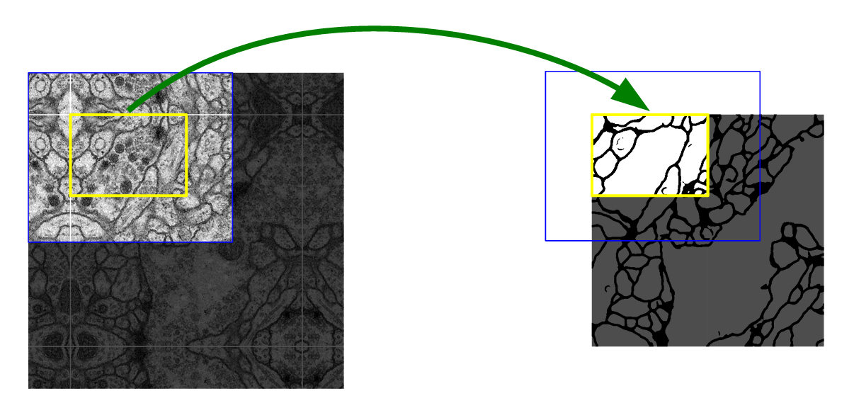
U-Net: Initially developed for biomedical image segmentation. Retains localization information
Source: Ronneberger et al. (2015)

Slide 29
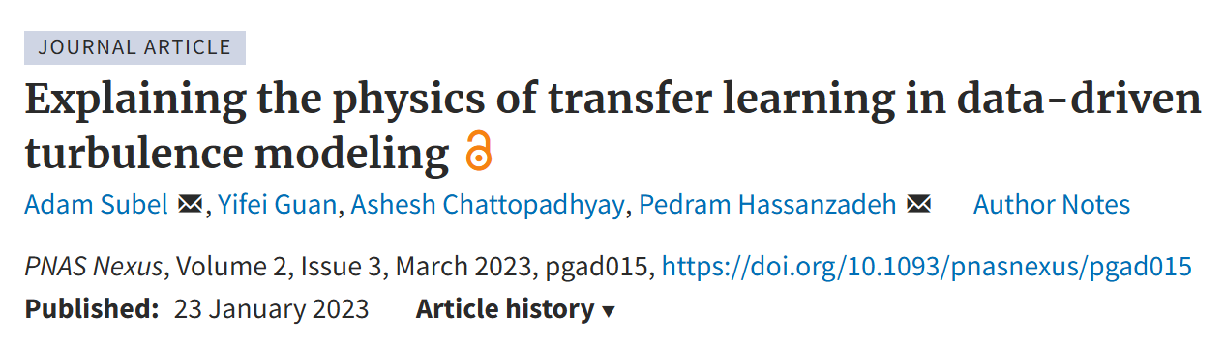
Transfer Learning = Reusing trained model for a different problem
Pick a model to reuse
Load the trained weights corresponding to a similar dataset
Retrain parts of the model
- Freeze existing layers & add dense layers to train
- Retrain the first layers of model (closest to the image, most specialized)

