Slide 1
DC Group Meeting 5/23/18
Timothy B. Hayward, Torri Roark

Slide 2
Align the drift chambers by finding the appropriate “offsets” to minimize the residuals of straight track (B=0) data (rg-a run 2467)
Investigate the effect on the W² elastic peak of shifting the the drift chambers

Slide 3
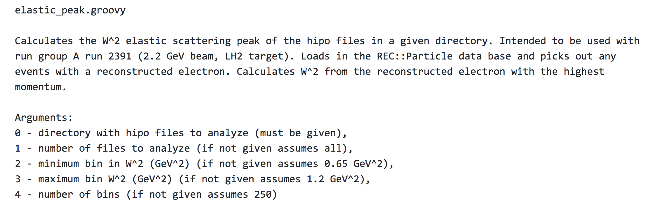
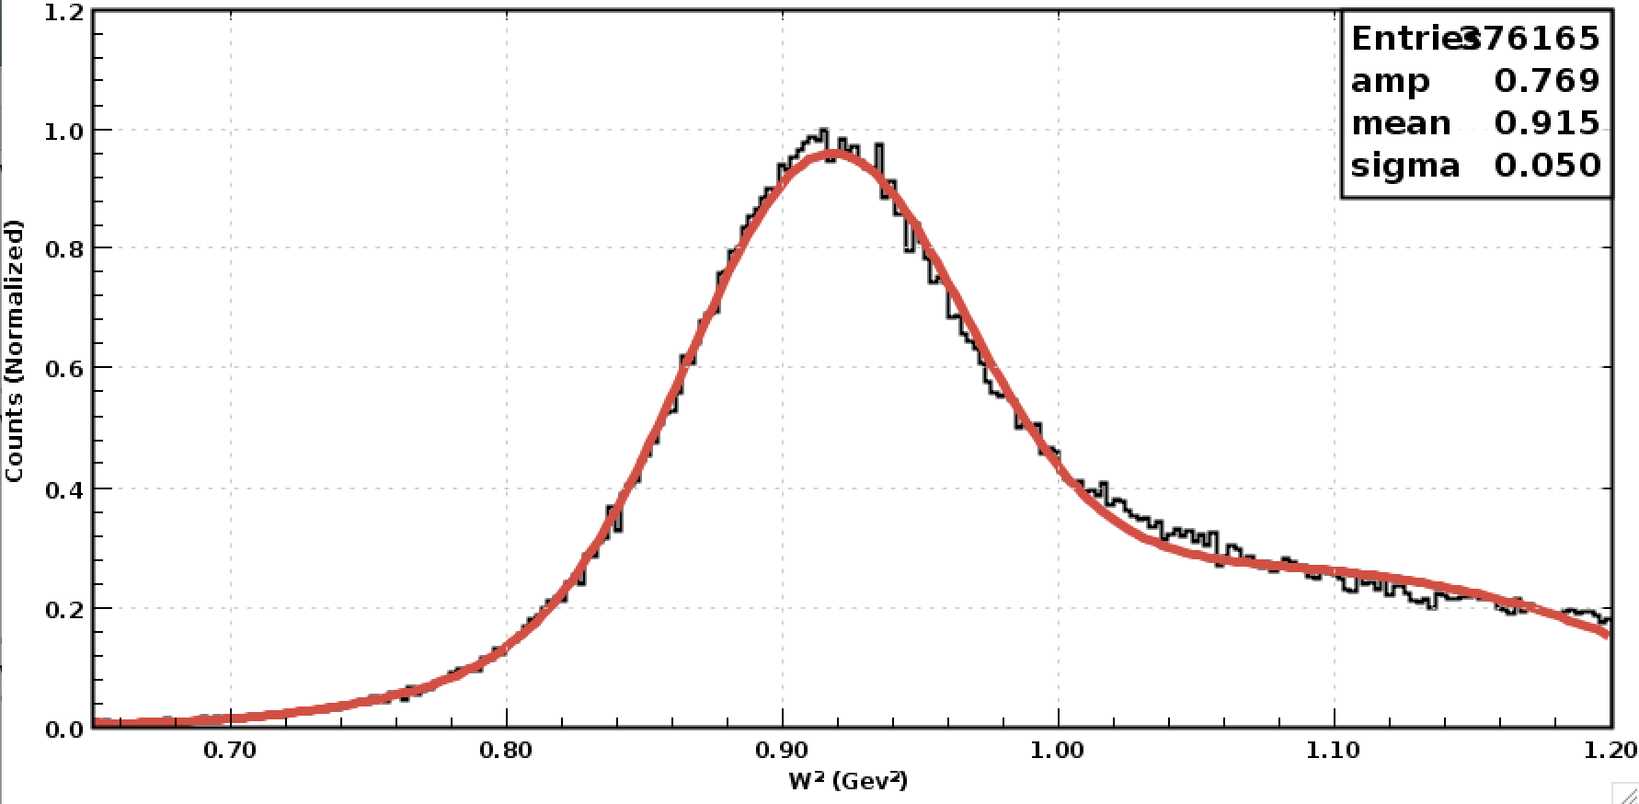
https://github.com/tbhayward/Clas12_DC_alignment/blob/master/groovy_scripts/elastic_peak.groovy
Elastic peak currently shifted to the right! (Primarily affected by the field position, but maybe we can improve it too?)

Slide 4
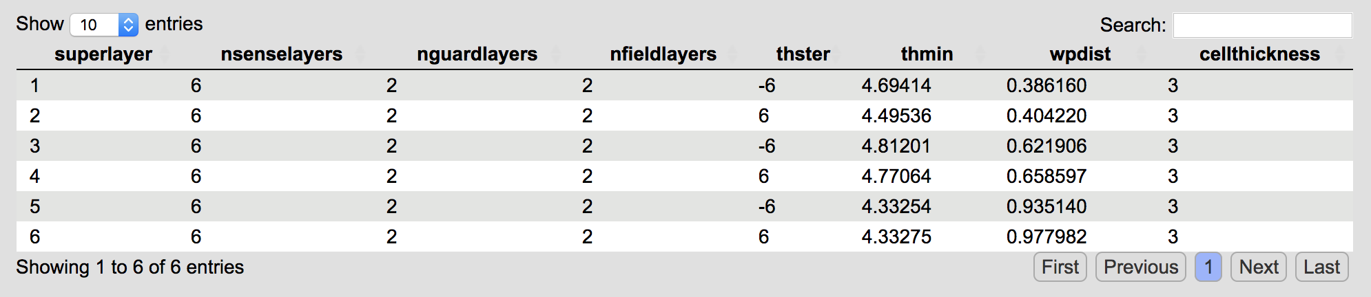
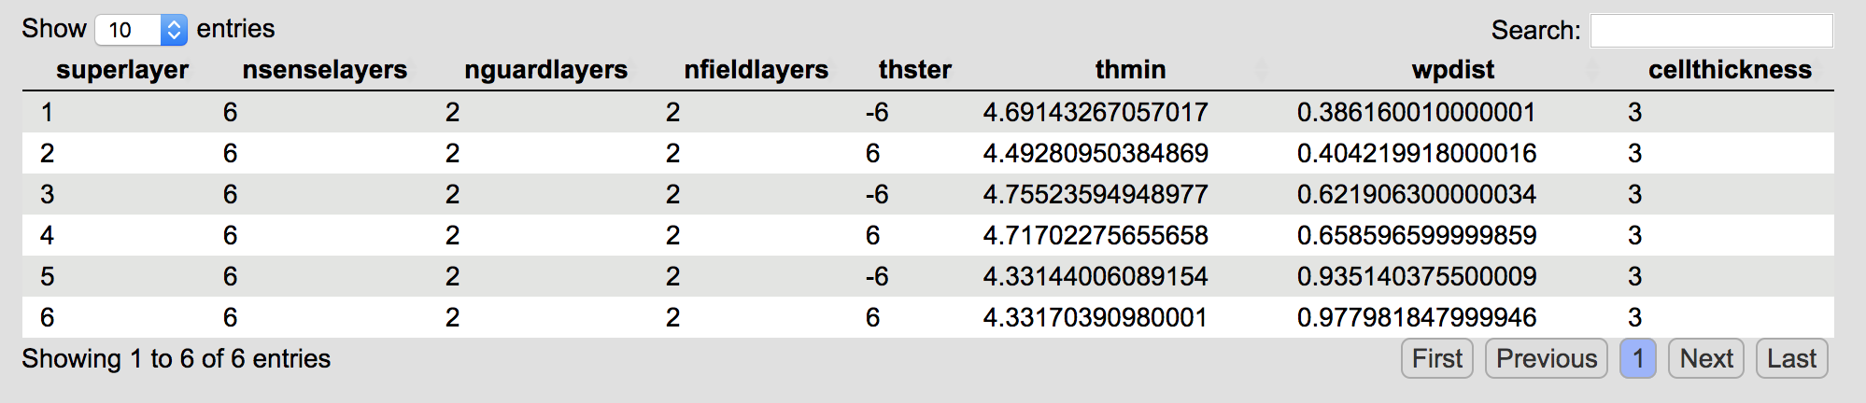
coatjava-5c.3.4 allows for
geometry database variation is defined via environment variable GEOMETRYDATABASEVARIATION
Allows for running reconstruction with DC alignment variation tables via
setenv GEOMETRYDATABASEVARIATION "test_align”
Default variation
Test files for reconstruction:
/volatile/clas12/thayward/drift_chambers/reconstruction/straight_track_runs/input/
test_align variation (may 2018 engineers)

Slide 5
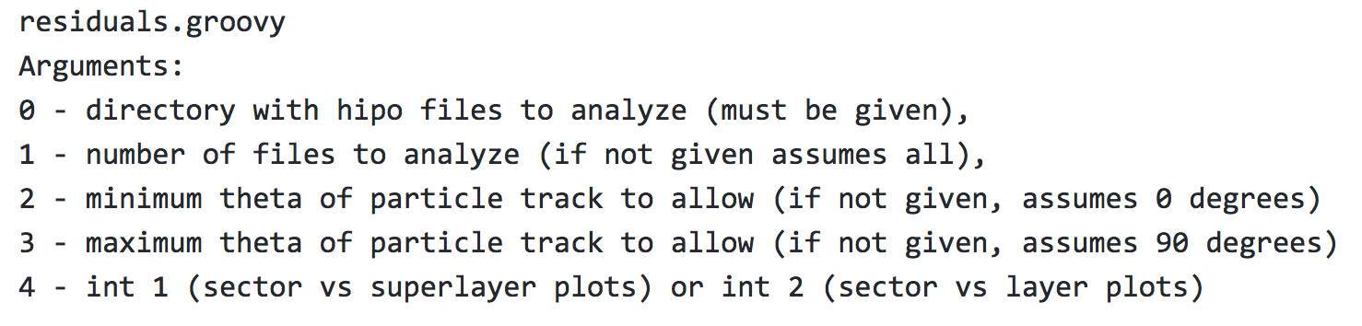
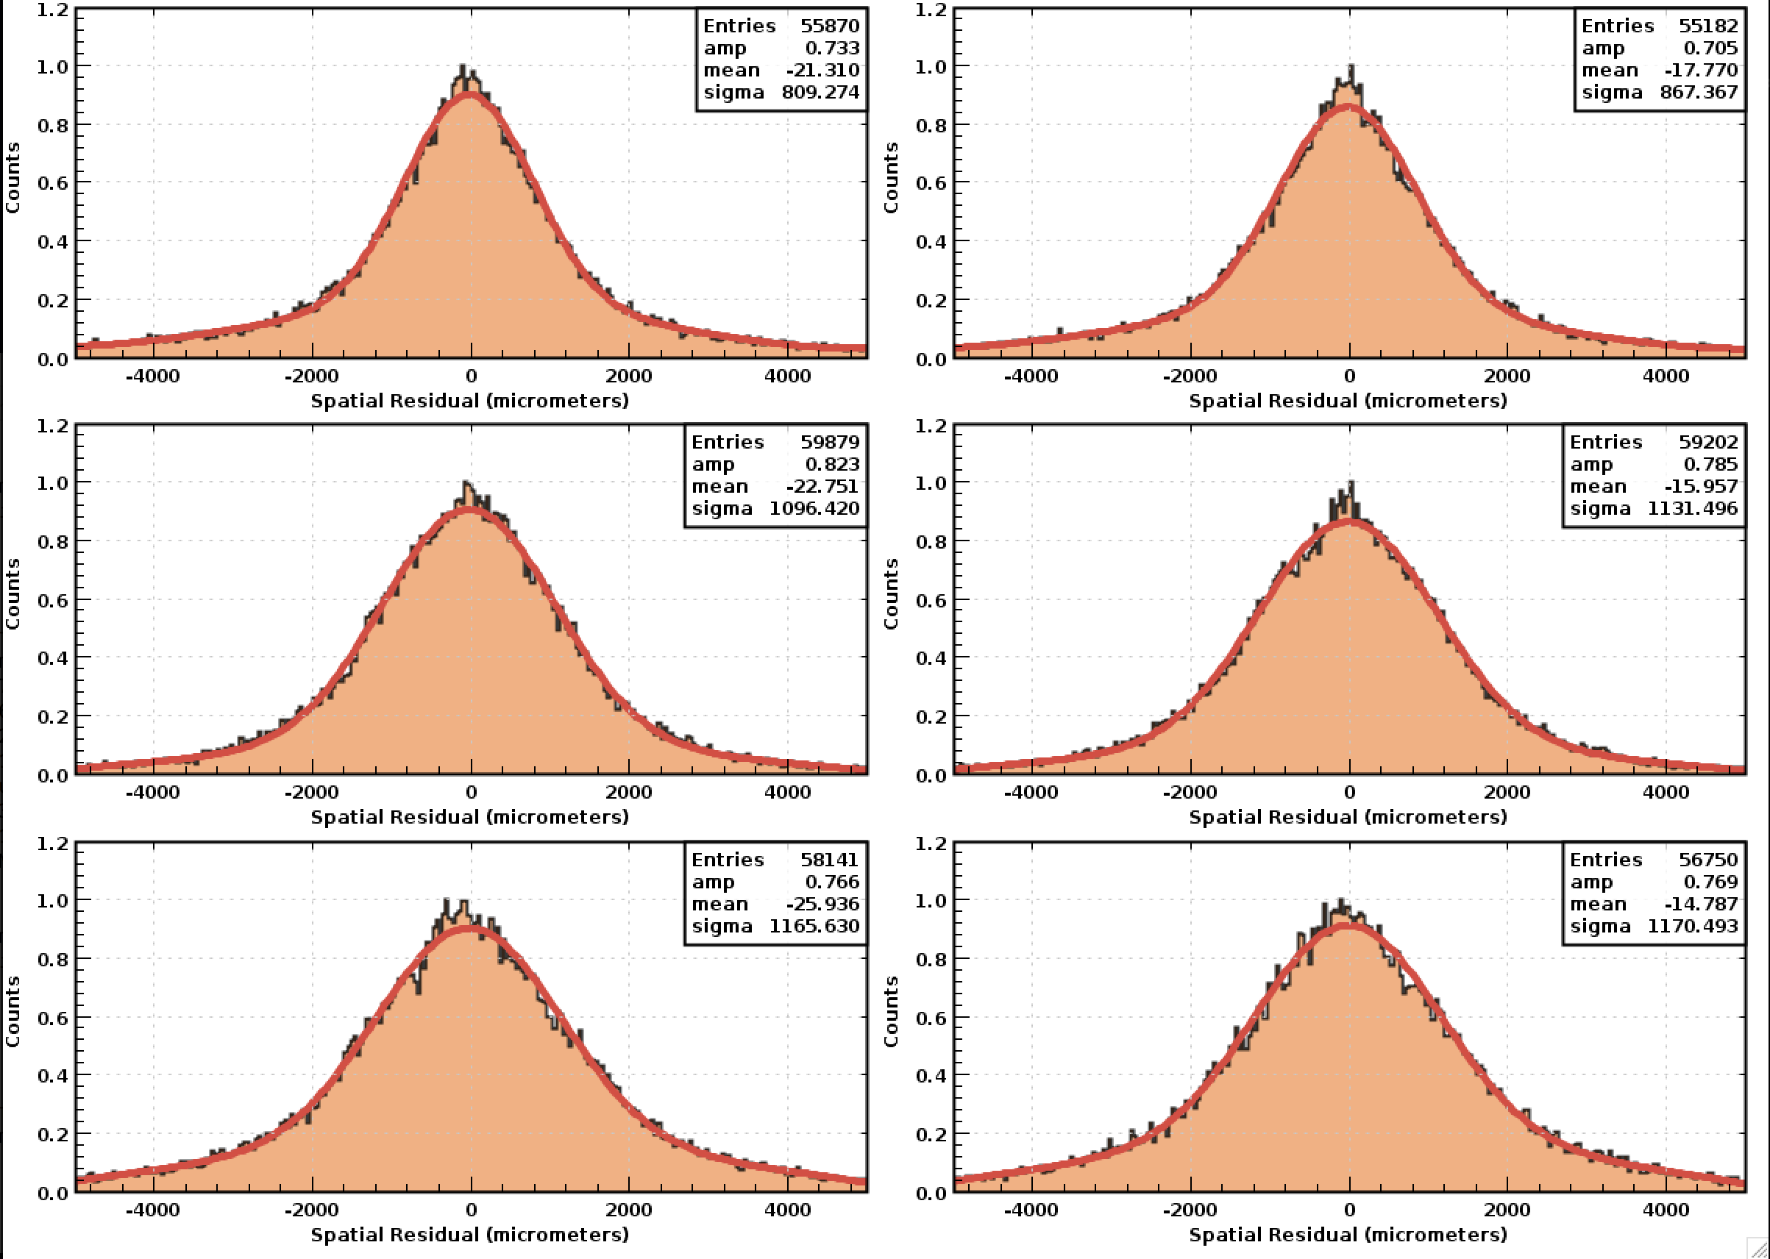
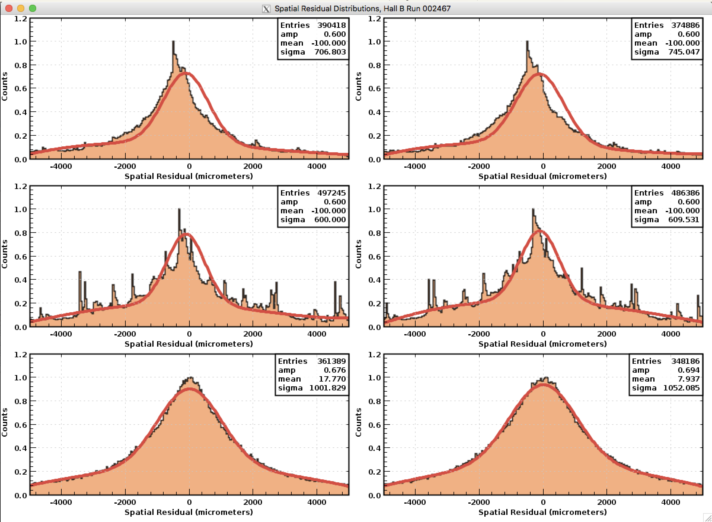
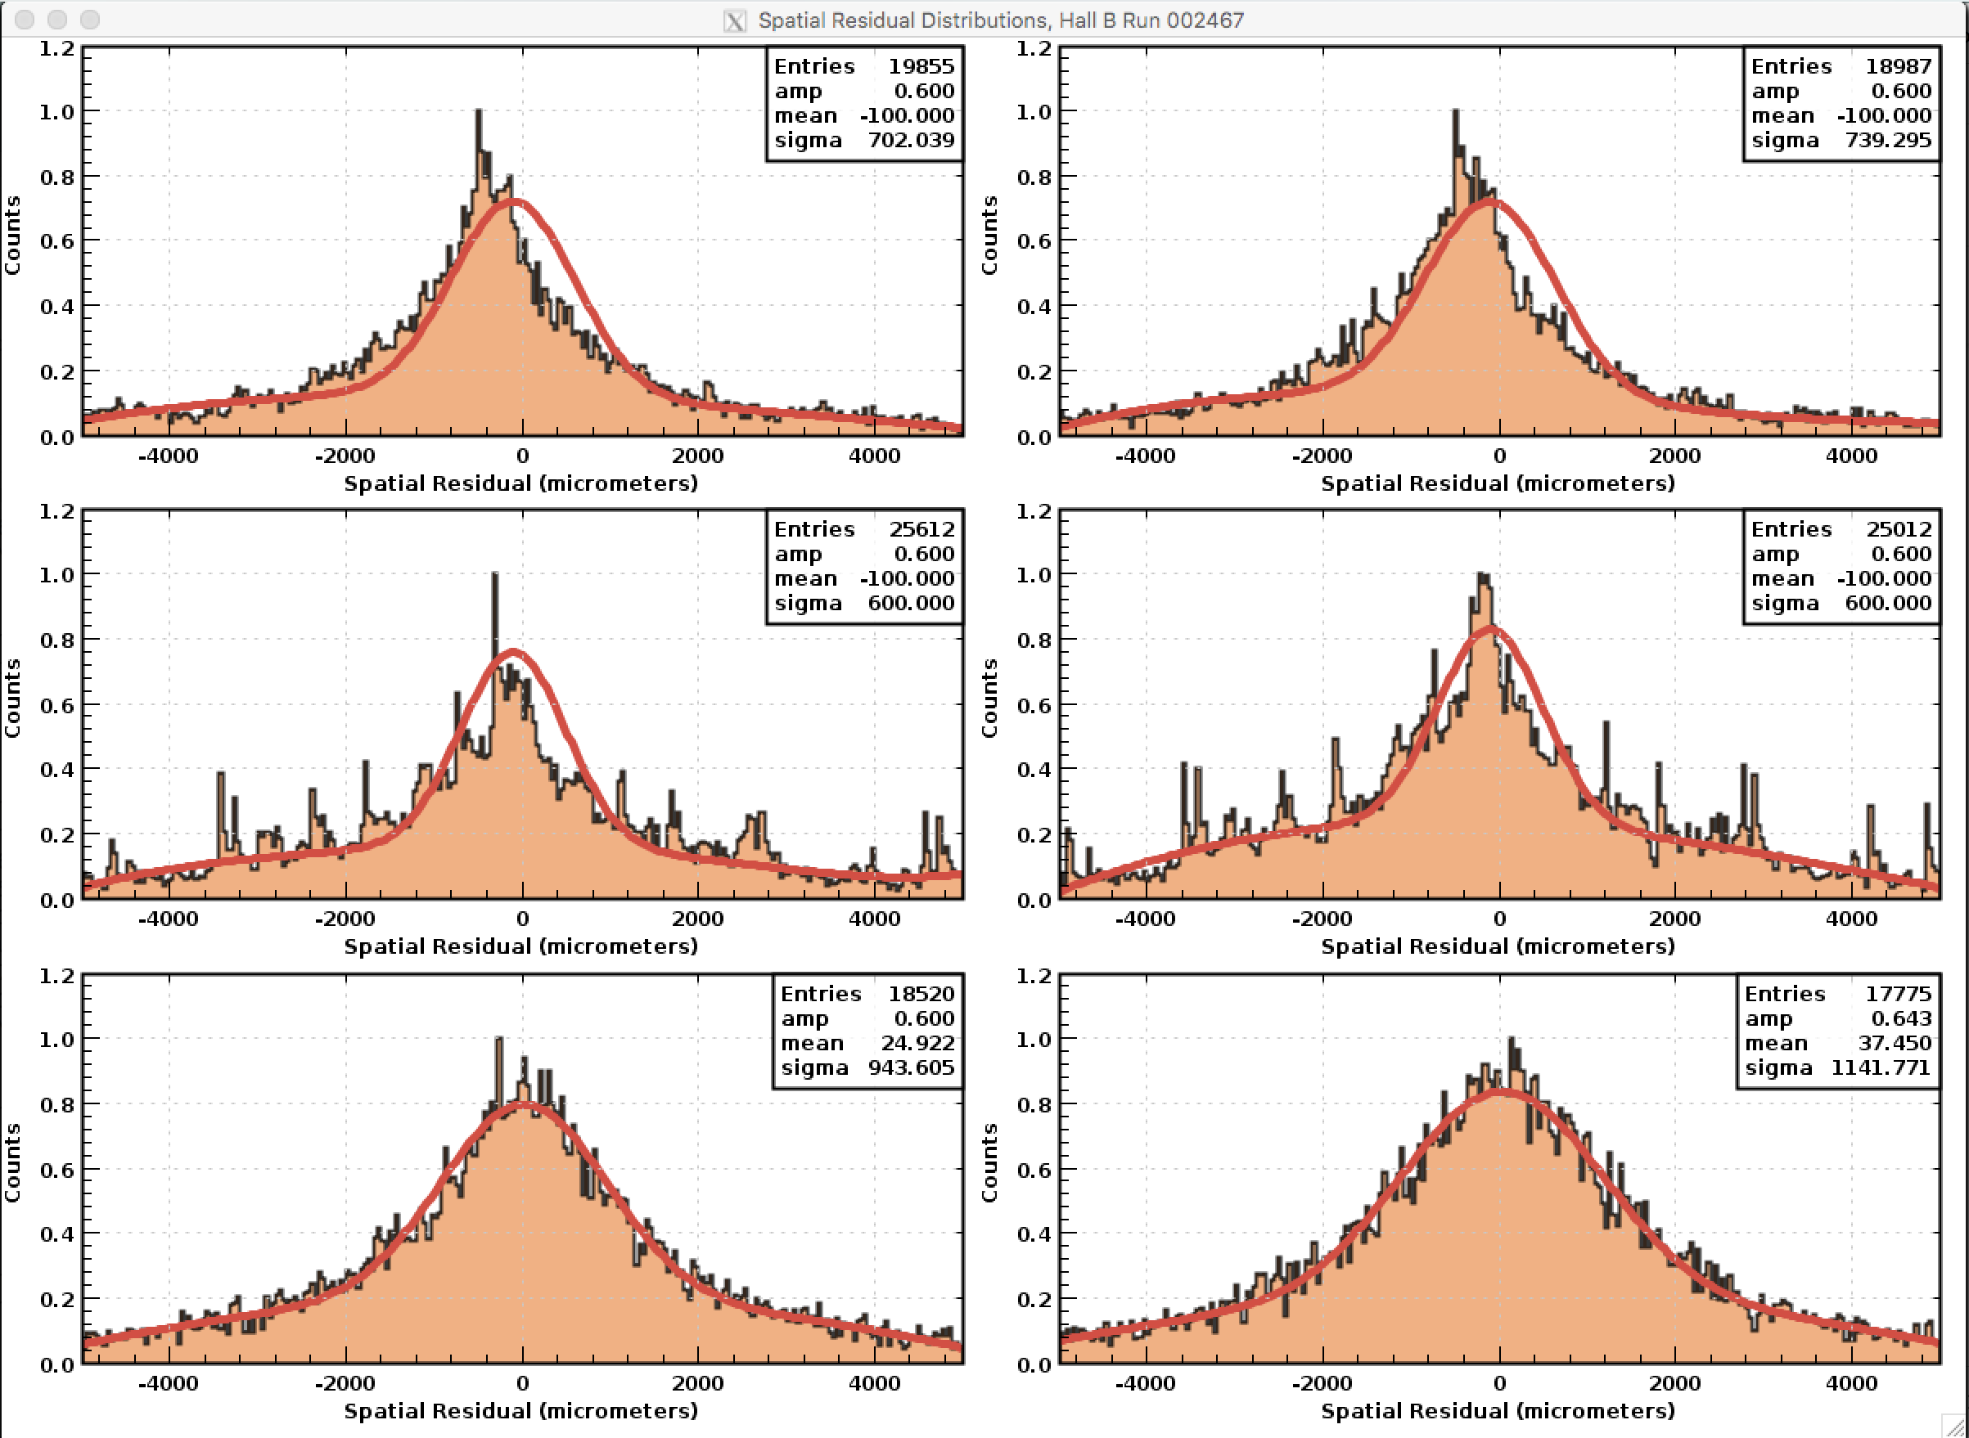
https://github.com/tbhayward/Clas12_DC_alignment/blob/master/groovy_scripts/residuals.groovy
Cooked calibration data
5c.3.4 Reconstruction: default variation
5c.3.4 Reconstruction: “test_align”, May 2018 engineers

Slide 6
To Do
Determine the cause of the strange behavior in superlayers 1-2, 3-4.
Investigate residuals as a function of angles (already scripted! Just needs to be done)
Create method for saving residual “data” to use to fit as a function of changes in the variation table.
Minimize this fit.
Run reconstruction of full-field data and determine weight to assign to elastic peak.

