Slide 1
DC Alignment Analysis Meeting, April 18

Slide 2
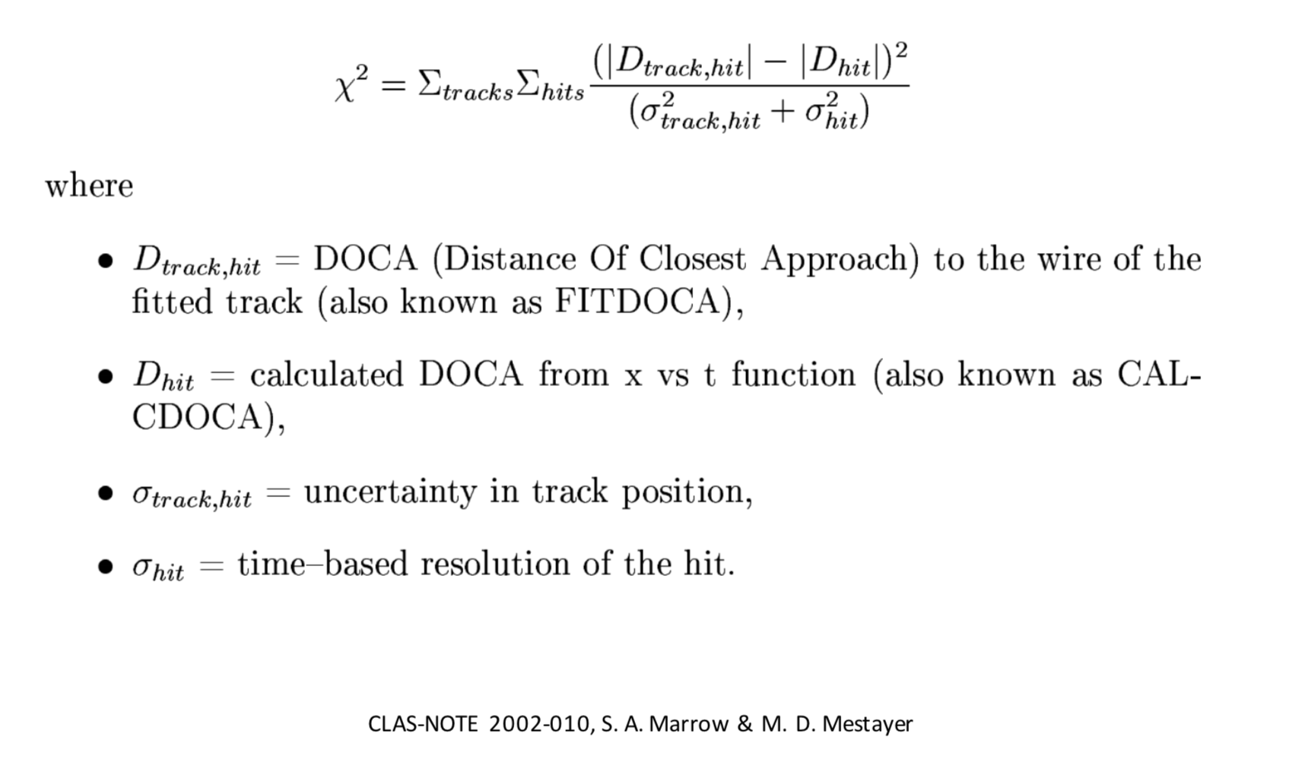
Goal: Align the CLAS drift chambers by finding the appropriate “offsets” to minimize the residuals of straight track (B=0) data.
run 2467 was an engineering run taken with no magnetic field: /volatile/clas12/data/rg-a/calibration/recooked/out_clas_002467*

Slide 3
General procedure
Develop method to implement shifts and rotations
Calculate 𝜒² from fitted tracks
Implement some shift/rotation and run reconstruction
Recalculate 𝜒²
Ultimately we want to fit the residuals as a function of the shifts/rotations instead of guessing shifts/rotations and checking the results

Slide 4
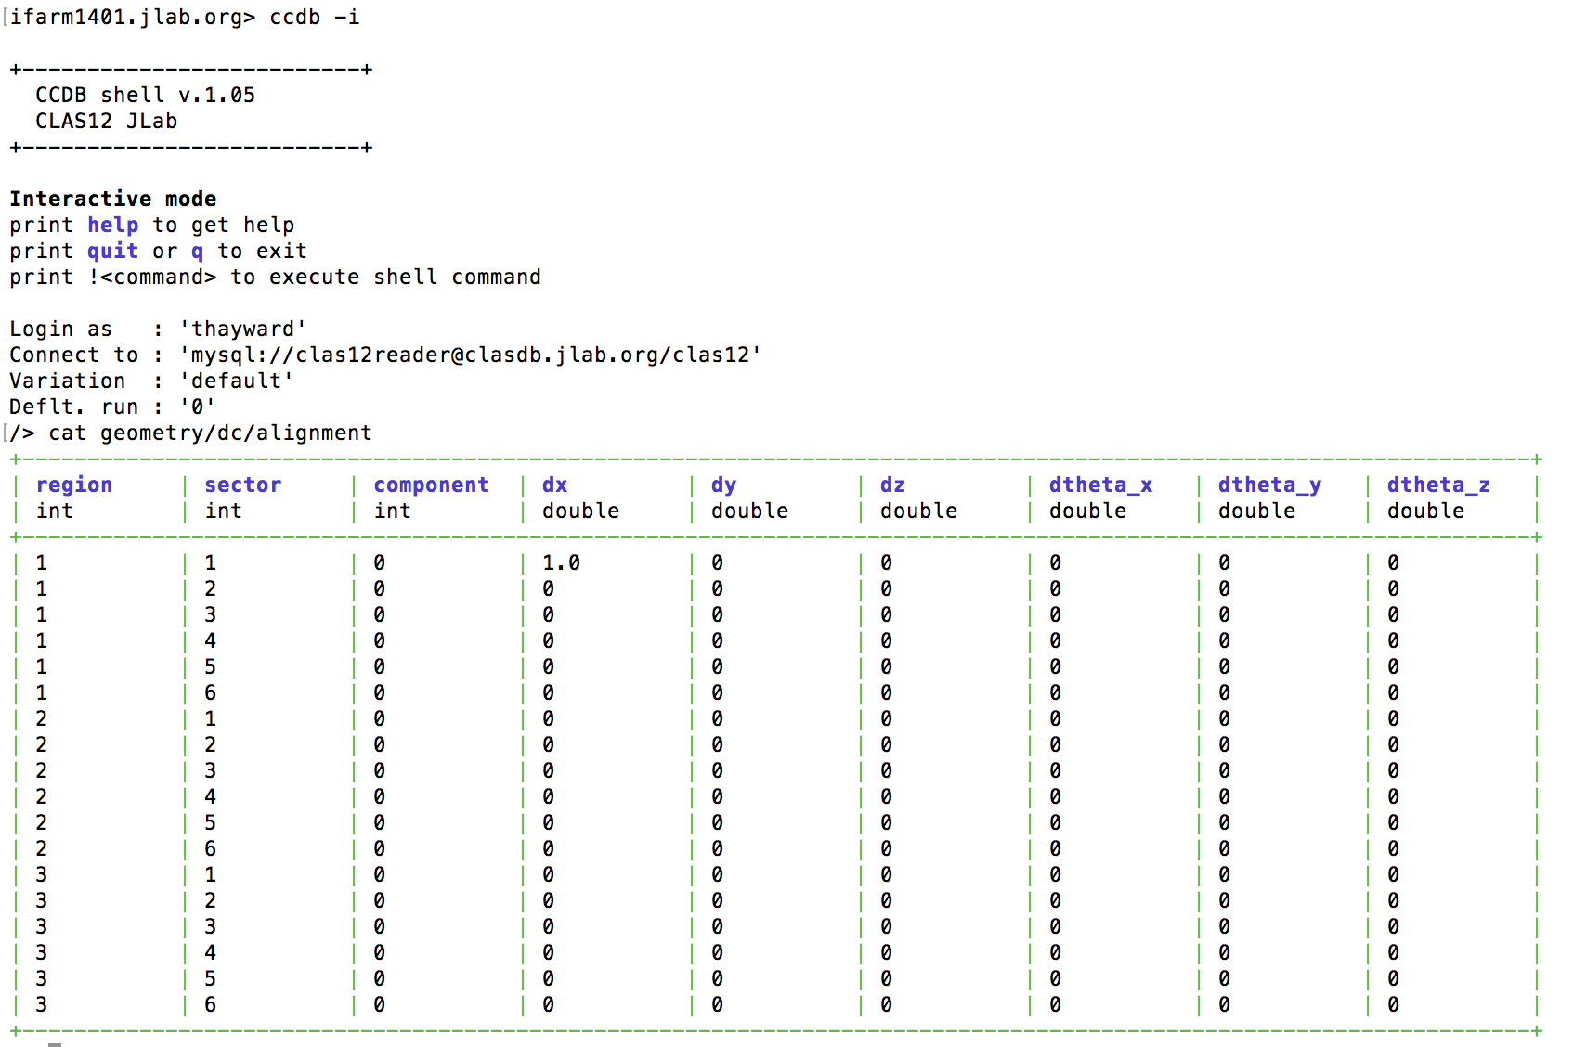
Data table added to ccdb (geometry/dc/alignment) to define shifts and rotations for reconstruction

Slide 5
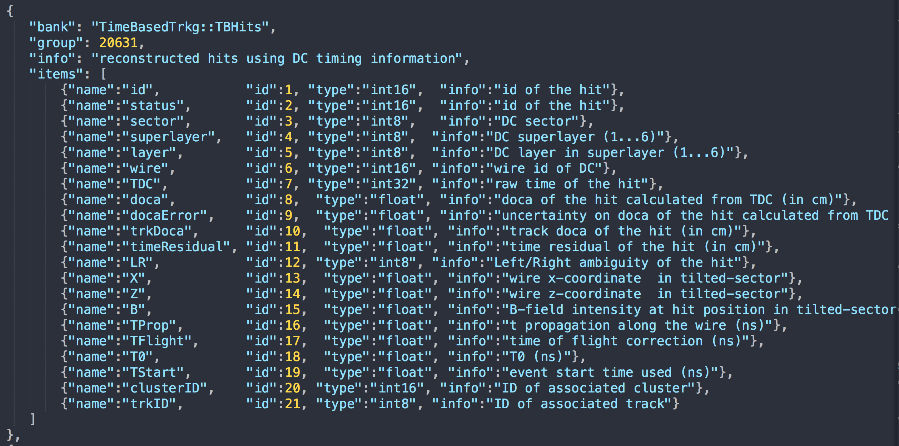

Slide 6
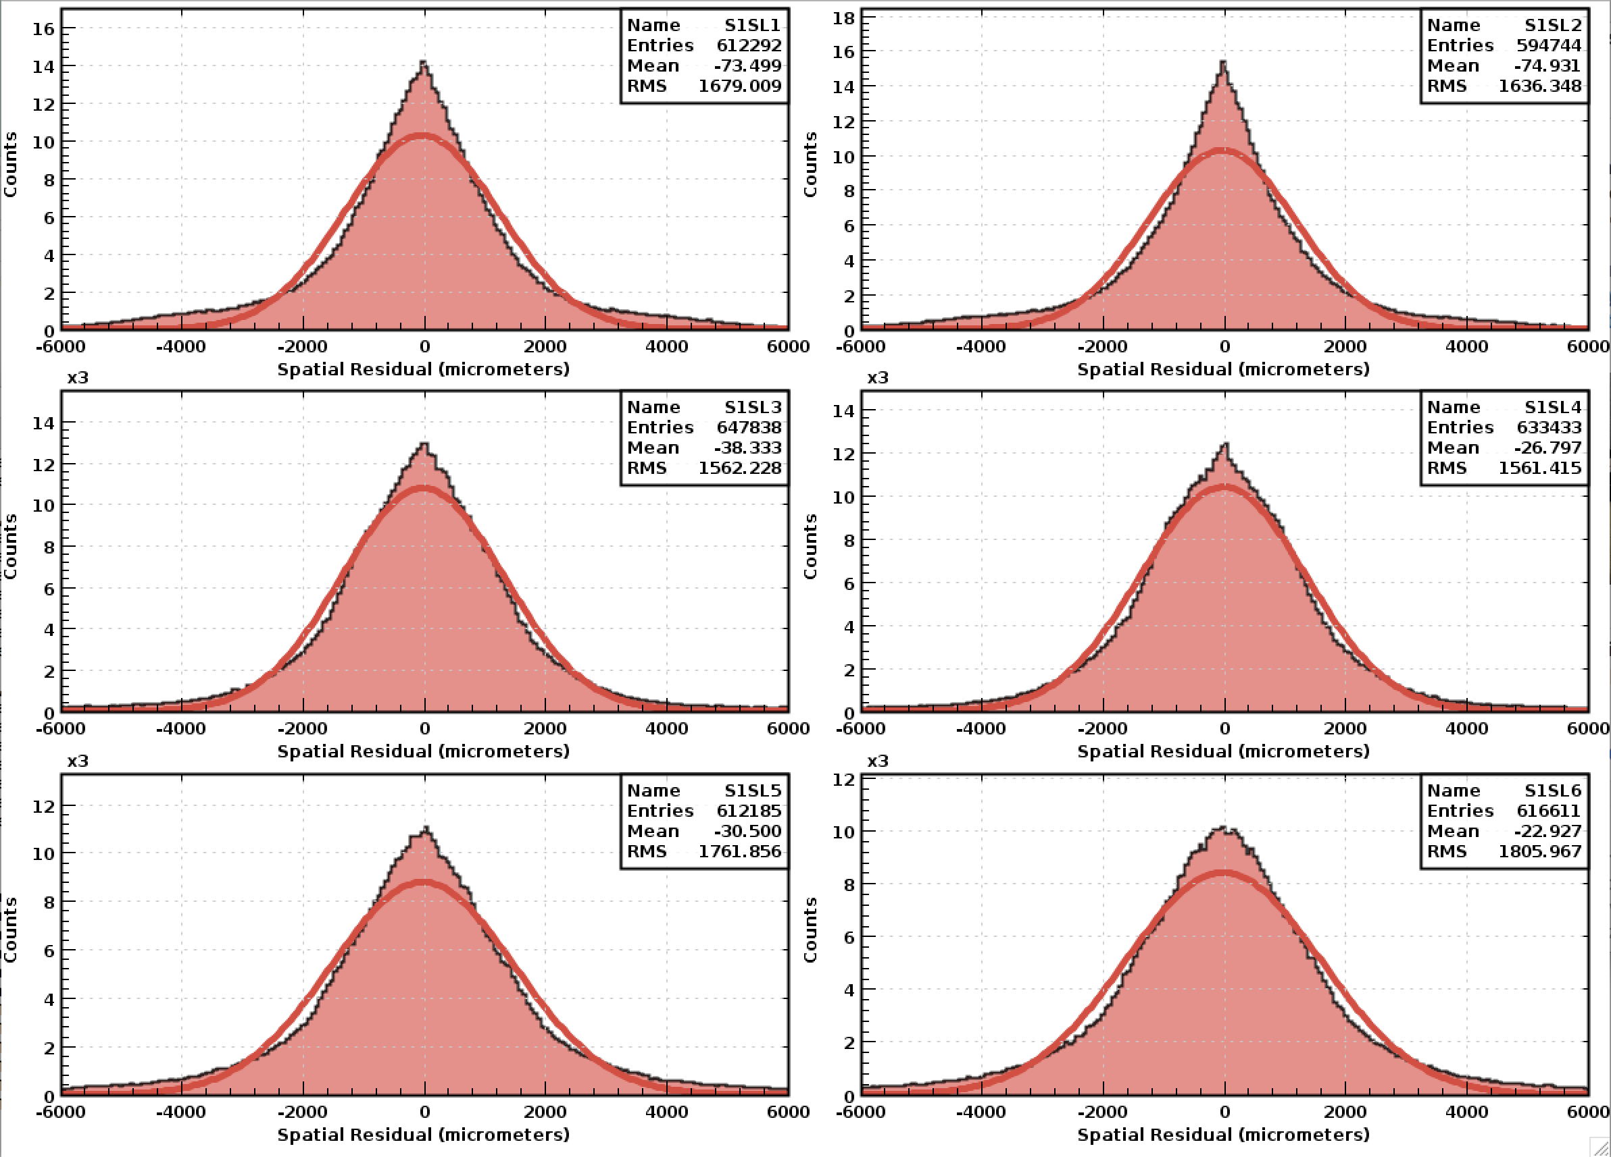
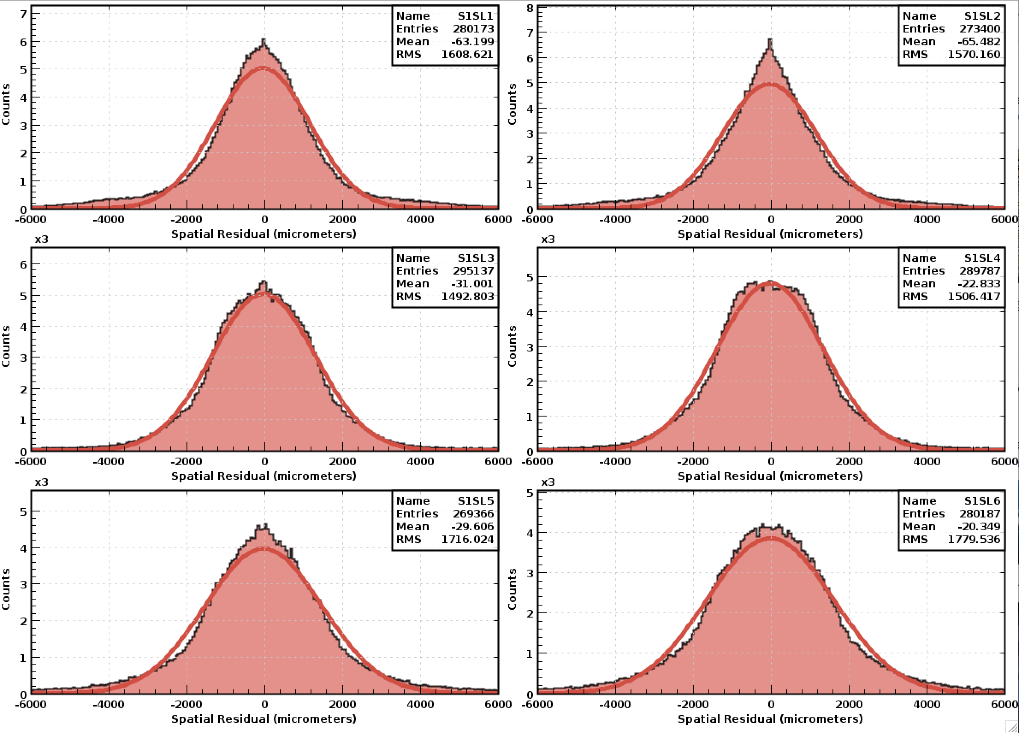
Preliminary analysis routine written with CLAS12 coatjava package to calculate residuals as a function of sector, superlayer and track angle:
Sector 1, 0 < θ < 90 degrees
Sector 1, 8 < θ 20 < degrees

Slide 7
Next steps: implement method for shifting the geometry and look for changes in the residuals.
Develop method for fitting residuals as a function of shifts/rotations.

