Slide 1

SIDIS Dihadron Measurements with CLAS12
CLAS12 First Experiment Analysis Review
Timothy B. Hayward

Slide 2
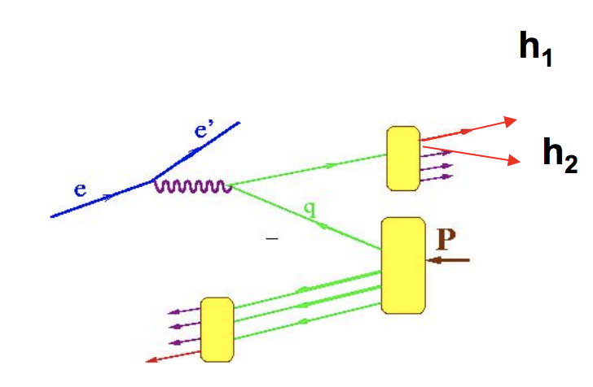
Dihadron Fragmentation Functions
Similar to single hadron formalism
Additional degree of freedom (relative momentum) allows for numerous advantages
  Separate contributions to asymmetries
  Existence of fragmentation functions with no single hadron correlation

Slide 3

What to measure?
Precision measurements of the cross section
Unpolarized form factors
e(x), higher twist-collinear PDF for quark-gluon correlations
  E12-09-008B, S. Pisano and A. Courtoy
h₁, transversity distribution of polarized quarks
  PR12-12-009, H. Avakian, S. Anefalos Pereira, A. Courtoy, K. Griffioen
G₁⟂, ɸ dependence of unpolarized hadrons on the initial quark helicity
  “possible” proposal from A. Vossen, H. Avakian, T. Hayward
Notes:
e(x) so far completely unknown
h1 is the least well known of the three fundamental collinear PDFs of the nucleon. Normally tricky because it is chiral-odd and so must be combined with a chiral-odd partner in order to form a chiral-even cross section
G1perp similar to e(x) proposal, Recently there has been rising interest in this function, since quark-jet model calculations relate this effect to complex spin-momentum correlations in hadronization, which opens up an extremely interesting path to learn about hadronization.

Slide 4
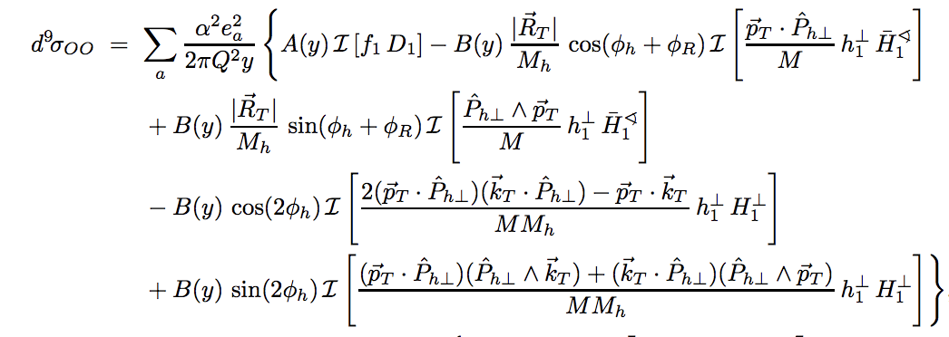
Unpolarized-Unpolarized Cross Section
Measurement of multiplicities of hadron pair production
D₁, the unpolarized fragmentation function, is multiplied by the well known PDF f₁
Can be isolated from the ɸ-dependent terms
e‘𝜋⁺𝜋⁻X / e‘X should follow z-dependence of the fragmentation function
Bachetta, Radici. hep-ph/0212300
Notes:
As to D1, in the absence of data for di-hadron multiplicities related to the unpolarized DiFF, it has been fitted to the output of PYTHIA [15] tuned for Belle kinematics

Slide 5
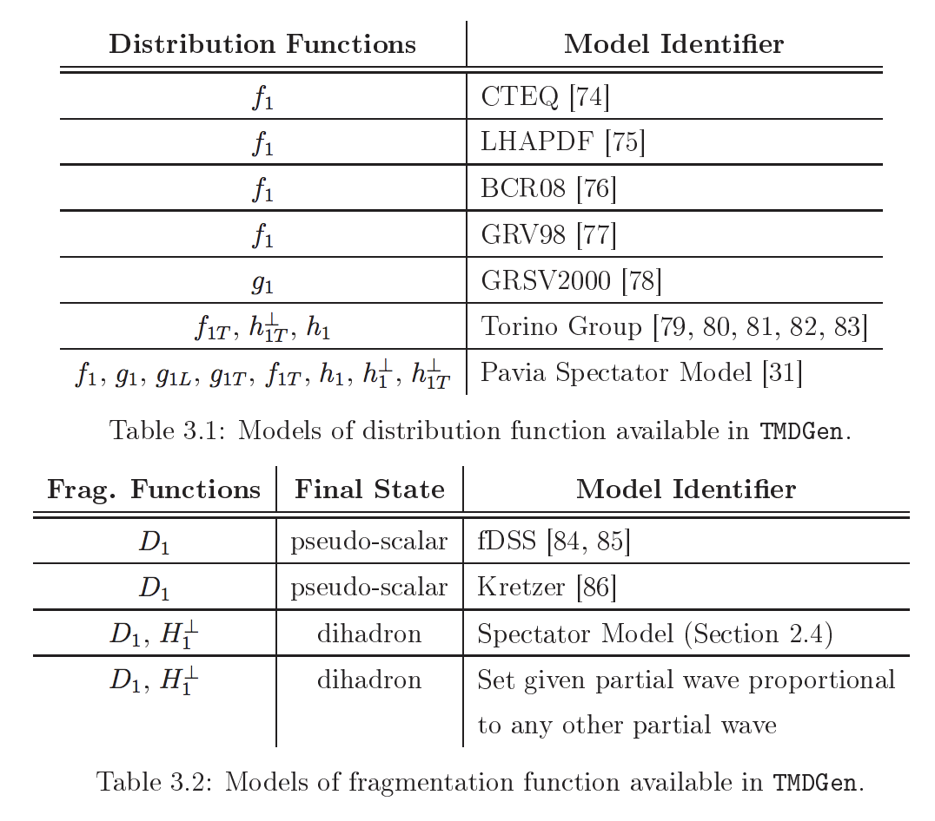
Event Generator
Stephen Gliske (HERMES) developed object-oriented generator “TMDGen”
Includes SIDIS dihadron models for angular dependence
No beam polarizations or longitudinally polarized target cross sections programmed for dihadrons
Gliske thesis (HERMES)

Slide 6
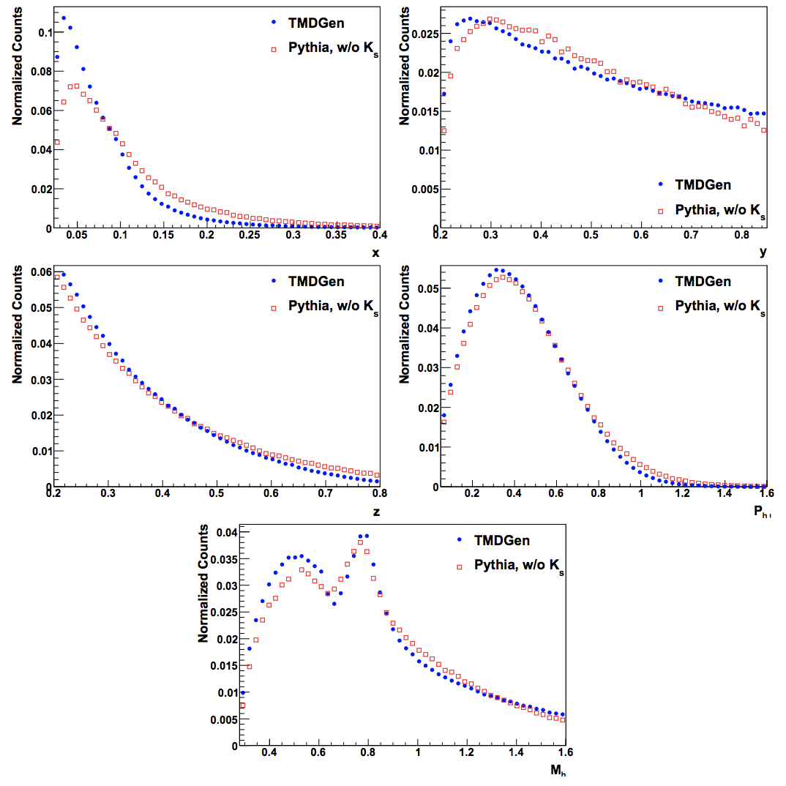
Event Generator
Gliske comparisons between Pythia and TMDGen for e’ 𝜋⁺𝜋⁻X
Gliske thesis (HERMES)
Notes:
x fraction of target momentum carried by struck quark
y fraction of beam energy transferred to virtual photon
z fraction of virtual photon energy carried by hadron system

Slide 7
Reconstruction Chain
TMDGen (root tree output)
Conversion to LUND File
gemc 4a.2.3
clara reconstruction (coatjava 5c.3.4)
This was really hard!
Generated 701947 ep ˃ e‘𝜋⁺𝜋⁻X events
EventBuilder reconstructed 37158 events (5.294%)

Slide 8
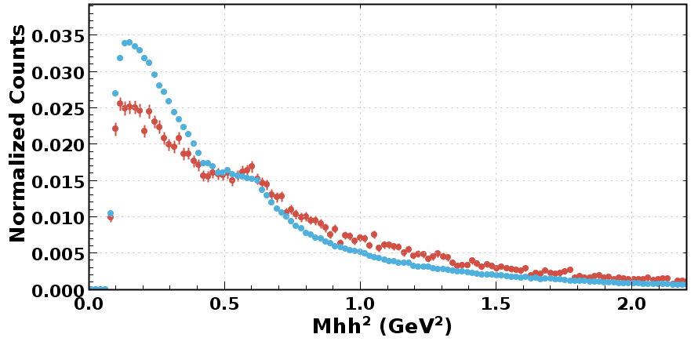
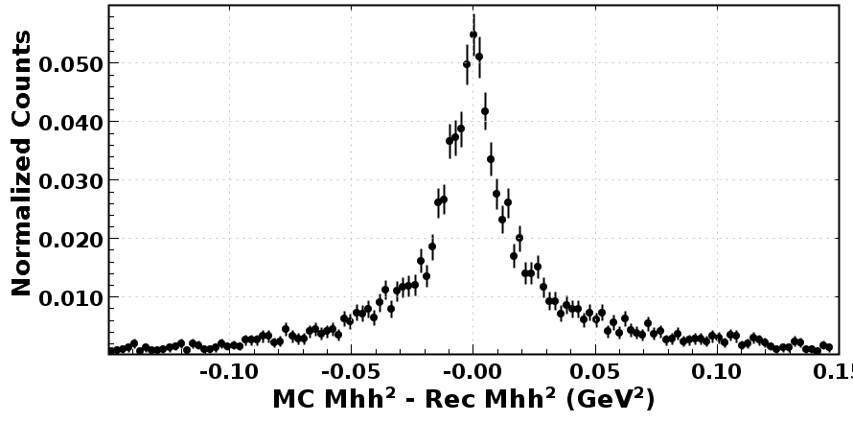
Monte Carlo Analysis
SIDIS dihadron variables generally used in the cross section:
  M_{hh}² (pair mass of the hadron pair)
  z = E_{hh}/𝜈 (fraction of the virtual photon energy carried by the hadron system)
  P_{h⟂} (projection of the hadron pair momentum perpendicular to the virtual photon direction)
MC
Reconstructed

Slide 9
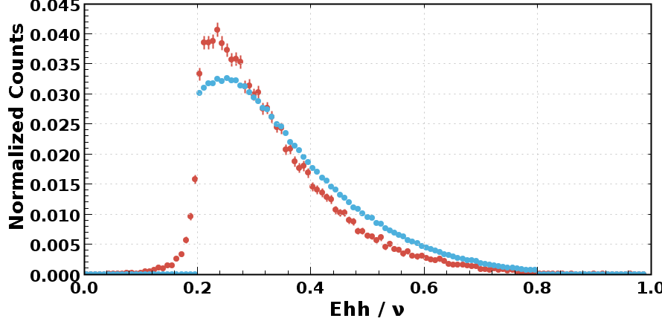
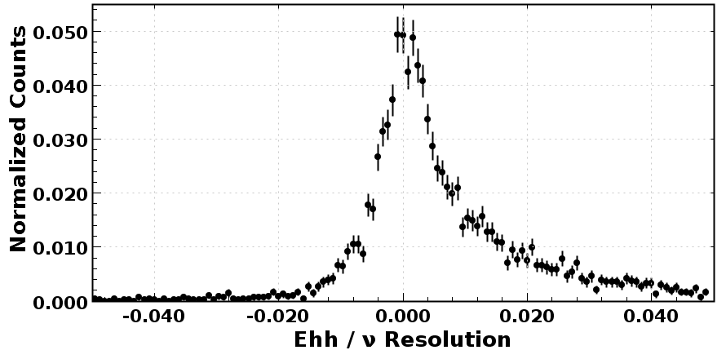
Monte Carlo Analysis
SIDIS dihadron variables generally used in the cross section:
  M_{hh}² (pair mass of the hadron pair)
  z = E_{hh}/𝜈 (fraction of the virtual photon energy carried by the hadron system)
  P_{h⟂} (projection of the hadron pair momentum perpendicular to the virtual photon direction)
MC
Reconstructed

Slide 10
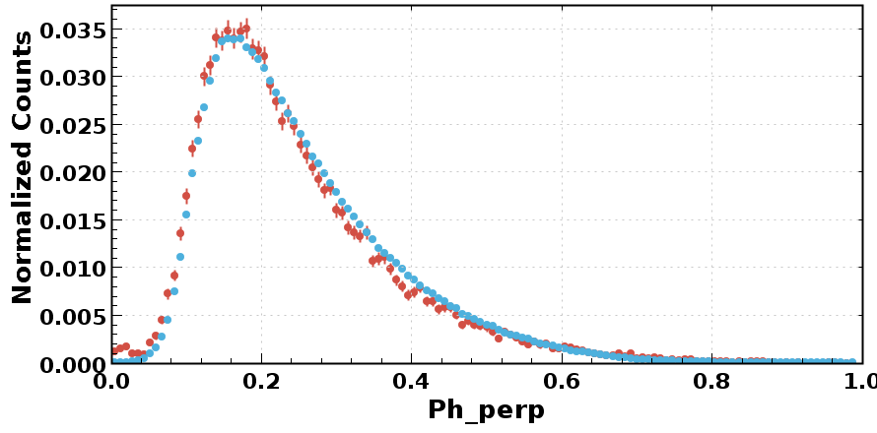
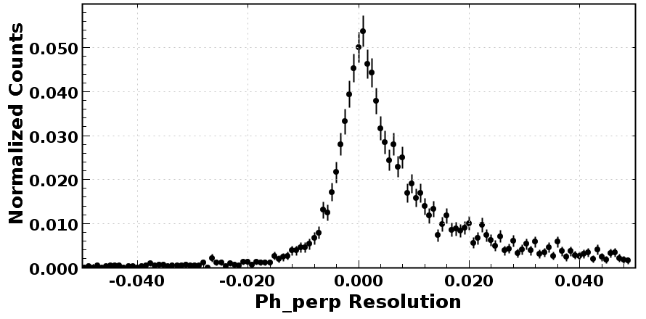
Monte Carlo Analysis
SIDIS dihadron variables generally used in the cross section:
  M_{hh}² (pair mass of the hadron pair)
  z = E_{hh}/𝜈 (fraction of the virtual photon energy carried by the hadron system)
  P_{h⟂} (projection of the hadron pair momentum perpendicular to the virtual photon direction)
MC
Reconstructed
(GeV)
(GeV)

Slide 11
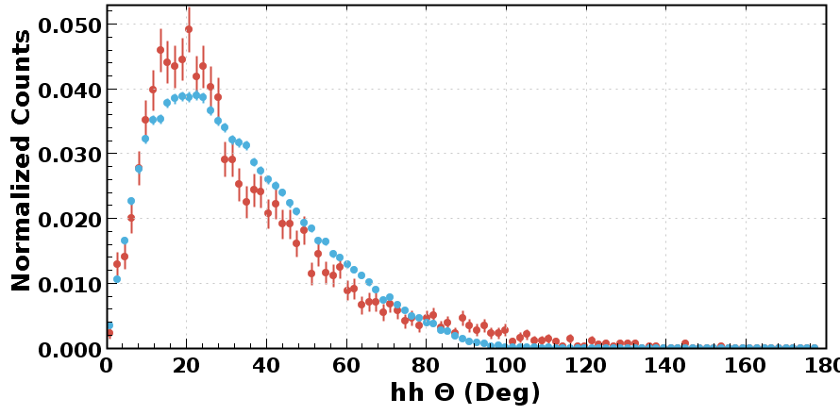
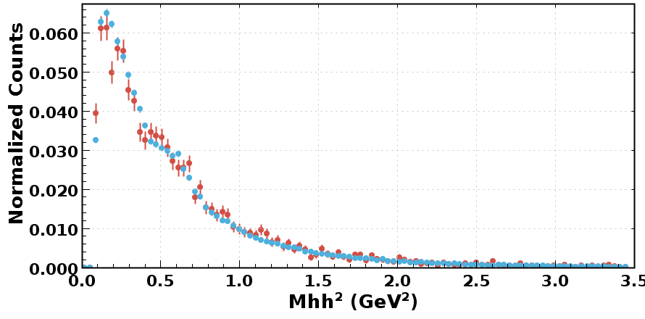
Incipient Data Analysis
Chose run 3222 (25 nA, 10.6 GeV, torus +1.00, solenoid -1.00) cooked with coatjava 5b.3.3
Used EventBuilder REC::Particle to find e’ pi+ pi- X events
Only cut applied is Q² > 1.0 GeV².
MC
Experimental

Slide 12
To Do
Develop PID cuts, implement fiducial cuts
Compare with other generators
Model the e‘𝜋⁺𝜋⁻X / e‘X ratio (need e‘X generator)
Reconstruction chain for unpolarized-tangentially polarized events (farm job running as we speak)
Maybe implement polarized beam and longitudinally polarized target cross sections in TMDGen
Questions?

