Slide 1

CLAS Dihadron Measurements
Extracting the Unpolarized Fragmentation Function
Timothy B. Hayward

Slide 2
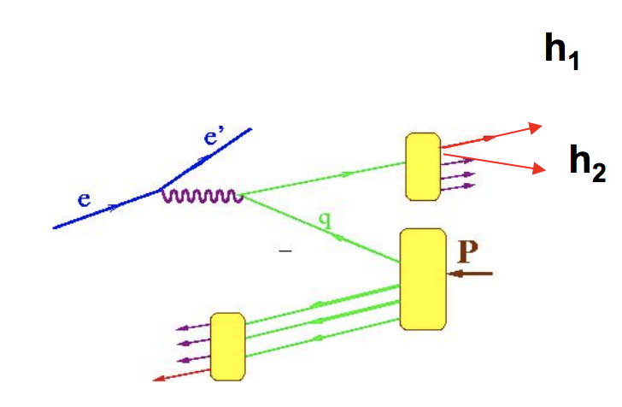
Dihadron Fragmentation Functions
Similar to single hadron formalism
Additional degree of freedom (relative momentum) allows for numerous advantages
  Separate contributions to asymmetries
  Existence of fragmentation functions with no single hadron correlation

Slide 3
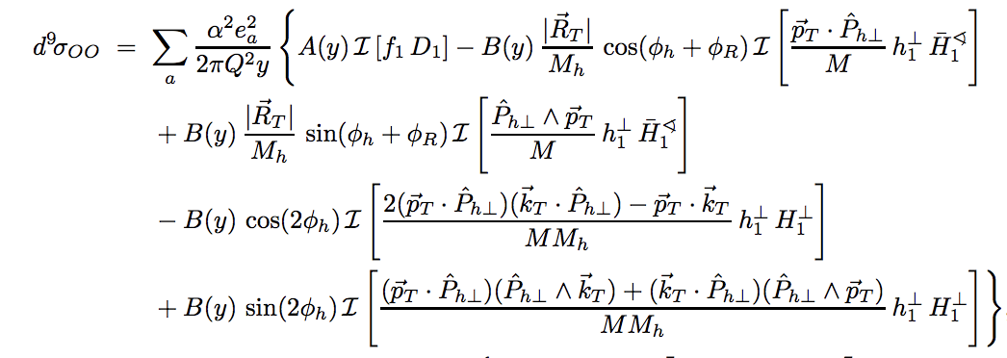
Unpolarized-Unpolarized Cross Section
D₁, the unpolarized fragmentation function, is multiplied by the well known PDF f₁
Can be isolated from the ɸ-dependent terms
Limited data available (Belle e⁺e⁻), extractions from fitting the single pair distribution functions from MC)
Bachetta, Radici. hep-ph/0212300
Notes:
As to D1, in the absence of data for di-hadron multiplicities related to the unpolarized DiFF, it has been fitted to the output of PYTHIA [15] tuned for Belle kinematics

Slide 4
Motivation for Multiplicity Measurement
Range in Q² allows for many bins to better understand z and m_{𝜋𝜋} dependence
Fixing the normalization of D₁ allows it to be used in the extraction of other fragmentation functions
Study contribution from higher-waves
No model dependent or phenomenological concerns
  See E12-09-008B, S. Pisano and A. Courtoy

Slide 5
Multiplicities
Measure the dihadron multiplicities defined by

Slide 6
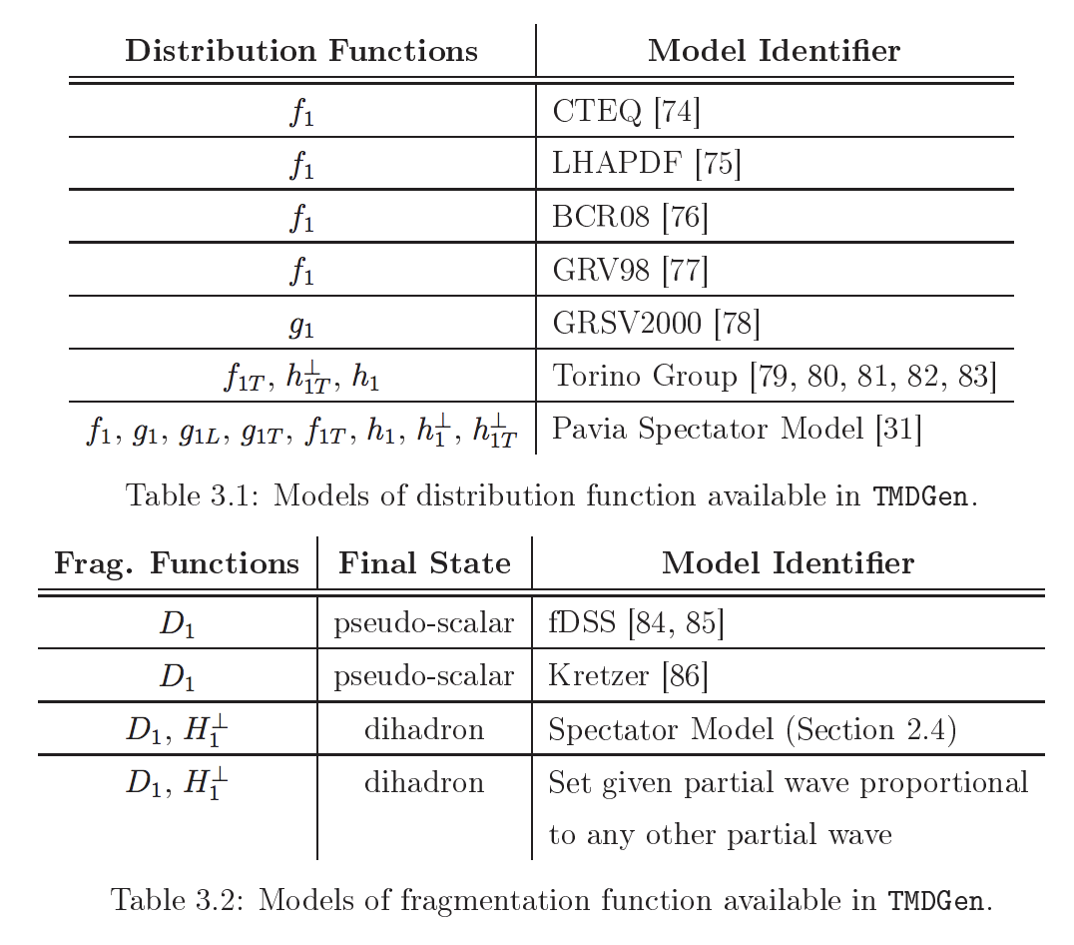
Event Generator
Stephen Gliske (HERMES) developed object-oriented generator “TMDGen”
Includes SIDIS dihadron models for angular dependence
No beam polarizations or longitudinally polarized target cross sections programmed for dihadrons
Gliske thesis (HERMES)

Slide 7
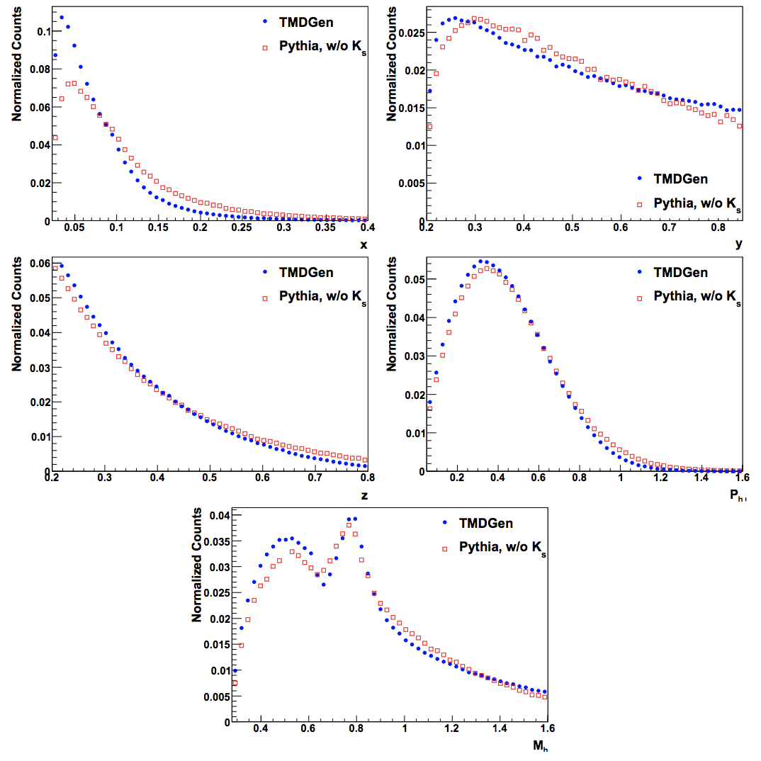
Event Generator
Gliske comparisons between Pythia and TMDGen for e’ 𝜋⁺𝜋⁻X
Gliske thesis (HERMES)
Notes:
x fraction of target momentum carried by struck quark
y fraction of beam energy transferred to virtual photon
z fraction of virtual photon energy carried by hadron system

Slide 8
Configurations and Channel Selection
CLAS software
gemc 4a.2.3
coatjava-5c.3.4
Configurations
Torus +1.0
Solenoid -1.0
Runs analyzed: 3222, 3973 and 3975, ~ 2300 files

Slide 9
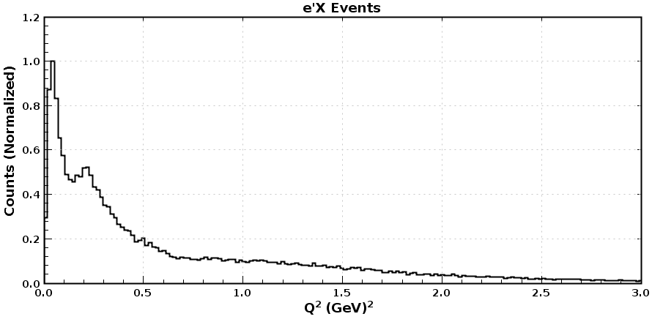
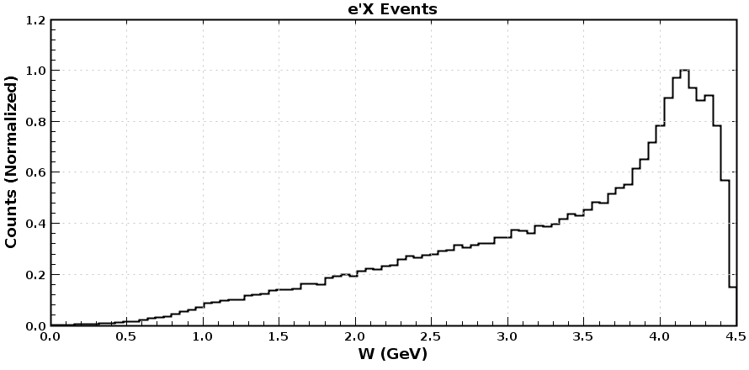
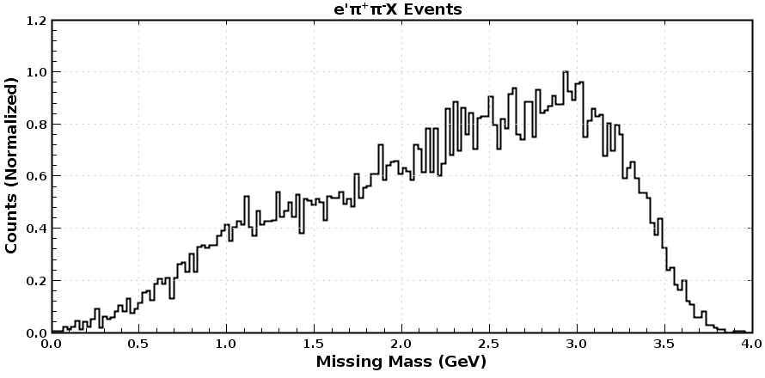
Channel Selection
DIS
Q² > 1.0 GeV²
W > 2.0 GeV
SIDIS
m_{X} > 1.05 GeV
Particles
EventBuilder
Highest energy e’, 𝜋⁺, 𝜋⁻

Slide 10
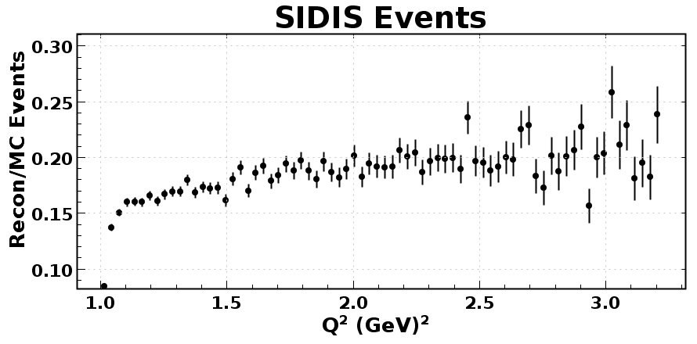
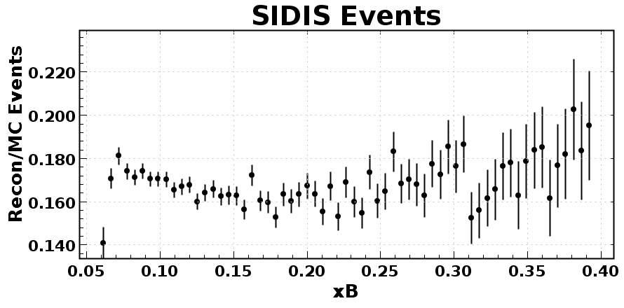
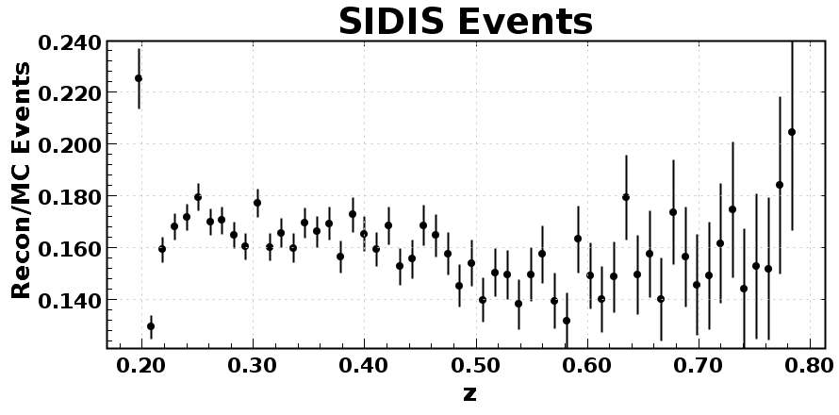
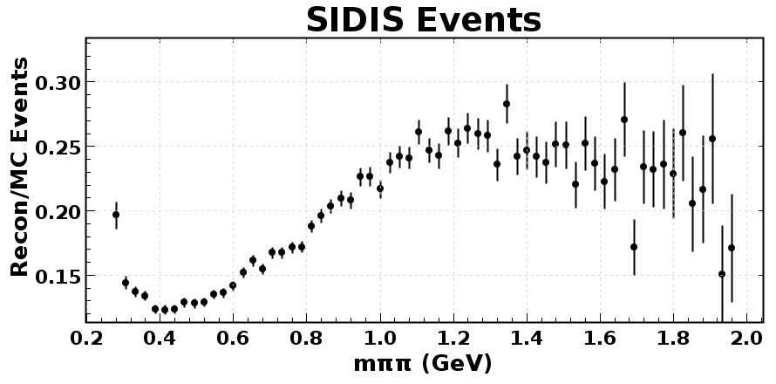
CLAS Acceptance Analysis
Reconstructed rate for Q², x_{B}, z and m_{𝜋𝜋} with +1.0/-1.0 configuration

Slide 11
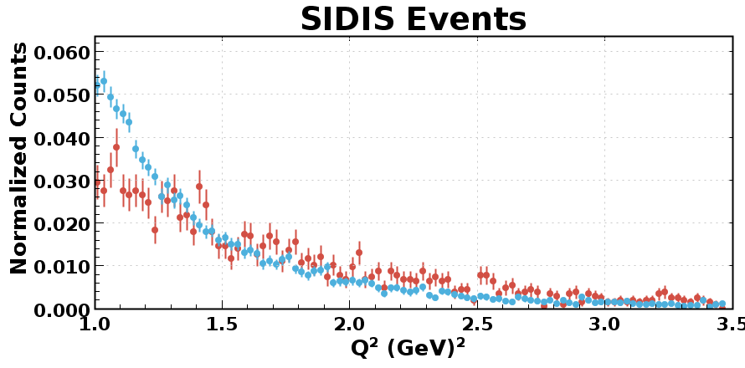
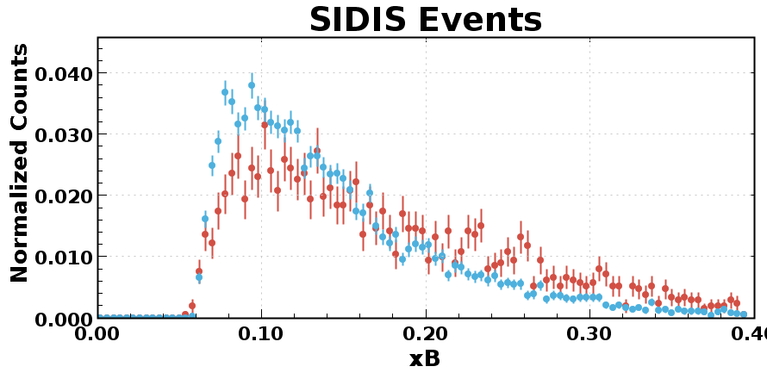
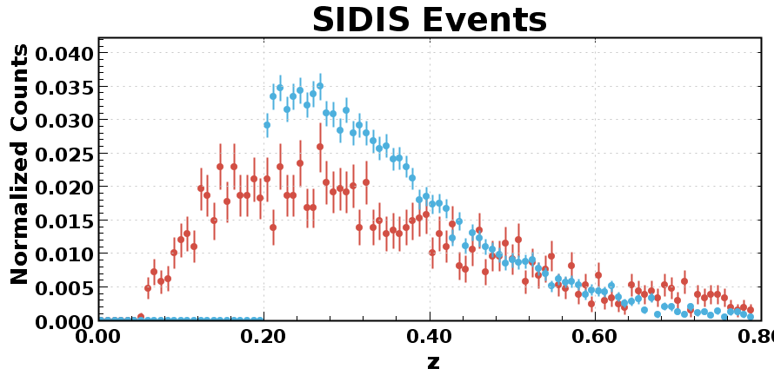
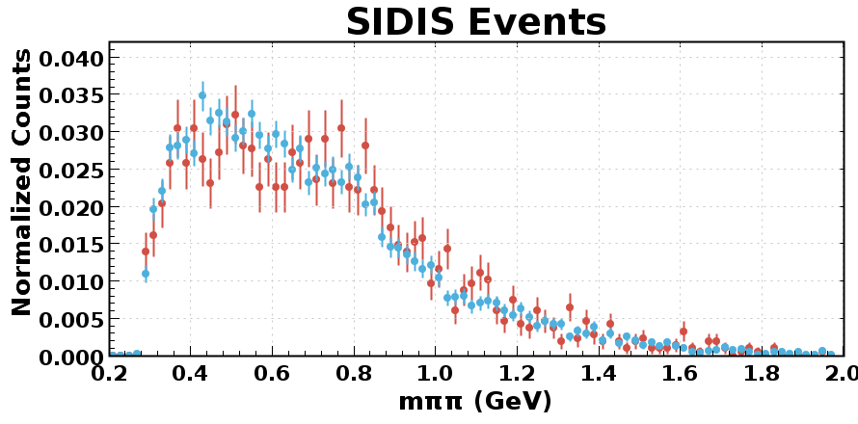
Monte Carlo Comparison with SIDIS Data
3 files chosen at random from run 3222
Event Generator
Experimental

Slide 12
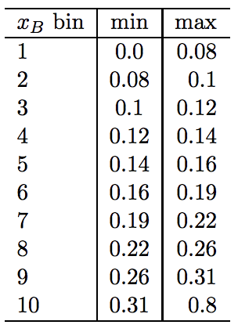
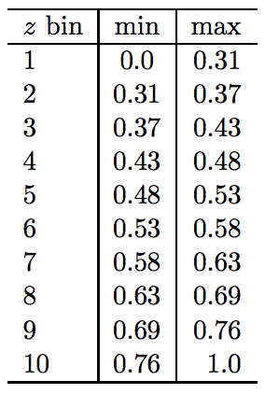
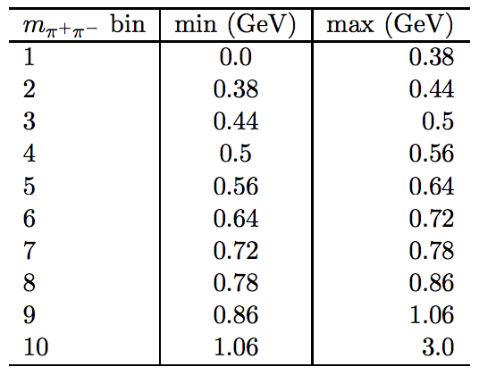
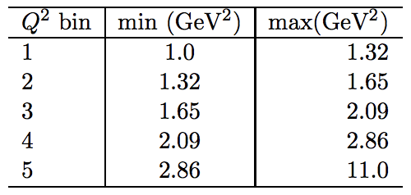
Bin Limits
Q² limits chosen by evaluating the effects from the evolution of f₁
x_{B} and z bins chosen for statistics
m_{𝜋𝜋} chosen from two-pion spectra, avoiding bins centered in meson resonances
  Again, see E12-09-008B, S. Pisano and A. Courtoy

Slide 13
Selected Results (chosen at random)

Slide 14
To Do
Fiducial cuts in DC and PCAL (etc?)
Improve hadron PID with beta/p check (cut out protons)
Error bars should really be larger (currently just statistics)
  Enhanced PID cuts will reduce statistics
  Include systematic resolution effects in error bars
  Adjust for acceptance (need acceptance for DIS events)
Other?

Slide 15
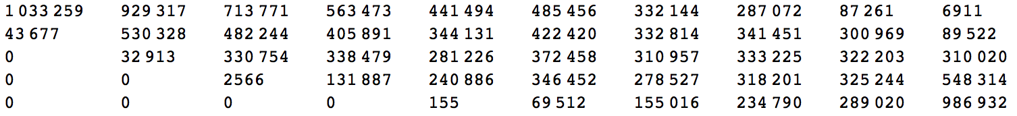
Further Results
DIS Counts
x_{b} bins
Q² bins

Slide 16
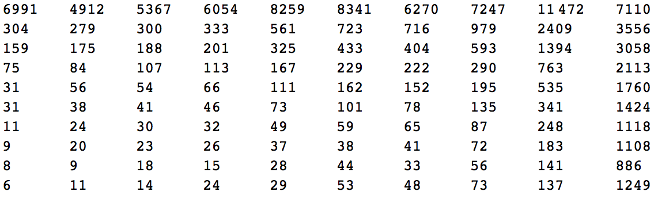
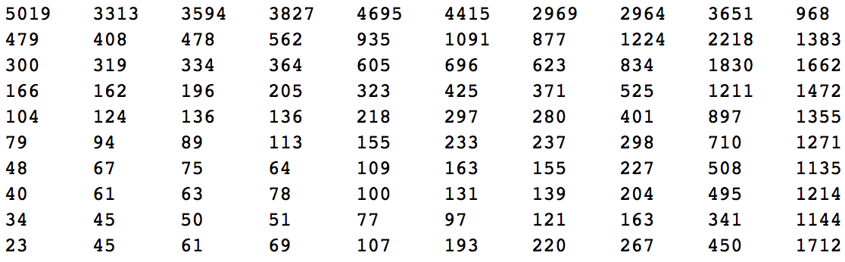
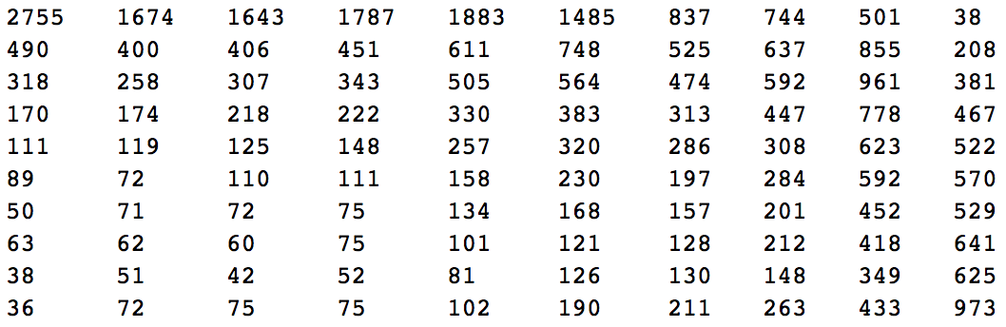
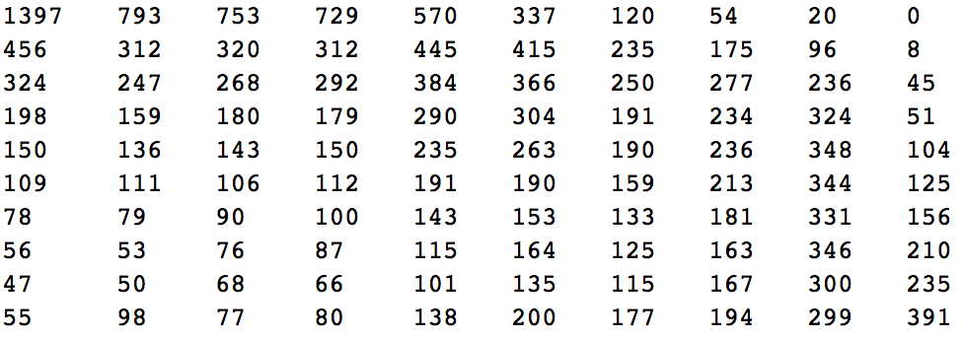
Further Results
SIDIS Counts, 1.00 < Q² < 1.32
0.00 < x_{B} < 0.08
m_{𝜋𝜋} bins
0.10 < x_{B} < 0.12
m_{𝜋𝜋} bins
z bins
z bins
0.14 < x_{B} < 0.16
m_{𝜋𝜋} bins
0.22 < x_{B} < 0.26
m_{𝜋𝜋} bins
z bins
z bins

Slide 17
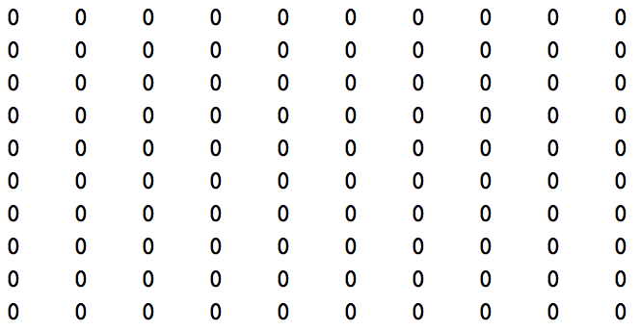
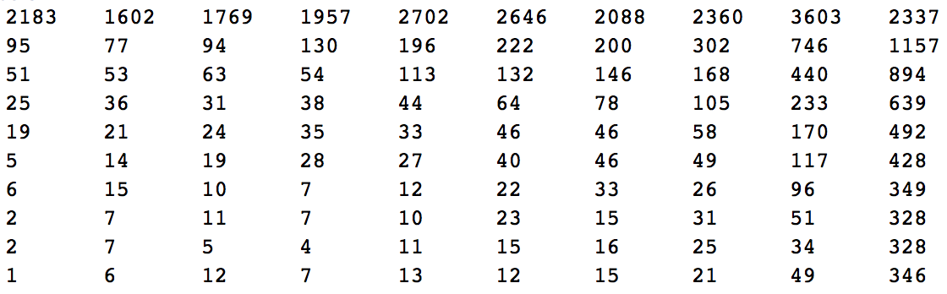
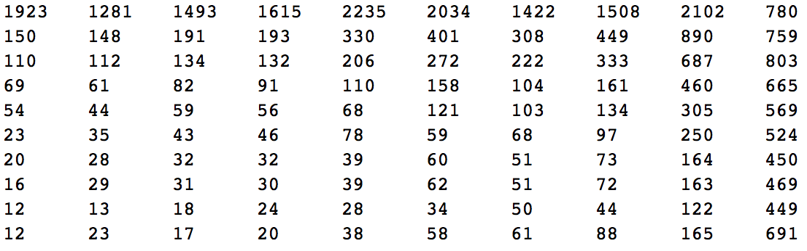
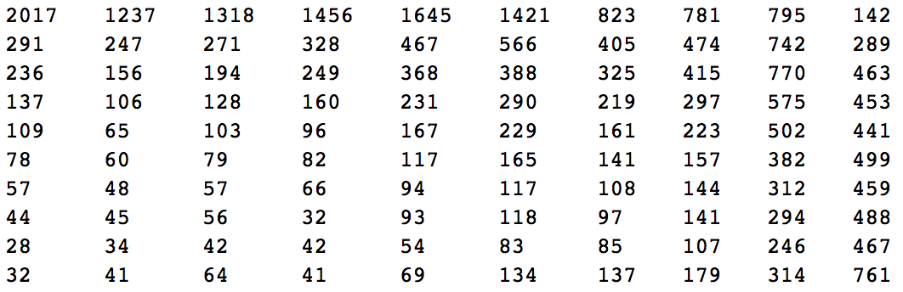
Further Results
SIDIS Counts, 1.65 < Q² < 2.09
0.00 < x_{B} < 0.08
m_{𝜋𝜋} bins
0.10 < x_{B} < 0.12
m_{𝜋𝜋} bins
z bins
z bins
0.14 < x_{B} < 0.16
m_{𝜋𝜋} bins
0.22 < x_{B} < 0.26
m_{𝜋𝜋} bins
z bins
z bins

Slide 18
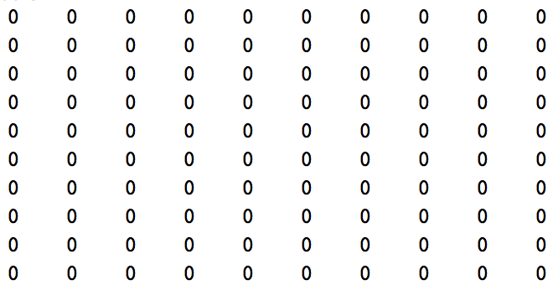
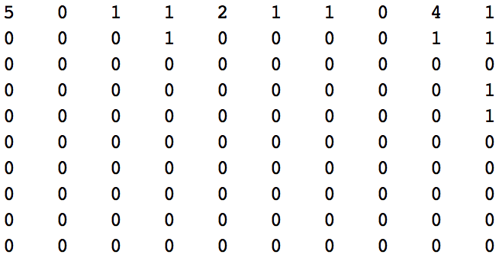
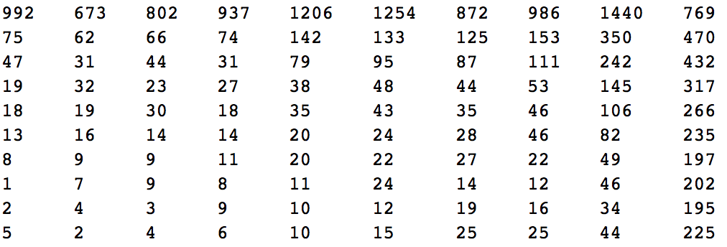
Further Results
SIDIS Counts, 2.86 < Q² < 11.0
0.00 < x_{B} < 0.08
m_{𝜋𝜋} bins
0.10 < x_{B} < 0.12
m_{𝜋𝜋} bins
z bins
z bins
0.14 < x_{B} < 0.16
m_{𝜋𝜋} bins
0.22 < x_{B} < 0.26
m_{𝜋𝜋} bins
z bins
z bins

