Slide 1

BAP Team D, Group ODROID
Tim Hosman, 4275691
Job van Staveren, 4317386
29-6-2016

Slide 2
Contents
Introduction
Structure
Casting Data
Charger Control
Supportive Work
Future Work
Conclusion

Slide 3
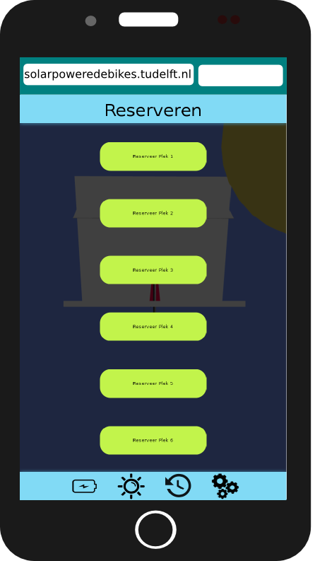
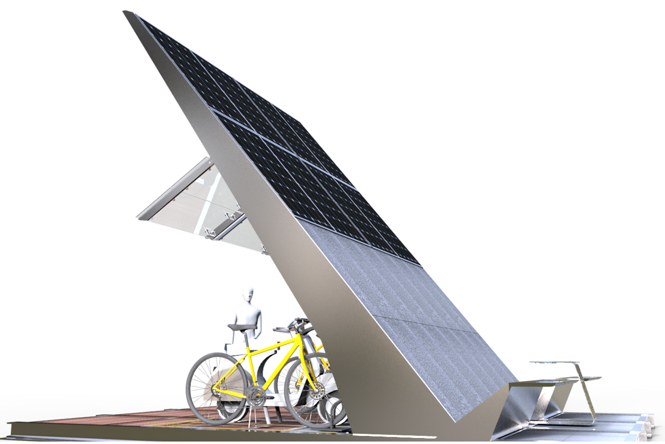
Sustainable Solar Charging Station
Introduction
Structure
Casting Data
Charger Control
Supportive Work
Future Work
Conclusion

Slide 4
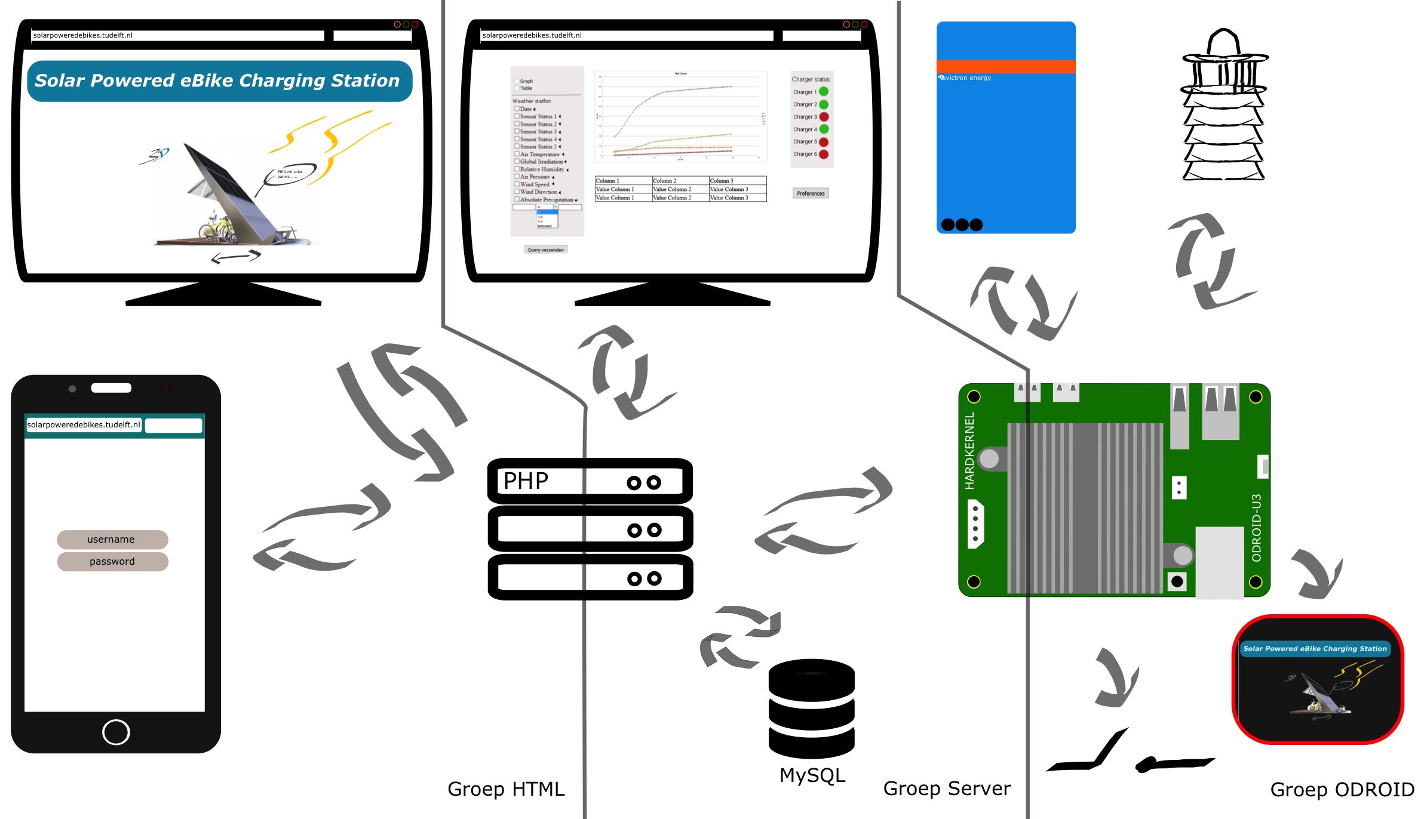
Structure
Introduction
Structure
Casting Data
Charger Control
Supportive Work
Future Work
Conclusion
Notes:
Odroid: Verzenden meetgegevens
Ophalen status opladers
Updaten status
Geen geheugenlekken

Slide 5
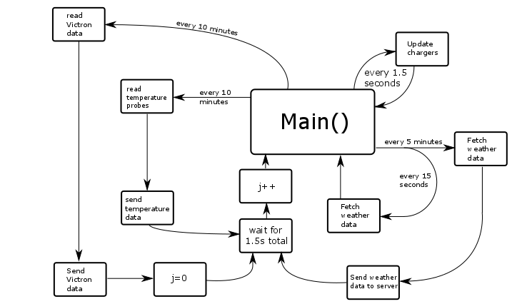
Structure
Introduction
Structure
Casting Data
Charger Control
Supportive Work
Future Work
Conclusion

Slide 6
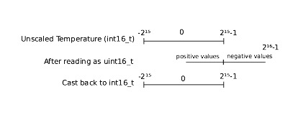
Casting Data
Introduction
Structure
Casting Data
Charger Control
Supportive Work
Future Work
Conclusion
Some registers contain signed values
Modbus function stores the result as uint16_t
Use casting to obtain the true value

Slide 7
Charger Control
Introduction
Structure
Casting Data
Charger Control
Supportive Work
Future Work
Conclusion
Only switched on when a cable is connected
Implemented as FSM
Different behavior during internet failure

Slide 8
Supportive Work
Introduction
Structure
Casting Data
Charger Control
Supportive Work
Future Work
Conclusion
Remote desktop
Booting scripts
Installation manual

Slide 9
Future Work
Introduction
Structure
Casting Data
Charger Control
Supportive Work
Future Work
Conclusion
Already done
Dynamic USB allocation
Local display
Motion-controlled LEDs
Cycle timing
Future work
E-bike battery voltage
Failures of the weather station/temperature probes

Slide 10
Conclusion
Introduction
Structure
Casting Data
Charger Control
Supportive Work
Future Work
Conclusion
Data acquisition
Control for the chargers
Local display
No memory leaks
Stable/robust code
Proof-of-concept motion-controlled LEDs

Slide 11
BAP Team D, Group ODROID
Tim Hosman, 4275691
Job van Staveren, 4317386
29-6-2016
Notes:
DEMO:
Motion sensor
Chargers laten zien (bij presentatie links op het scherm het dashboard, rechts remote desktop en klein skype venster)
Reboot van de ODROID
Lokale scherm laten zien
Fan aanzetten

