Slide 1

Control, Dashboard and End-User Interface for a Solar Powered eBike Charging Station
Nourdin Aït el Mehdi
Daniël Brouwer
Tim Hosman
Timothy de Moor
Job van Staveren
David Veselka

Slide 2
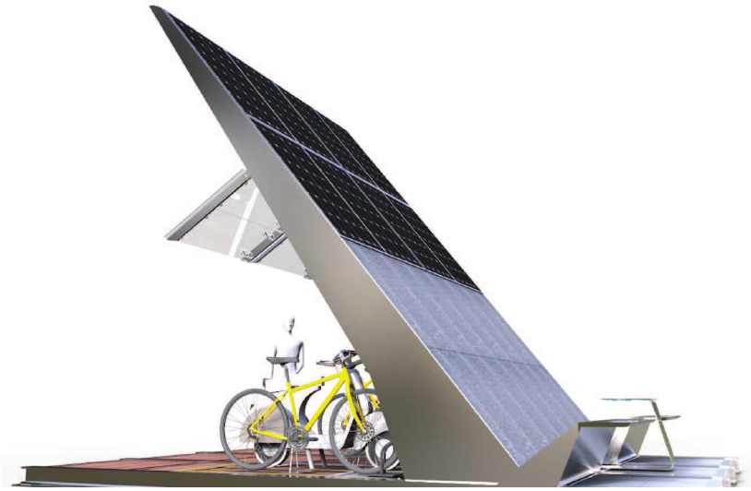
Concept
SUNRISE: Smart Unified Networking Rig for an Integrated Solar Ebike charger

Slide 3
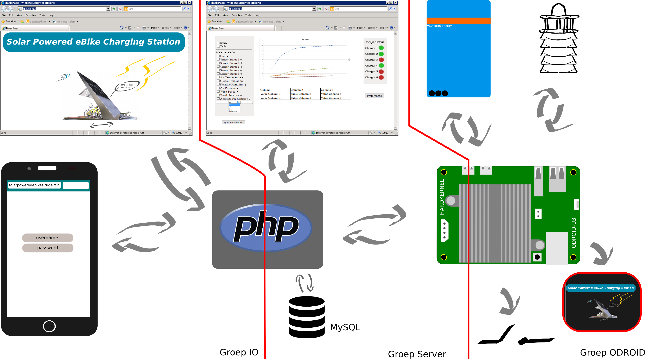
Concept

Slide 4
Demo

