Slide 1
Online Retail Sales Dashboard
Summary of Key Insights from Exploratory Data Analysis

Slide 2
Key Performance Indicators
Total Revenue: 10,666,685
Total Orders: 19,960
Total Customers: 4,338
Average Order Value: 534.40

Slide 3
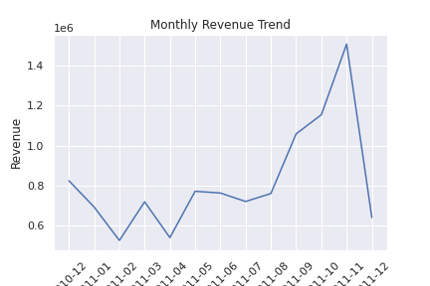
Monthly Revenue Trend

Slide 4
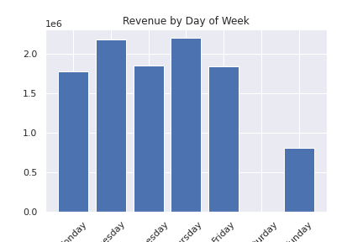
Revenue by Day of Week

Slide 5
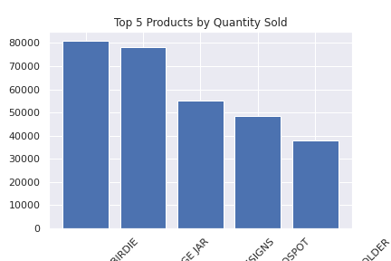
Top 5 Selling Products

