Slide 1
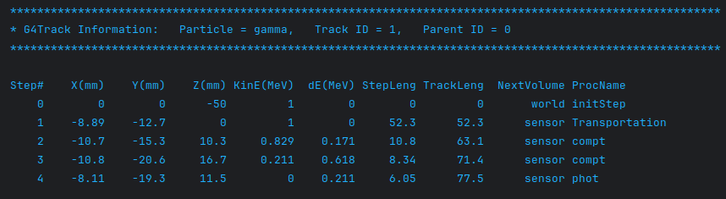
Geant steps
sim.g4_verbose, sim.g4_verbose_level_tracking = True, 1
Same track
Gate10 hits
hits = uproot.open(file_path)['Hits'].arrays(library='pd')

Slide 2
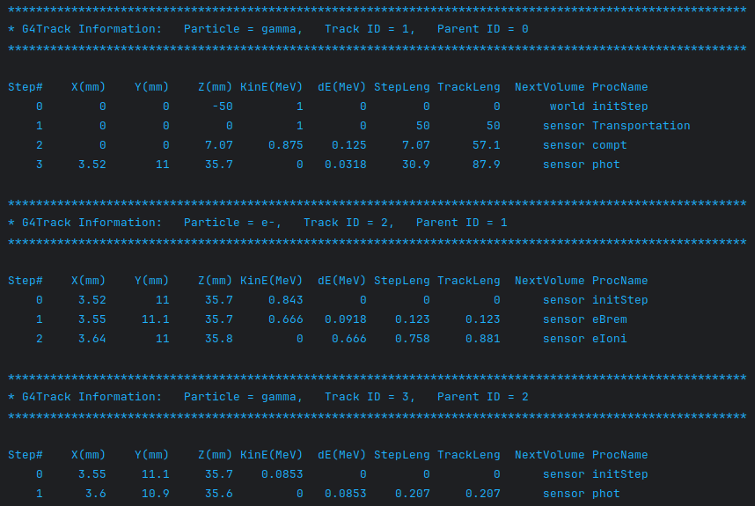
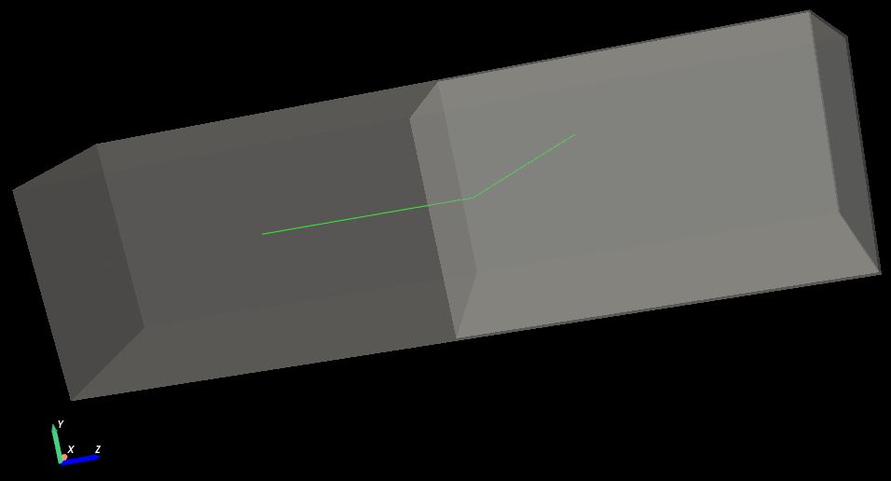
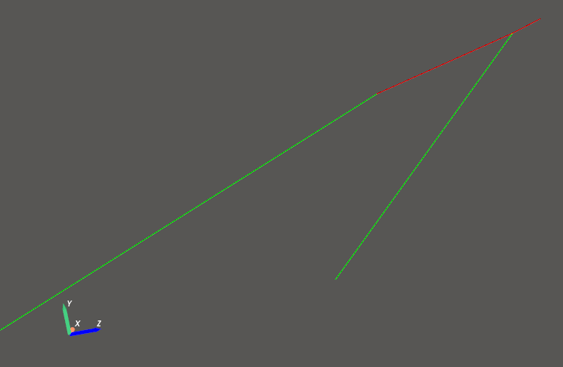
Compton interaction in sensor from primary gamma, recoil e- tracked + bremsstrahlung

