Slide 1
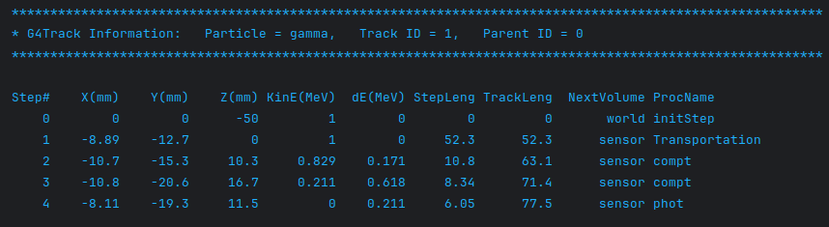
Geant steps
sim.g4_verbose, sim.g4_verbose_level_tracking = True, 1
Same track
Gate10 hits
sim.g4_verbose, sim.g4_verbose_level_tracking = True, 1

