Slide 1
CGP Evolution on an iCE40 FPGA
Thomas Bioren

Slide 2
Goals
Exceed the rate of evolution of traditional EHW evolution
Exceed the fitness of traditional EHW evolution
Create more complex circuits than are possible with EHW
Notes:
- Make success measures more precise
- Display my thesis statement on the slides

Slide 3
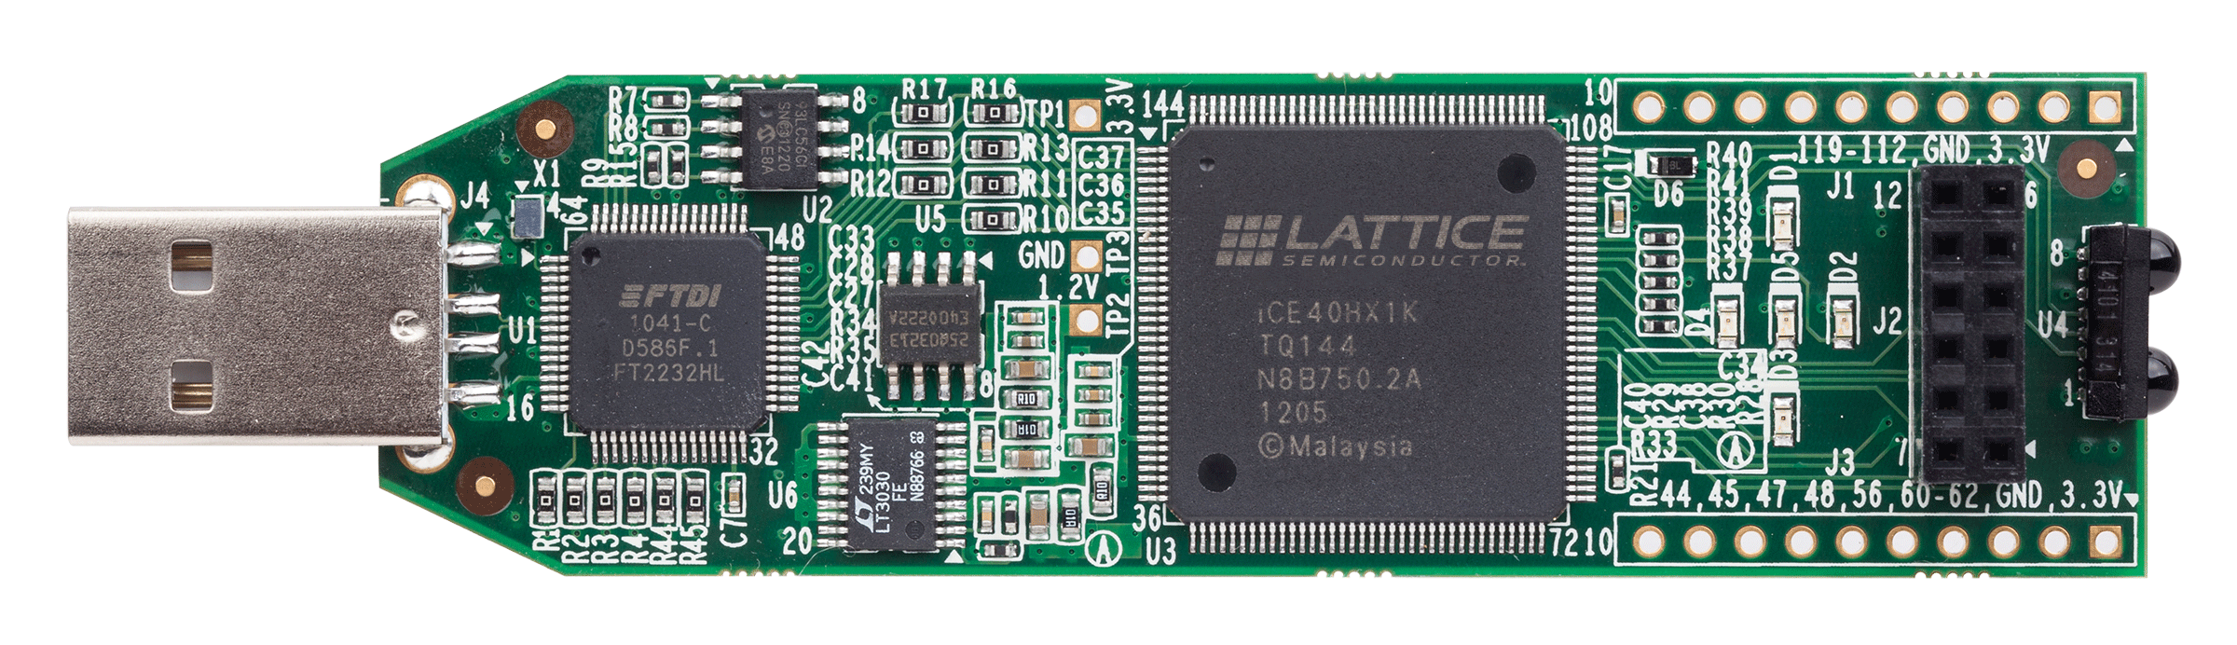
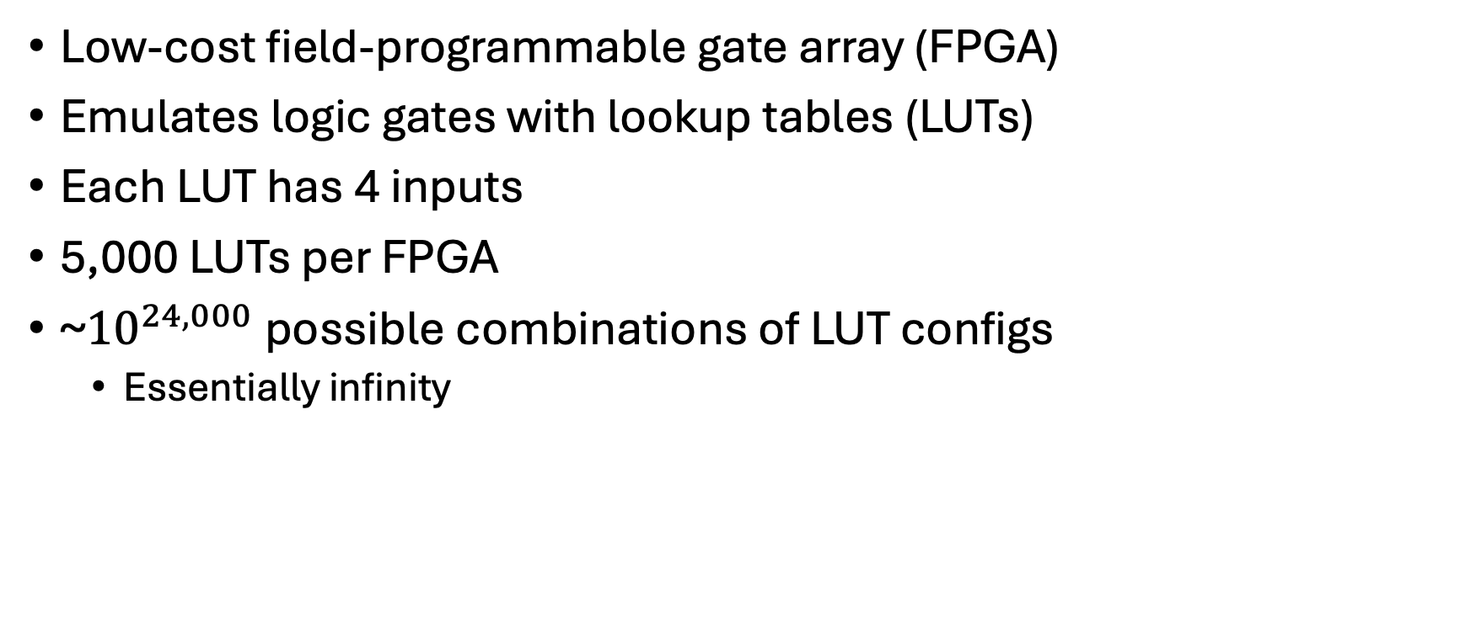
iCE40 FPGA
Low-cost field-programmable gate array (FPGA)
Emulates logic gates with lookup tables (LUTs)
Each LUT has 4 inputs
5,000 LUTs per FPGA
~${10}^{24,000}$ possible combinations of LUT configs
Essentially infinity

Slide 4
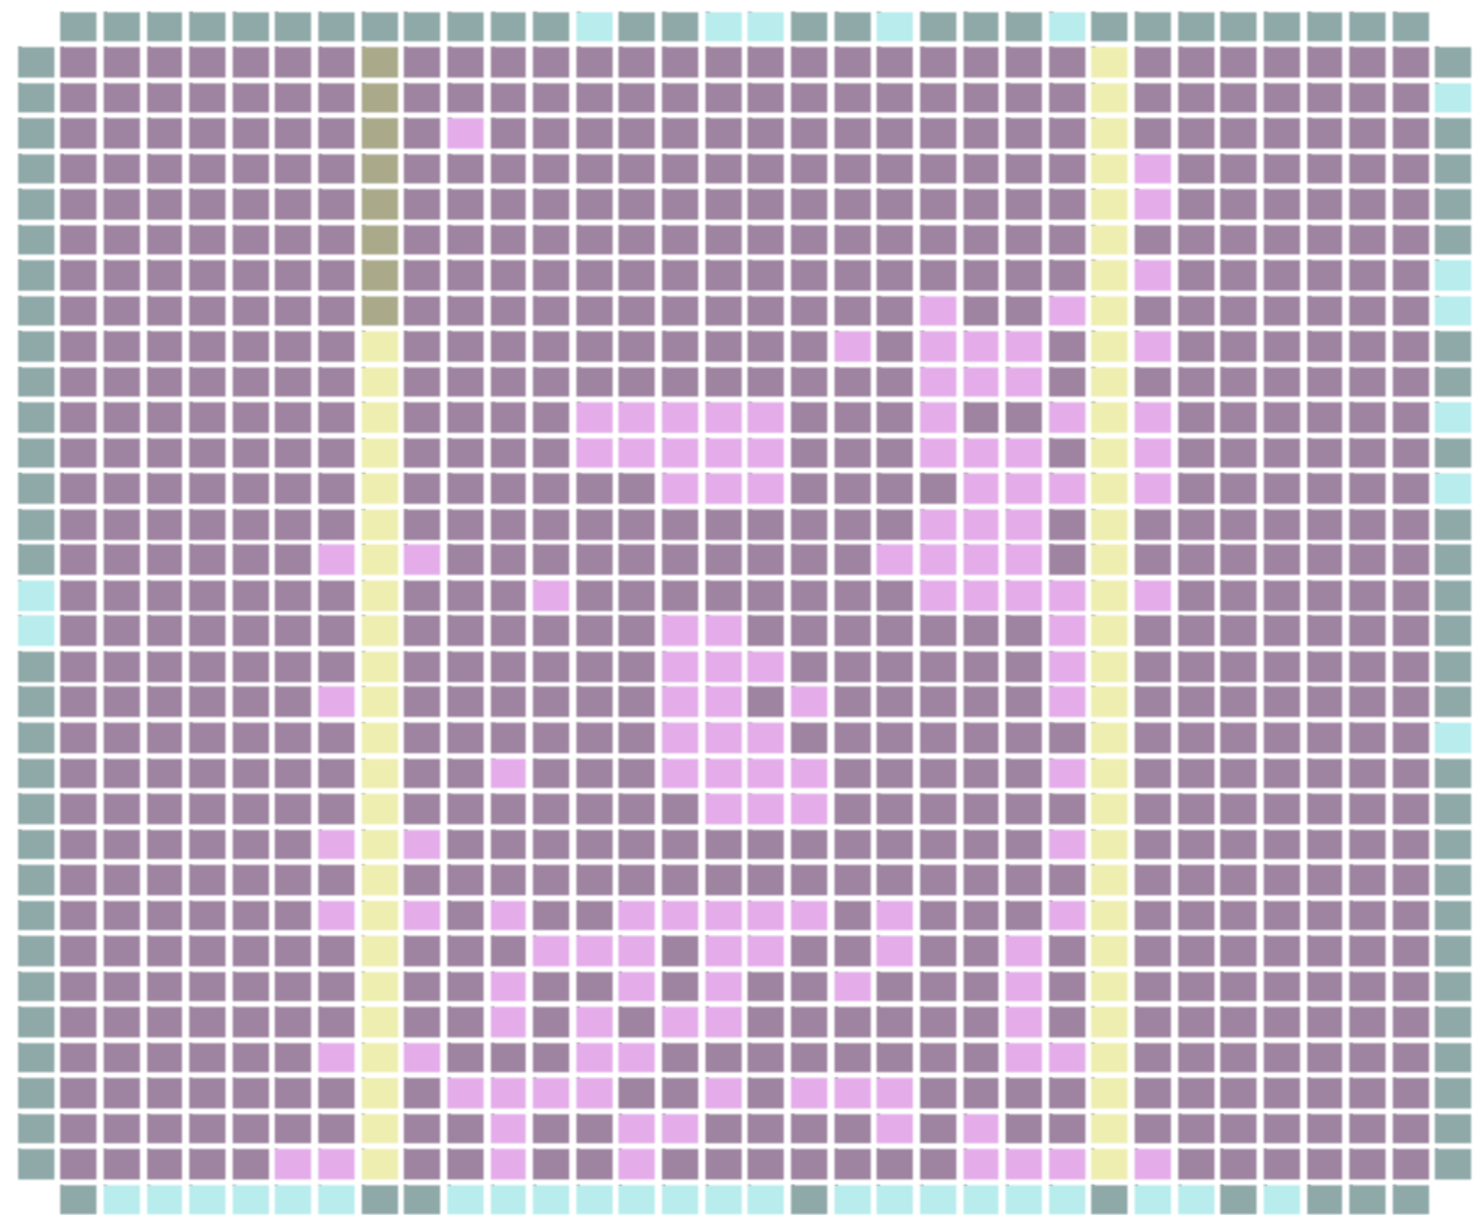
iCE40 Layout
Pink = logic tiles
Blue = I/O
Yellow = RAM

Slide 5
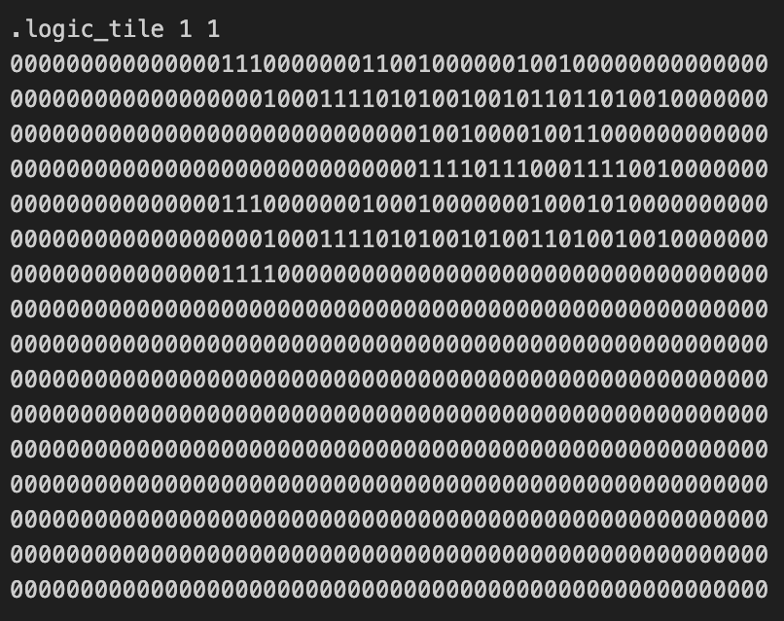
Evolvable Hardware
Pseudorandom bitstream mutations
Vast majority are harmful
Limit search space by limiting the bits we can flip

Slide 6
Thesis
Similar “pseudorandom mutation” on a CGP genotype
Genotype gets encoded to a bitstream
Genotype mutation restrictions limit bad mutations
Can easily scale search space
0000000000000000 | 00 | 00 | 00 | 00 | 00 | 00 | 00 | 00
LUT Behavior | Input 0 X offset | Input 0 Y offset | Input 1 X offset | Input 1 Y offset | Input 2 X offset | Input 2 Y offset | Input 3 X offset | Input 3 Y offset

Slide 7
Creating the Bitstream
Genotype
Verilog
Intermediate JSON (Yosys)
Bitstream (nextpnr)

Slide 8
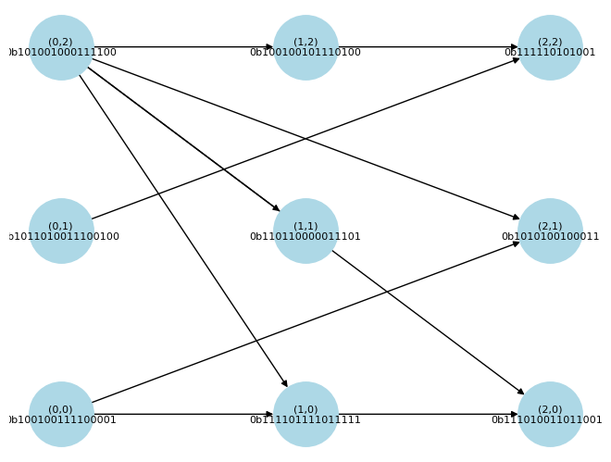
Graph Structure

Slide 9
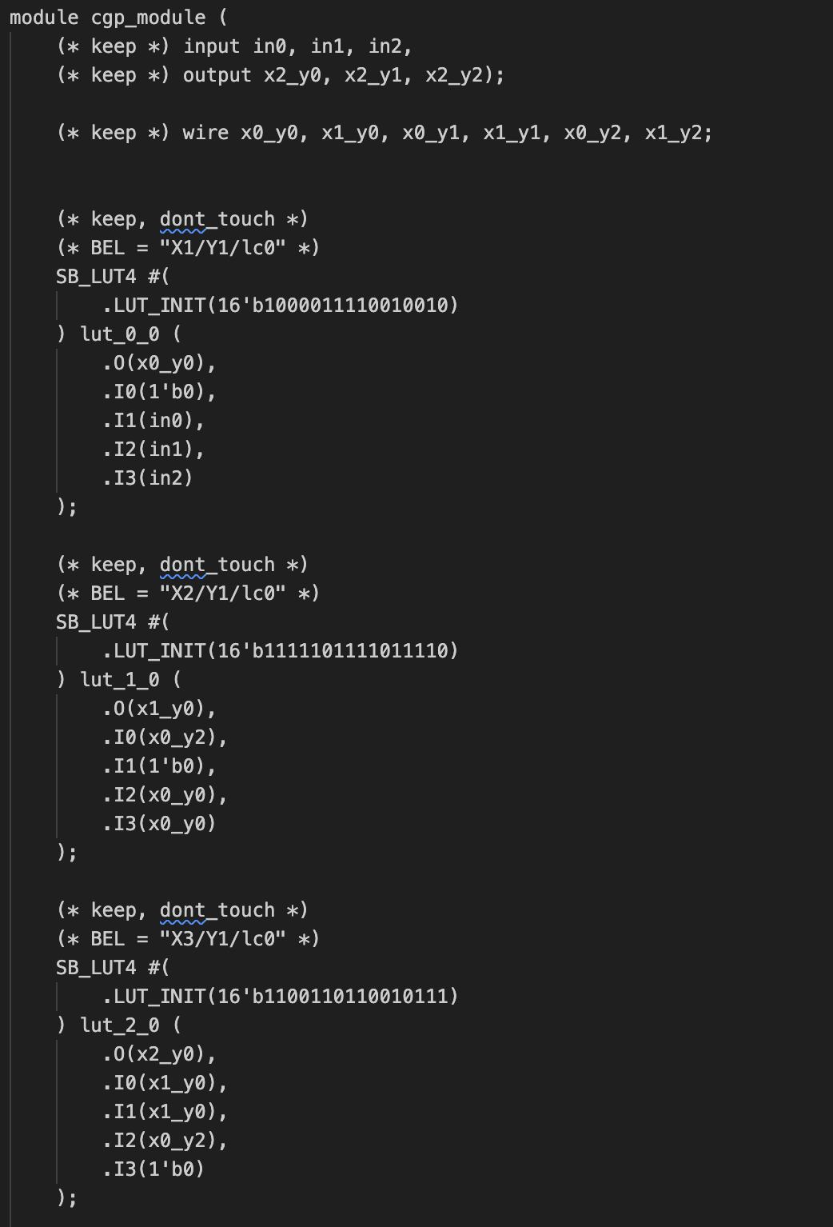
Verilog

Slide 10
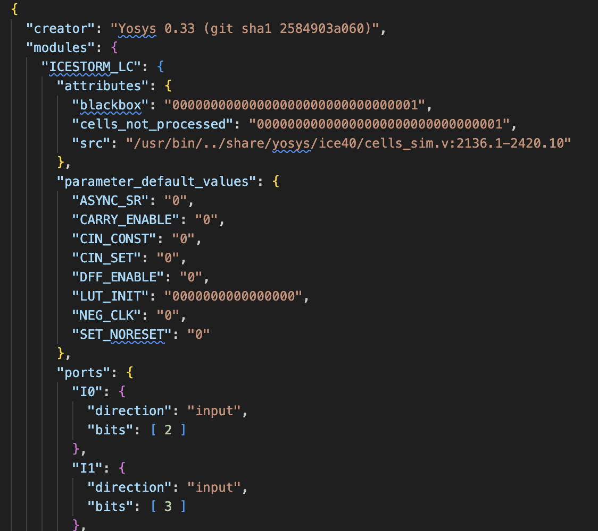
JSON Blob
Too big to show completely

Slide 11
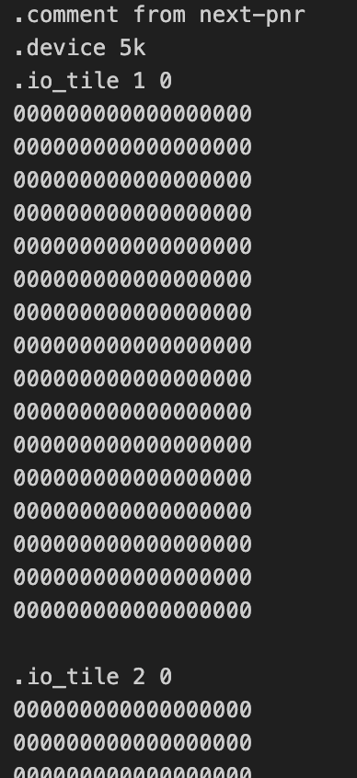
Bitstream
Too big to show completely

Slide 12
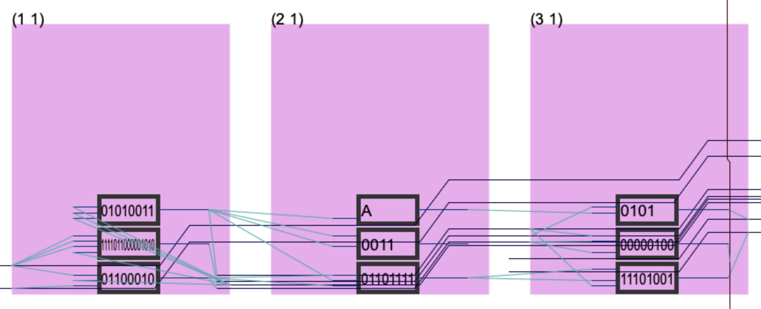
iCE40 Layout
Not the entire layout

Slide 13
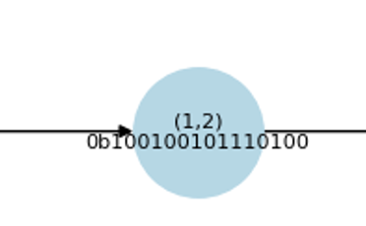
Example: Tracing (0,0)
Anything without an input is driven low.
External IO connections are not shown on graph.

Slide 14
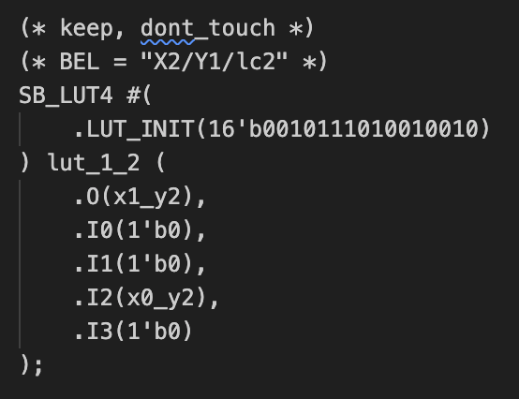
Conversion to Verilog
(* keep, dont_touch *) stops Yosys from optimizing.
(* BEL = “X1/Y1/lc0” *) is the address of the LUT I’m referencing.
I0, I1, I3 are driven low because they aren’t connected to any inputs in the genotype.
I2 is connected to (0,2).
Logic evaluates to false if accounting for driven low inputs.

Slide 15
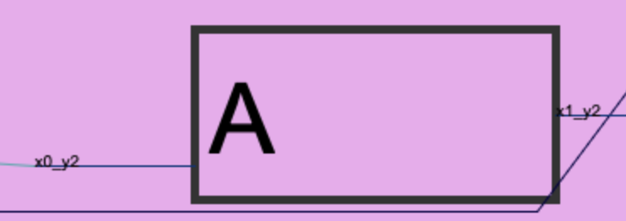
iCE40 Layout
This logic is also False (A is driven low)
nextpnr will create equivalent logic to assist in internal routing
Not important because the behavior of each LUT is maintained.

Slide 16
Next Steps
Run Simulated experiments
Modify nextpnr to not permute LUTs (hopefully)

