Slide 1
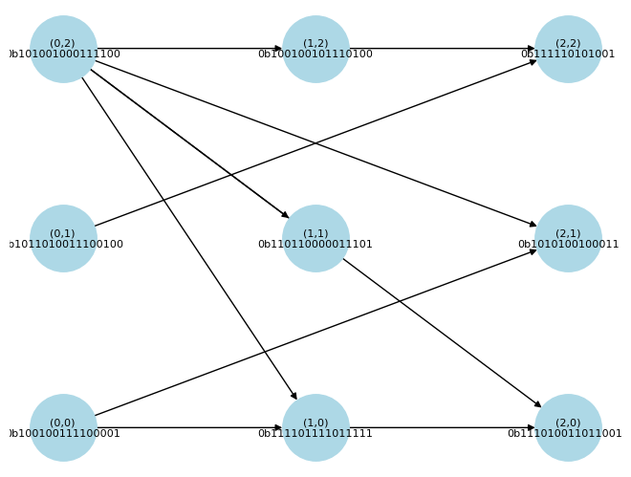
Graph Structure

Slide 2
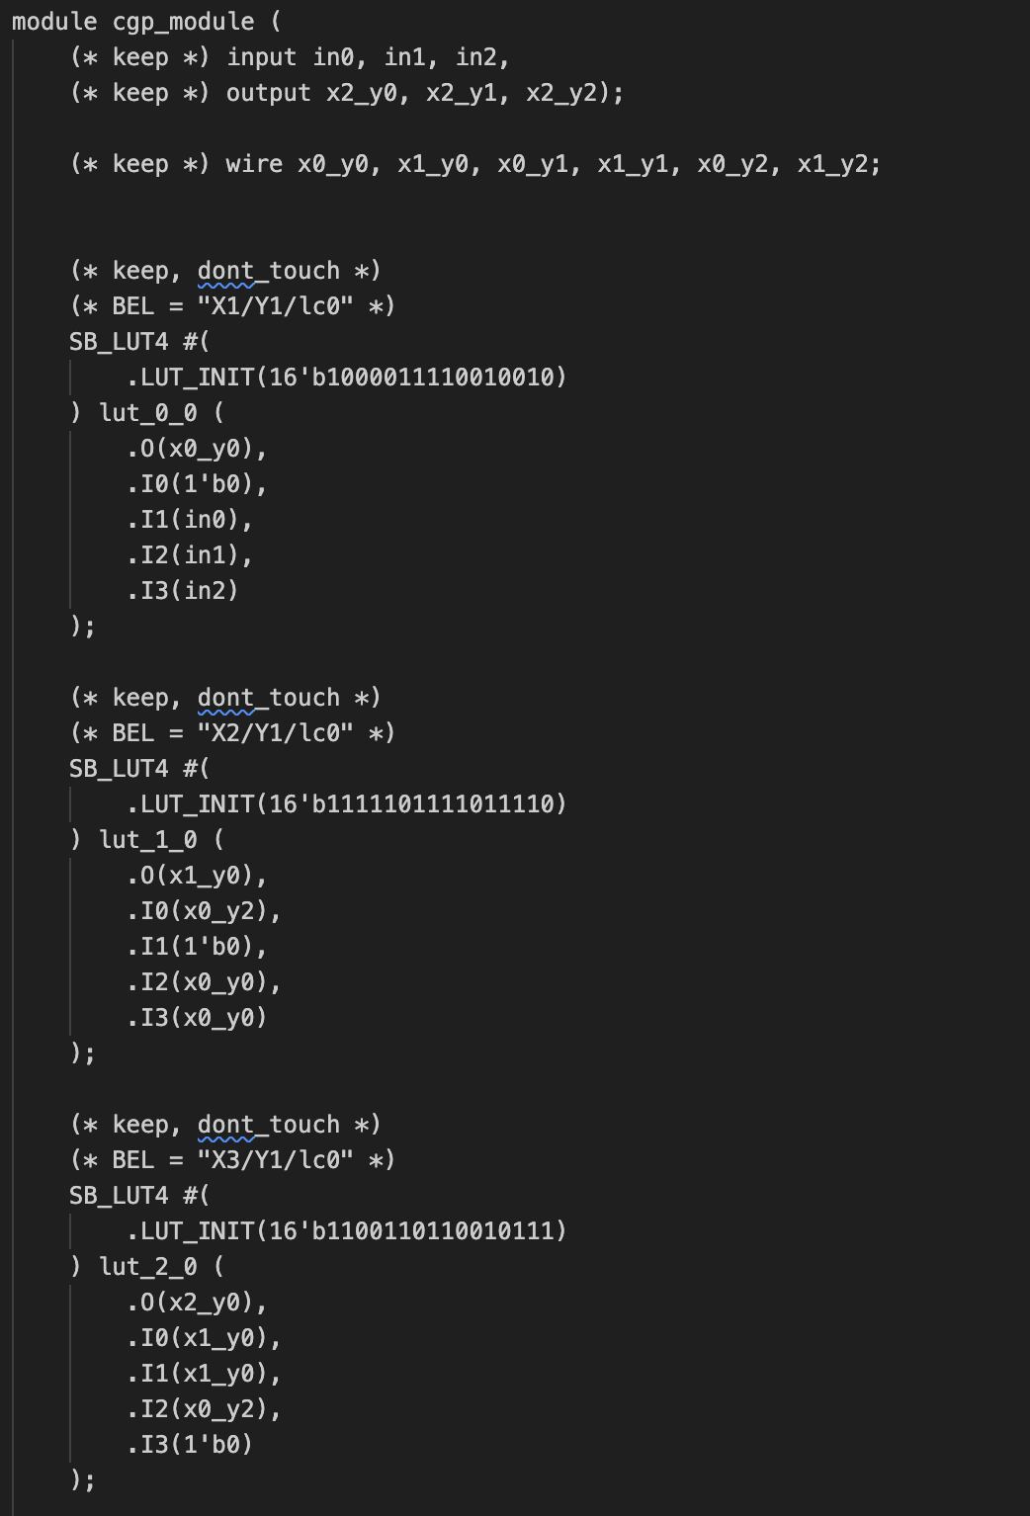
Verilog

Slide 3
JSON Blob
Too big to show

Slide 4
Bitstream
Too big to show

Slide 5
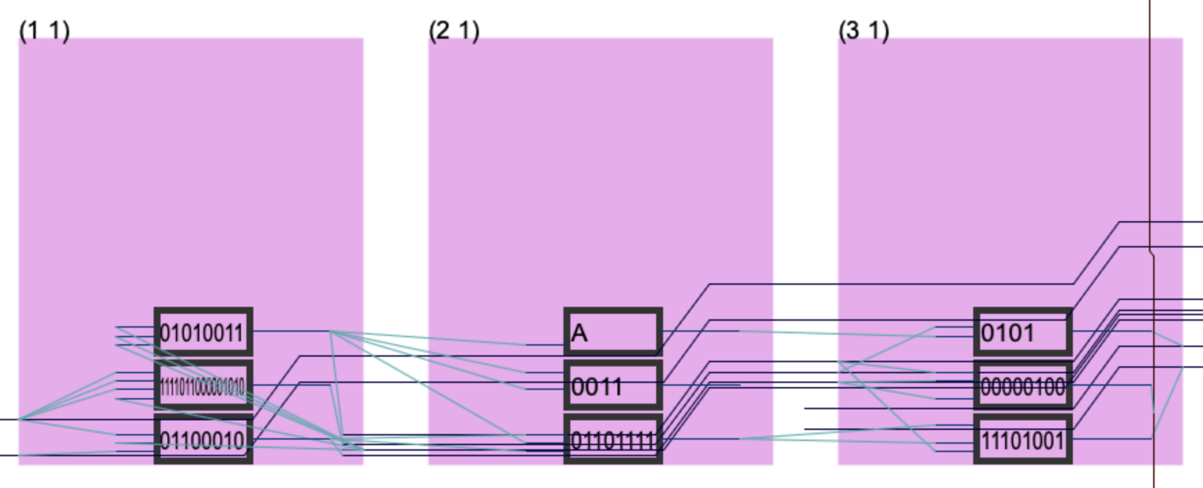
iCE40 Layout

Slide 6
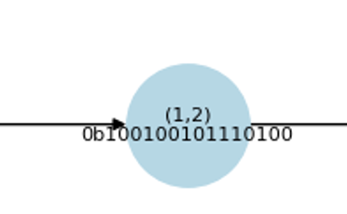
Example: Tracing (0,0)
Anything without an input is driven low.
External IO connections are not shown on graph.

Slide 7
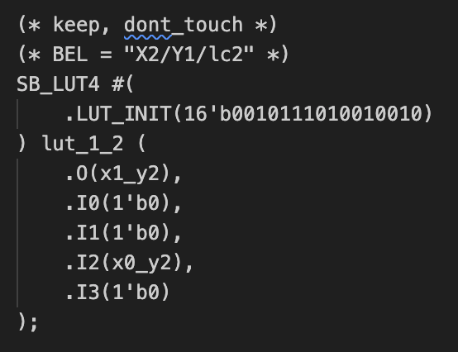
Conversion to Verilog
(* keep, dont_touch *) stops Yosys from optimizing.
(* BEL = “X1/Y1/lc0” *) is the address of the LUT I’m referencing.
I0, I1, I3 are driven low because they aren’t connected to any inputs in the genotype.
I2 is connected to (0,2).
Logic evaluates to false if accounting for driven low inputs.

Slide 8
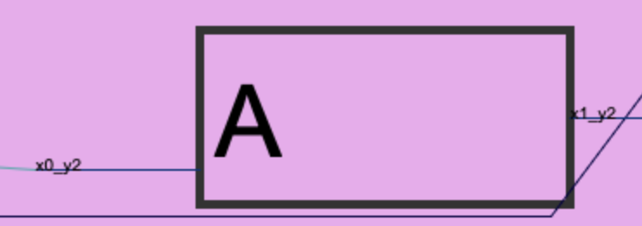
iCE40 Layout
This logic is also False (A is driven low)
nextpnr will create equivalent logic to assist in internal routing
Not important because the behavior of each LUT is maintained.

