Slide 1
Comparing Direct and Indirect Encoding for FPGA Bitstream Evolution
Thomas Bioren

Slide 2
Presentation Outline
Relevant Background
What is an FPGA?
iCE40 FPGA Specifics
What is Bitstream Evolution?
Why is this Important?
Methods
Direct Encoding
Indirect Encoding
Thesis Statement
Current Progress

Slide 3
Relevant Background

Slide 4
What is an FPGA?

Slide 5
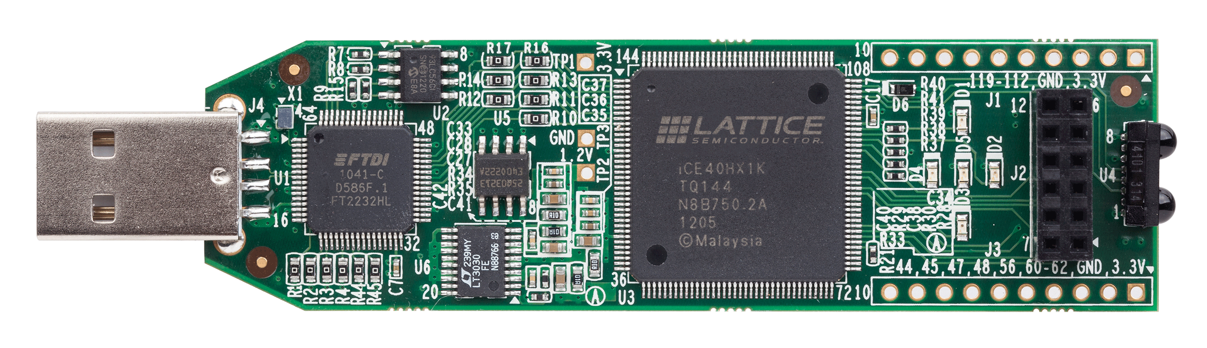
Field-Programmable Gate Array (FPGA)
An integrated circuit that can be repeatedly reprogrammed after manufacturing
Mimics logic gates with lookup tables (LUTs)
LUTs are connected together to form circuits
Use Cases:
Prototyping circuits before mass-production
Digital signal processing (DSP)
Telecommunications
Radar
UAVs
Notes:
https://www.ibm.com/think/topics/field-programmable-gate-arrays

Slide 6
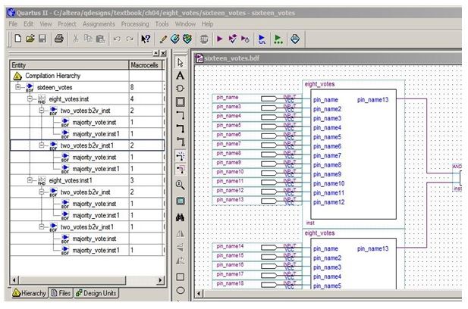
Programming an FPGA
Configured using a bitstream
Hardware design languages (HDLs) are compiled to bitstreams
Tools like Quartus can help design FPGAs

Slide 7
iCE40 FPGA

Slide 8
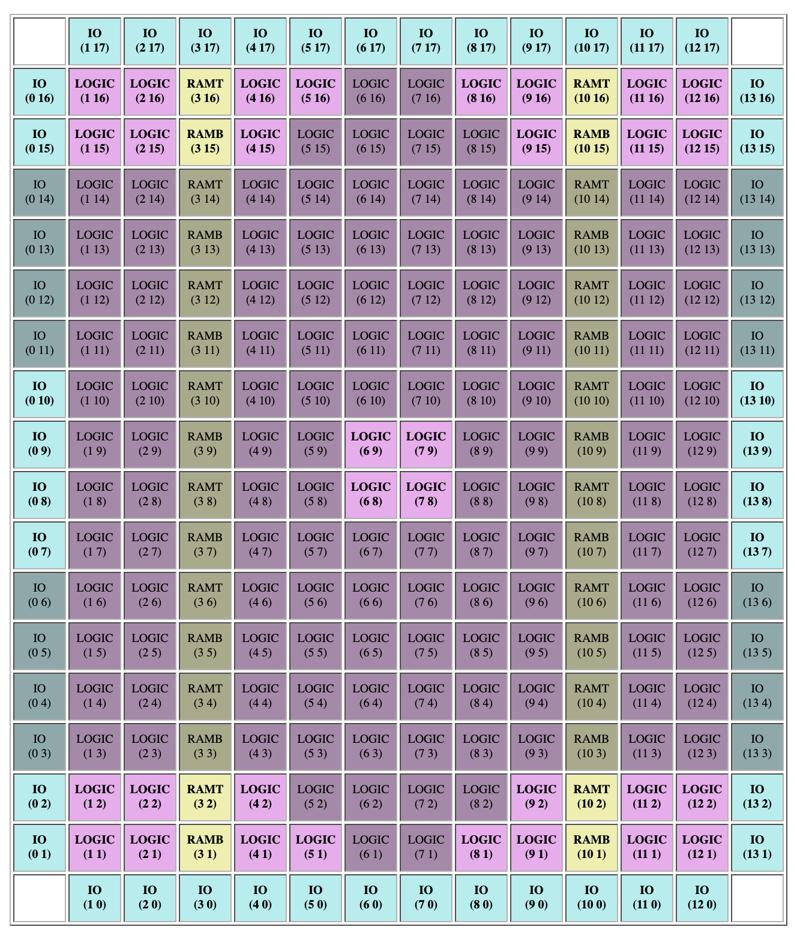
iCE40 FPGA
1,000 LUTs organized in logic tiles (pink)
LUTs are connected by nets to make a circuit

Slide 9
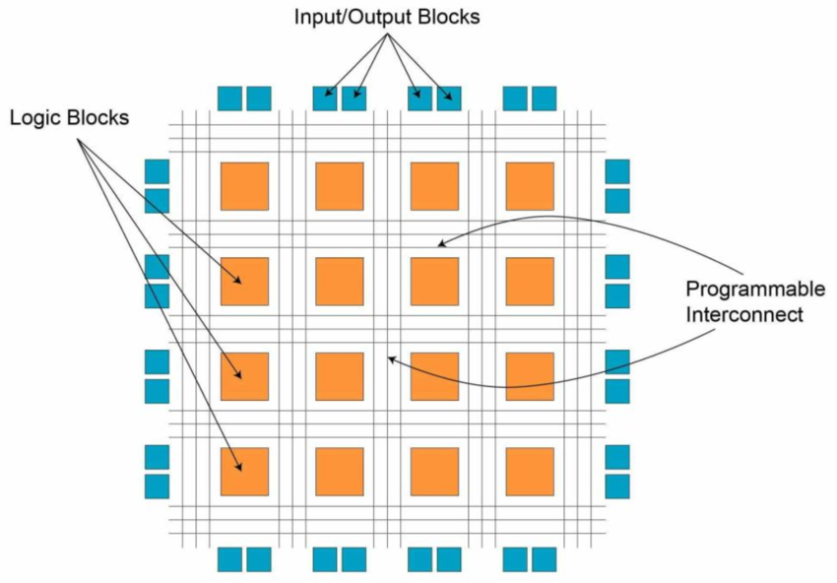
Connectivity
LUTs have 4 inputs and 1 output
You cannot directly wire LUT I/O together
Nets (simplified)
A grid of wires across the entire FPGA
You tell a LUTs to connect to a specific net
Accelerating convolutional neural networks: Exploring FPGA-based architectures and challenges - Scientific Figure on ResearchGate. Available from: https://www.researchgate.net/figure/The-structure-of-an-FPGA-11_fig5_381808932 [accessed 28 Oct 2025]

Slide 10
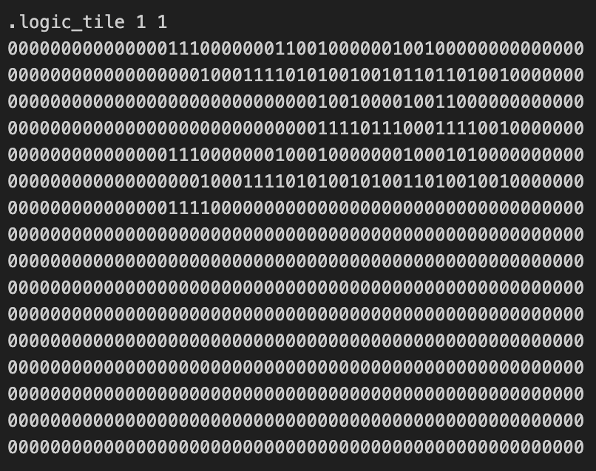
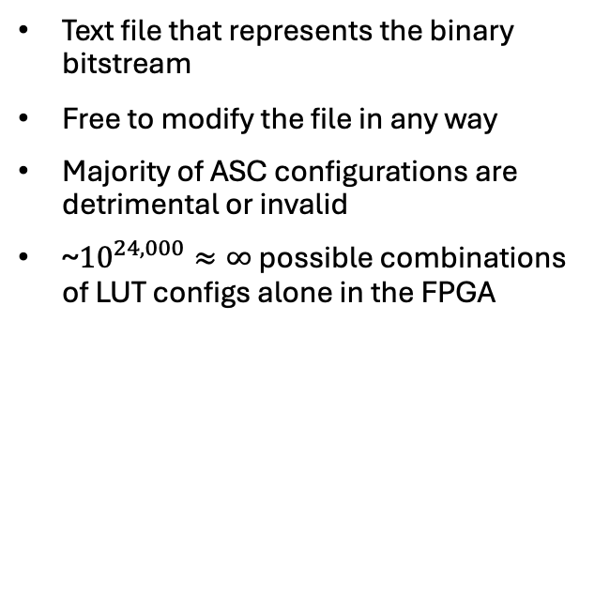
Bitstream ASC File
Text file that represents the binary bitstream
Free to modify the file in any way
Majority of ASC configurations are detrimental or invalid
~${10}^{24,000}≈∞$ possible combinations of LUT configs alone in the FPGA

Slide 11
Bitstream Evolution

Slide 12
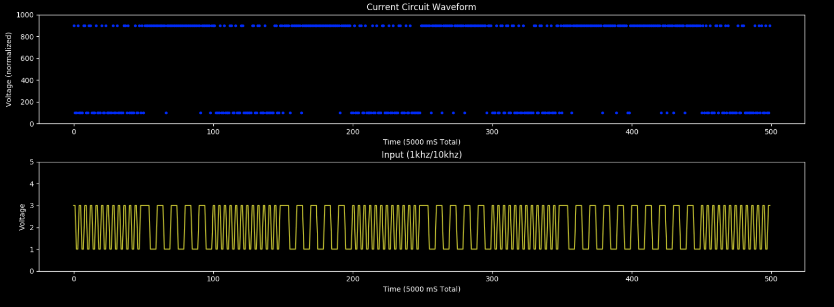
Bitstream Evolution
Using evolutionary algorithms to evolve a bitstream for a certain goal
Examples
Tone Discrimination (pictured)
Signal Generation
Variance Maximization

Slide 13
Why is this Important?

Slide 14
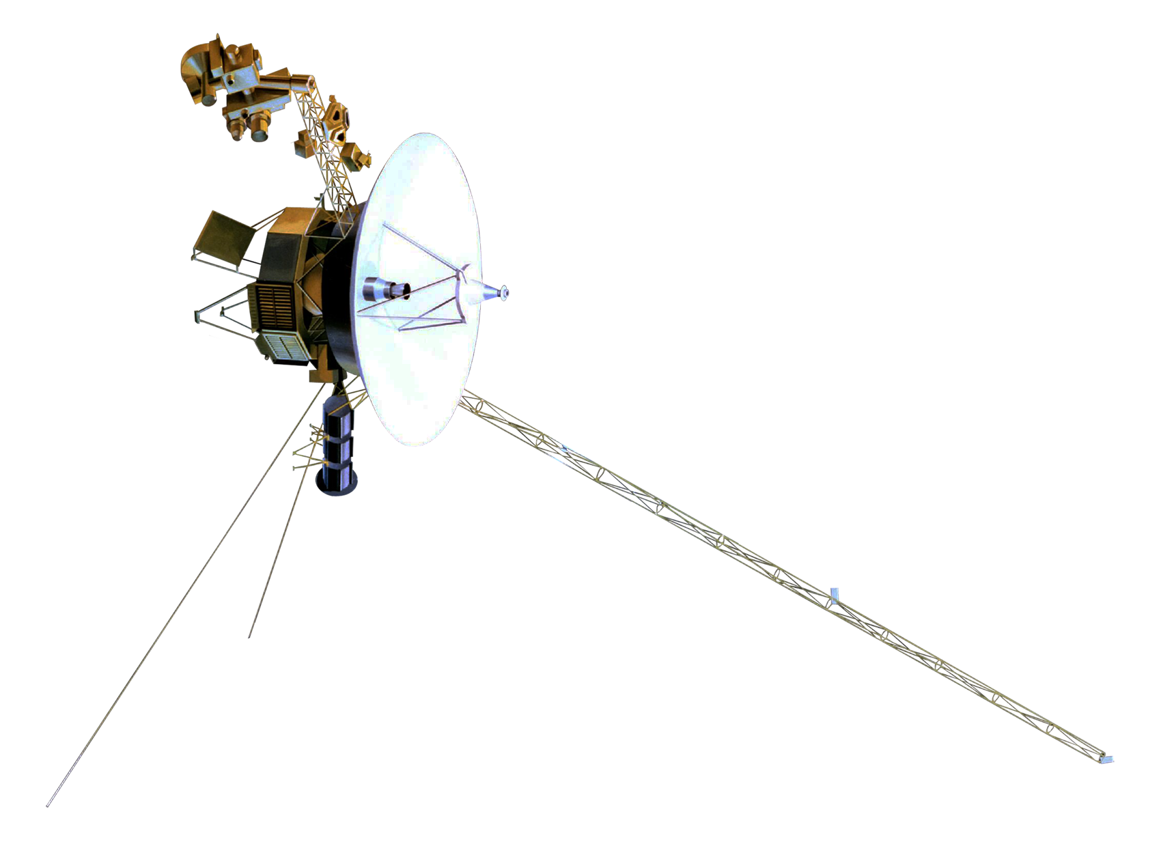
Adaptive Systems
Systems that need to be fault-tolerant
Systems that need to adapt to rapidly changing environments
Deep-space probes, UAVs, etc.
Robots that adapt to their environment

Slide 15
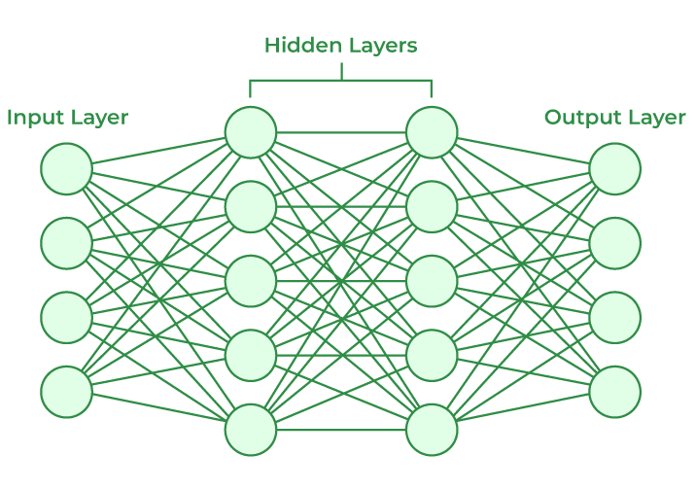
Neural Networks
Energy efficient
Allow reconfiguration for training
Notes:
Johnston SP, Prasad G, Maguire L, McGinnity TM. An FPGA hardware/software co-design towards evolvable spiking neural networks for robotics application. Int J Neural Syst. 2010 Dec;20(6):447-61. doi: 10.1142/S0129065710002541. PMID: 21117269.

Slide 16
Methods

Slide 17
Direct FPGA Encoding Method

Slide 18
Procedure
Python ASC Representation of Population
ASC Files
Upload to FPGA
Evaluate Bitstream's Fitness against Goal
Identify Best Individuals and Generate New Population
Directly modifying bitstream
All mutations (within mutation area) are fair game
Most mutations are bad
Some may damage the FPGA

Slide 19
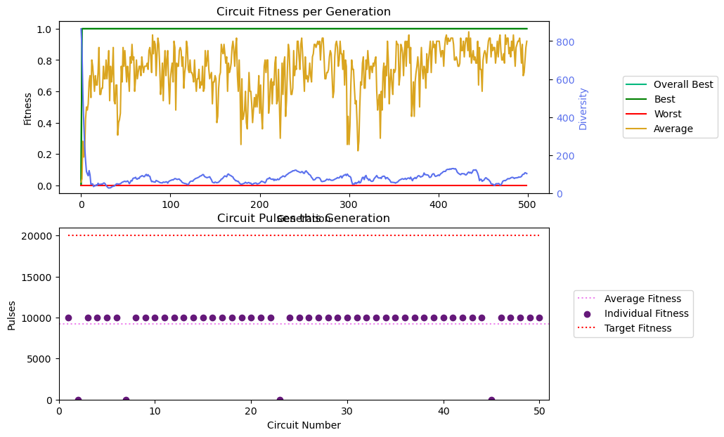
General Experiment Progression

Slide 20
Indirect FPGA Encoding Method

Slide 21
Procedure
Genotype Representation
Verilog Representation
Intermediate BLIF Representation (Yosys)
ASC File (nextpnr)
Upload to FPGA
Evaluate Fitness
Identify Best Individuals and Generate New Population
Using Cartesian Genetic Programming (CGP)

Slide 22
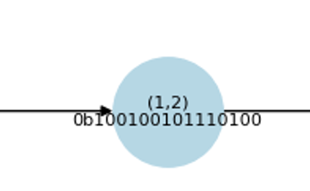
Example: Tracing (1,2)
Anything without an input is driven low.
External IO connections are not shown on graph.

Slide 23
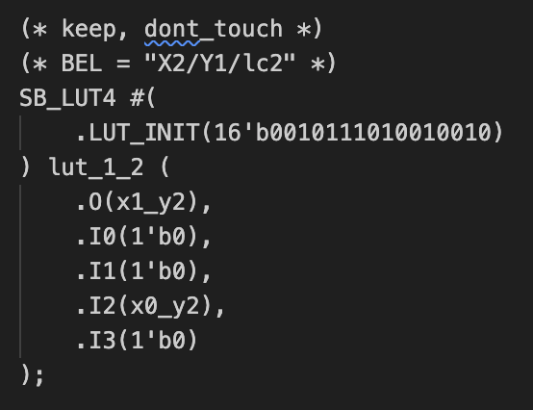
Conversion to Verilog
(* keep, dont_touch *) stops Yosys from optimizing.
(* BEL = “X1/Y1/lc0” *) is the address of the LUT I’m referencing.
I0, I1, I3 are driven low because they aren’t connected to any inputs in the genotype.
I2 is connected to (0,2).
Logic evaluates to false if accounting for driven low inputs.

Slide 24
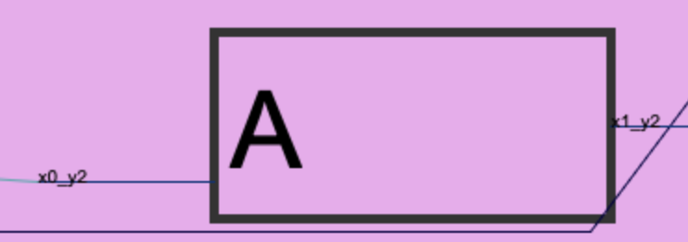
iCE40 Layout
This logic is also False (A is driven low)
nextpnr will create equivalent logic to assist in internal routing
Not important because the behavior of each LUT is maintained.

Slide 25
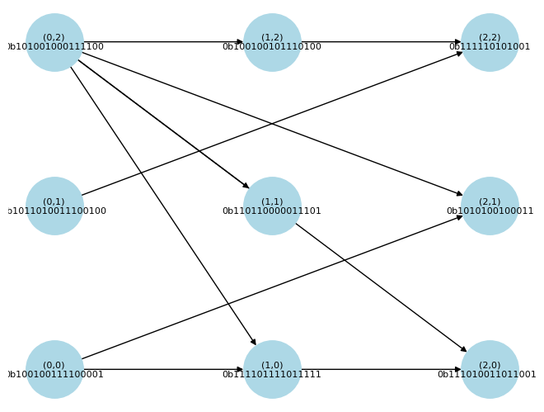
Genotype Representation
Every individual is represented by an array of 32-bit integers
Each integer encodes LUT behavior and connections
Makes invalid configurations (almost) impossible
0000000000000000 | 00 | 00 | 00 | 00 | 00 | 00 | 00 | 00
LUT Behavior | Input 0 X offset | Input 0 Y offset | Input 1 X offset | Input 1 Y offset | Input 2 X offset | Input 2 Y offset | Input 3 X offset | Input 3 Y offset

Slide 26
Thesis Statement
My goal is to prove bitstream evolution using an indirect encoding method yields a statistically significant increase in the average rate of fitness improvements per generation over direct encoding methods.

Slide 27
Current Progress

Slide 28
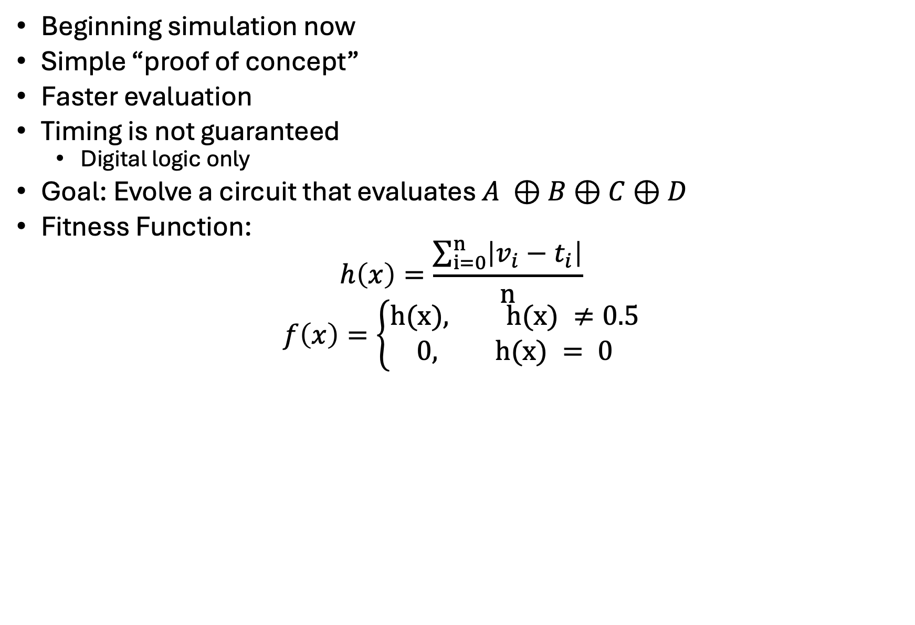
Experiment 1: Simulation
Beginning simulation now
Simple “proof of concept”
Faster evaluation
Timing is not guaranteed
Digital logic only
Goal: Evolve a circuit that evaluates $A ⊕B⊕C⊕D$
Fitness Function:
$$h\left(x\right)=\frac{\sum_{i=0}^{n}{\left|v_{i}−t_{i}\right|}}{n}$$
$$f\left(x\right)=\left\{\begin{aligned}h(x), h(x) ≠0.5 \\ &0, h(x) = 0\end{aligned}\right.$$

Slide 29
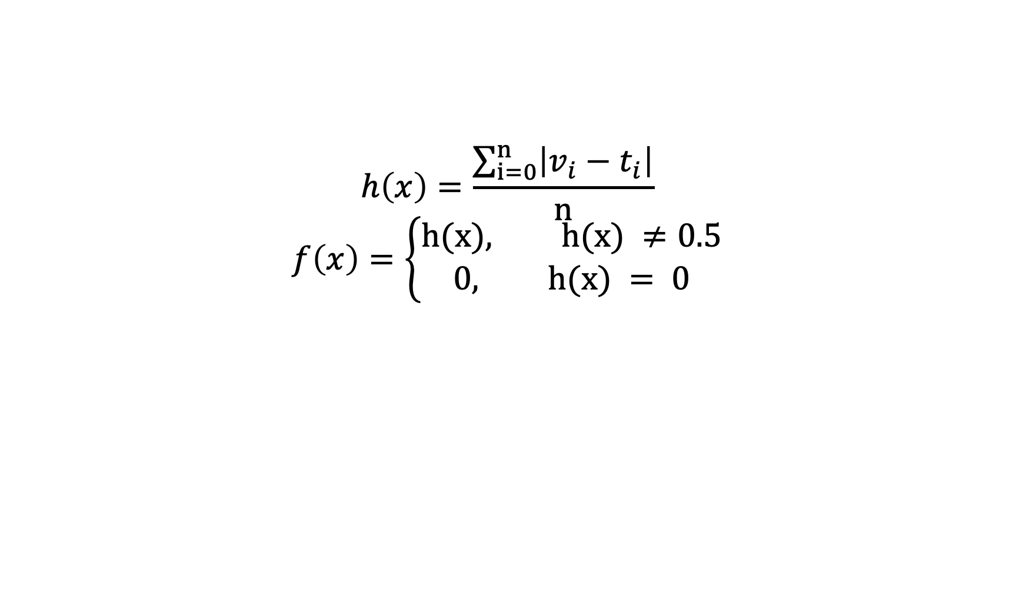
Fitness Function
$$h\left(x\right)=\frac{\sum_{i=0}^{n}{\left|v_{i}−t_{i}\right|}}{n}$$
$$f\left(x\right)=\left\{\begin{aligned}h(x), h(x) ≠0.5 \\ &0, h(x) = 0\end{aligned}\right.$$

Slide 30
Results: Indirect Encoding

Slide 31
Results: Direct Encoding
Hope to have by next week

Slide 32
Thank You

