Slide 1




Buzzworthy Resource Locator (BRL) High-Level Design
Team Yellow – Presented by Ben Edens and Ted Bjurlin
Notes:
[TED]

Slide 2


Refresher: What is the BRL?
Team Yellow:
Ben Edens
Claire Oliver
Dennis Shelby
Janniebeth Melendez
Ted Bjurlin
Wiki-style REST API backend
Internal developer resource-sharing service
URLs w/ title and description
Commenting
Upvoting
Flagging for manager review
Permissions levels
Manager
Developer
General Employee
10/24/25
Notes:
[BEN] Using the BRL for your URL

Slide 3

Technical Design Decisions - Language
Programming Language – Java 25 LTS
Current Long-Term Support (LTS) release
Allows for access modifiers
Inherently object-oriented
Robust framework
Simplified access to trusted libraries
10/24/25
Notes:
[BEN] MongoDB Stuff
Highly scalable
Free to start off with. Don't have to pay for it until you've scaled the system enough to need it, allowing you to ensure the program is successful before allocating additional (financial) resources to scale it. $0.008 per hour once you need to scale. It would cost $70.08 to run it for a full year!
Secure. If we didn't have JWT, we could use a slew of security capabilities from the DB
Using Atlas, which is the cloud-based DB, allows us to have constant access to the DB. Secure, accessible, flexible.
Gotta have Maven because the Java Driver for Mongo gets stored in the pom.xml file of Maven. We could have gotten around it, but the DB is created to work seamlessly with Java and Maven, which support other goals in our project.
Allows us to store data more efficiently than if we used SQL

Slide 4
Technical Design Decisions - Standards
Inline Documentation – Javadoc
Config File Type – Java Properties
Naming Conventions – Java Style
File/Class names: Upper camel case
Variable names: Lower camel case
Directory names: all lowercase, no spaces
10/24/25
Notes:
[TED]
Javadoc
Included in JDK
Generates HTML from doc comments
.properties
A standard within the Java ecosystem
Easy for users to read and write
Allows us to use a single config style for all purposes
Naming Conventions
Following the java style guide provided by oracle
Using the java standard conventions allows any developer joining our problem who is familiar with java to immediately understand our style conventions.

Slide 5
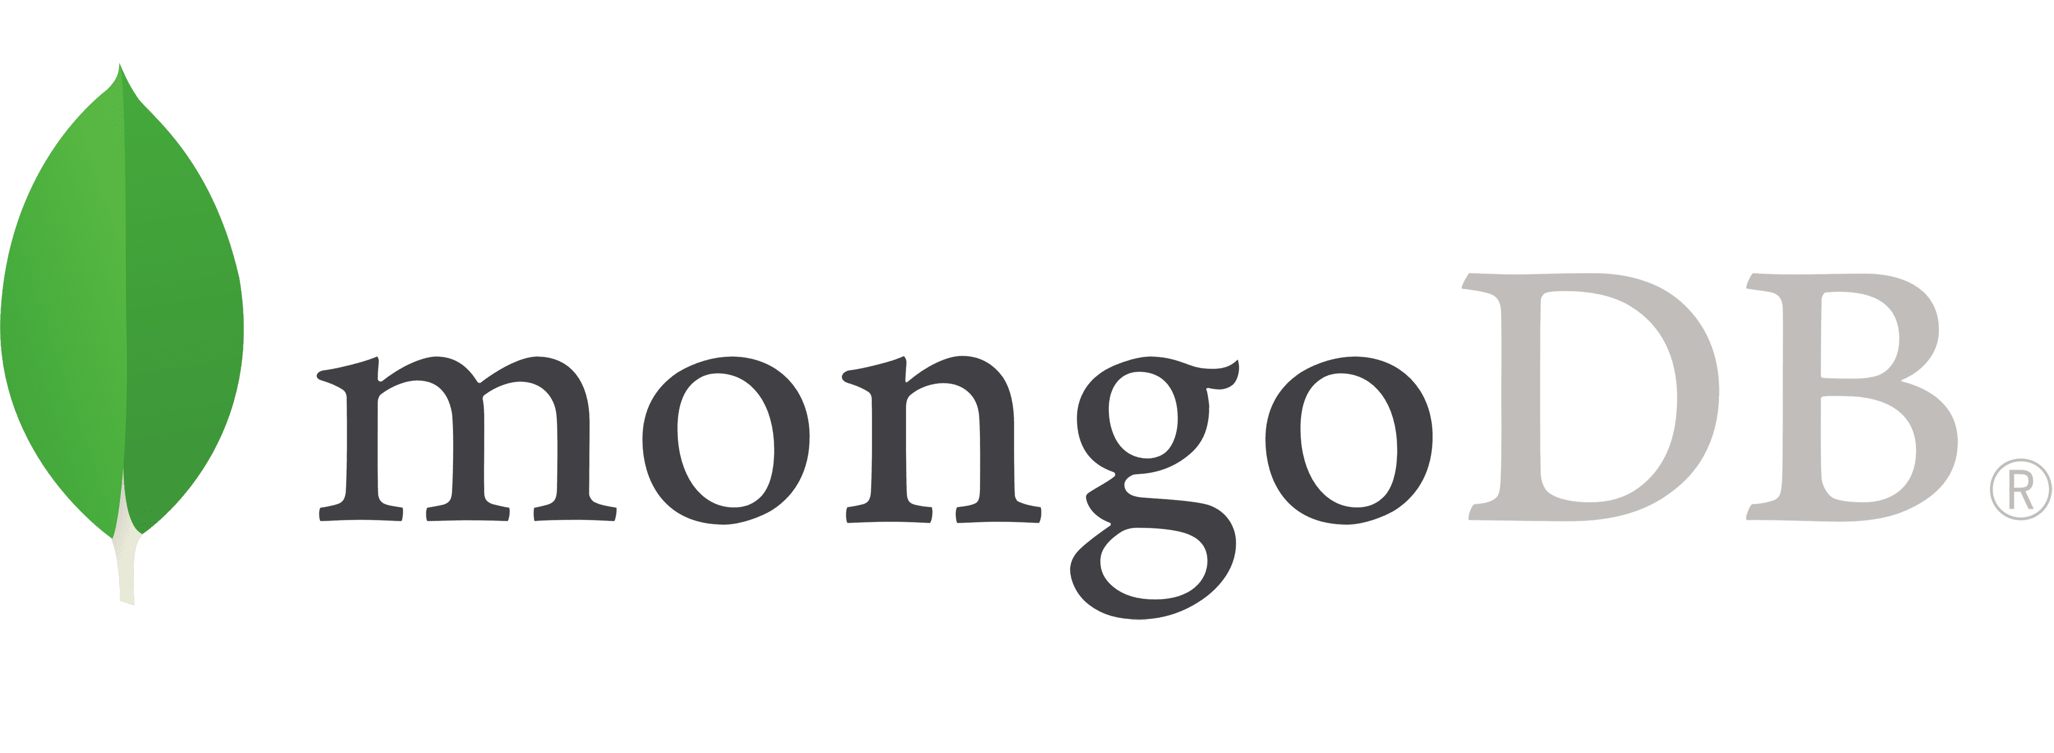




Technical Design Decisions - Tooling
Database – Mongo DB (non-relational)
Testing & Automation – Maven, JUnit
Web Server – Tomcat
Logging – Log4j
10/24/25
Notes:
[TED]
MongoDB Stuff
Highly scalable
Free to start off with. Don't have to pay for it until you've scaled the system enough to need it, allowing you to ensure the program is successful before allocating additional (financial) resources to scale it. $0.008 per hour once you need to scale. It would cost $70.08 to run it for a full year!
Secure. If we didn't have JWT, we could use a slew of security capabilities from the DB
Using Atlas, which is the cloud-based DB, allows us to have constant access to the DB. Secure, accessible, flexible.
Gotta have Maven because the Java Driver for Mongo gets stored in the pom.xml file of Maven. We could have gotten around it, but the DB is created to work seamlessly with Java and Maven, which support other goals in our project.
Allows us to store data more efficiently than if we used SQL

Slide 6
Data Dictionary - Resources
Field Name | Data Type
index | Number
employeeID | Number
employeeName | Text
resourceURL | Text
dateAdded | Date (MM/DD/YYYY)
timeAdded | Time (HH:MM:SS)
title | Text
description | Text
comments | Comment Array
upVotes | Upvote Array
managerFlags | ManagerFlagArray
Notes:
[BEN]

Slide 7
Data Dictionary - Comments, Upvotes, & Manager Flags
Field Name | Data Type
index | Number
employeeID | Number
employeeName | Text
message | Text
Notes:
[BEN]

Slide 8
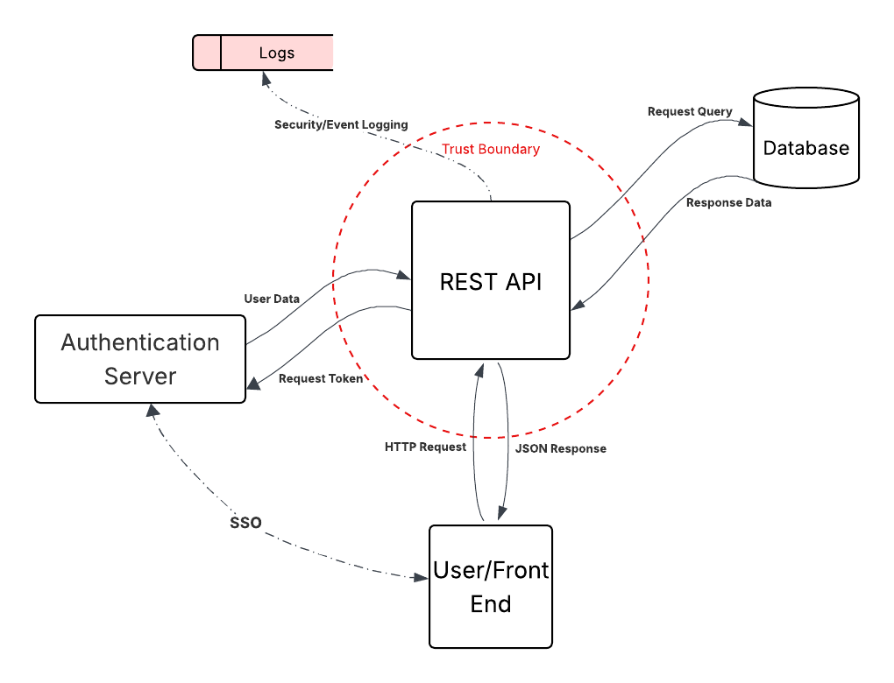
High Level Data Flow Diagram (DFD)
Packages:
API Endpoint
Business Logic
Auth Server Interface
Database Interface
Logging
Security
Config Management
Successful Prototypes
10/24/25
Notes:
[TED]

Slide 9

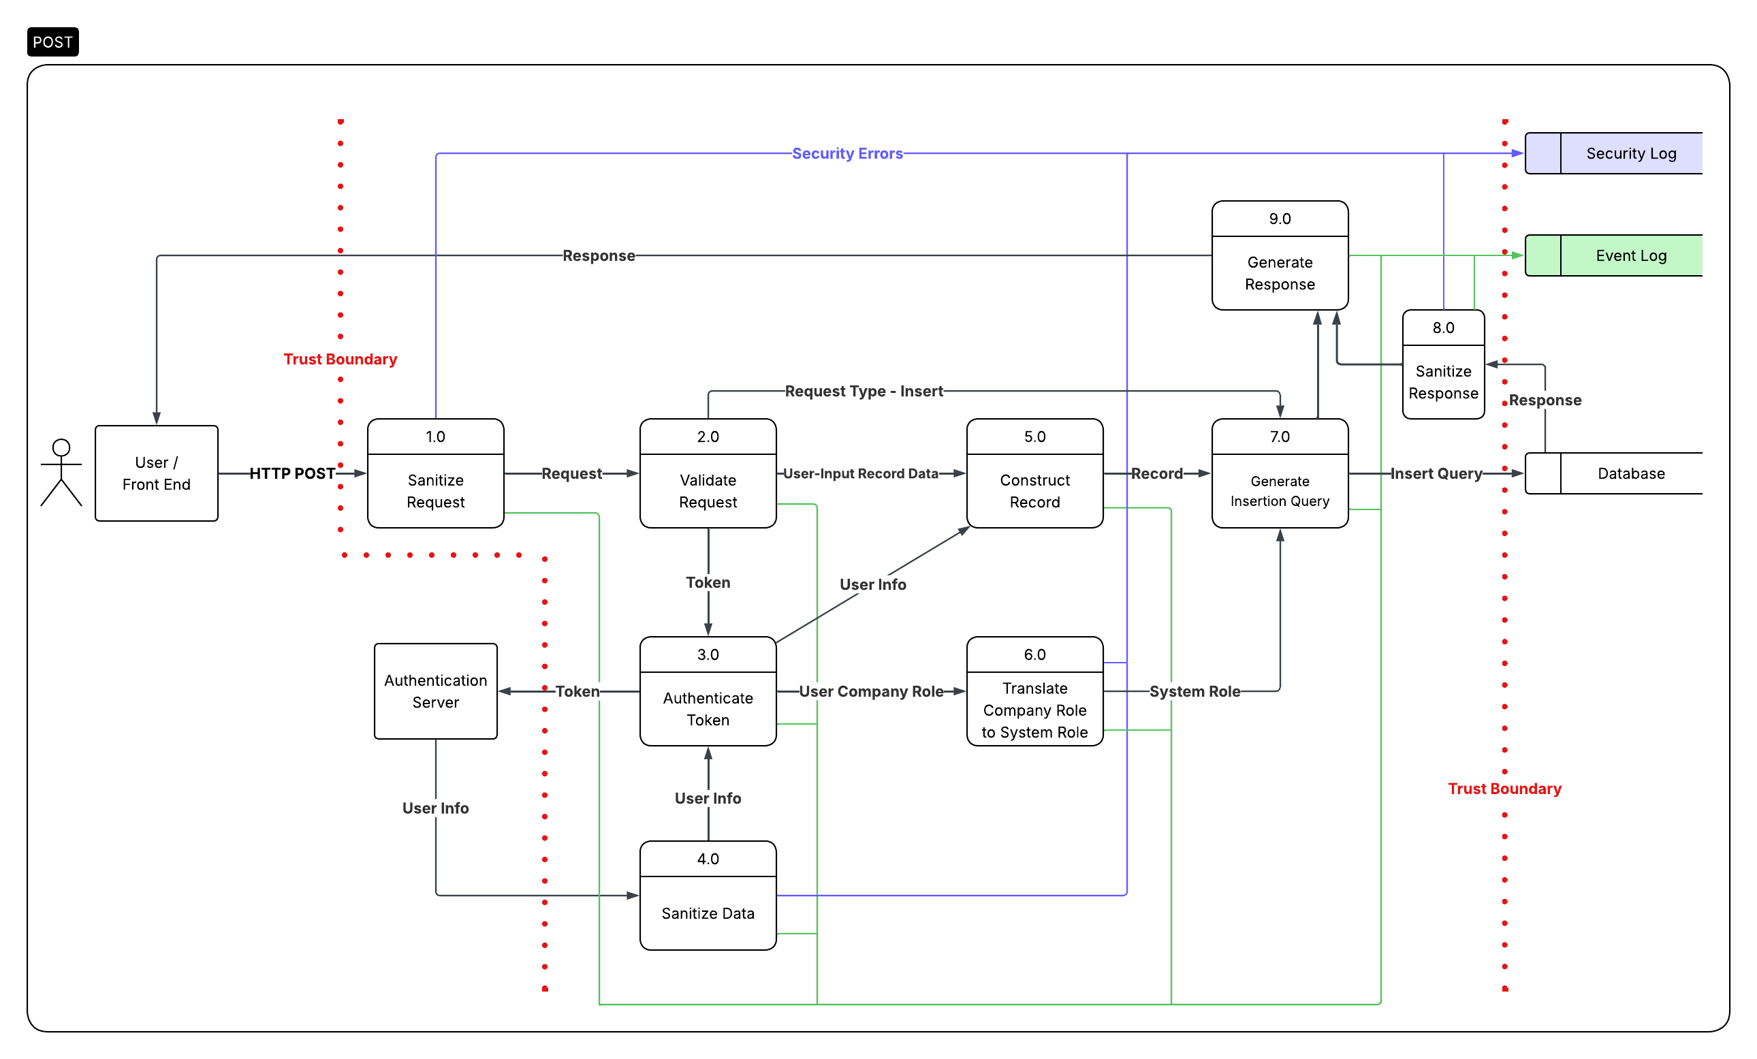
REST API POST Request
Use Cases:
Adding a new resource record
Adding a comment
Adding a review flag
Adding a rating
10/24/25
Notes:
[BEN]

Slide 10
REST API POST Request
Use Cases:
Adding a new resource record
Adding a comment
Adding a review flag
Adding a rating
10/24/25
Notes:
[BEN]

Slide 11
REST API POST Request
Use Cases:
Adding a new resource record
Adding a comment
Adding a review flag
Adding a rating
10/24/25
Notes:
[BEN]

Slide 12
REST API POST Request
Use Cases:
Adding a new resource record
Adding a comment
Adding a review flag
Adding a rating
10/24/25
Notes:
[BEN]

Slide 13
REST API POST Request
Use Cases:
Adding a new resource record
Adding a comment
Adding a review flag
Adding a rating
10/24/25
Notes:
[BEN]

Slide 14
REST API POST Request
Use Cases:
Adding a new resource record
Adding a comment
Adding a review flag
Adding a rating
10/24/25
Notes:
[BEN]

Slide 15
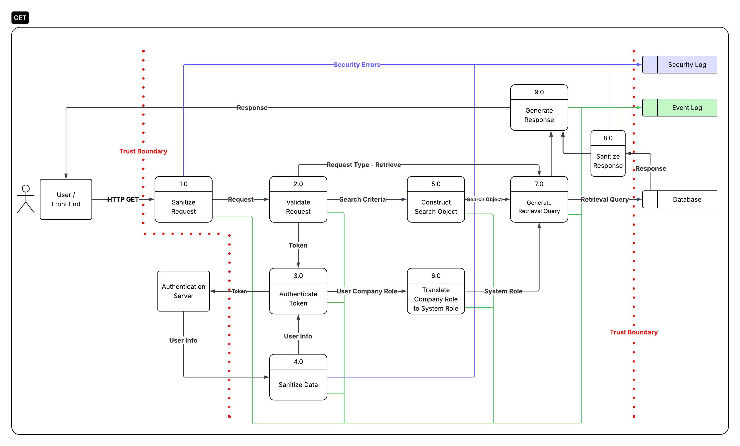
REST API GET Request
Use Cases:
Listing all resources
10/24/25
Notes:
[BEN]

Slide 16
REST API GET Request
Use Cases:
Listing all resources
10/24/25
Notes:
[BEN]

Slide 17
REST API GET Request
Use Cases:
Listing all resources
10/24/25
Notes:
[BEN]

Slide 18

REST API DELETE Request
Use Cases:
Deleting a resource record
Deleting a comment
Removing a manager review flag
10/24/25
Notes:
[BEN]

Slide 19
REST API DELETE Request
Use Cases:
Deleting a resource record
Deleting a comment
Removing a manager review flag
10/24/25
Notes:
[BEN]

Slide 20
REST API DELETE Request
Use Cases:
Deleting a resource record
Deleting a comment
Removing a manager review flag
10/24/25
Notes:
[BEN]

Slide 21
Any Questions?
Exit Presentation
10/24/25
Notes:
[TED]

