Slide 1
Improving Your Statistical Questions

Slide 2
Far better an approximate answer to the right question, which is often vague, than an exact answer to the wrong question, which can always be made precise.
[Tukey, 1962]

Slide 3
Type 3 Error: “The error, or probability, of having solved the wrong problem”
[Mitroff & Featherington, 1974]

Slide 4
To generate knowledge we need description, prediction, explanation, and exploration.

Slide 5
Descriptive modeling uses statistical models to summarize data. The focus is on measurement, less on constructs or theory.

Slide 6
Kinsey used interviews that provided a statistical basis to draw conclusions about sexual experiences of Americans, challenging conventional beliefs about sexuality.

Slide 7
Explanatory modeling uses statistical models to test causal explanations derived from theories.

Slide 8
THEORY
STATISTICAL
HYPOTHESIS
DATA
Corroboration Problem
(Theoretician’s Problem)
Statistical Inference Problem
(Statistician’s Concern)
[Meehl, 1990]

Slide 9
Predictive modeling uses statistical models to predict future or otherwise unknown observations.

Slide 10
Explanatory modeling requires sample size justification based on for example power. Predictive modeling requires relatively large hold-out datasets.
[Shmeuli, 2010]

Slide 11
Explanatory modeling requires well controlled experiments. Predictive modeling requires a context that represents the often messy reality.
[Shmeuli, 2010]

Slide 12
Explanatory modeling focuses on interpreting each significant causal factor. Predictive modeling accepts difficult to interpret models. Significant factors can be ignored if it improves prediction.
[Shmeuli, 2010]

Slide 13
Exploratory research aims to gain familiarity with a phenomenon. Answers the question: What is going on here?

Slide 14
What happens if you ask people in the subway to give up their seat?
[Milgram & Sabini, 1978]
Notes:
https://www.nytimes.com/2004/09/14/nyregion/excuse-me-may-i-have-your-seat.html

Slide 15
Another goals of exploration is tentative model building, for example through data visualization).
Notes:
It is important to realize when you are stil building a model, and when you are ready to test it.

Slide 16
Tukey (1977): “the greatest value of a picture is when it forces us to notice what we never expected to see.”

Slide 17
Science is loosening and tightening. Exploration leads to hypothesis generation in a loosening stage.
[Fiedler, 2004]

Slide 18
Don’t be forced into a hypothesis testing straight-jacket when you want to explore, describe, or predict.

Slide 19
Theory
Experiment

Slide 20
Theory
Experiment

Slide 21
The Statistician’s Fallacy: Saying what it is researchers ‘want to know’

Slide 22
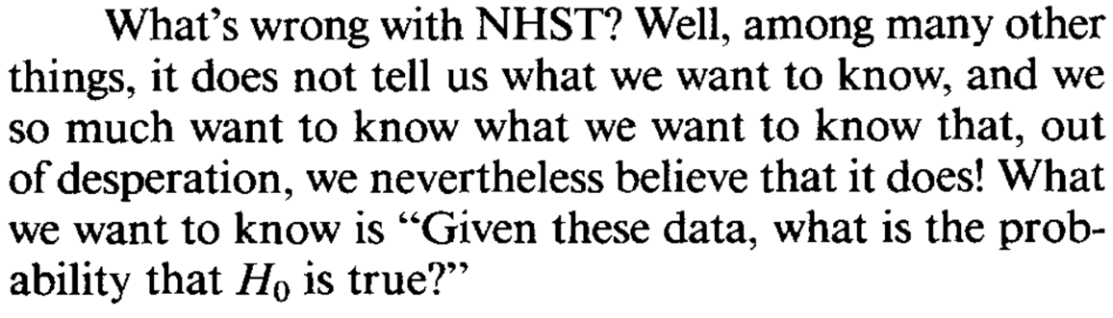
[Cohen, 1994]
Notes:
the posterior probability of a hypothesis

Slide 23
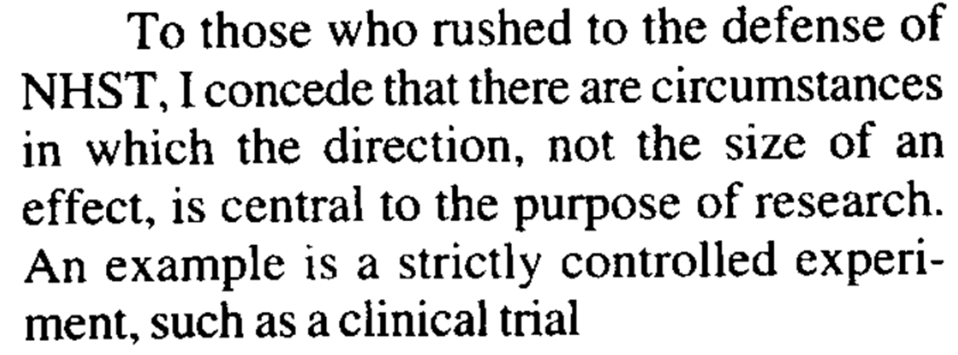
[Cohen, 1995]

Slide 24
‘what you want to know is that when a statistical test of significance comes out positive, what is the probability that you have a false positive’
[Colquhoun, 2017]
Notes:
the false positive report probability

Slide 25
‘What we want to know is the size of the difference between A and B and the error associated with our estimate’
[Kirk, 1996]
Notes:
the effect size and its confidence interval

Slide 26
‘what we really want to know is how likely it is that the observed data are misleading’
[Blume, 2011]
Notes:
the likelihood

Slide 27
‘we want to know how strong the evidence is, given that we actually observed the value of the test statistic that we did’
[Bayarri, Benjamin, Berger, & Sellke, 2016]
Notes:
the Bayes factor

Slide 28
‘We want to know what the data say about a conjectured solution to a problem: What erroneous interpretations have been well ruled out?’
[Mayo, 2018]
Notes:
the severity with which a hypothesis has been tested.

Slide 29
There might be many things you want to know. The relative weight depends on the research phase and your philosophy of science.

Slide 30
Instead of others telling you what you want to know, you should be able to justify the question you are asking.

