Slide 1
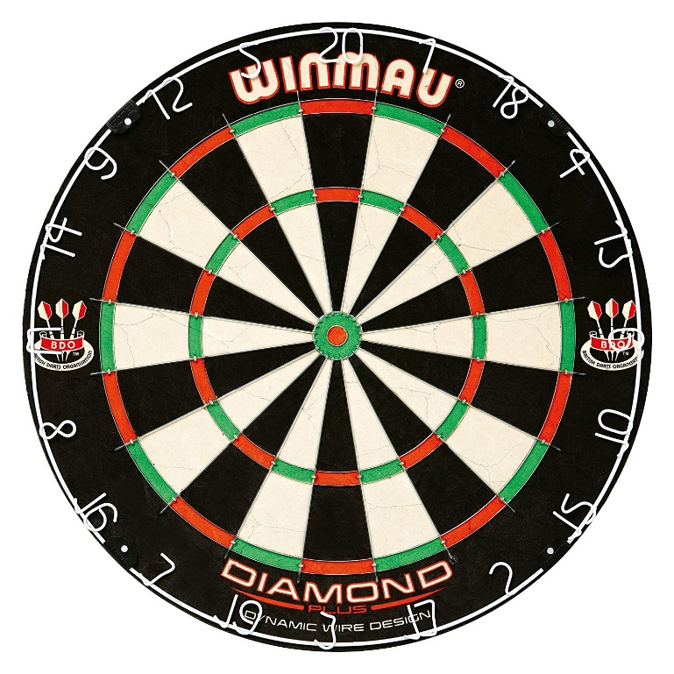
Do You Really Want To Test a Hypothesis?

Slide 2
Hypothesis tests are like a game of darts. A methodological procedure to decide who is better than the rest.

Slide 3
Dart games are designed to decide who of 2 players is better than the other.

Slide 4
A dart a fraction left or right of the divisor between 1 and 20 can mean you win or lose.
Notes:
‘surely God loves the player who throws 1 mm to the right of the divisor between 20 and 1 as much as the player throwing 1 mm to the left of it.’

Slide 5
Divide all possible states of the world into what is predicted and what is not predicted.

Slide 6
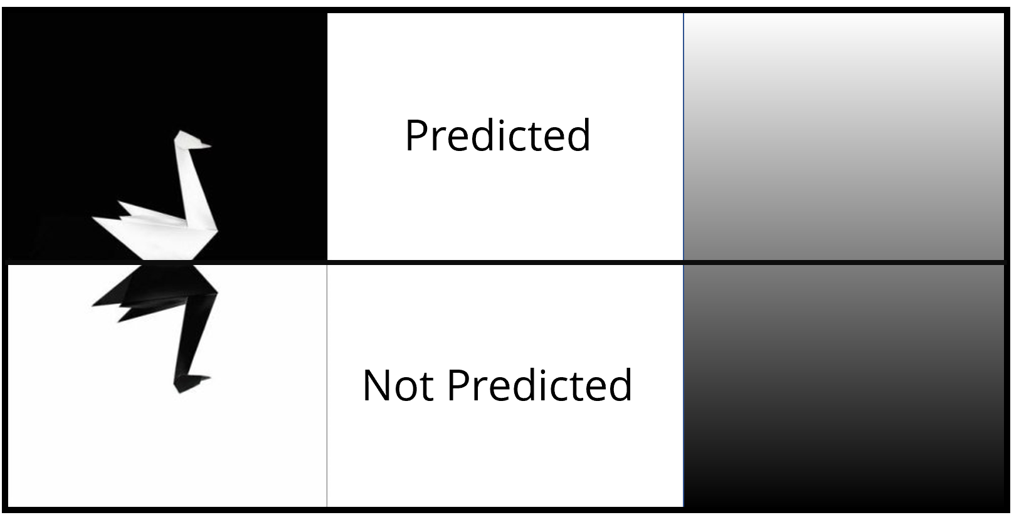

Slide 7
We can make predictions falsifiable by “specifying certain rejection rules which may render statistically interpreted evidence 'inconsistent' with the probabilistic theory”.
[Lakatos, 1978]

Slide 8
“The Neyman-Pearson approach rests completely on methodological falsificationism”
[Lakatos, 1978]
Notes:
Difference between a significnce test (Fisher) and hypothesis test (Neyman).

Slide 9
Hypothesis tests can lead to incorrect decisions, or errors. As Neyman and Pearson write, the goal is to ‘not be too often wrong’.
[Neyman & Pearson, 1933]

Slide 10
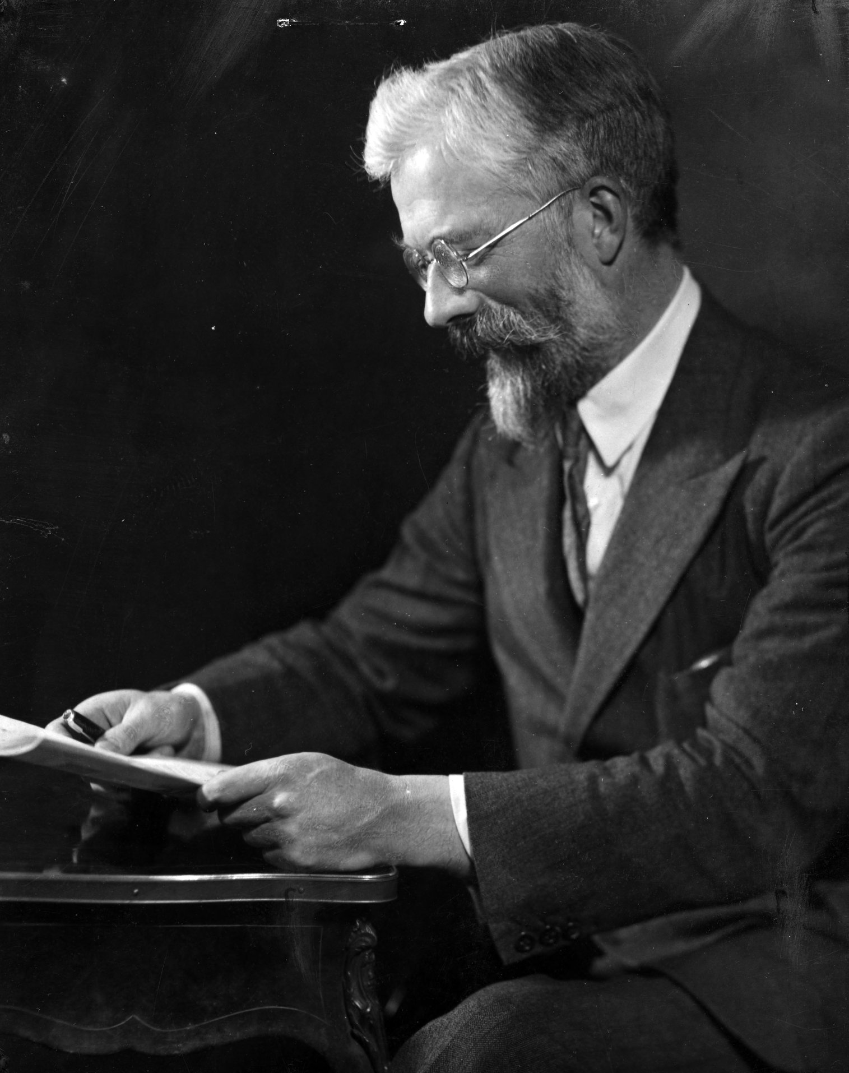
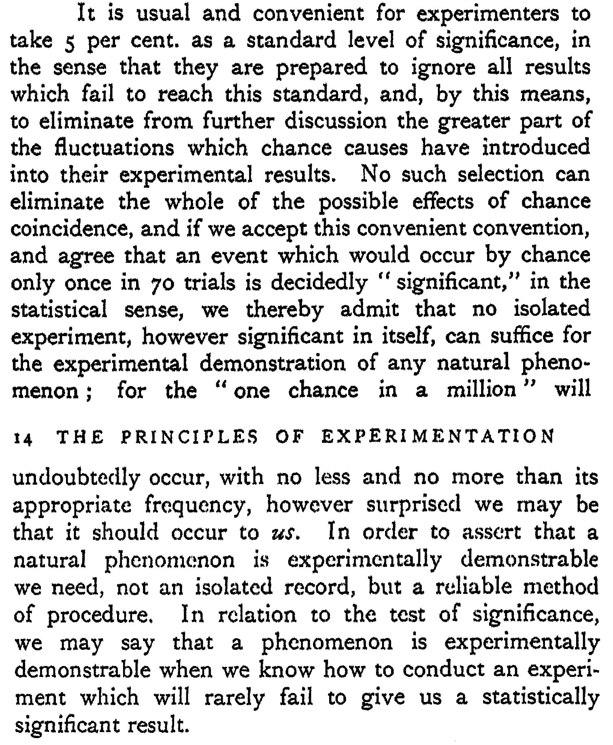

Slide 11
“Such a rule tells us nothing as to whether in a particular case H is true when x≤x₀ or false when x>x₀”
[Neyman & Pearson, 1933]

Slide 12
Why would you want to test a hypothesis with a methodological rule?

Slide 13
1) You need to make a decision how to act.
This ‘act’ can be to ‘accept’ or ‘reject’ H0.

Slide 14
You can also remain in doubt. A “region of doubt may be obtained by a further subdivision of the region of acceptance”
[Neyman, 1933]

Slide 15
Do you actually need to make decisions? In a cumulative science, this seems unavoidable.

Slide 16
2) Are your hypotheses ‘good players’? There is no need to let me play the world champion in darts.
We know who will win.
Notes:
It is also true that is we take 2 crappy players, neither of them might be the best player

Slide 17
Randomization is an important argument for the plausibility of the null.
Crud is a strong argument against the null.

Slide 18
The null-hypothesis does not need to be a nil-hypothesis. You can divide the world into a range you accept and reject any way you like.

Slide 19
3) Can you control the error rates? We don’t throw darts from 100 feet or 1 foot. We can’t make decisions when error rates are huge.

Slide 20
Successful predictions show the predictive validity of a theory, increasing its verisimilitude.

Slide 21
When a dart player says the next dart will go in the bulls-eye, and it does, we are impressed. A hypothesis test works in a similar manner.

Slide 22
There should be cases where you 1) do not need to make a decision, 2) do not have good hypotheses, or 3) can’t set error rates.

Slide 23
In those cases a hypothesis test might not answer the question you are asking. We should stop overusing hypothesis tests.

Slide 24
Hypothesis tests are a very specific tool, that answers a very specific question, under very specific conditions.

