Slide 1
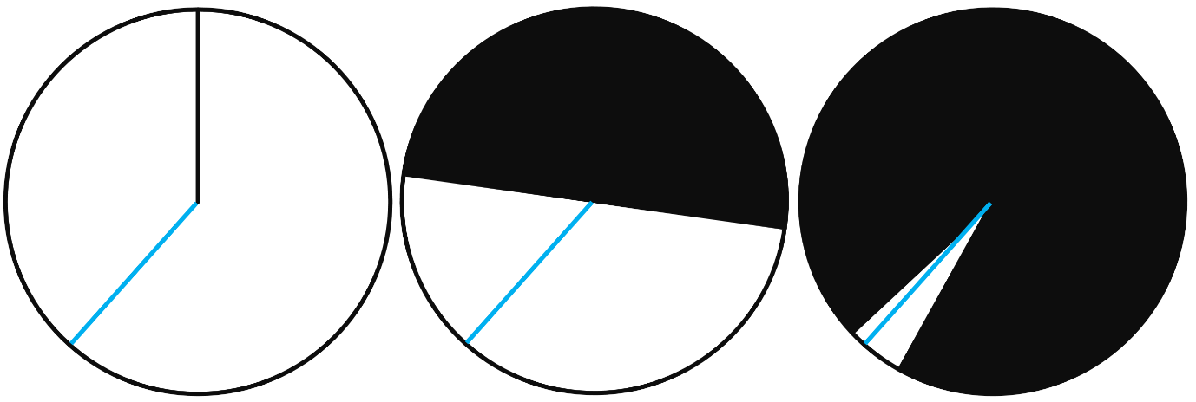
Risky Predictions

Slide 2
Not all predictions we can test are equally exciting.

Slide 3
Two groups rate their mood on a 7-point scale. If I predict the difference will fall between -6 and +6,
it must be so.

Slide 4
Two-Sided
One-Sided
Range

Slide 5
Severity Requirement (weak): One does not have evidence for a claim if nothing has been done to rule out ways the claim may be false.
[Mayo, 2018]
Notes:
Not evidence – negative claim

Slide 6
Hypothesizing After Results are Known (HARKing) is the least severe test possible. You already know the data support the hypothesis.

Slide 7
Severity (strong): If a claim passes a test that was highly capable of finding flaws or discrepancies from the claim and yet none or few are found, then the passing result is evidence for the claim.
[Mayo, 2018]
Notes:
Positive claim

Slide 8
Studies can have a high capability to be wrong statistically, theoretically, or methodologically.
Notes:
Positive claim

Slide 9
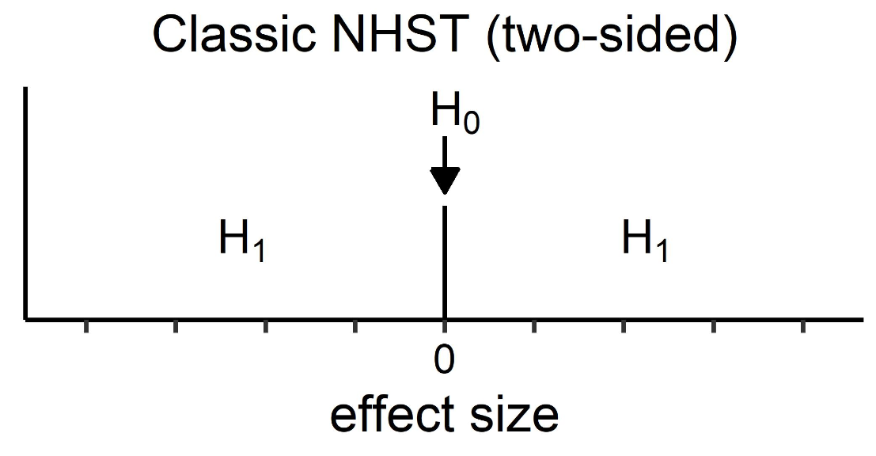

Slide 10
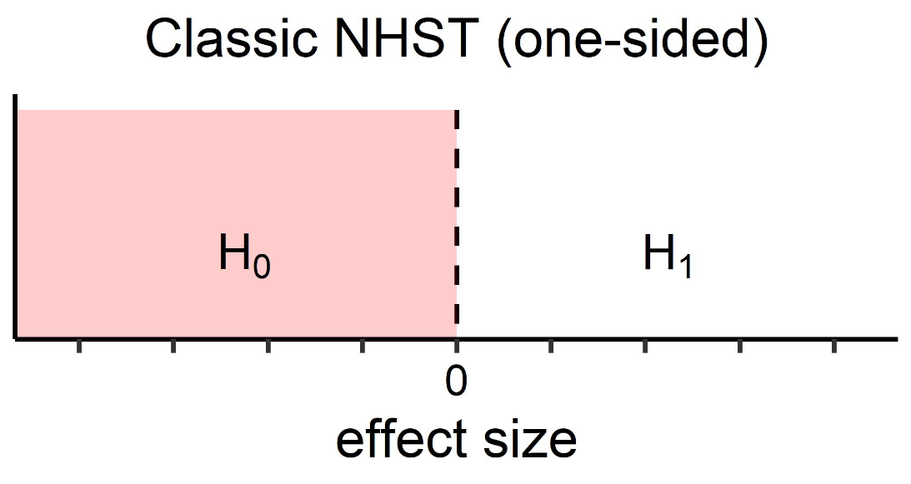

Slide 11
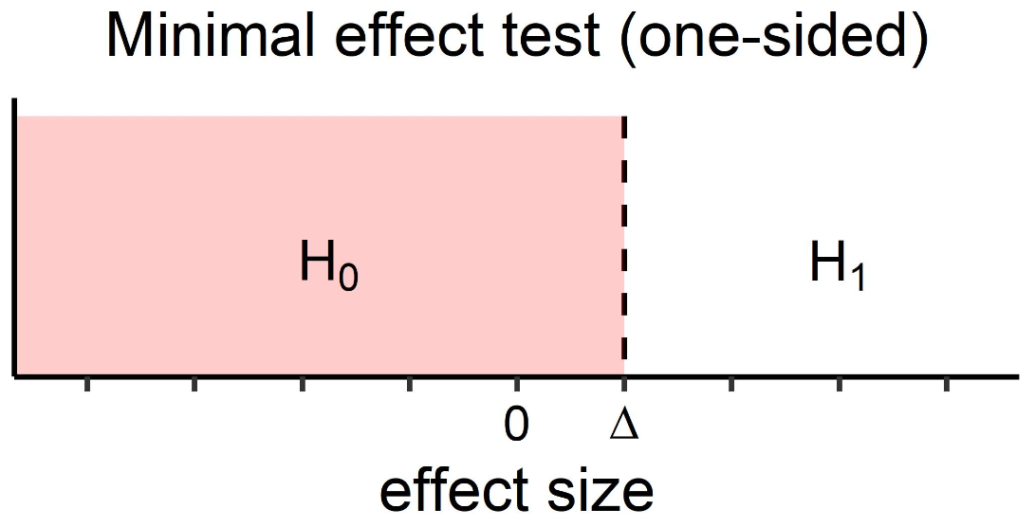
Notes:
AKA superiority test

Slide 12
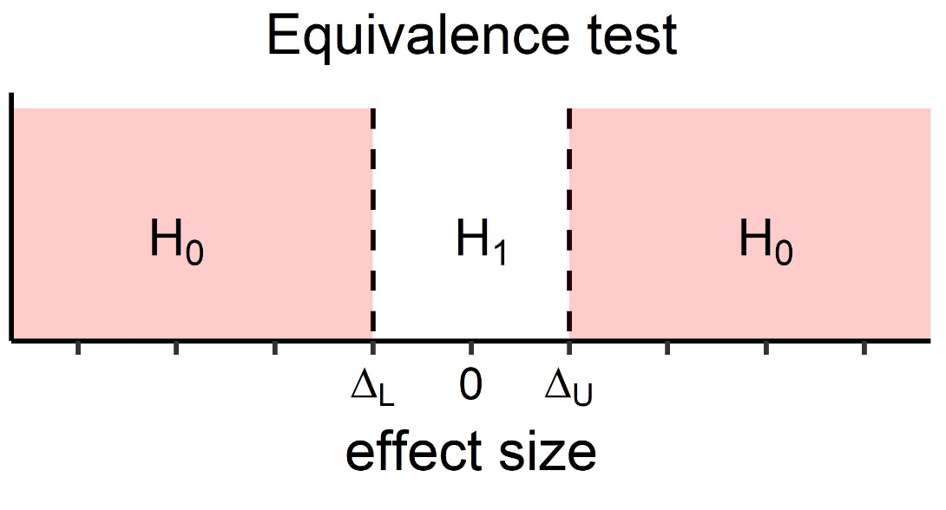

Slide 13
Range predictions say: We want theoretically relevant effects to be significant, but not theoretically irrelevant effects.

Slide 14
Range predictions allow you to design a study that can be falsified based on clear criteria.

Slide 15
Making a riskier prediction gives your theory more verisimilitude.

Slide 16
Many of the criticisms on p-values disappear when p-values are calculated for range predictions.

Slide 17
We no longer have practically insignificant but statistically significant findings.

Slide 18
Not every effect will become statistically significant with large samples.

Slide 19
Imagine we predict a mean difference should be larger than 0.1 to be meaningful and should theoretically be smaller than 0.6.

Slide 20
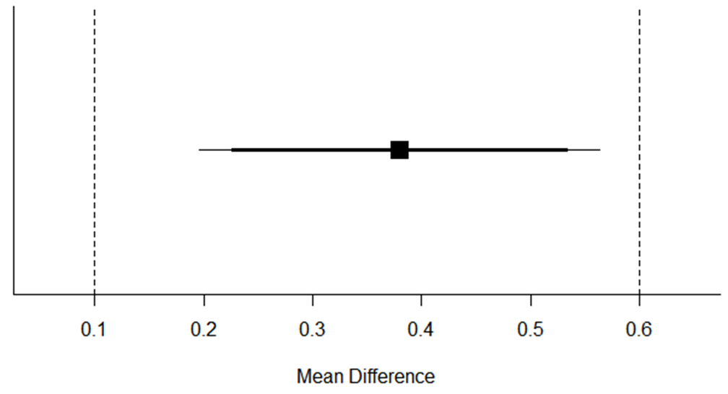
Notes:
We test the effect falls between 0.1 and 0.6 – riskier!

Slide 21
We have made a riskier prediction than a traditional two-sided hypothesis test, and our prediction was confirmed – impressive!

Slide 22
The traditional null-hypothesis test is only one of many ways to test hypotheses – try to make riskier predictions.

