Slide 1
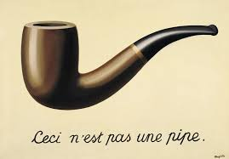
Falsifying Hypotheses in Theory

Slide 2
Have you ever designed a study where the goal was to show there was no effect? I predict the answer is: no.

Slide 3
Most scientific research questions are stated in order to demonstrate the prediction that an effect or a difference exists.

Slide 4
Sometimes the demonstrating the absence of an effect might be interesting.

Slide 5
Is a new intervention equally effective?
Is a theoretically predicted effect absent?

Slide 6
What would falsify the hypothesis in your last or next study?
Notes:
Joke bout falling asleep during a colloquium, waking up, and always being able to ask this questions.

Slide 7
You might think: p>α. But absence of evidence is not evidence of absence.

Slide 8
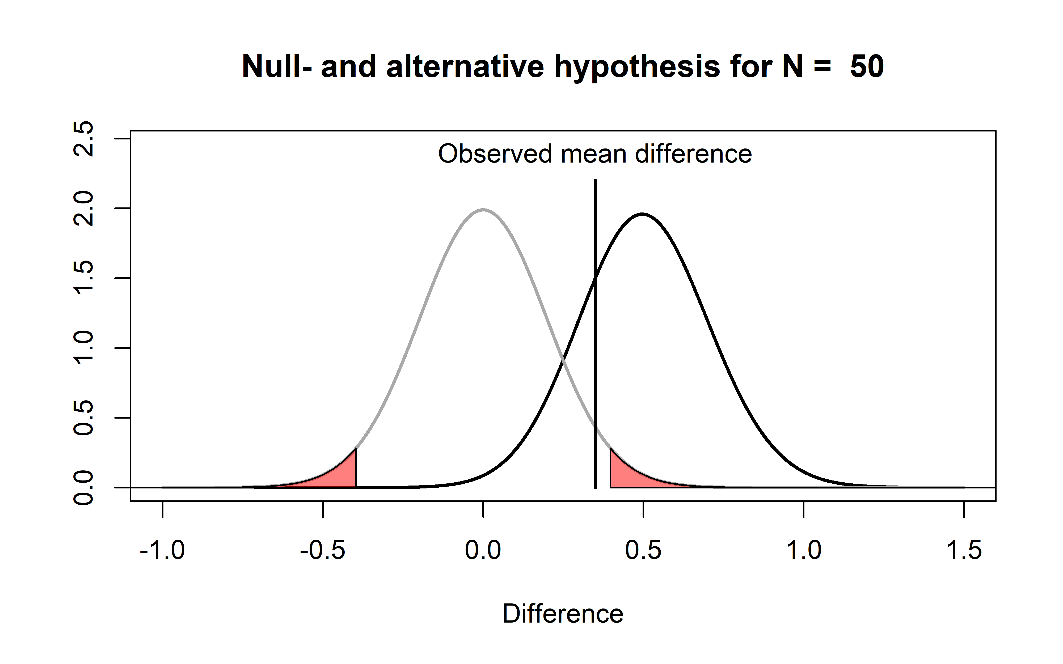

Slide 9
Open your own last paper. Search for
p > .05. How did you interpret this result?

Slide 10
You might think:
A significant result in the opposite direction.

Slide 11
Is any effect in the predicted direction support for H1?

Slide 12
Is an effect size of d = 10 support for your theory?

Slide 13
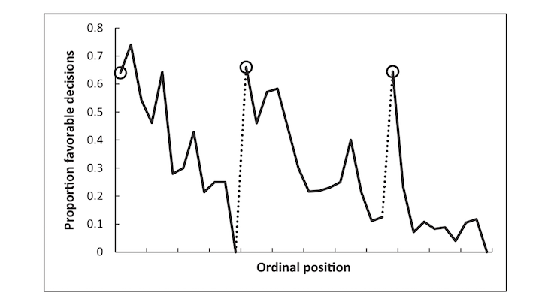
[Danziger, Levav, & Avnaim-Pesso, 2011, but see Glöckner, 2016]
Notes:
Cohen’s d of almost 2 – too huge

Slide 14
Is an effect size of d = 1.0 support for your theory?

Slide 15
Is an effect size of d = 0.1 support for your theory?

Slide 16
Is an effect size of d = 0.01 support for your theory?

Slide 17
Is an effect size of d = 0.001 support for your theory?

Slide 18
90% power for d = 0.001 in a t-test requires 42 million observations in total.

Slide 19
You can never prove an effect is exactly 0

Slide 20
Authors of a theory should state what potential outcomes would lead them to regard the theory as disproven.
[De Groot, 1969]

Slide 21
“In the absence of a true process of replication and falsification […] the entire discipline risks a slide toward the unfalsifiable.”
We have undead theories.
[Ferguson & Heene, 2012]

Slide 22

A theory “is a bit like someone else’s toothbrush – it is fine for that individual’s use, but for the rest of us…. Well, we would just rather not, thank you.”
[Watkins, 1984]

Slide 23
“Only when theories are detached from individuals and many different researchers (working in different labs and driven by different motives) participate in a pluralistic endeavor can the full potential and the weaknesses of a theory be expected to unfold.”
[Fiedler, 2004]

Slide 24
Whenever possible, think about, and clearly state, what would falsify your prediction.

