Slide 1
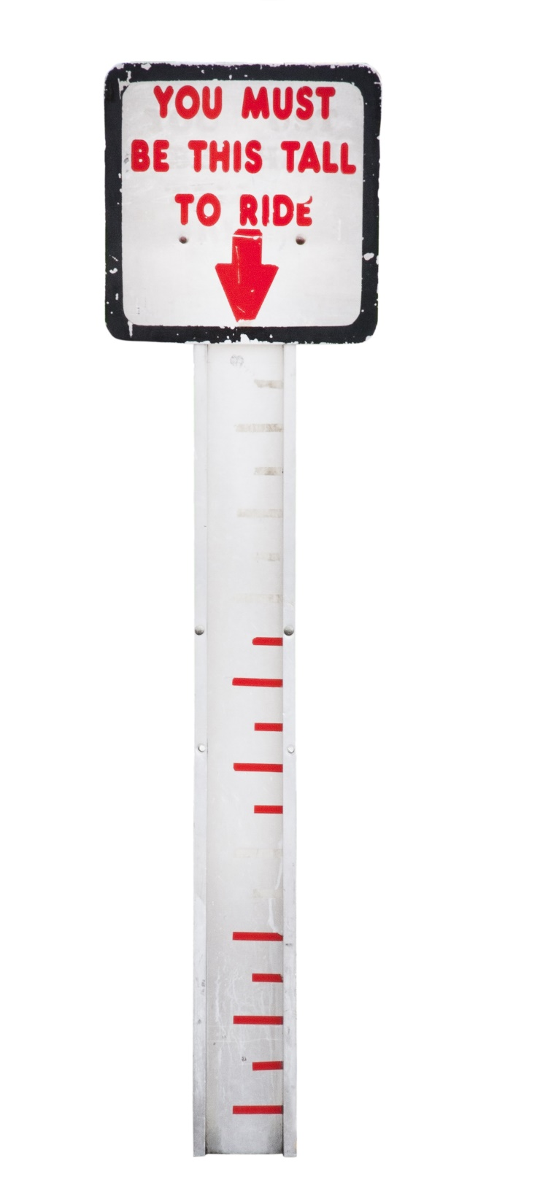
Setting the Smallest Effect Size of Interest

Slide 2
When designing a study, think about your smallest effect size of interest: Which effects are too small to care about?

Slide 3
Take a moment to think about this question for your own research. What would be ‘too small’?

Slide 4
Having a smallest effect size of interest (SESOI) makes it easy to power for effects you want, not effects you expect.

Slide 5
Power is a curve, low for tiny effects, high for very large effects. So make sure it is large enough for effects you care about.

Slide 6
Having high power for the SESOI guarantees you have designed an informative study.

Slide 7
Setting a SESOI also makes your study falsifiable. What would disprove your prediction? Data < SESOI.

Slide 8
How do you determine the SESOI?
Theoretical Predictions
Practical Significance

Slide 9
Burriss et al. (2015) showed an increased redness in the face during the fertile phase of their ovulatory cycle in women, but this increase was too small to see with the naked eye by men. This significant effect falsified the hypothesis.

Slide 10
Psychologists are often interested in effects that are large enough to be noticed by individuals. What is the minimally important difference?

Slide 11
Anchor-based methods try to determine the SESOI based on a self-reported ‘small’ difference on a measure. Measure at T1 and T2, and at T2 as: Do you feel a better or worse, from 1-5?

Slide 12
Norman, Sloan, and Wyrwich (2003) proposed that there is a surprisingly consistent minimally important difference of half a standard deviation, or d = 0.5, in health outcomes.

Slide 13
Alternatively, determine the SESOI based on practical significance. Which effect sizes are large enough to be worthwhile?

Slide 14
Cost-benefit analysis: How large should an effect be to achieve sufficient benefits that warrant the costs of an intervention?

Slide 15
Is your effect additive? Then tiny effects can stack. Effects that need to surpass a threshold are not likely to stack.

Slide 16
If nothing else, set the SESOI based on feasibility. Given typical resources in a field, which effect sizes can you reliably study?

Slide 17
You make implicit choices about which effects are too small to matter all the time.

Slide 18
The maximum number of observations you will collect determines the smallest effect that you can detect.

Slide 19
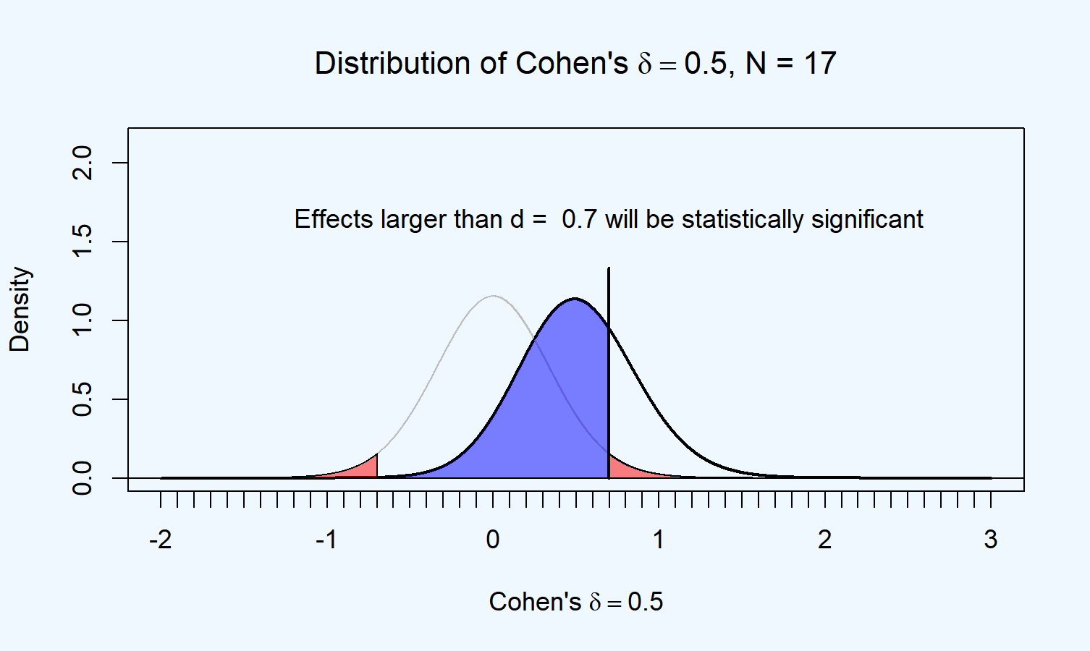

Slide 20
You can show the absence of effects that can be detected given the sample sizes used in a field.

Slide 21


Slide 22
Thinking about your SESOI shows how statistics and theory interact. Always think about the SESOI when designing studies.

