Slide 1
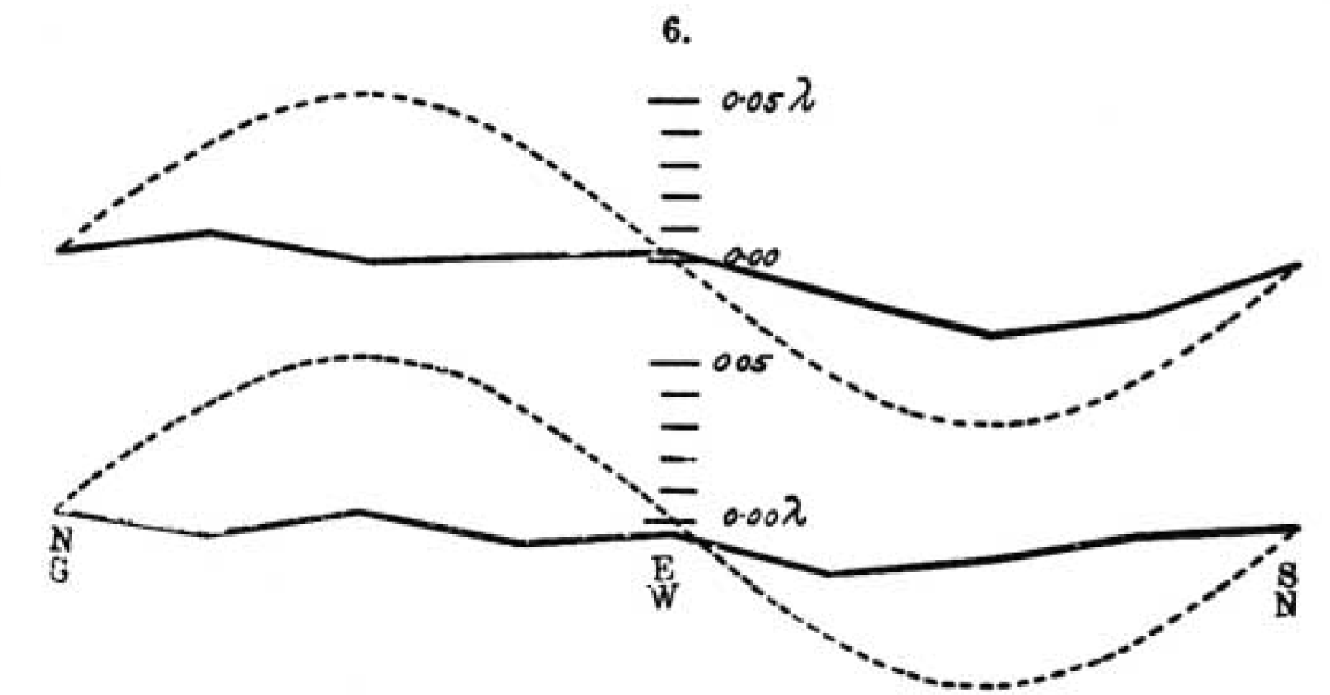
Falsifying Hypotheses in Practice

Slide 2
Statistical approaches to falsify a prediction:
Equivalence testing
(Bayesian) Estimation
Bayes factors

Slide 3
All of these approaches require you specify the alternative hypothesis. This is a good thing!

Slide 4
What we can test: Is the effect smaller than what we predicted/care about?

Slide 5
Does a 8 week meditation class reduce lower back pain compared to controls?
Harms & Lakens, 2018

Slide 6
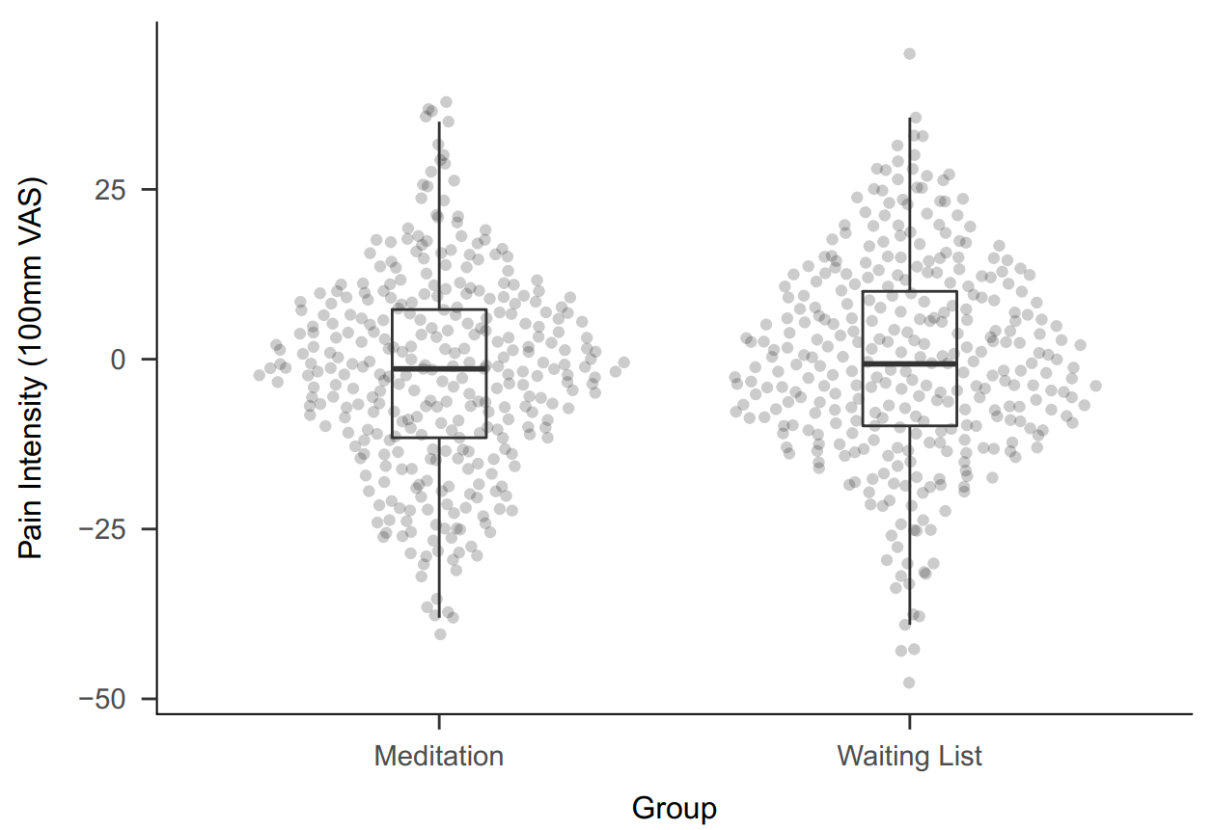

Slide 7
Despite the large sample (N = 664) we can not reject the null: t(661.63) = -1.64, p = 0.101.
Now what?

Slide 8
Report the effect size the study had high power to detect (e.g., 90% power to detect d > 0.3). (No longer recommended).

Slide 9
Use equivalence tests to reject the presence of a meaningful effect.

Slide 10
Determine the Smallest Effect Size of Interest. Set an equivalence range. Test if values outside this range can be statistically rejected.

Slide 11
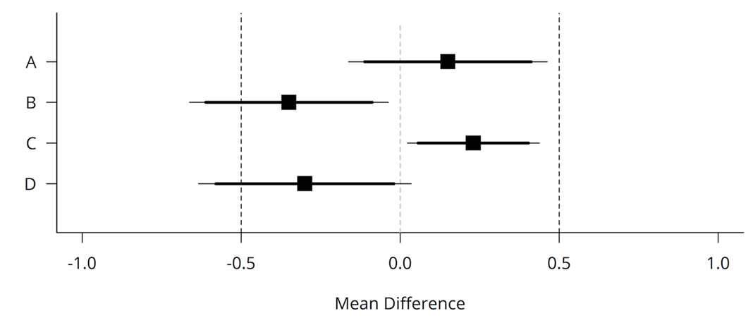

Slide 12
The SESOI can be set based on practical significance, theoretical predictions, or even the resources a field has.

Slide 13
Each of these ways of setting the SESOI asks a different question. It is up to you to justify why your question is interesting.

Slide 14
For the standard pain scale, a difference of 9 mm is seen as the minimal clinically important difference.

Slide 15
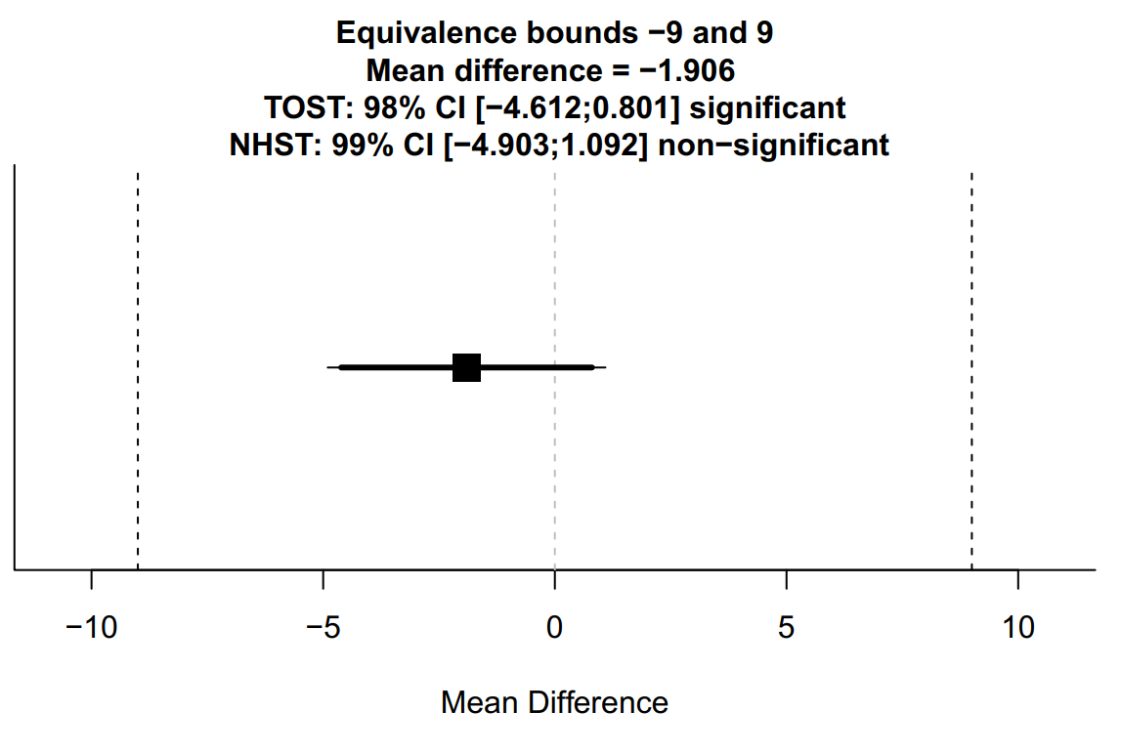

Slide 16
The Bayesian ROPE (Region of Practical Equivalence) procedure uses a posterior distribution of most plausible values to draw inferences.
[Kruschke, 2018]

Slide 17
If the 95% HDI can be compared against the region of practical equivalence. We can reject values in the region, accept them, or remain undecided.

Slide 18
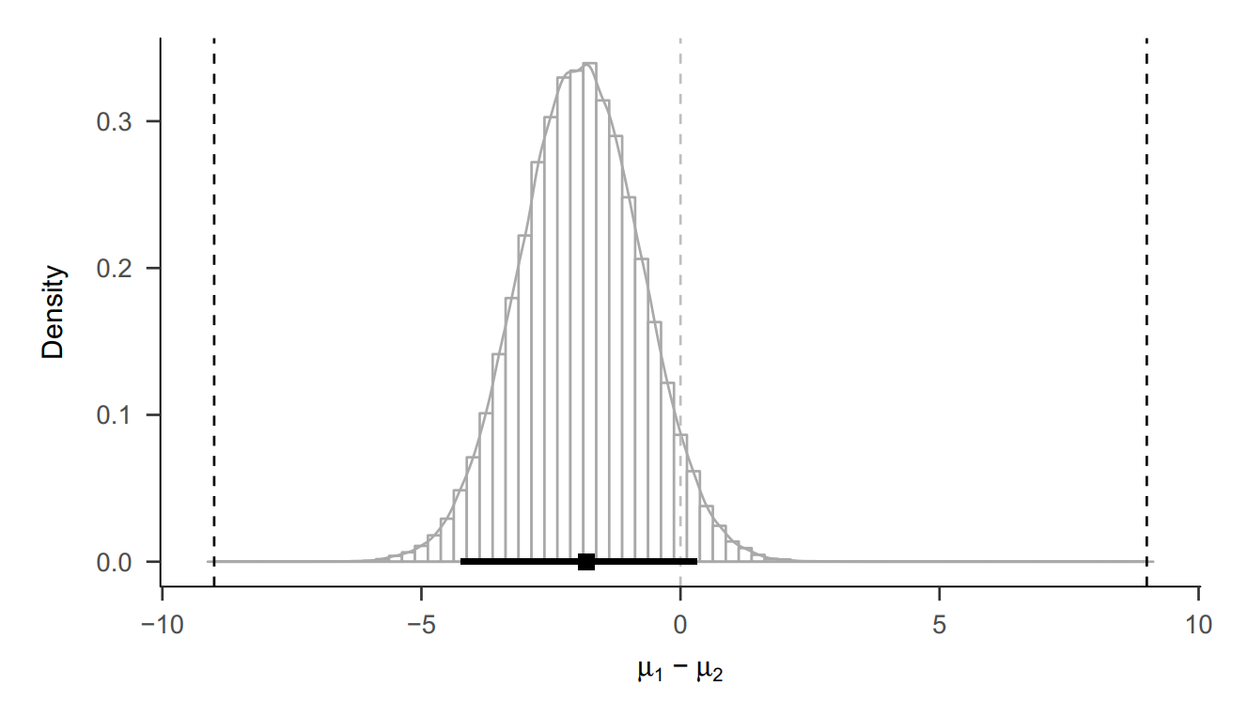

Slide 19
ROPE and equivalence testing are conceptually similar, but philosophically different. One controls error rates, the other uses the whole distribution for inference.

Slide 20
Bayesian statistics can also be used to directly test two competing models using a Bayes Factor.
[Rouder et al., 2009]

Slide 21
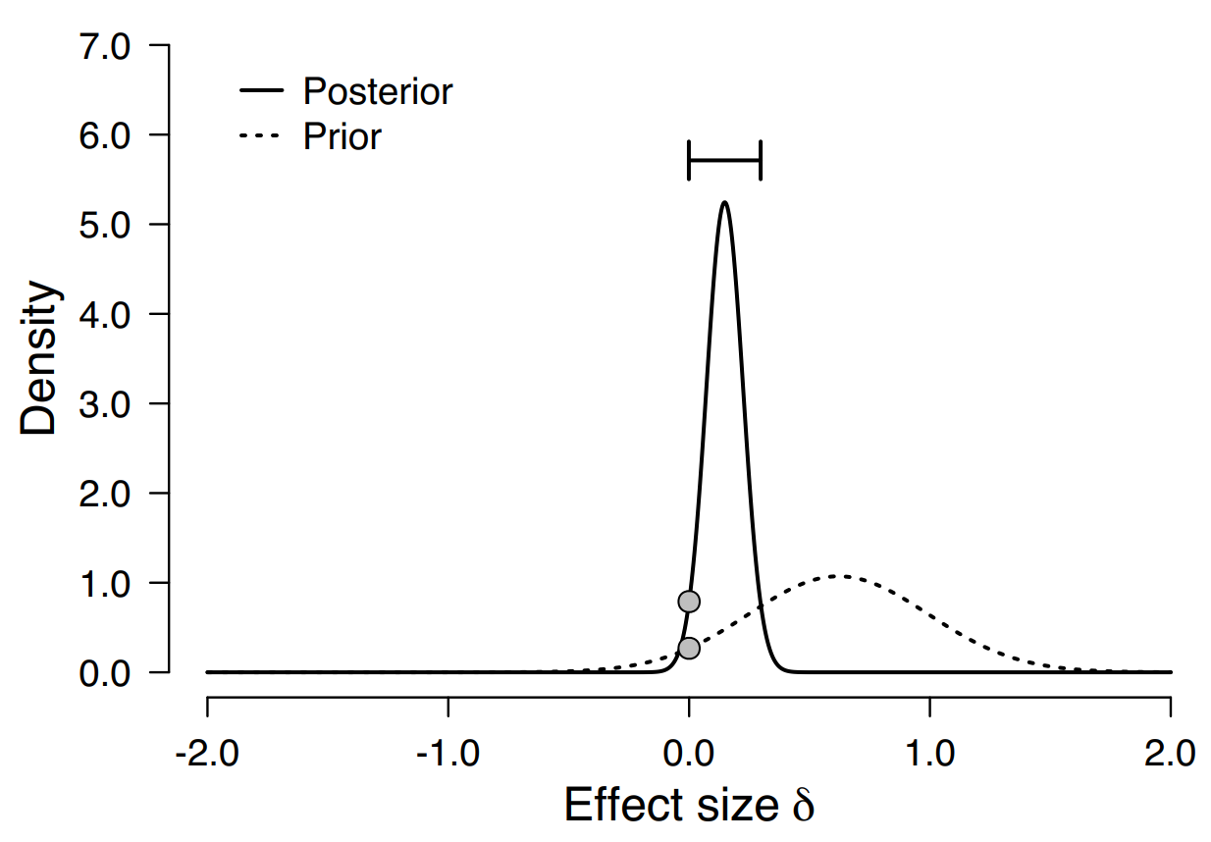
BF01 = 2.95
Notes:
The Bayes factor tells us how much our belief in the null model versus the alternative model should change.

Slide 22
Don’t just use ‘default priors’. Priors are an important part of the question you ask and need to be justified.

Slide 23
Bishop’s law: the better-designed a study is, the more likely it is to obtain a null result.

Slide 24
Make sure the studies you design yield informative results both when H₁ is true, as when H₀ is true.

