Slide 1

Justifying Error Rates

Slide 2
Why do we use an alpha level of 0.05?

Slide 3
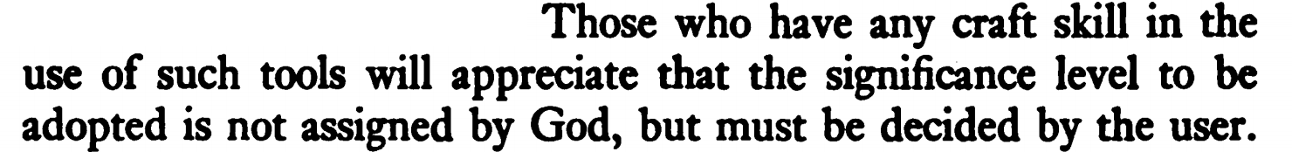
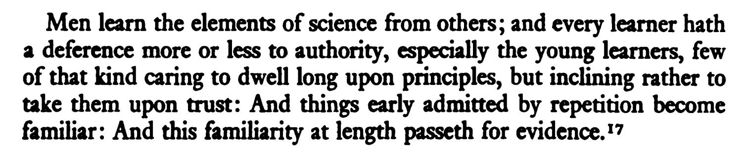
[Ravetz, 1971]
[Berkeley, 1735]
Notes:
I used to think: If many people do something, there must be a good reason for it. I now think an important part of becoming a scientist is learning that is not true.

Slide 4
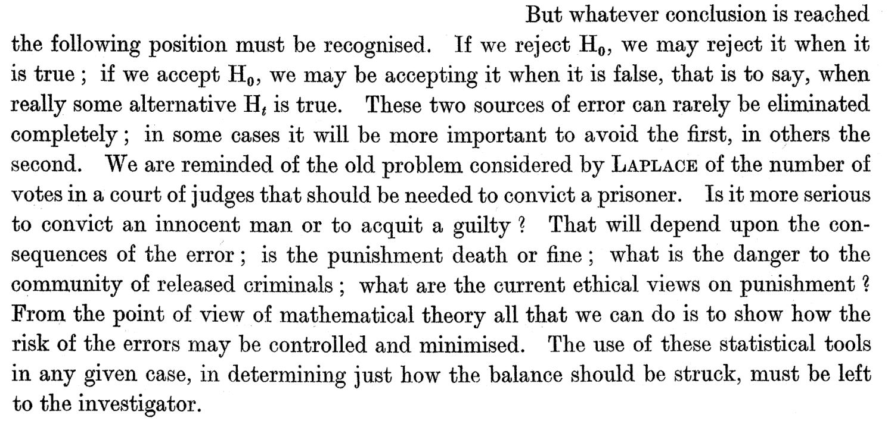
[Neyman & Pearson, 1933]
Notes:
In the second lecture in the first module we read Fisher – now let’s read Neyman and Pearson.

Slide 5

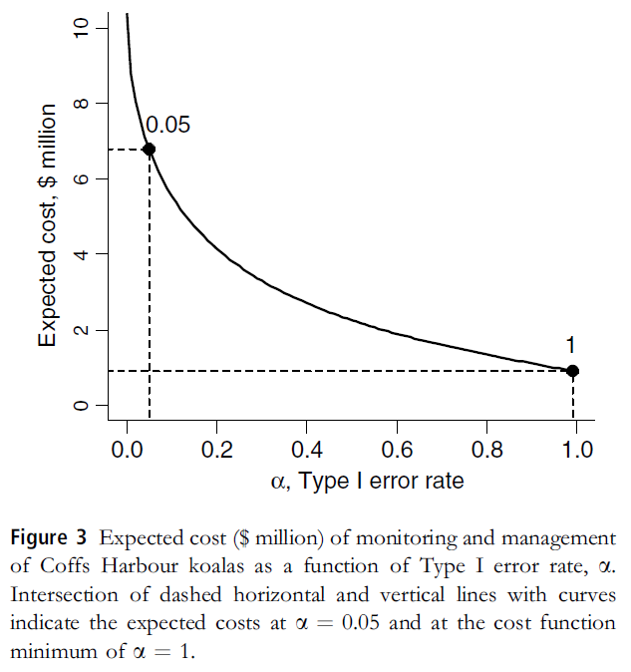
[Field et al., 2004]
A Koala, disappointed in you because you always use an alpha level of 0.05.

Slide 6
Why is it recommended to aim for a statistical power of at least 80%?

Slide 7
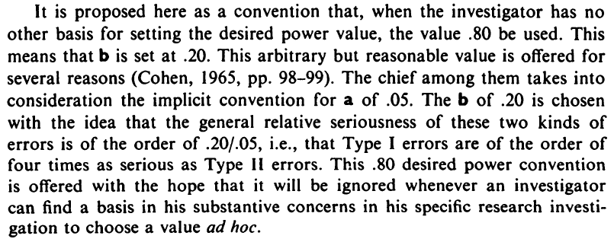
[Cohen, 1988]

Slide 8
Why do researchers set error rates that do not reflect the rate at which they want to make errors? Norms.

Slide 9
In statistical decision theory a hypothesis test is a choice between actions (accept or reject H₀), given states of the world (H₀ or H₁ is true), that have specific outcomes.

Slide 10
 | H₀ True | H₁ True
Accept H₀ | 0 | Loss₀
Accept H₁ | Loss₁ | 0

Slide 11
Decisions can be made more efficiently by minimizing the combined cost of Type 1 and Type 2 errors.

Slide 12
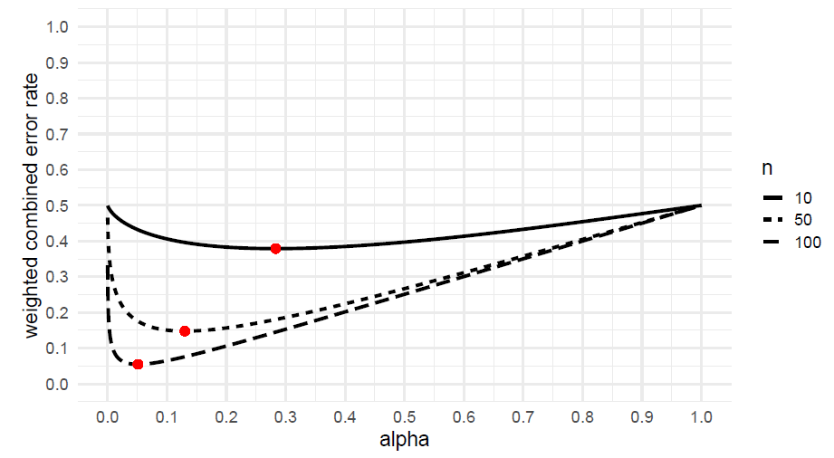
Notes:
For an effect size of d = 0.5, the optimal alpha level depends on the sample size you will collect.

Slide 13
Alternatively, you can decide to use balanced error rates (e.g., have the same Type 1 error rate as Type 2 error rate).

Slide 14
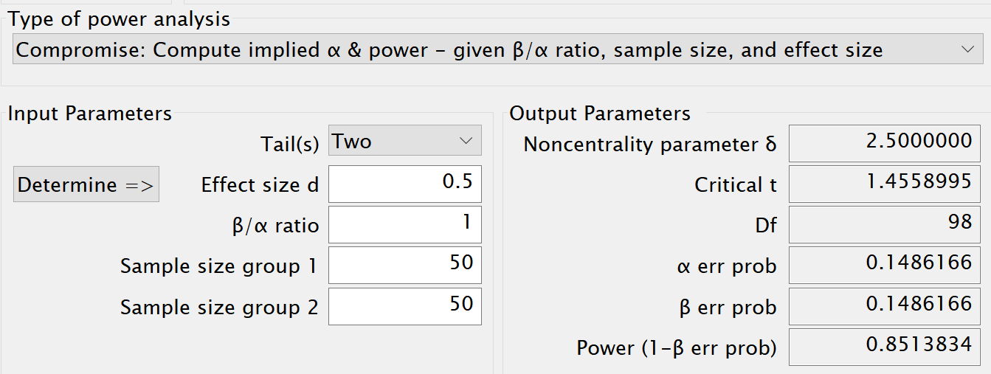
Notes:
Collect 50 observations in each group, SESOI at d = 0.5, balanced error rates are 0.149

Slide 15
This approach requires you to think about the SESOI, relative weights of alpha and beta, and prior probabilities.

Slide 16
A second reason to lower the Type 1 error rate as the sample size increases is Lindley’s paradox.

Slide 17
“The rule of thumb quite popular now, that is, setting the significance level arbitrarily to .05, is shown to be deficient in the sense that from every reasonable viewpoint the significance level should be a decreasing function of sample size.”
[Leamer, 1978]

Slide 18
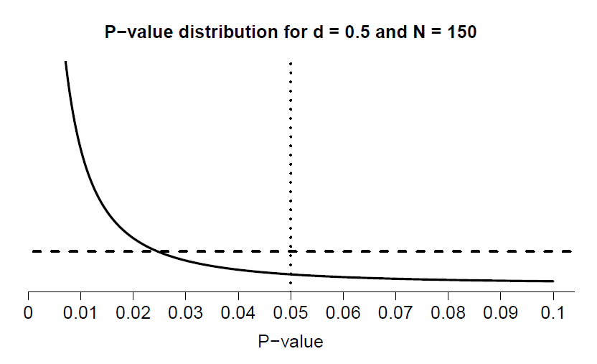
P-value distribution if H1 is true
(99% power)
P-value distribution if H0 is true
Notes:
D = 0.5

Slide 19
P-value distribution if H1 is true
(99% power)
P-value distribution if H0 is true
Notes:
D = 0.5

Slide 20
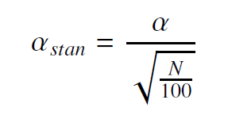
There is no single approach, but a simple suggestion by Good (1982):
Notes:
Based on the relationship between a p-value and bayes factor

Slide 21
Significant results would maintain a similar level of evidence as when α = 0.05 in a sample of 100 participants.

Slide 22
“If, in contrast with present policy, it were conventional that editorial readers for professional journals routinely asked: ”What justification is there for this level of significance?" authors might be less likely to indiscriminately select an alpha level from the field of popular eligibles."
[Skipper, Guenther & Nass, 1967]

Slide 23
Instead of justifying error rates, Johnson (2013) suggests to switch to a lower norm of α = 0.005 instead.

Slide 24
I believe we should move beyond rules of thumb. Make an honest attempt to justify everything.

Slide 25
The default use of α = 0.05 and 80% power were never meant as defaults. Error rates are important enough to be able to justify them.

