Slide 1
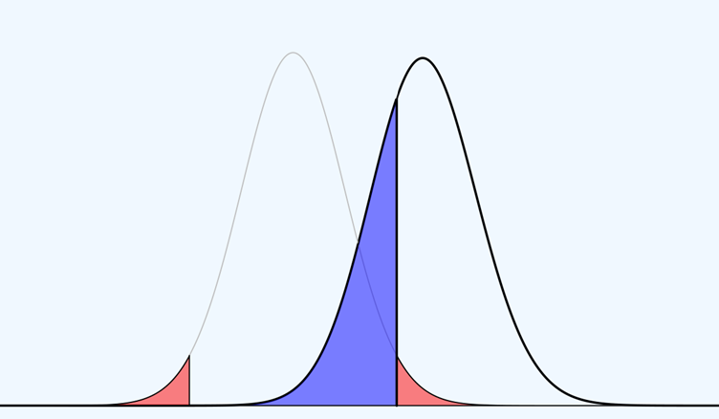
Power Analysis

Slide 2
An increasing number of journals asks for a sample size justification.

Slide 3
An a-priori power analysis can be used to select a sample size for hypothesis tests based on desired error rates.

Slide 4
Statistical power is the long-run probability of observing p < α with N participants, assuming a specific effect size.

Slide 5
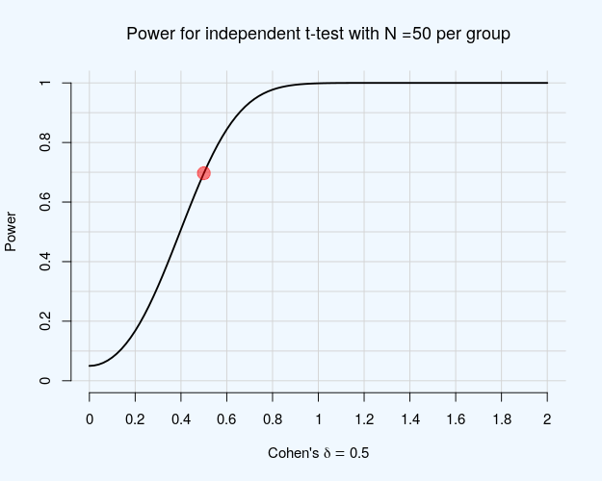

Slide 6
Low Power

Slide 8
High Power

Slide 9
A-Priori Power Analysis
Alpha level (α)
Power (1-β)
Effect size
Sample Size

Slide 10
A-Priori Power Analysis
Alpha level (α)
Power (1-β)
Effect size
Sample Size

Slide 11
Post-hoc Power Analysis
Alpha level (α)
Power (1-β)
Effect size
Sample Size
Notes:
We specify the effect size as the observed value

Slide 12
Post-hoc power provides no more information than a p-value. For sufficiently large samples, a p = 0.05 in a t-test equals 50% power.
[Hoenig & Heisey, 2001]

Slide 13
You can’t use post-hoc power to interpret non-significant effects.

Slide 14
A sensitivity analysis can be worthwhile when designing a study or reporting exploratory analyses.

Slide 15
Sensitivity Analysis
Alpha level (α)
Power (1-β)
Effect size
Sample Size
Notes:
Also useful if your sample size is limited.

Slide 16
One challenge in power analysis is that you never know the true effect size. This leads to the ‘sample size samba’.
[Schulz & Grimes, 2005]

Slide 17
A pilot study does not provide a meaningful effect size estimate for
planning subsequent studies.
[Leon, Davis, & Kraemer, 2011]

Slide 18
Follow-up bias: Following up on pilot studies only when the sample size estimate for the main study is considered feasible.
[Albers & Lakens, 2018]

Slide 19
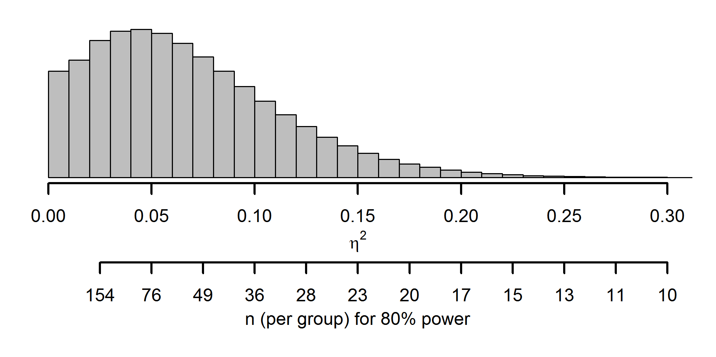
Distribution of η² for a medium effect size

Slide 20
Distribution of η² for a medium effect size

Slide 21
Distribution of η² for a medium effect size
0.03

Slide 22
Distribution of η² for a medium effect size

Slide 23
Distribution of η² for a medium effect size

Slide 24
Power analysis based on significant studies should be computed based on a truncated F distribution.
[Taylor & Muller, 1996]

Slide 25
Plan for effects you care about. Ask yourself: What is your smallest effect size of interest?

Slide 26
Determine test & direction
Determine alpha
Determine SESOI
Determine beta
Calculate N
[Lenth, 2001]

Slide 27
The true effect might be larger than the SESOI. Use sequential analyses if possible.

Slide 28
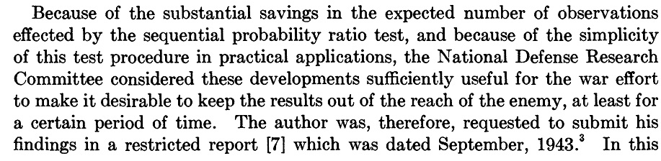
[Wald, 1945]

Slide 29
Sequential analyses will make your experiments more efficient in the long run while controlling error rates.
[Lakens, 2014]

Slide 30
Think about feasibility. If your N is fixed, you are choosing α and β.

Slide 31
Consider the cost of data in each condition. Unequal sample sizes can be more efficient.
[Allison et al., 1997]

Slide 32
When you design a study ask yourself if you can expect to get an informative answer.

