Slide 1
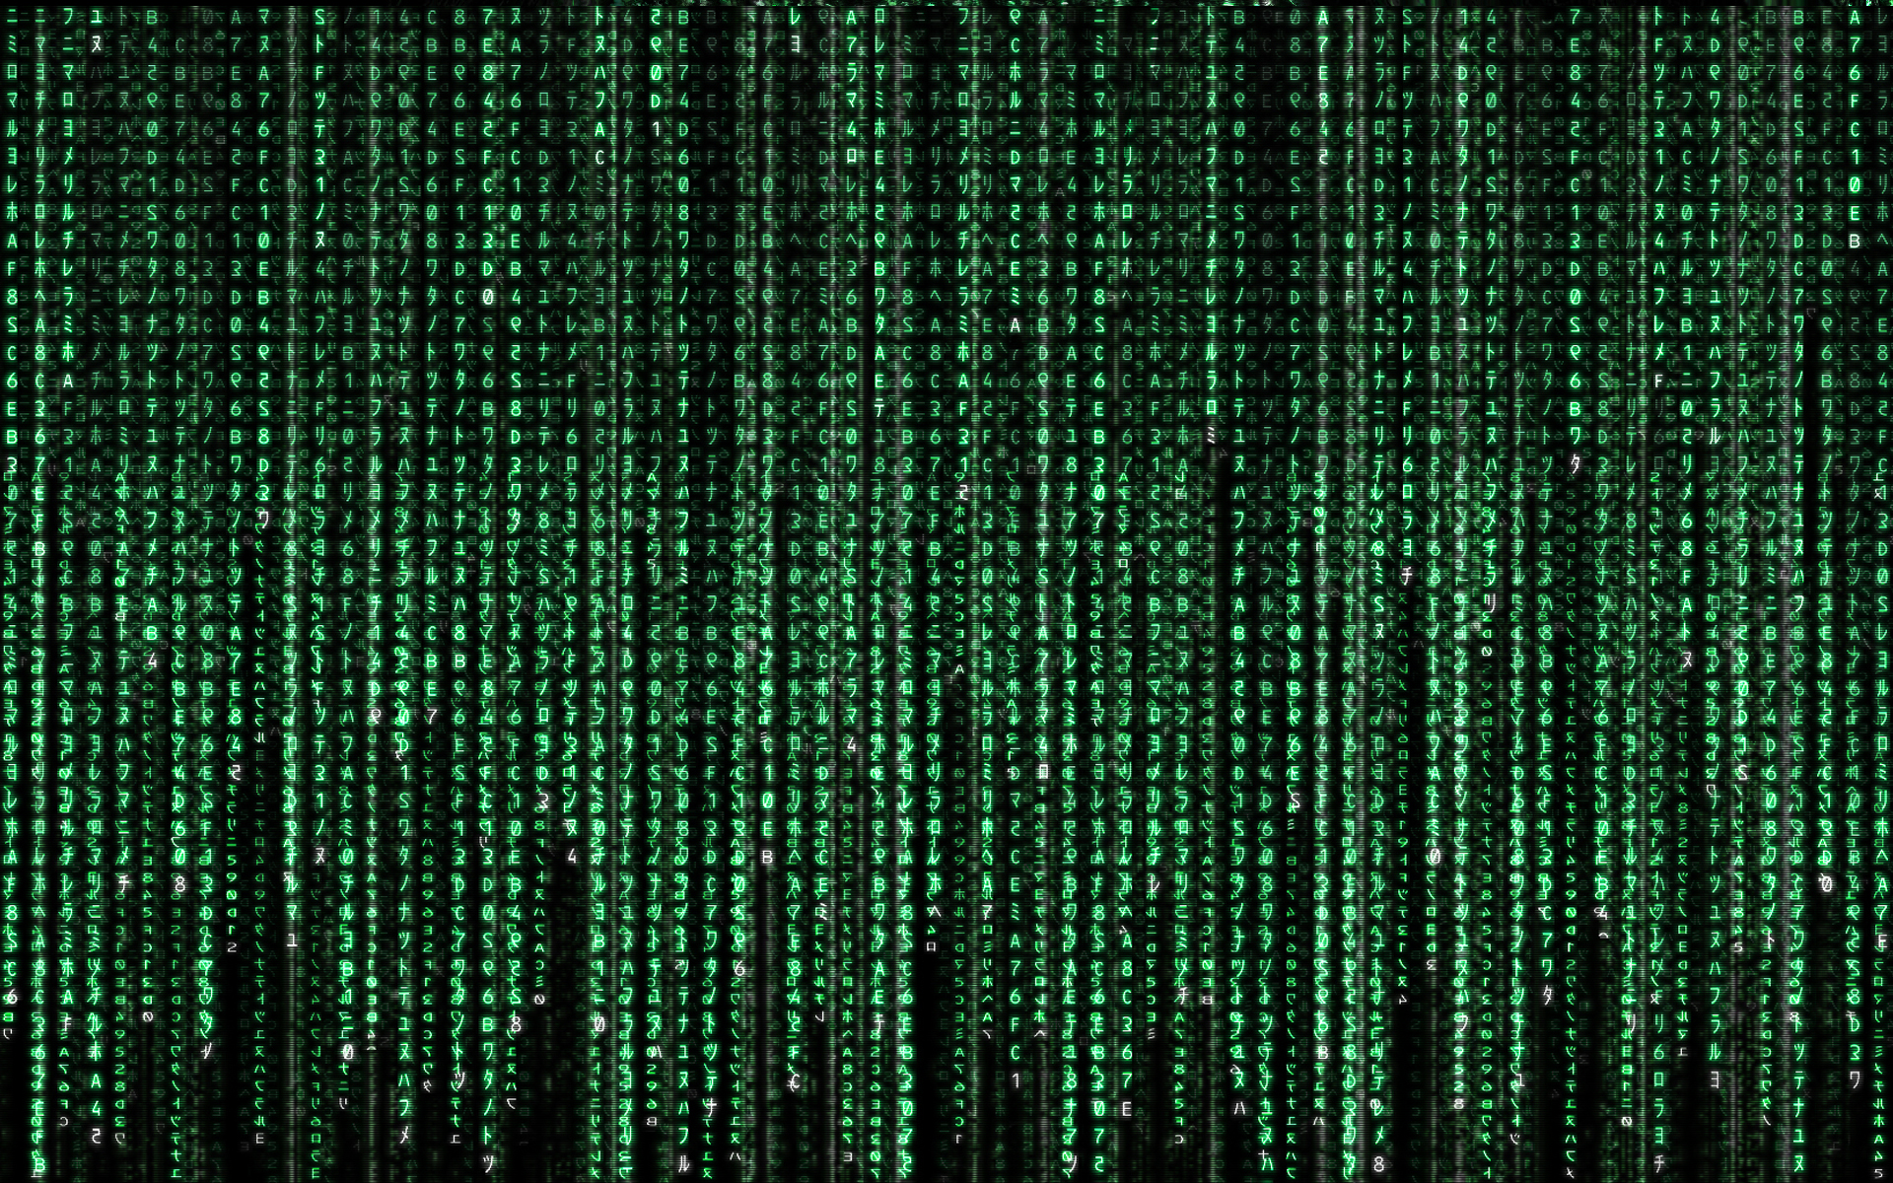
Simulation
Notes:
https://www.flickr.com/photos/isaiah115/7301506118/

Slide 2
Simulation is a method to study a model by randomly sampling from a probability distribution.

Slide 3
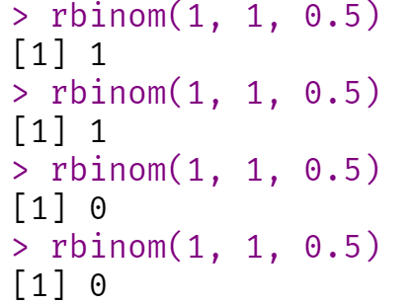
rbinom(1, 1, 0.5)

Slide 4
Simulations are great tools to understand statistical concepts.

Slide 5
nSims <- 100000
M <- 106
N <- 26
SD <- 15
p <- numeric(nSims)
For (i in 1:nSims) {
x <- rnorm(n = N, mean = M, sd = SD)
z <- t.test(x, mu = 100)
p[i] <- z$p.value }

Slide 6
How are p-values distributed under different levels of power?

Slide 7
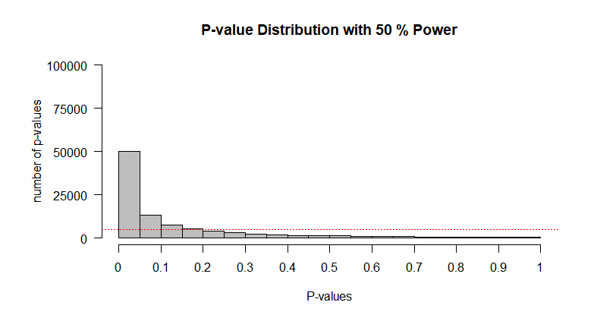

Slide 8
How does a p-value change as we add 1 observation at a time under the null?

Slide 9
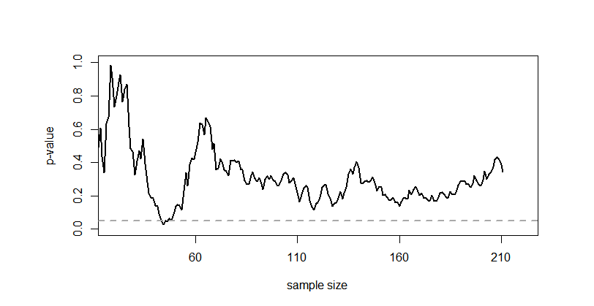

Slide 10
Simulations can be used to evaluate statistical procedures.

Slide 11
What happens when researchers perform power analyses based on pilot studies, but only when the sample size is considered feasible?
[Albers & Lakens, 2018]

Slide 12
What does a meta-analysis look like when there is massive publication bias?
[This MOOC, next module]

Slide 13
It is useful to simulate data that match your expectations before performing a study.

Slide 14
You can use simulated data to create an analysis script for a preregistration.

Slide 15
You can use the data simulation code and analysis script to perform an a-priori power analysis.

Slide 16
Generate data that have desired properties.
Perform the test on the simulated data.
Store the results. Repeat.
Count successes.

Slide 17
Power analyses based on simulations are more flexible than analytic solutions.

Slide 18
E.g., power for a 2x2x2 within-subject design with Holm correction for multiple comparisons.

Slide 19
Getting realistic input values is difficult. Use validated measures. Look at open data (from large enough datasets).

Slide 20
If you don’t know what you are measuring well enough to estimate the SD, you are not ready to test a hypothesis.

Slide 21
Look at best case and worst case scenarios in sensitivity analyses.
Notes:
Includes 0 effects!

Slide 22
If effects sizes decrease by 50% (e.g. due to bias) the sample size in a power analysis increases four times.

Slide 23
Create synthetic data that preserve key statistical features to share sensitive data for exploratory data analysis by other researchers.
[Nowok, Raab, Dibben, 2014]
Notes:
http://gradientdescending.com/generating-synthetic-data-sets-with-synthpop-in-r/

Slide 24
Simulations can also be used to create models of science that can be used to ask questions about how science works (or should work).

Slide 25
For example, what is the impact of rewarding quantity over quality, if researchers compete for resources, and can engage in questionable research practices?
[Smaldino & McElreath, 2016]

Slide 26
Learning how to perform simulation studies is a useful tool to evaluate procedures, learn statistics, or create computational models.

