Slide 1

Mixed Results

Slide 2
One of the bigger problems of p-values is their use as a threshold to publish.

Slide 3
Mixed results and non-significant results are less likely to be written up.

Slide 4
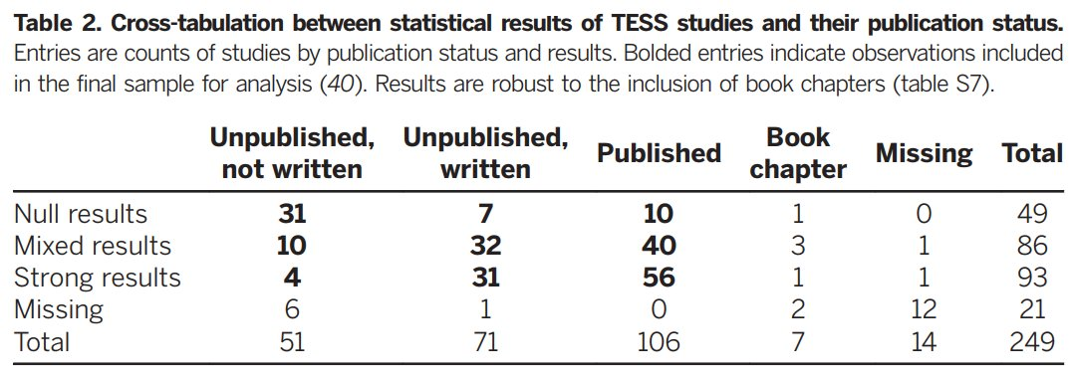
[Franco, Malhotra, & Simonovits, 2014]

Slide 5
Non-significant studies should be expected:
0.8×0.8×0.8×0.8=0.41

Slide 6
Scientific journals do not represent reality.

Slide 7
Imagine you perform 3 studies, and 2 are significant. Is that convincing evidence?

Slide 8
With 80% power and α = 0.05 this result will be observed 38.4% of the time.

Slide 9
The data are more likely under H1 than H0 with a likelihood ratio of 53.89. This is strong evidence for H1.

Slide 10
Would you trust scientific journals that publish mixed results more or less than those that do not?

Slide 11
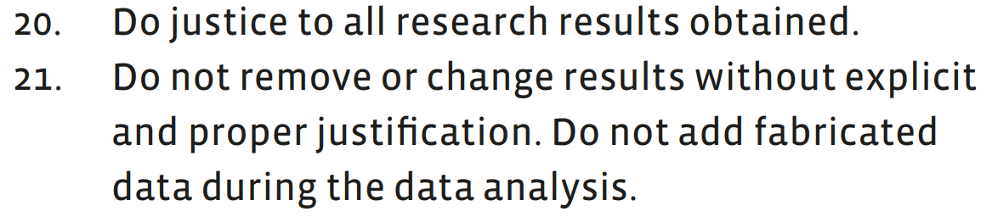
Publication bias is one of our biggest challenges.

Slide 12
Unless you only study true effects with 100% power, you will observe p > α in your career.

Slide 13
How can you share null-results of well-designed studies so researchers can find them?

Slide 14
Perform replication and extensions studies and include all (!) studies in an internal meta-analysis.

Slide 15
Design informative studies and publish conclusive null-effects. Use Registered Reports.

Slide 16
Discuss all related studies in the discussion section. Link to raw data and an online summary.

Slide 17
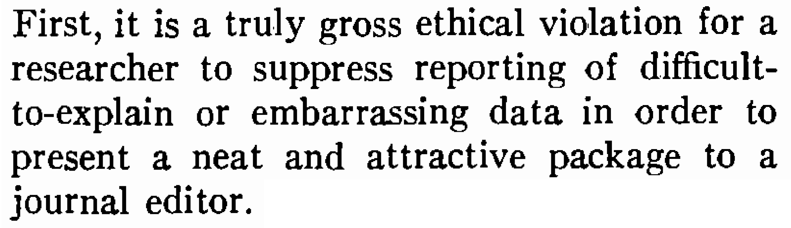
[Greenwald, 1975]

Slide 18
As a reviewer do not let null or mixed results bias your evaluation of the methodology or scientific contribution.

Slide 19
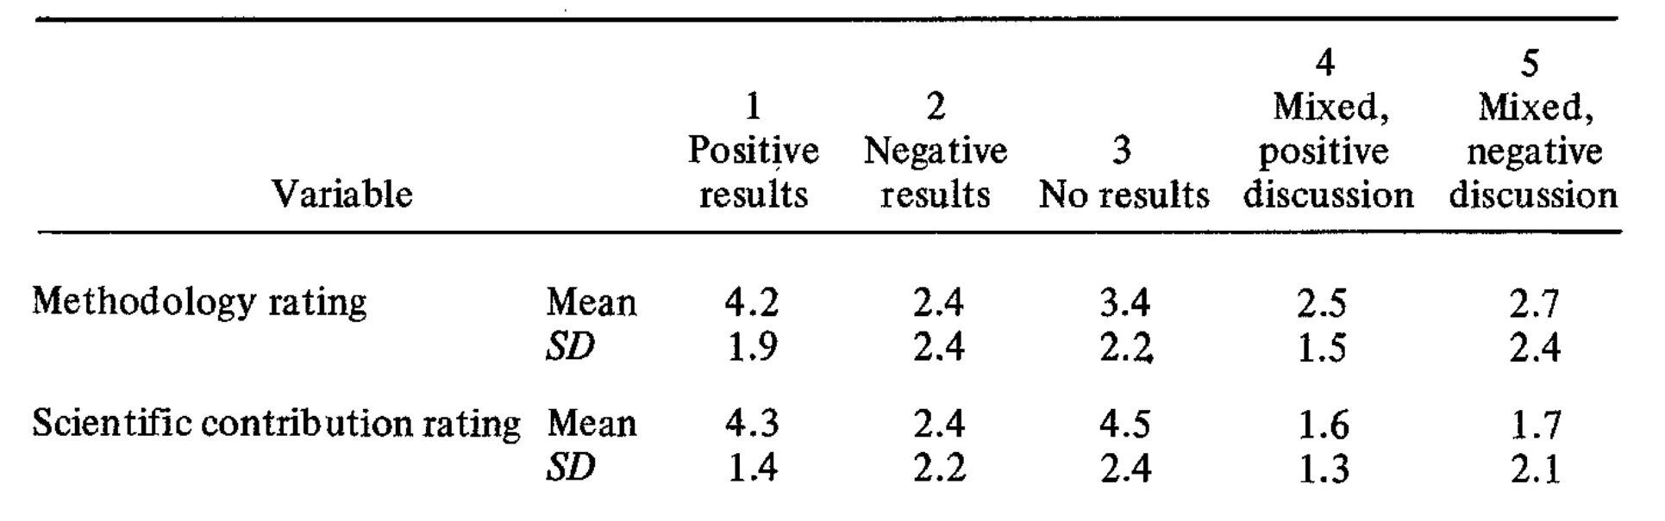
[Mahoney, 1977]

Slide 20
The Final Rule: The FDA requires researchers to submit certain studies to a trial registry and report results within a year.
Notes:
Since 2017, for certain trials. Fines of 10.000 a day results are not reported.

Slide 21
Mixed results will occur. Prepare for them and publish all results of well-designed studies.

