Slide 1

Introduction to Meta-Analysis

Slide 2
Both statistically and philosophically replications are important for science.

Slide 3
A meta-analysis can combine raw effects (e.g., means) or standardized effects.

Slide 4
Which question does a meta-analysis answer?

Slide 5
Prospective meta-analysis: Studies eligible for the meta-analysis are identified before the results of any of those studies became known.

Slide 6
For each effect, calculate the effect size estimate and its variance. Code variables that might explain variation.

Slide 7
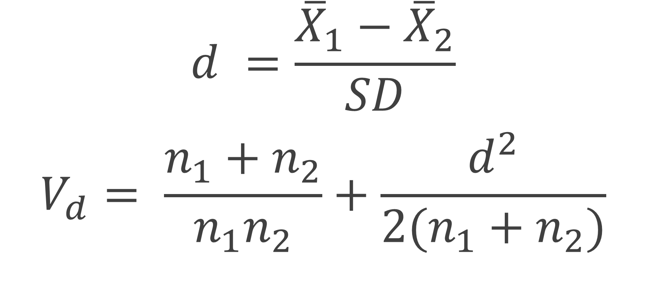
$$d =\frac{{\overline{X}}_{1}−{\overline{X}}_{2}}{SD}$$
$$V_{d}= \frac{n_{1}+n_{2}}{n_{1}n_{2}}+\frac{d^{2}}{2(n_{1}+n_{2})}$$
Notes:
Formula 4.18 and 4.20, Borenstein et al,. Pages 26 and 27

Slide 8

Borenstein et al. provide a very accessible introduction to meta-analysis.

Slide 9
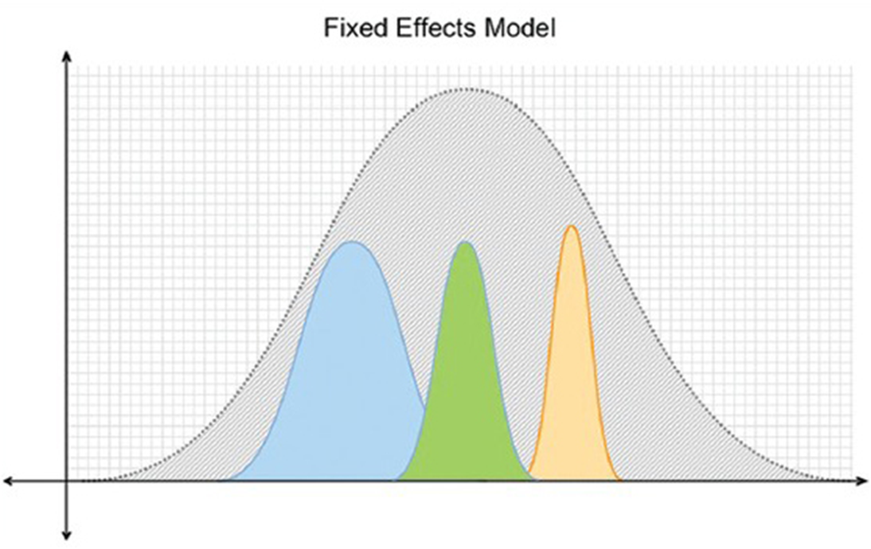
[Bigby, 2014]

Slide 10
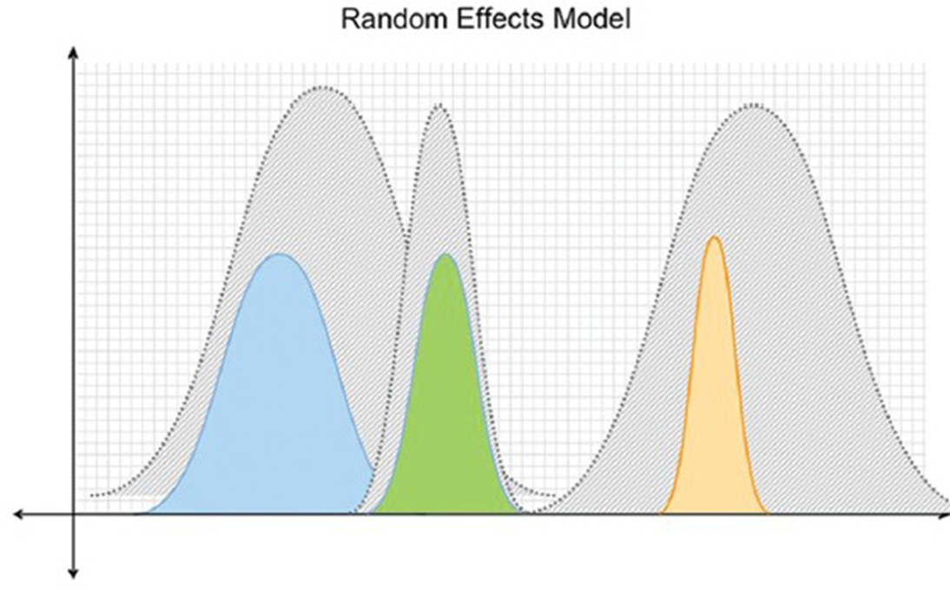
[Bigby, 2014]

Slide 12
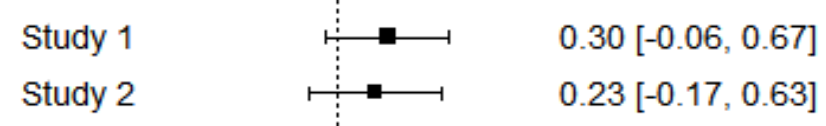
Would you have continued this line of research?

Slide 13
Don’t expect p < α in each study. Perform close replications and report all data.

Slide 14
One of the most important outcomes of a meta-analysis is the amount of heterogeneity (or variation) in effect sizes.

Slide 15
Explaining heterogeneity is an important goal of meta-analyses.

Slide 16
When performing a meta-analysis, consider the quality of studies and the presence of bias.

Slide 17
Don’t use non-transparent software to perform a meta-analysis. Instead use open and reproducible packages (e.g., metafor in R).
[Lakens, Hilgard, & Staaks, 2016]

Slide 18
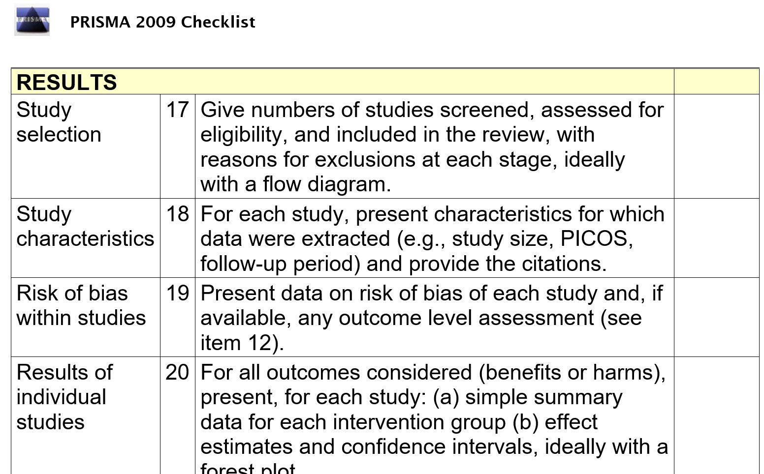

Slide 19
Recruit expertise (e.g., from the library for your literature search). Pre-register the analysis plan (see PROSPERO).

Slide 20
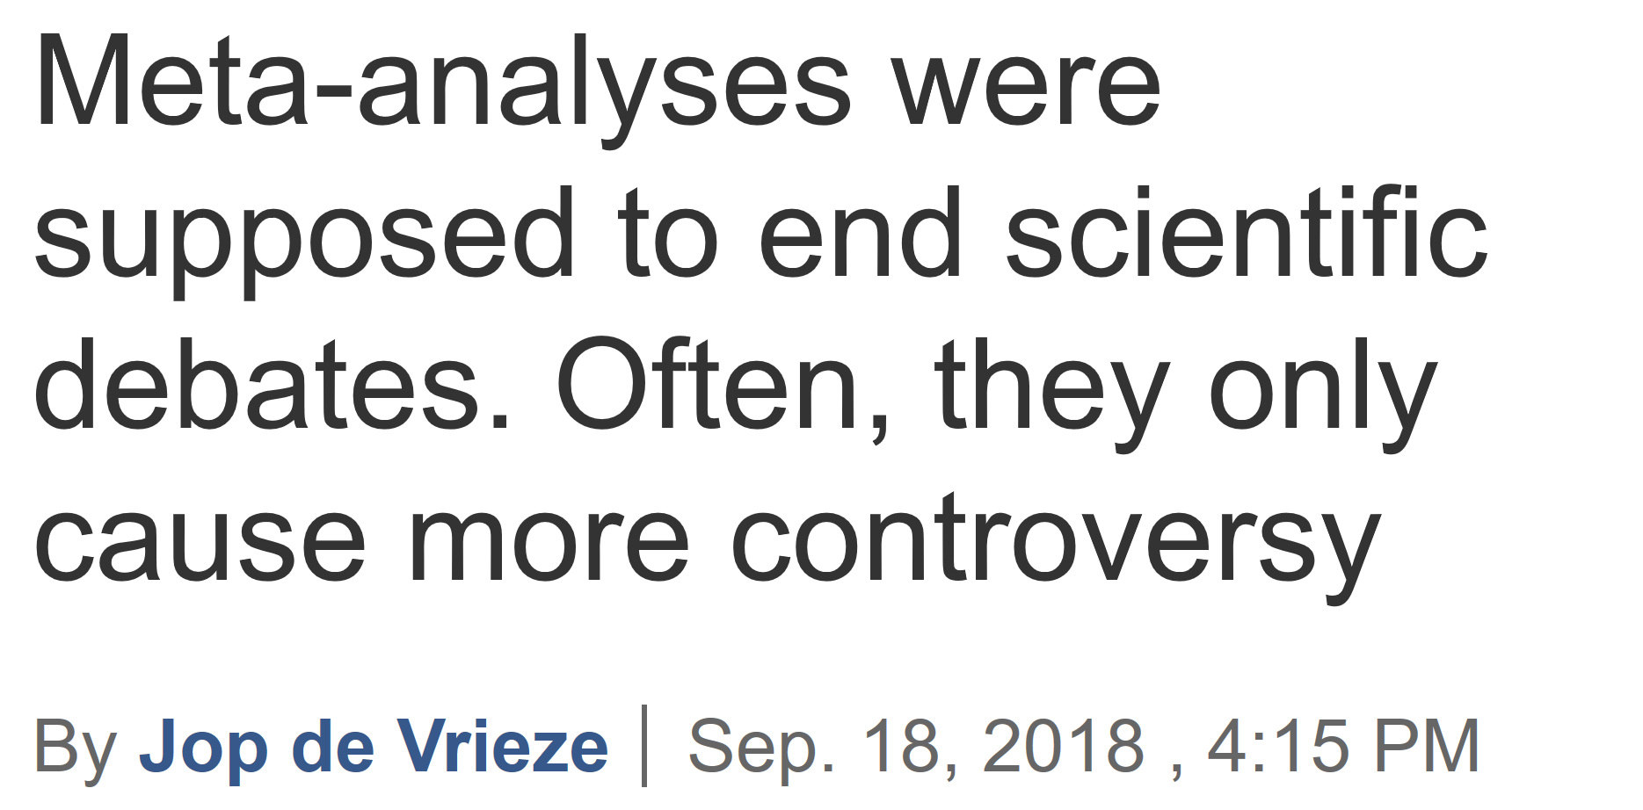

Slide 21
Meta-analysis might yield reliable effect size estimates. They allow you to explore theoretically interesting variation between studies.

