Slide 1
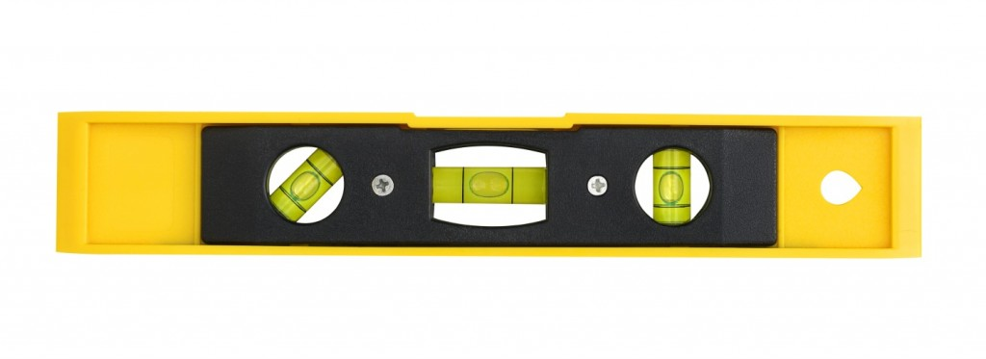
Detection
Bias

Slide 2
Bias can be introduced throughout the research process. It is useful to prevent this or to detect it.

Slide 3
“Confronted with the statistical news flash of the day, your first question is: Are the results due to selective reporting, cherry picking, or any number of other similar ruses?”
[Mayo, 2018]

Slide 4
Research Misconduct: Making up data or results, or changing or omitting data or results such that the research isn’t accurately represented in the research record.
Notes:
https://ori.hhs.gov/definition-misconduct

Slide 5
For example, Andrew Wakefield authored a fraudulent paper in 1998 that claimed a link between the measles, mumps, and rubella (MMR) vaccine and autism. It was retracted in 2010.
Notes:
https://ori.hhs.gov/definition-misconduct

Slide 6
Errors: Statistical reporting errors, ranging from incorrect degrees of freedom, to reporting
p = 0.056 as p < 0.05.
[Nuijten et al, 2015]
Notes:
https://ori.hhs.gov/definition-misconduct

Slide 7

Notes:
https://ori.hhs.gov/definition-misconduct

Slide 8
Inconsistencies: Results do not match the data generating process. Many papers report means that are not possible given the sample size (GRIM-test).
[Brown & Heathers, 2017]
Notes:
For example, if 2 people fill in a question on a 7-point scale, the mean should end on 0 or 0.5. Not 0.3.

Slide 9
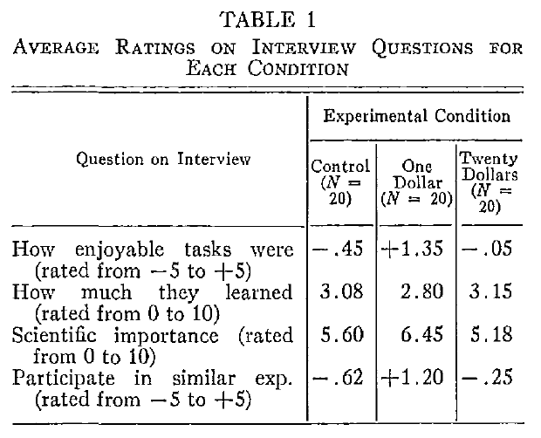
[Festinger & Carlsmith, 1959]
[Heino, 2016]
Notes:
http://nickbrown.fr/GRIM
the experimenters concluded that many human beings, when persuaded to lie without being given sufficient justification, will carry out the task by convincing themselves of the falsehood, rather than telling a bald lie.

Slide 10
[Festinger & Carlsmith, 1959]
[Heino, 2016]
Notes:
http://nickbrown.fr/GRIM

Slide 11
HARKing: Hypothesizing after the results are known. Proposing a hypothesis that was not foreseen or deemed plausible before looking at the data as the hypothesis of interest.
[Kerr, 1998]
Notes:
Problematic because of unknown multiple comparisons.

Slide 12
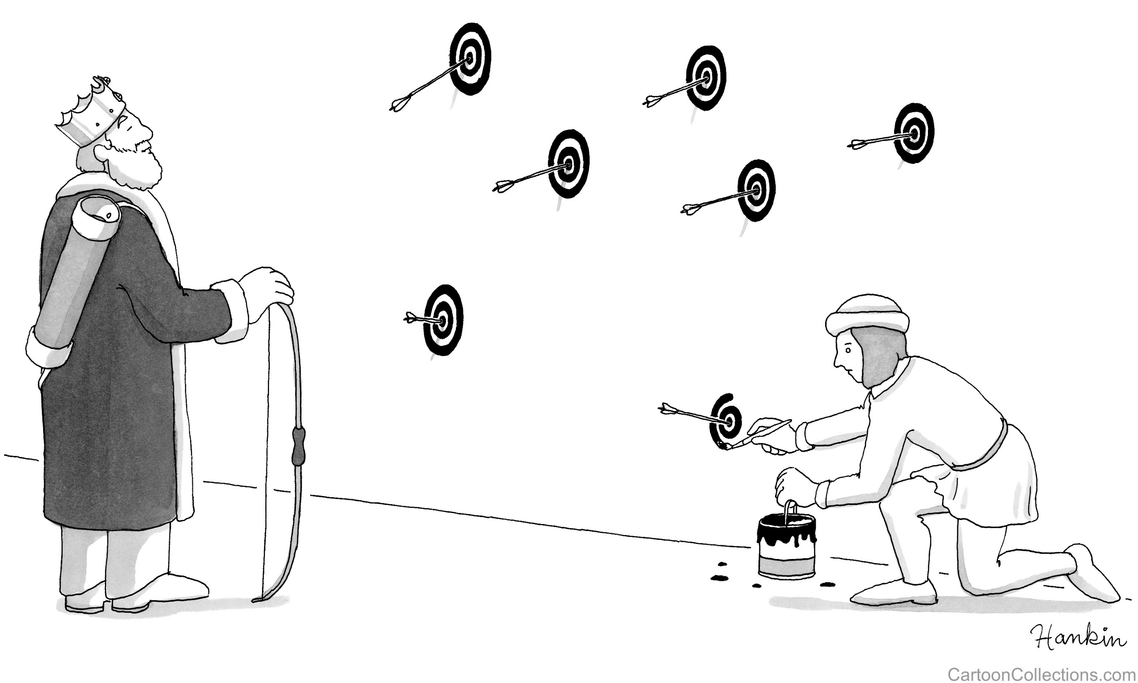
Notes:
Bought access to use in presentations: https://www.cartooncollections.com/cartoon?searchID=CC141259

Slide 13
Publication bias: research that appears in the published literature is systematically unrepresentative of the real population of completed studies.

Slide 14
Publication bias is caused by personal judgments that a study is flawed, preferring to write up positive results, or negative results being rejected.

Slide 15
It is only possible to correct for publication bias if we can model the bias. Since we do not exactly know how to model bias, we can not correct for publication bias.

Slide 16
Some older bias detection techniques are no longer considered valid. For example, fail-safe N is only useful to identify meta-analyses that are not state of the art.

Slide 17
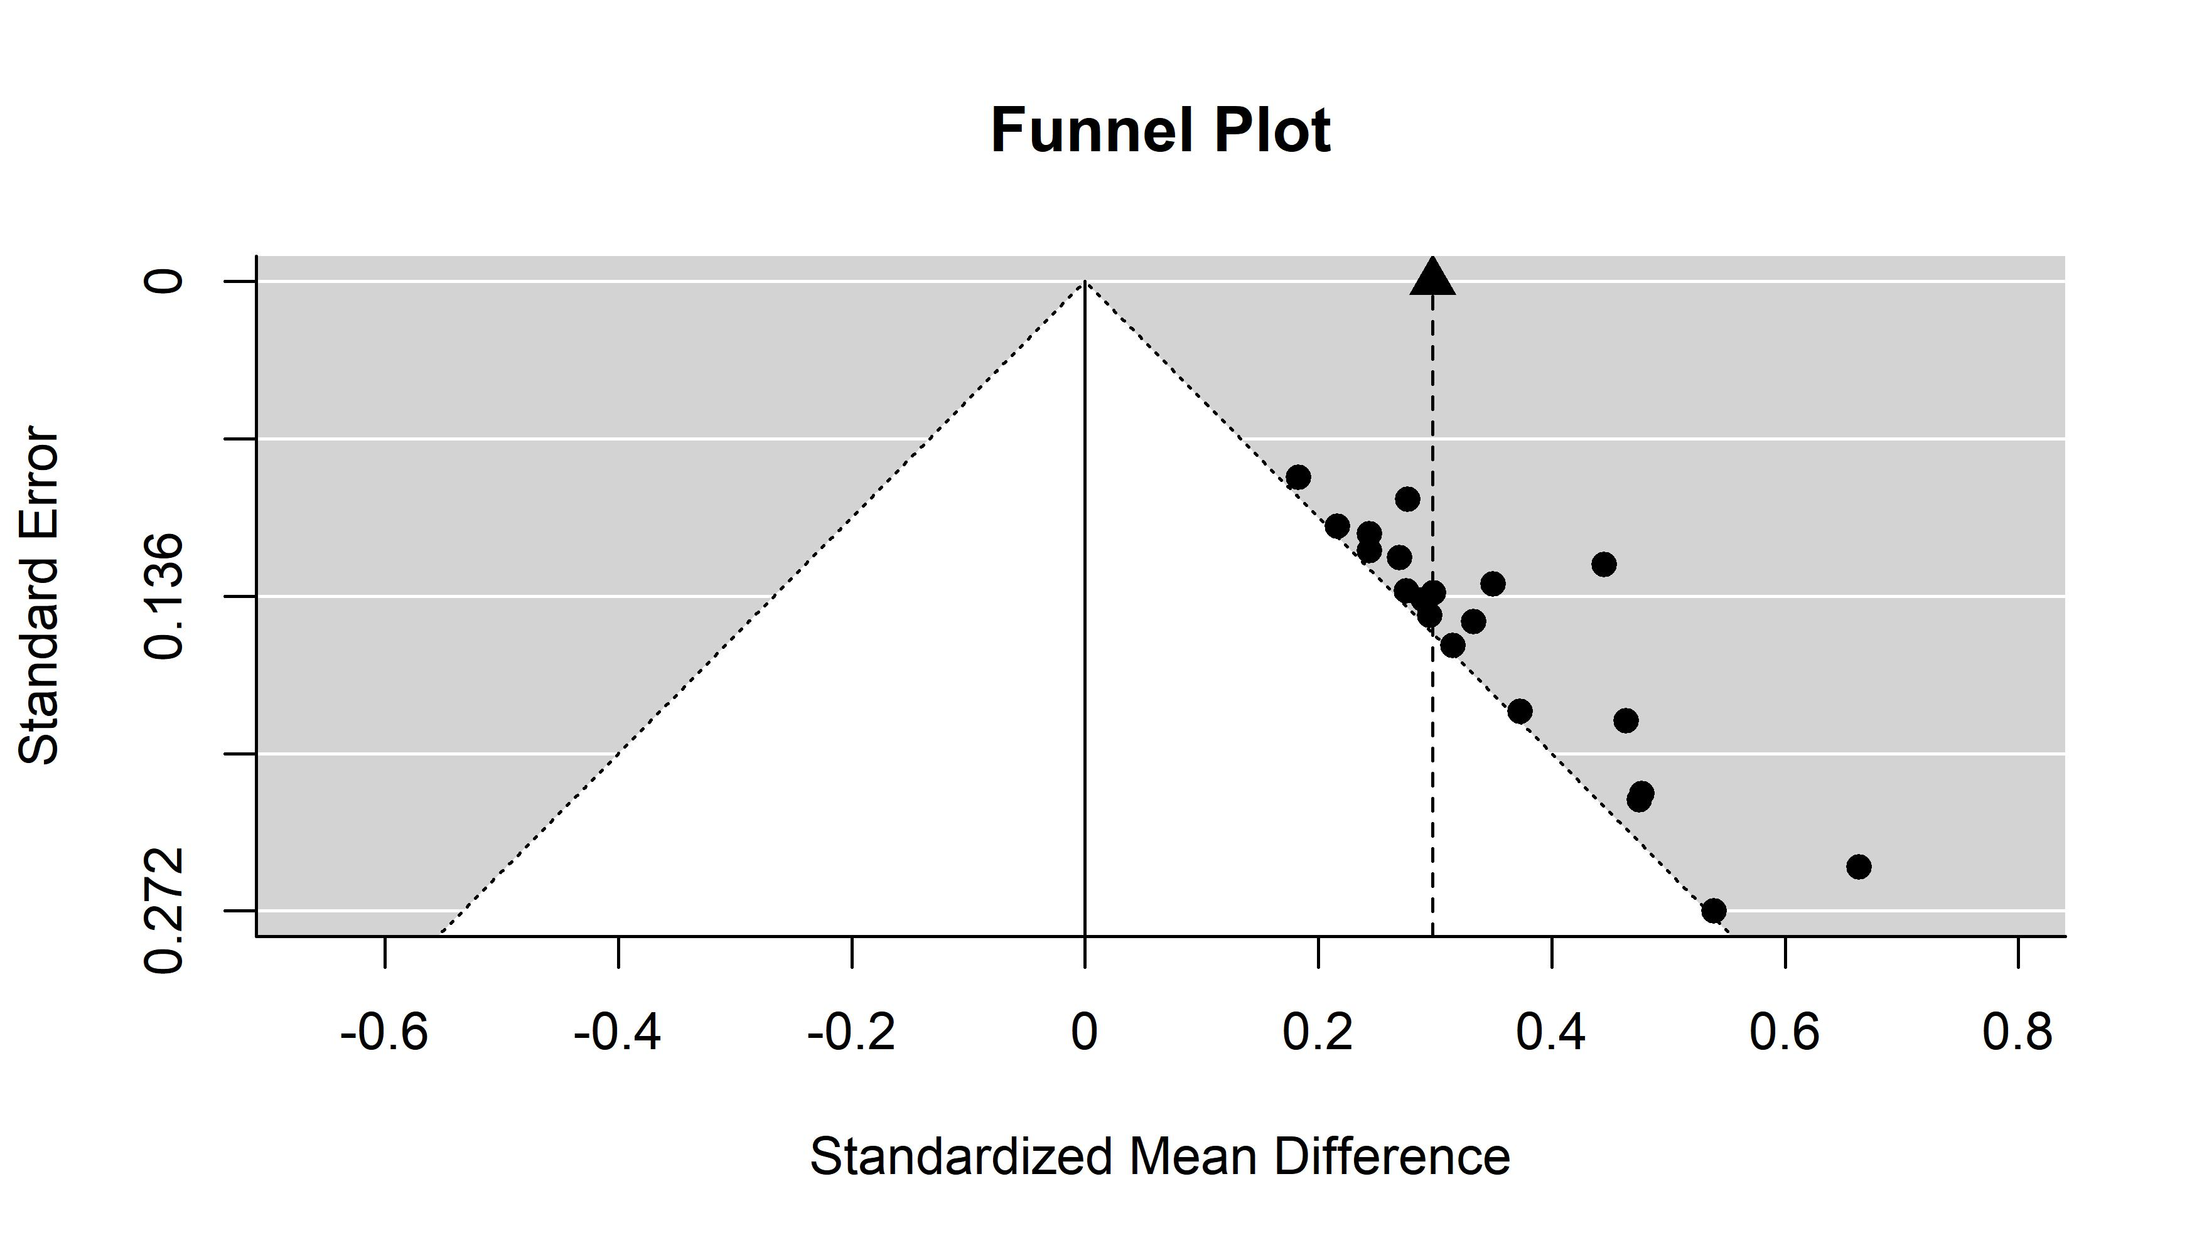

Slide 18
N = Infinite
N = 562
N = 114
N = 56

Slide 19
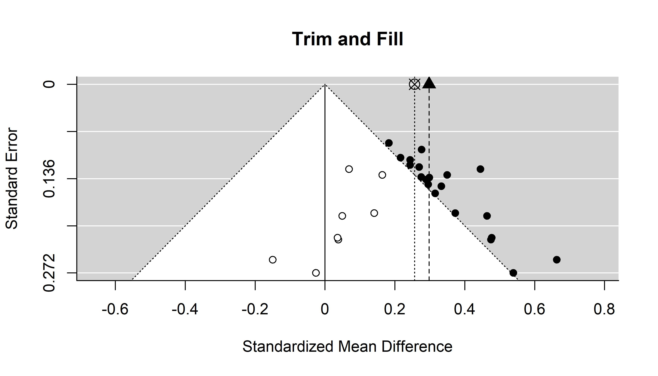
Trim-and-fill can detect bias.

Slide 20
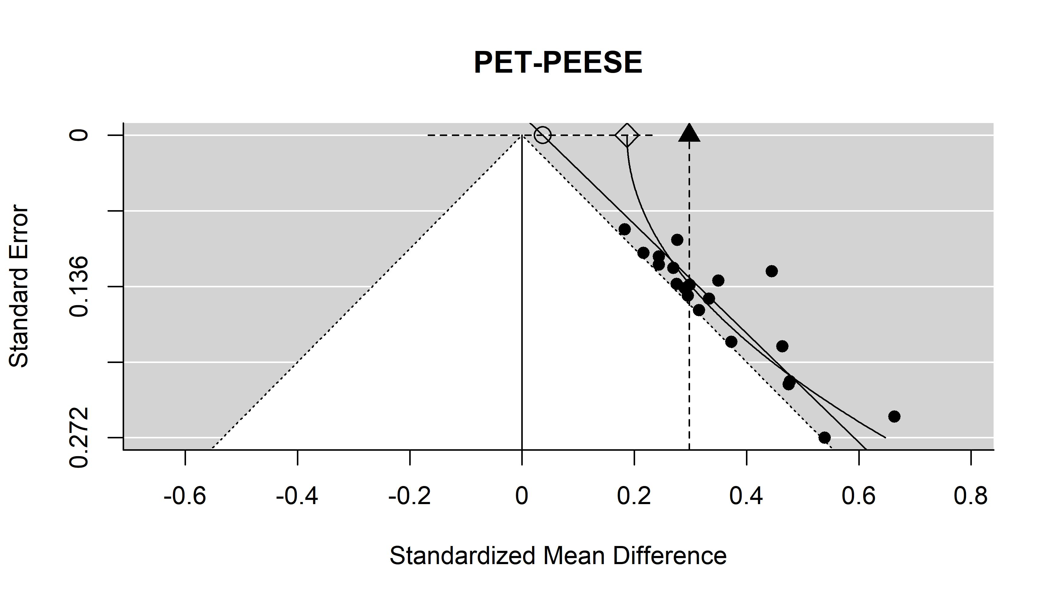

Slide 21
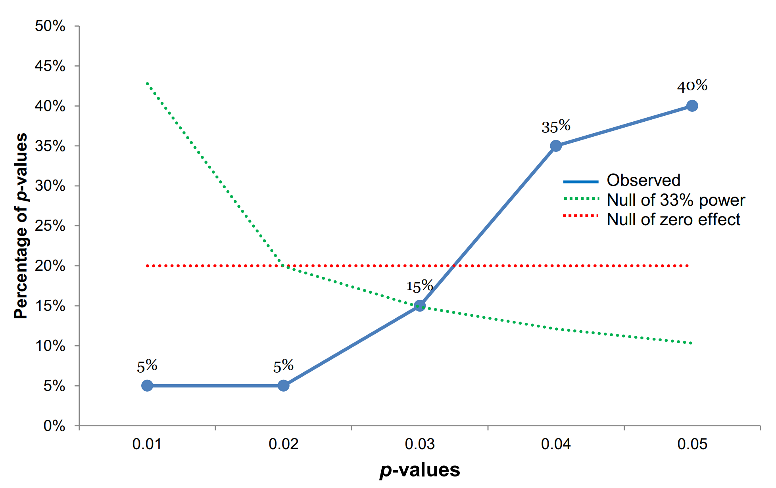

Slide 22
All these techniques only detect bias under certain models. If they detect bias, there is reason to worry. If they don’t detect bias, there might still be reason to worry.

Slide 23
Accumulation bias: Whether and when to perform a meta-analysis is influenced by looking at the available results.
[ter Schure & Grünwald, 2019]
Notes:
Plays a role even without publication bias.
Similar as sequential analysis

Slide 24
Regrettably, our scientific literature is not unbiased. Take this into account when evaluating research findings.
Notes:
Plays a role even without publication bias.
Similar as sequential analysis

