Slide 1
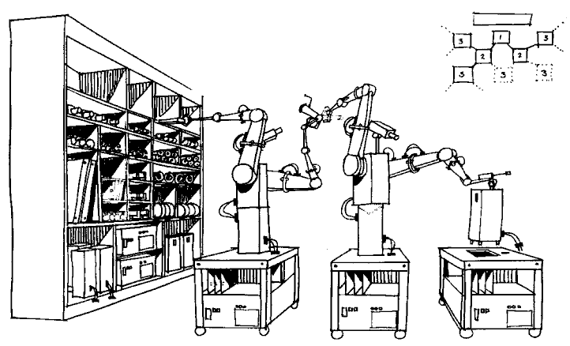
Computational Reproducibility

Slide 2
Computational reproducibility: Using the same data to get the same results.
Notes:
Explain ‘data rot’

Slide 3
Making sure someone else can computationally reproduce your results should be a goal in any scientific workflow.
Notes:
Explain ‘data rot’

Slide 4
There is no single standard and novel software solutions continuously emerge.
Notes:
Explain ‘data rot’

Slide 5
Open source software is licensed such that it is free to use, making it widely accessible.
Notes:
Explain ‘data rot’

Slide 6
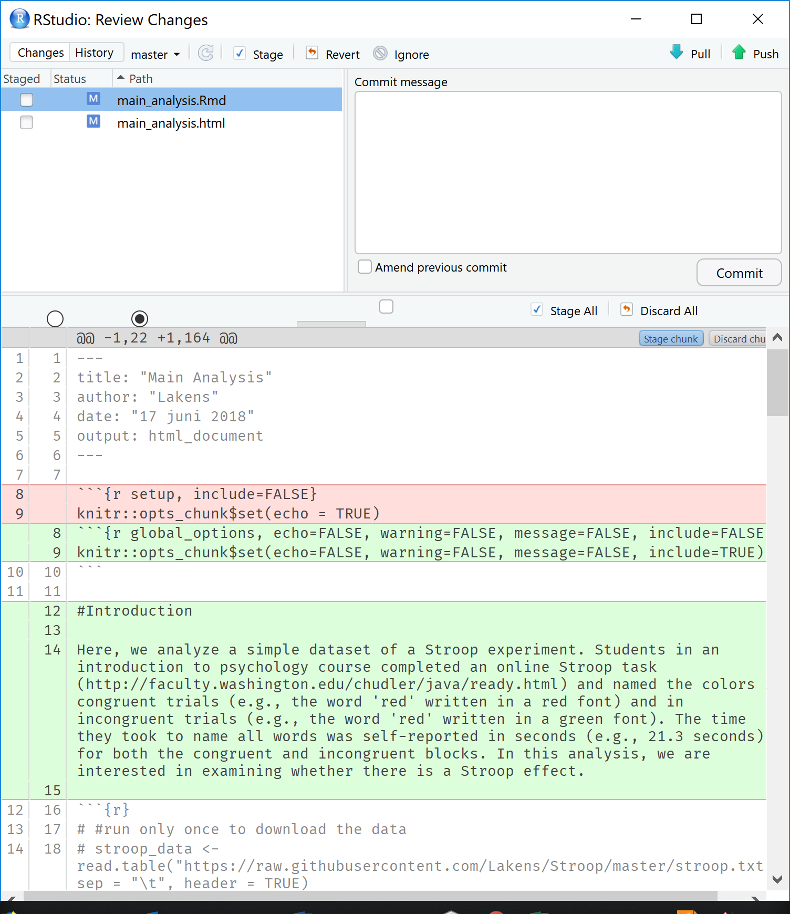
Version control: Track all changes to files over time and store each version.
Notes:
Explain ‘data rot’

Slide 7
Using version control makes it easy to go back to earlier versions, review changes, and see which collaborator made changes to files.
Notes:
Explain ‘data rot’

Slide 8


Notes:
Explain ‘data rot’

Slide 9


Notes:
You can use

Slide 10

R Markdown makes it possible to write completely reproducible manuscripts, combining text and
data analysis.

Slide 11
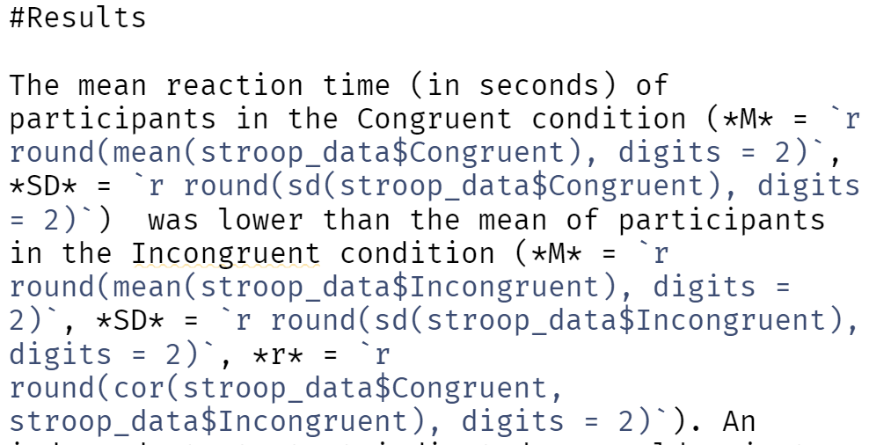

Slide 12
Any change to the raw data will lead to updates in the text, tables, and figures throughout the document.

Slide 13
You will still make errors, but they are now reproducible. More transparency means errors will become more visible.

Slide 14
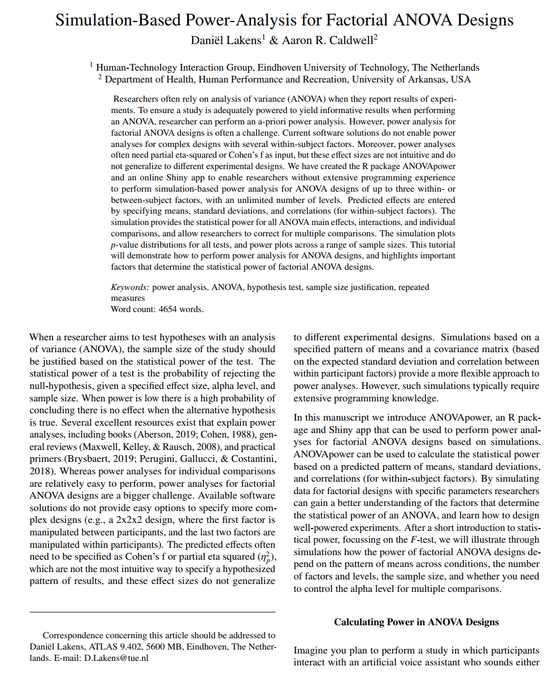
Use the papaja R package for manuscripts with APA lay-out.

Slide 15

Zotero is an open source reference manager. Use Better BibTex and citr for citations in R Markdown.

Slide 16
Ask participants for permission to share data in the informed consent whenever possible, and share raw data and code.

Slide 17
“I understand that the research data, without any personal information that could identify me, may be shared with others”
Notes:
From Utrecht University: https://www.uu.nl/en/research/research-data-management/guides/informed-consent-for-data-sharing

Slide 18
Sharing a reproducible script and the data when submitting a manuscript can increase the quality of peer reviews.

Slide 19

Add a license to your work to communicate how others can use your data, code, and materials (e.g., MIT license).

Slide 20
Upload data to a data repository that guarantees long term storage. Add a Digital Object Identifier (DOI).

Slide 21
Add a codebook and search engine indexable metadata. Try to make the data FAIR: Findable, Accessible, Interoperable and Reusable.

Slide 22


Slide 23
Try to reproduce your own results before sharing them, or ask a collaborator to check the computational reproducibility of your code.

Slide 24
Doing computationally reproducible research is a skill you need to train. Take one step at a time, and you will get there in the end!

