Slide 1
Research
Integrity
Research
Practice

Slide 2
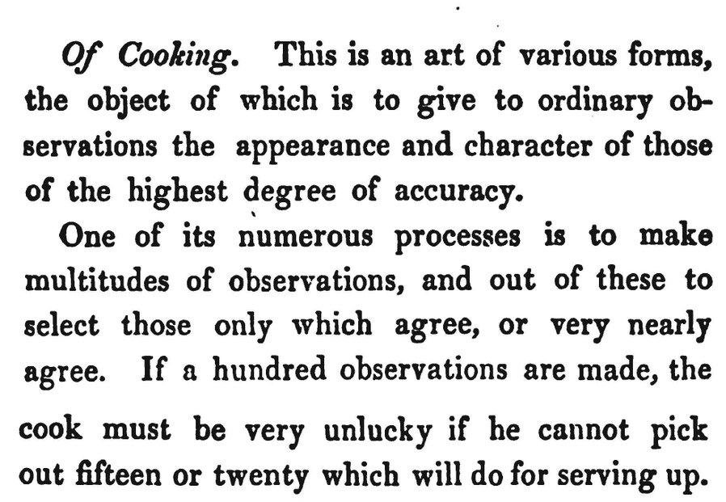
Charles Babbage, 1830, Reflections on the Decline of Science in England: And on Some of Its Causes'

Slide 3
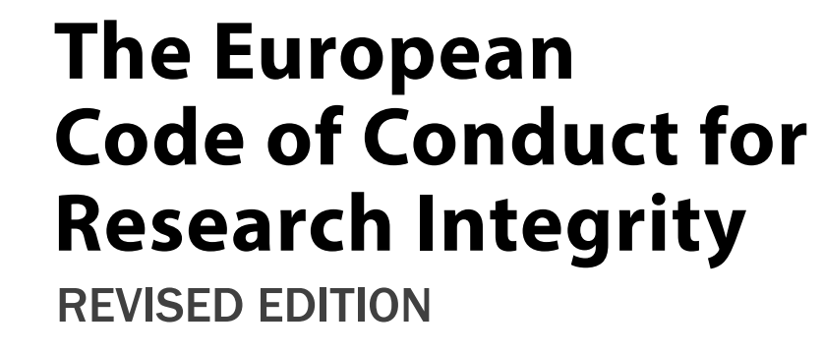
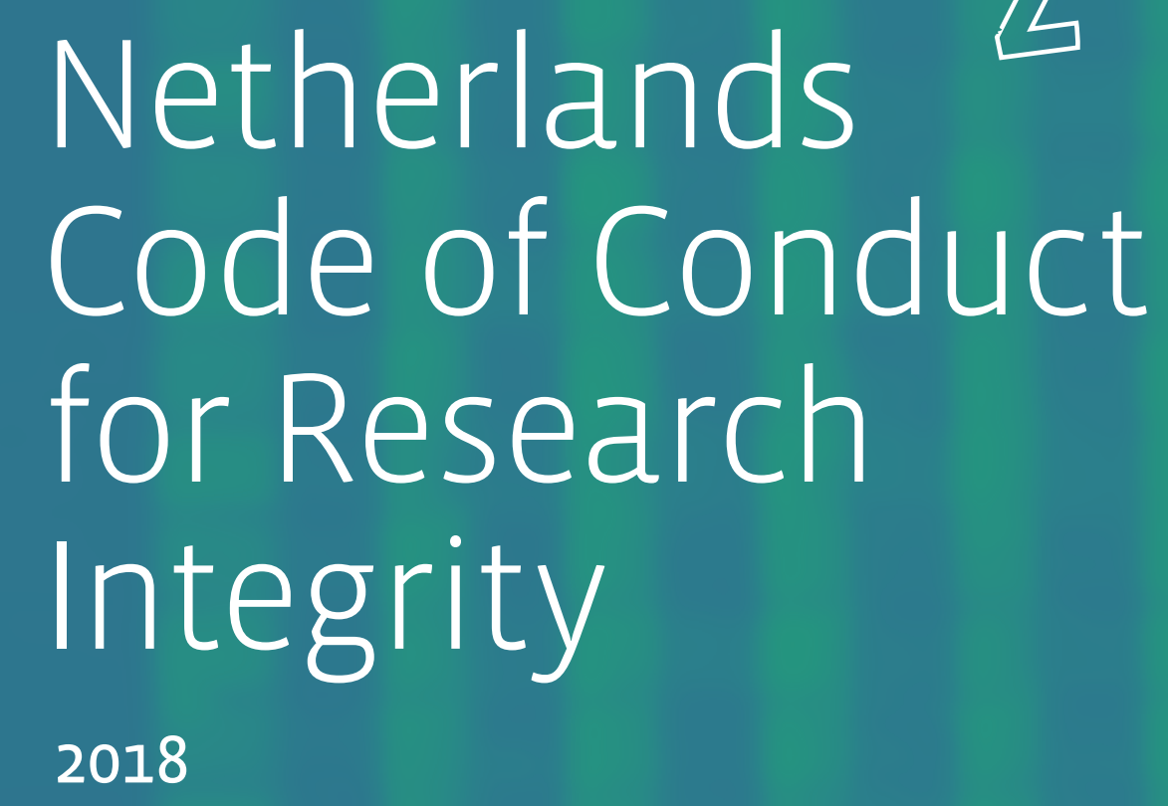
Have you ever read the Code of Conduct for Research Integrity?

Slide 4
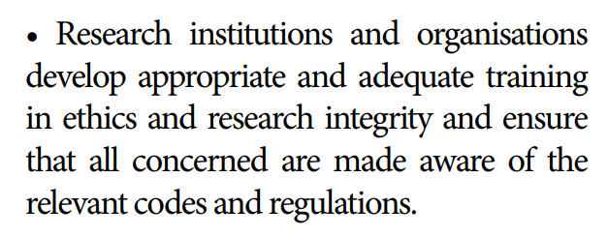

Slide 5
A scientist runs several experiments, but only reports those experiments that show the results they want to see. In your view, how morally acceptable or unacceptable is this?

Slide 6
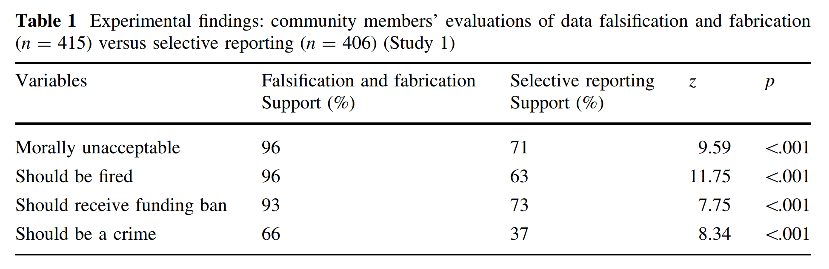
[Pickett & Roche, 2017]

Slide 7
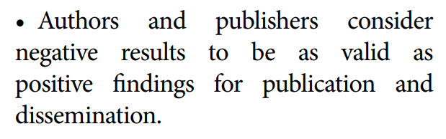
‘Withholding research results’ is deemed ‘unacceptable’.

Slide 8
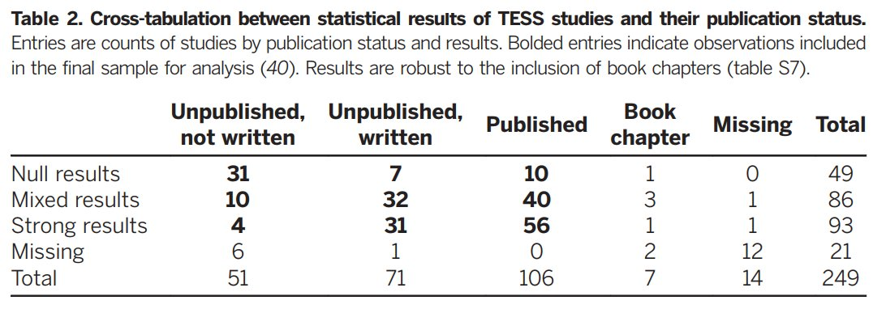
[Franco et al., 2014]

Slide 9
There are no questionable research practices, only questionable reporting practices.
[Dotsch & Wigboldus, 2015]

Slide 10
Around 68% [42%] of psychologists admit they selectively report studies [regarding a specific finding] that ‘worked’ at least once.
[John et al., 2012; Fiedler & Schwarz, 2017]

Slide 11
Other practices researchers admit to are selectively reporting measures or conditions, optional stopping, rounding p = .054 to p < .05, and fraud.
[John et al., 2012; Fiedler & Schwarz, 2017]

Slide 12
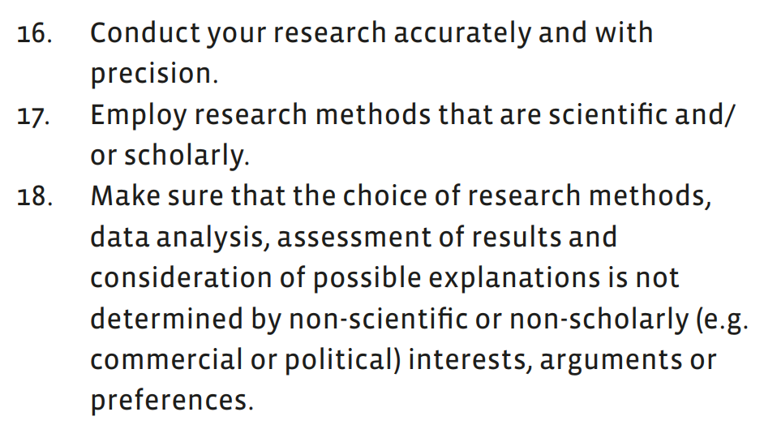

Slide 13
What are benefits of
questionable reporting practices?

Slide 14
What are costs of
questionable reporting practices?

Slide 15
Inflation of the Type 1 error rate quickly destroys the evidence in your data.

Slide 16
Don’t mindlessly follow new norms of what you can and can’t do. Understand the problem and the available solutions.

Slide 17
For example, sequential analyses instead of optional stopping, exploratory analyses instead of HARKing.

Slide 18
Supervisors and managers should encourage good research practices.

Slide 19
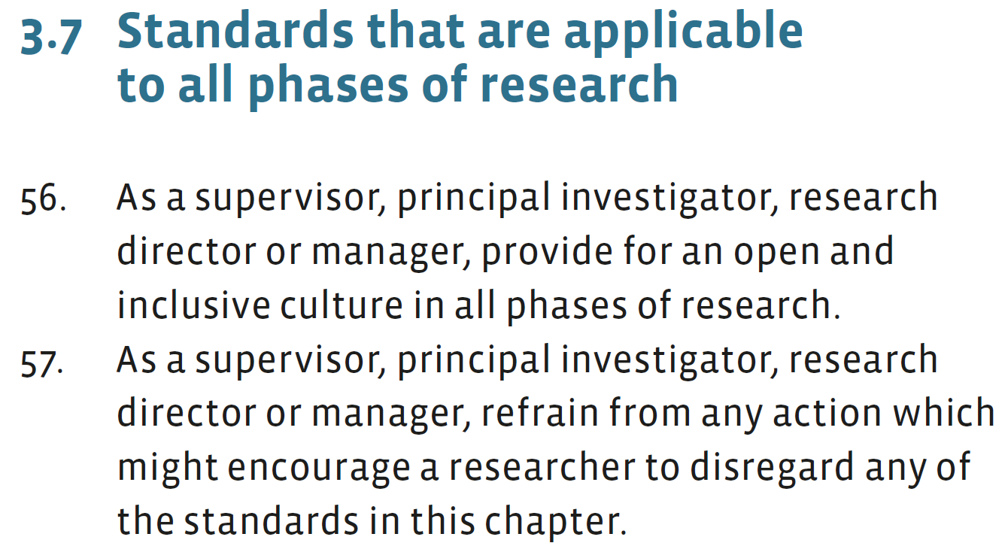

Slide 20
Have an open discussion with colleagues about how research practices can be improved. Address one challenge at a time.

Slide 21
How will you share mixed and null results? How is lower output as a result of higher standards rewarded?

Slide 22
What should you do if you see others engage in questionable practices? How is collaboration and team science rewarded?

Slide 23
Questionable practices are centuries old. We need to work together to do reliable and honest work with respect and accountability.

