Slide 1


Expenditure Tracker (Personal Finance Management)
Simplifying Daily Expense Management with OCR and Analytics
PRINCE TAWIAH
MS DATA SCIENCE
SUPERVISOR: DR. WEIHUA ZHOU

Slide 2


Problem and Objectives
❌ Manual tracking is error-prone and inefficient.
📉 Lack of actionable insights into spending.
✅ Automate expense tracking using OCR and Python GUI.
📊 Visualize trends and export reports for deeper analysis.

Slide 3
System Overview & Tech Stack
Tkinter GUI with OCR (Tesseract) for receipt scanning.
MySQL database for secure local data storage.
Matplotlib for charts and dashboards.
CSV export for use with external tools.

Slide 4
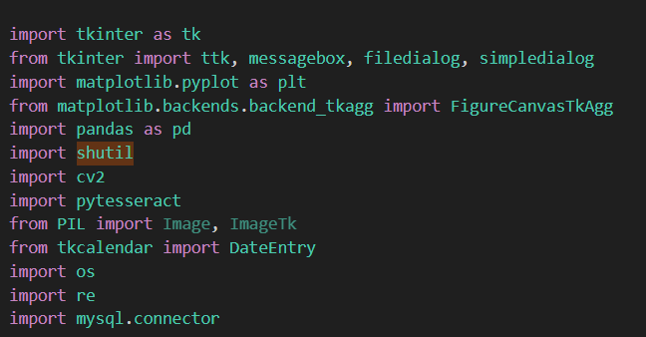
Key Features
📝 Manual and OCR-based expense entry.
📅 Date picker and category dropdown.
📈 Dashboard with pie and trend charts.
📤 Export to CSV. Secure local storage.

Slide 5

Challenges & Future Scope
⚠️ OCR misreads low-quality receipts.
📁 Duplicate image handling.
🔐 Multi-user login and cloud backup.
🤖 AI-based auto-categorization, mobile version.

Slide 6
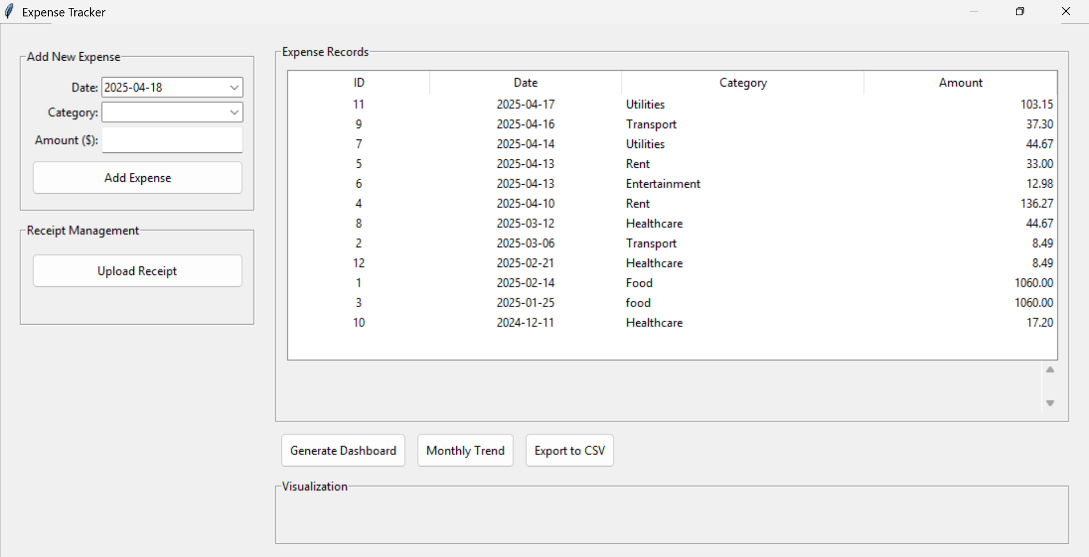
GUI

Slide 7
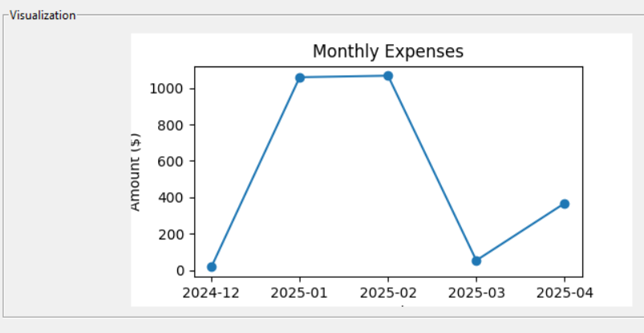
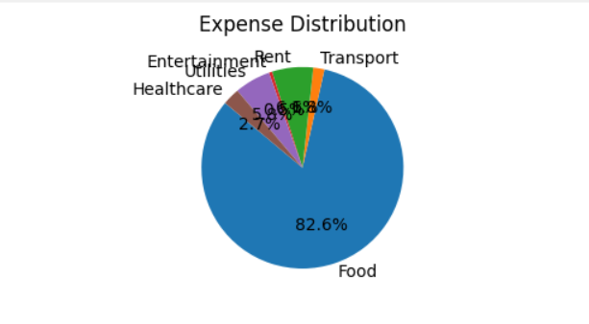
Visualization

Slide 8
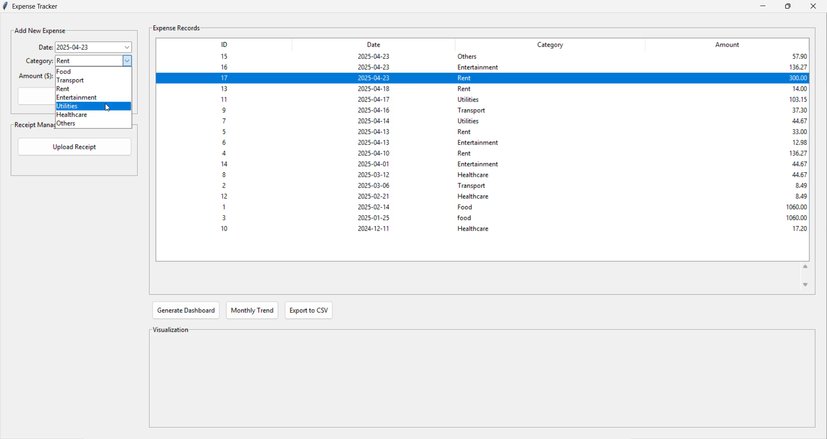
DEMO

Slide 9
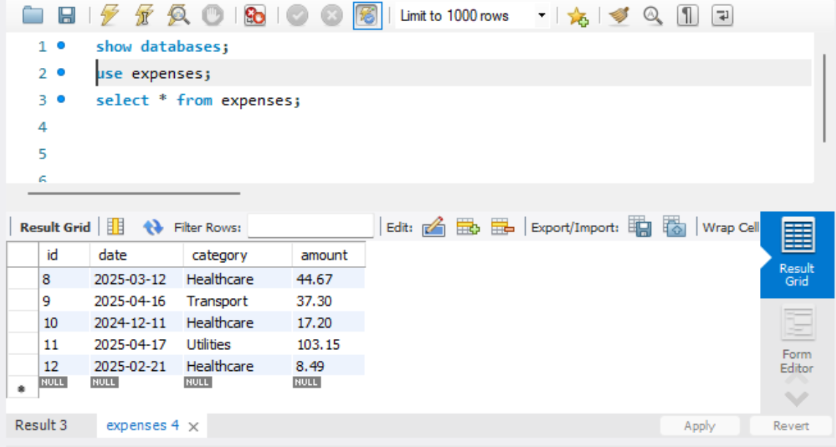
MySQL Database

Slide 10
Conclusion
✅ Simplifies personal finance management.
🔍 Enhances visibility into expenses.
💾 Secure, local-first solution with export features.
🙌 Thank you!

