Slide 1
CASE 3 · FOOD DELIVERY DEMAND PULSE
A regional food-delivery company
is overpaying surge incentives —
and making deliveries slower.
+3.7 min
50,000
7 cities
12.7%
longer delivery when surge is applied
orders analysed
Jan-Mar 2025
surge outside peak hours
43.2 min (surge) vs 39.5 min (no surge)
Surge policy fires after queues form — not before. It compensates riders for a backlog it never prevented.
1 / 5

Slide 2
APPROACH
Stack, method, and key trade-offs
WHAT WE BUILT
KEY TRADE-OFFS
Python + Pandas
EDA, aggregations, surge vs delivery correlation (scipy.stats)
Rolling mean vs ARIMA for forecast?
Chose rolling mean — honest at 7-day horizon with high day-to-day variance. ARIMA needs 6+ months to stabilise.
Matplotlib charts
6 annotated charts — hourly demand, surge overlap, city cohorts, forecast
Correlation vs causation on surge?
Reported r = 0.12 as association, not causation. Ops team needs an A/B test to confirm direction.
Narrated Jupyter notebook
Runs top-to-bottom. Each section has a markdown explanation before code.
City-level vs aggregate analysis?
Both. Aggregated for trend clarity; city cohort confirmed all 7 cities peak identically — uniform policy is fine.
PptxGenJS slide deck
Surge 'misfire' definition?
7-slide ops deck + this 5-slide evaluator deck, both built programmatically
Orders outside hours 12–14 and 19–22 with surge applied. Conservative — flags only clear off-peak, not edge cases.
2 / 5

Slide 3
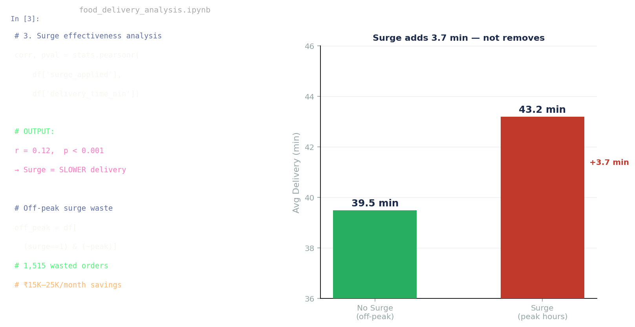
THE BUILD
Notebook + charts, running end-to-end
Narrated notebook
Each analysis section has a plain-English markdown cell above the code. Runs top-to-bottom with pre-run outputs.
The smoking-gun cell
r = 0.12, p < 0.001 — surge correlates with slower delivery. Printed directly as output, not buried in a chart.
Chart: delivery vs surge
Visual proof — no peak hour shows surge reducing delivery time. Green vs red bars make it impossible to miss.
✓ Jupyter notebook (narrated, runnable)
✓ 7-slide ops deck (PPTX)
✓ 7-day forecast CSV
✓ Exec summary (1-page)
3 / 5

Slide 4
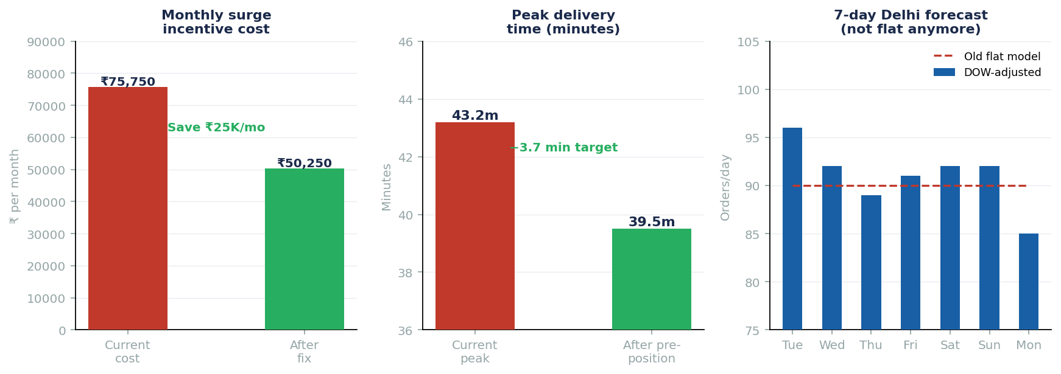
OUTCOMES
What the analysis found, with numbers
01
Surge fires in off-peak 12.7% of the time — 1,515 wasted orders over 90 days
02
Surge orders arrive 3.7 min slower than non-surge (r=0.12, p<0.001)
03
Weekend surge rate 32.2% vs 20.5% weekday — no weekend policy exists
04
DOW-adjusted forecast: Tue 96 orders, Mon 85 — 13% swing the flat model missed
4 / 5

Slide 5
WHAT'S NEXT
With another week, here's what gets built.
Day 1–2
Day 3–4
A/B test design — production-ready
Weather-augmented forecast
Formalise the weekend pre-position experiment with exact sample size calculation, randomisation unit (city-week), and a power analysis for the 2-min delivery improvement target. Hand it to the Ops team as a runnable protocol.
Pull rain probability data from the IMD Open API and add it as a regressor to the Delhi forecast. Test MAPE improvement. Expected: 4–6pp reduction. Generalise to all 7 cities.
Highest priority — cheapest to run, fastest signal
Forecast MAPE target: below 12%
Day 4–5
Day 5–7
Streamlit ops dashboard
Cuisine-level demand segmentation
Live city × hour demand heatmap, surge overlap indicator, and 7-day forecast panel. Ops Head can slice by city and weekday/weekend without touching a spreadsheet.
Biryani and Fast Food behave differently at peak. A cuisine-aware pre-position model could target rider type by zone, not just rider count. Early-stage but high potential.
Stretch goal — depends on data pipeline access
Exploratory — needs restaurant-level location data
5 / 5

