Slide 1
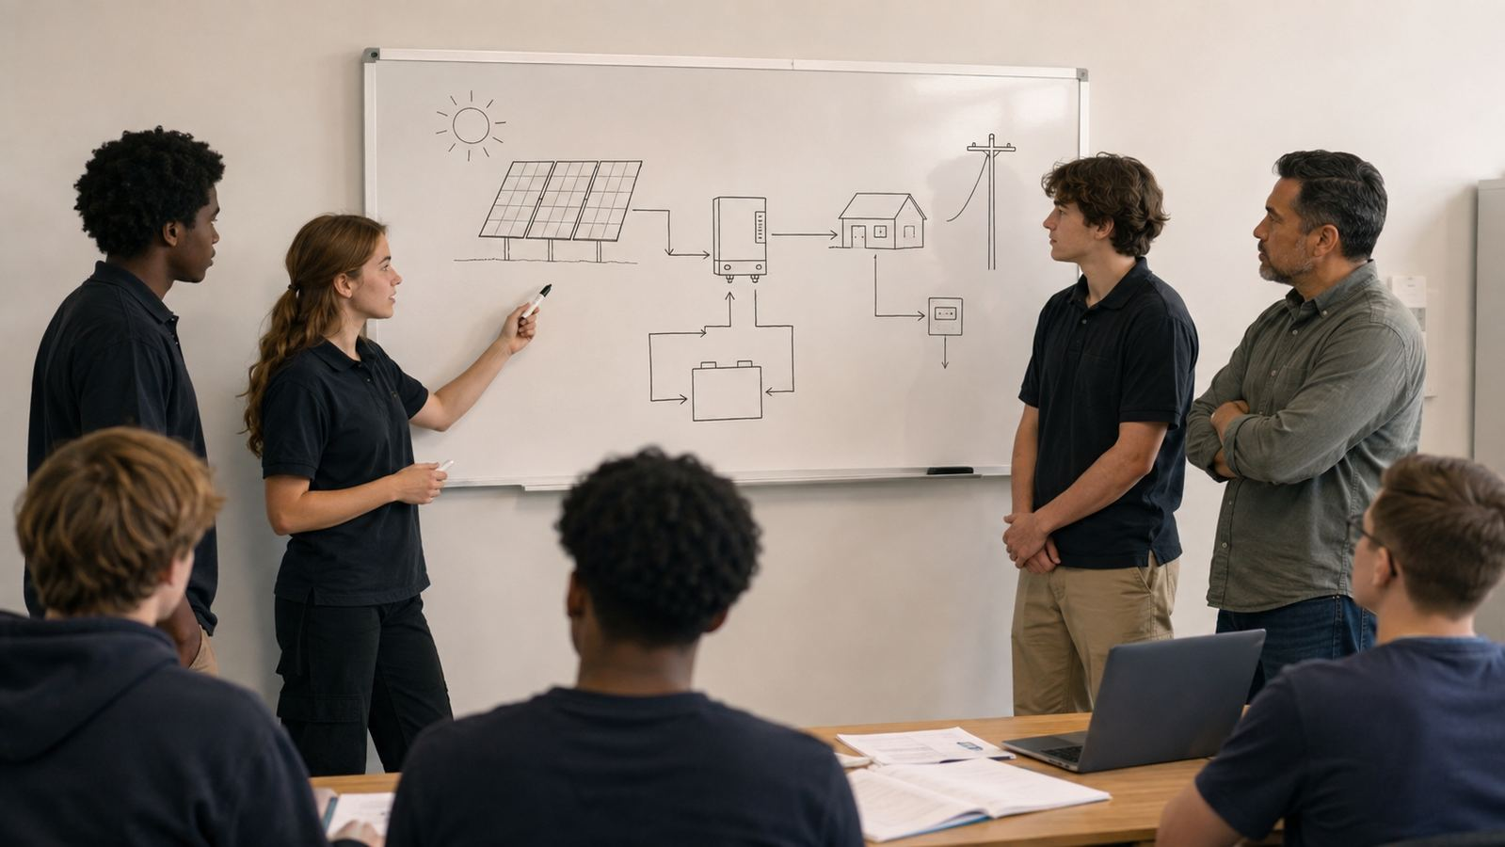
PV102 Day 8
Commissioning Troubleshooting and Professional Handoff
Test, document, and hand off what the system actually does.
CTS Day 24 | Thursday, August 13, 2026 | 10:00 AM-3:00 PM

Slide 2
Today’s job
Professional solar work starts before parts move.
• Students close PV102 by verifying a system from evidence: pre-energization inspection, polarity and continuity checks, voltage checks, functional checks, fault response, documentation, and client handoff.
• Carry forward the Day 1 habit: match architecture to real need.
• Today adds one design layer and one clean handoff.
Do not guess when an unknown can be recorded.
PV102 Day 08 | Thursday, August 13, 2026 | Slide 2
Test, document, and hand off what the system actually does.

Slide 3
Learning targets
By 3:00 PM students should be able to:
• Use a commissioning sequence to verify before energizing.
• Interpret basic test results without guessing beyond evidence.
• Troubleshoot from symptom to boundary to measurement.
• Prepare a concise handoff that names what passed, what failed, what changed, and what remains unknown.
Evidence beats confidence. A tragic lesson for civilization, apparently.
PV102 Day 08 | Thursday, August 13, 2026 | Slide 3
Test, document, and hand off what the system actually does.

Slide 4
Morning readiness check
Quiz first, then review as evidence.
• Work independently for 12-15 minutes.
• Use wrong answers to locate teaching gaps.
• Ask: what fact would prove this answer?
• Keep review short and specific.
The quiz measures instruction as much as students.
PV102 Day 08 | Thursday, August 13, 2026 | Slide 4
Test, document, and hand off what the system actually does.

Slide 5
Core rule
• Test, document, and hand off what the system actually does.
• Say it once at the start.
• Bring every debate back to it.
• Use it to reject weak handoffs.
One rule, repeated until reality behaves.
PV102 Day 08 | Thursday, August 13, 2026 | Slide 5
Test, document, and hand off what the system actually does.

Slide 6
What students already know
PV101 and RCS are not separate islands.
• PV modules produce DC power.
• Series and parallel change voltage/current behavior.
• Continuity requires de-energized verification.
• Troubleshooting starts from evidence.
• Handoffs protect the next person.
PV102 Day 08 | Thursday, August 13, 2026 | Slide 6
Test, document, and hand off what the system actually does.

Slide 7
New judgment today
The skill moves from “can I build it?” to “should this be the design?”
• Define the job.
• Gather the evidence.
• Name the constraint.
• Protect the boundary.
• Record unknowns.
PV102 Day 08 | Thursday, August 13, 2026 | Slide 7
Test, document, and hand off what the system actually does.

Slide 8
Energy path and decision boundary
Need
Evidence
Design
Protection
Handoff
Every arrow is a boundary. Boundaries need ratings, protection, isolation, and documentation.
PV102 Day 08 | Thursday, August 13, 2026 | Slide 8
Test, document, and hand off what the system actually does.

Slide 9
Decision checks
Decision
Evidence
Reject if
Keep a design choice
Measured or observed site/load data
It only sounds good
Reject a shortcut
Safety or equipment boundary
It hides a hazard
Carry unknown forward
Named verification step
It becomes fake certainty
Approve handoff
Next person can act safely
It depends on mind reading
PV102 Day 08 | Thursday, August 13, 2026 | Slide 9
Test, document, and hand off what the system actually does.

Slide 10
Guided example
Model one complete thinking path.
• Start with the client/job statement.
• Add one measured or observed fact.
• Make one design decision.
• Name one safety boundary.
• Name one unknown and how to verify it.
PV102 Day 08 | Thursday, August 13, 2026 | Slide 10
Test, document, and hand off what the system actually does.

Slide 11
Team roles
Three teams of two, roles rotate after the first pass.
• Designer: proposes the first path.
• Verifier: challenges evidence and limits.
• Recorder/handoff lead: writes what the next person needs.
• In a pair, one person may hold two roles, then swap.
PV102 Day 08 | Thursday, August 13, 2026 | Slide 11
Test, document, and hand off what the system actually does.

Slide 12
Lab mission
Commissioning and Fault Handoff Challenge
• Teams inspect a training system or fault card set, run a commissioning sequence, identify one fault, and deliver a final technical handoff.
This is the work block. Keep it practical and evidence-based.
PV102 Day 08 | Thursday, August 13, 2026 | Slide 12
Test, document, and hand off what the system actually does.

Slide 13
Scenario options
Assign one, or let teams choose if the room can handle democracy today.
• Training kit has a hidden open fuse and incomplete label.
• Paper system has reversed polarity at one component card and missing OCPD label.
• Mock client handoff has incomplete load table and no record of final voltage checks.
PV102 Day 08 | Thursday, August 13, 2026 | Slide 13
Test, document, and hand off what the system actually does.

Slide 14
Lab procedure
Run the same loop every day.
• Review the system scope and safety boundary.
• Complete pre-energization inspection using the checklist.
• Run only authorized de-energized checks first.
• Use evidence to identify the fault or missing documentation.
• Record pass/fail results and corrective action recommendation.
PV102 Day 08 | Thursday, August 13, 2026 | Slide 14
Test, document, and hand off what the system actually does.

Slide 15
Acceptance criteria
A complete answer has five parts.
• Match the need.
• Show the path.
• Name the dominant constraint.
• State the safety boundary.
• Record unknowns instead of guessing.
PV102 Day 08 | Thursday, August 13, 2026 | Slide 15
Test, document, and hand off what the system actually does.

Slide 16
Safety boundary
No training objective is improved by pretending energy is harmless.
• Use only instructor-approved equipment and procedures.
• Treat PV and batteries as energy sources.
• Stop when measurements do not make sense.
• Follow manufacturer instructions and program safety procedures.
Stop, isolate, verify, ask. The glamorous life.
PV102 Day 08 | Thursday, August 13, 2026 | Slide 16
Test, document, and hand off what the system actually does.

Slide 17
Instructor probe questions
Use these when teams get vague.
• What evidence supports that?
• What would make this design fail?
• Which boundary protects the person or equipment?
• What unknown are you carrying forward?
• What would the next crew need to know?
PV102 Day 08 | Thursday, August 13, 2026 | Slide 17
Test, document, and hand off what the system actually does.

Slide 18
Peer verification
Peers check the handoff, not the personality of the speaker. Humanity struggles here.
• Can I identify the job?
• Can I follow the path?
• Can I name the constraint?
• Can I see the safety boundary?
• Can I find the unknowns?
PV102 Day 08 | Thursday, August 13, 2026 | Slide 18
Test, document, and hand off what the system actually does.

Slide 19
Common failure modes
Correct these early.
• Component list with no job.
• Guess presented as fact.
• Missing safety boundary.
• No units or runtime.
• Handoff too vague to use.
PV102 Day 08 | Thursday, August 13, 2026 | Slide 19
Test, document, and hand off what the system actually does.

Slide 20
Evidence language
Require technical sentences.
• Observed: what you saw.
• Measured: value with unit or clear method.
• Assumed: guess being carried forward.
• Verified: checked against source, procedure, or measurement.
PV102 Day 08 | Thursday, August 13, 2026 | Slide 20
Test, document, and hand off what the system actually does.

Slide 21
Handoff structure
Make the next person safer.
• Scope: what job is being solved.
• Decision: what was chosen or rejected.
• Evidence: why.
• Boundary: what must be protected.
• Unknowns: what still needs verification.
PV102 Day 08 | Thursday, August 13, 2026 | Slide 21
Test, document, and hand off what the system actually does.

Slide 22
Exit ticket
Individual close-out
• What is one thing you now refuse to accept as “good enough” without evidence?
Collect before reset so the day leaves a paper trail. Weirdly useful.
PV102 Day 08 | Thursday, August 13, 2026 | Slide 22
Test, document, and hand off what the system actually does.

Slide 23
Day-to-day continuity
This is one system, not seven disconnected worksheets.
• PV102 is complete. Carry the habit forward: define the job, verify the path, protect the boundary, document the truth.
• Carry forward site notes, load tables, diagrams, and unknowns.
• Do not erase uncertainty. Resolve it.
PV102 Day 08 | Thursday, August 13, 2026 | Slide 23
Test, document, and hand off what the system actually does.

Slide 24
Final reminder
What professionals do
• Define the job.
• Verify the path.
• Protect the boundary.
• Document the truth.
Test, document, and hand off what the system actually does.
PV102 Day 08 | Thursday, August 13, 2026 | Slide 24
Test, document, and hand off what the system actually does.

Slide 25
Close
• Test, document, and hand off what the system actually does.
Reset tools. Collect packets. Archive the handoffs.
PV102 Day 08 | Thursday, August 13, 2026 | Slide 25
Test, document, and hand off what the system actually does.

