Slide 1
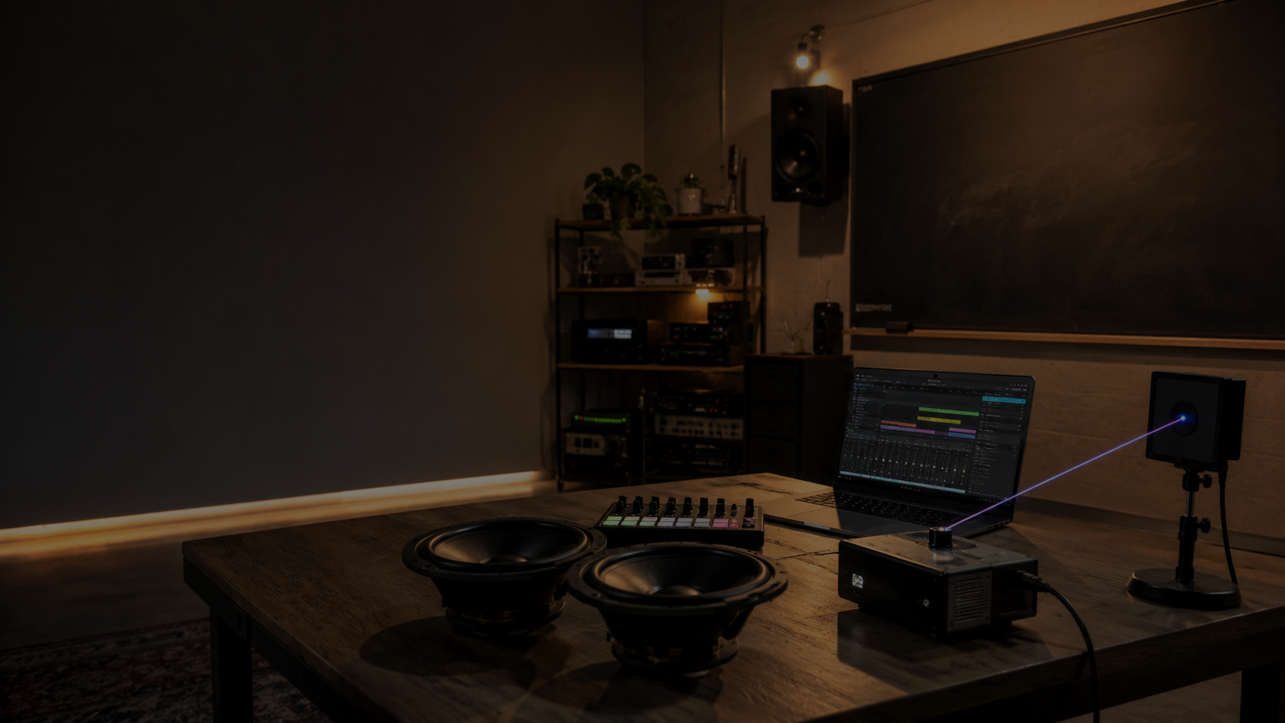
EDM101 Day 1
Introduction, Laser Safety, and Type O Project Launch
CTS Day 25 | Monday, August 17, 2026 | 10:00 AM-3:00 PM

Slide 2
Today’s job
How do we turn electricity into an experience people can hear, feel, and see?
• Meet EDM101: sound, light, control, fabrication, and safety.
• Pass the laser-safety check before any energized demo.
• Inspect the two speaker drivers.
• Launch the HOQS Paraflex Type O 2x12 project.
Professional show technology is fun only when the energy is controlled.
EDM101 Day 01 | Monday, August 17, 2026 | Slide 2
Electricity becomes experience: sound, light, motion, and safe control.

Slide 3
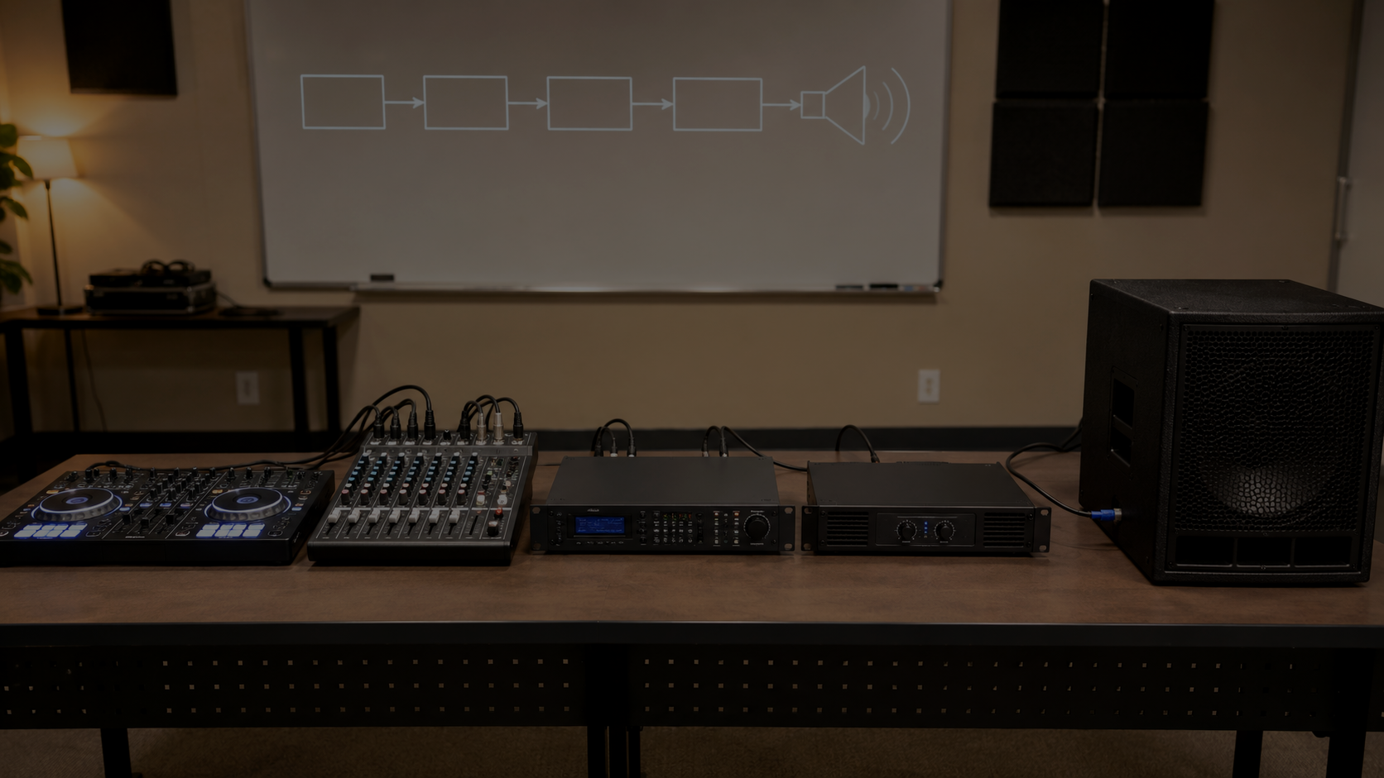
One course spine
SOURCE
PROCESSING
OUTPUT DEVICE
PHYSICAL ENERGY
HUMAN
Audio and lasers are different systems with the same discipline: control the path before releasing energy.
EDM101 Day 01 | Monday, August 17, 2026 | Slide 3
Electricity becomes experience: sound, light, motion, and safe control.

Slide 4
Audio signal path
DJ / LAPTOP
MIXER
DSP
AMPLIFIER
SPEAKER
AIR / BODY
• Ask what goes in, what job happens, and what comes out.
• A speaker is not magic; it is a transducer.
• The cabinet is part of the acoustic system, not furniture with ambition.
EDM101 Day 01 | Monday, August 17, 2026 | Slide 4
Electricity becomes experience: sound, light, motion, and safe control.

Slide 5
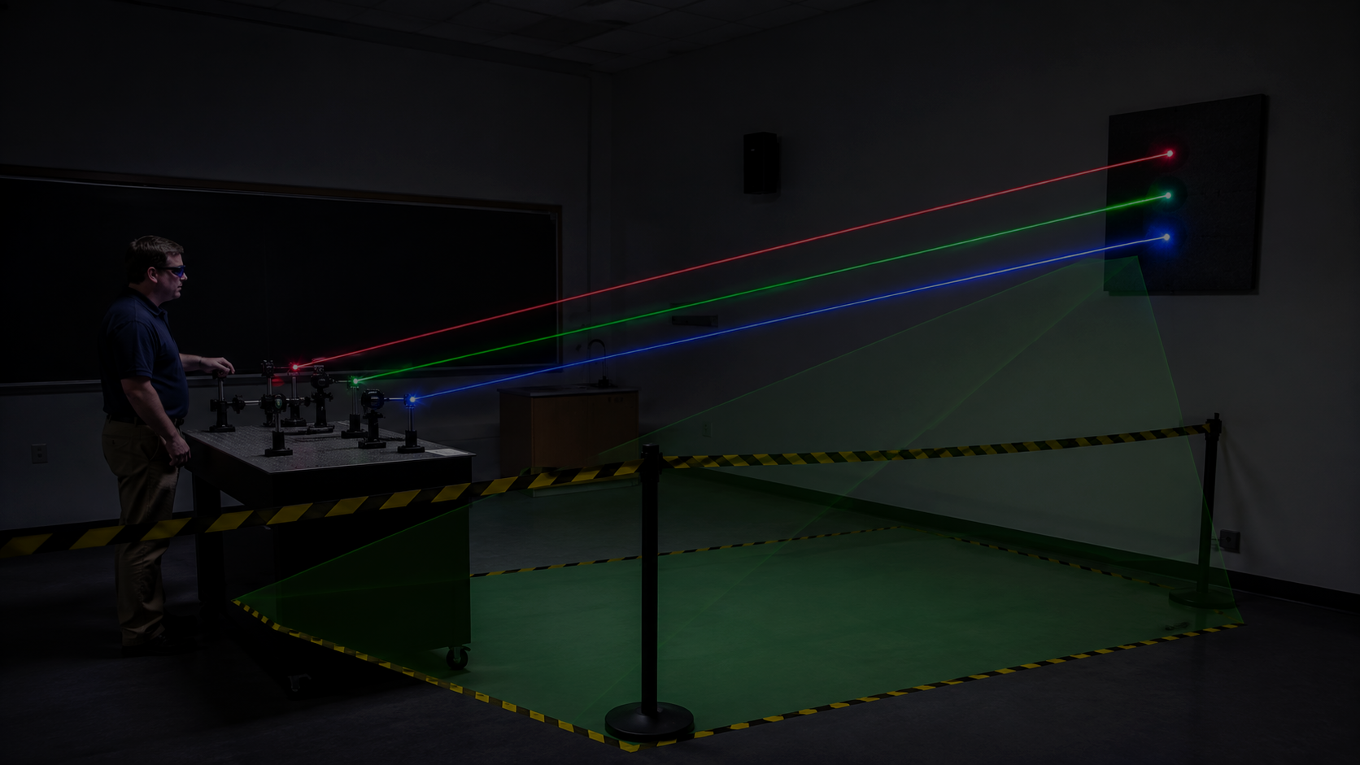
Laser signal path
CONTROLLER
CABLE / INTERFACE
LASER PROJECTOR
BEAM PATH
TARGET / STOP
No controlled path, no energized beam.
• Beam direction is planned before power.
• Reflective objects are hazards.
• The operator owns the system until it is shut down.
EDM101 Day 01 | Monday, August 17, 2026 | Slide 5
Electricity becomes experience: sound, light, motion, and safe control.

Slide 6
Laser safety essentials
• Controlled beam path
• Beam termination
• Restricted area
• No reflections
• No audience scanning
• Stop-work authority
If the setup is not clean, the lab becomes a planning exercise. That still counts.
The laser does not care that the class is excited.
EDM101 Day 01 | Monday, August 17, 2026 | Slide 6
Electricity becomes experience: sound, light, motion, and safe control.

Slide 7
Laser safety test
First assessment: safety thinking, not vocabulary theater.
• Work independently.
• Use plain language.
• Explain the reason, not just the rule.
• Review wrong answers before any demo.
No pass, no laser lab role.
EDM101 Day 01 | Monday, August 17, 2026 | Slide 7
Electricity becomes experience: sound, light, motion, and safe control.

Slide 8
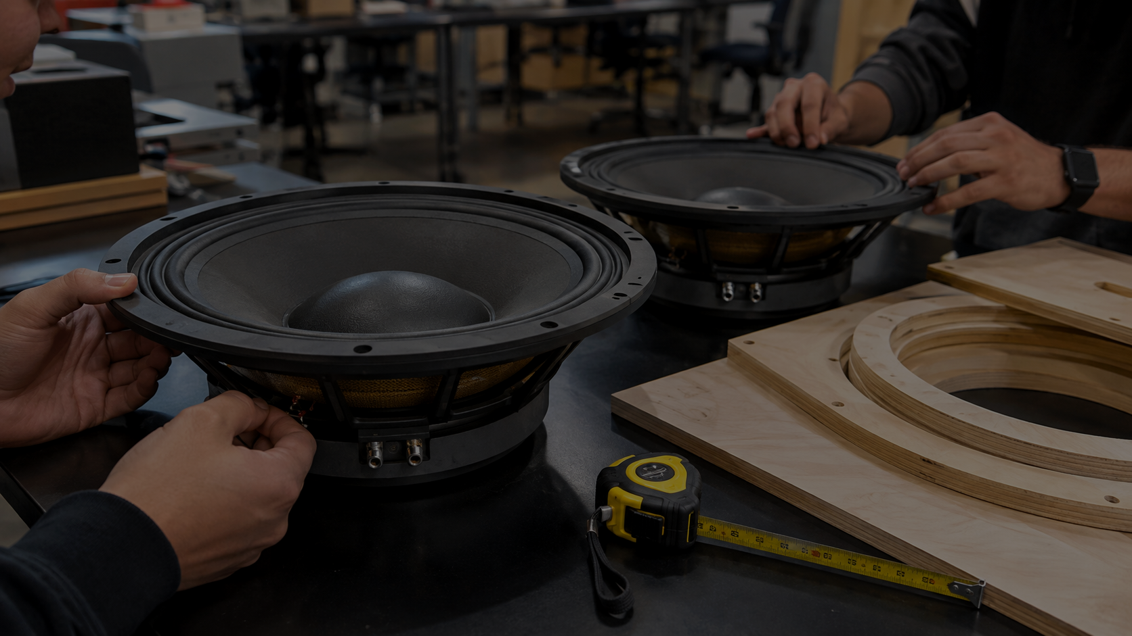
Meet the drivers
• Cone
• Surround
• Basket / frame
• Magnet
• Terminals
• Voice-coil location
Question: Why can’t we just wire this up and call it a sound system?
The driver moves air. The cabinet controls what that air does.
EDM101 Day 01 | Monday, August 17, 2026 | Slide 8
Electricity becomes experience: sound, light, motion, and safe control.

Slide 9
The cabinet is part of the instrument
ELECTRICAL
MECHANICAL
ACOUSTIC
HUMAN EXPERIENCE
• A failure in any one layer changes the result.
• Air leaks, wrong cuts, bad wiring, or no protection all matter.
• Build quality is sound quality with fewer excuses.
EDM101 Day 01 | Monday, August 17, 2026 | Slide 9
Electricity becomes experience: sound, light, motion, and safe control.

Slide 10
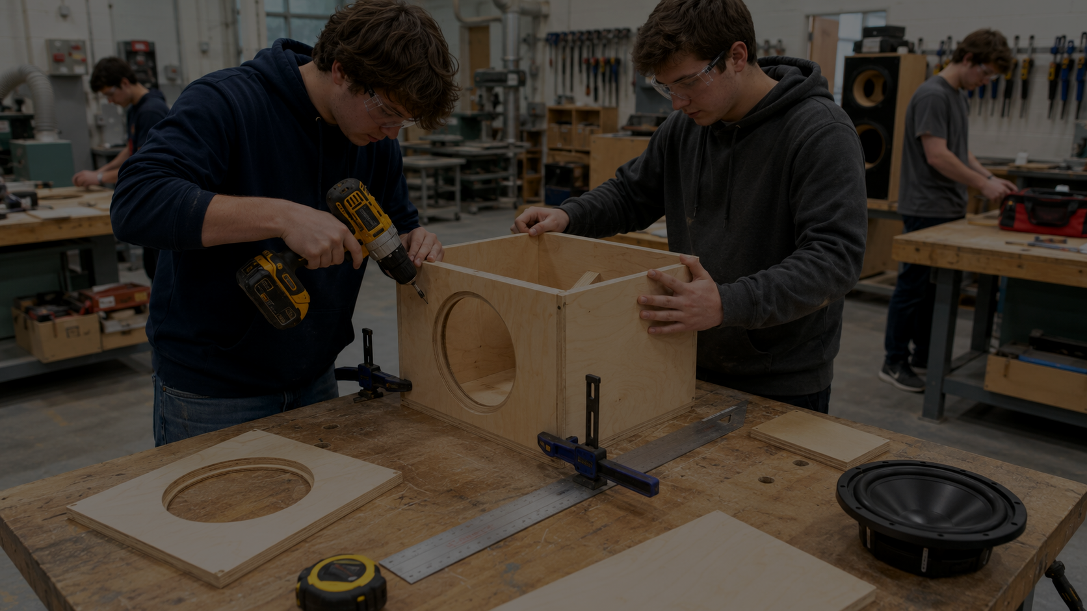
Main project: HOQS Type O 2x12
This cohort builds a real Paraflex cabinet.
• Use the official HOQS plan supplied by instructor.
• Build the cabinet geometry correctly.
• Use PA310-8 drivers as temporary build/test drivers.
• Later: install the ideal sub drivers and reuse these Daytons in a kick build.
Works. Works safely. Optimized. Those are not the same thing.
EDM101 Day 01 | Monday, August 17, 2026 | Slide 10
Electricity becomes experience: sound, light, motion, and safe control.

Slide 11
Before wood moves
PLAN
MEASURE
LAYOUT
CUT
DRY FIT
VERIFY
ASSEMBLE
SEAL
WIRE
INSPECT
TEST
HANDOFF
A cabinet is not “done” until another person can safely understand what was built.
EDM101 Day 01 | Monday, August 17, 2026 | Slide 11
Electricity becomes experience: sound, light, motion, and safe control.

Slide 12
Today’s laser lab
• Trace the laser system from controller to visible output.
• Observe how control changes the physical result.
• Name the safety boundary that stays fixed.
• Compare laser signal flow to audio signal flow.
Instructor-controlled only.
EDM101 Day 01 | Monday, August 17, 2026 | Slide 12
Electricity becomes experience: sound, light, motion, and safe control.

Slide 13
Today’s student work
• Laser safety test
• Signal-chain worksheet
• Driver inspection notes
• Type O question list
• Exit ticket
Question list is the point. We build better after we know what we do not know.
EDM101 Day 01 | Monday, August 17, 2026 | Slide 13
Electricity becomes experience: sound, light, motion, and safe control.

Slide 14
Exit ticket
1. Trace either an audio or laser signal path from input to human perception.
2. Name one laser-safety rule and explain why it exists.
3. What do you want to understand about the Type O before we build it?
Useful questions become tomorrow’s lesson plan. Convenient, almost like teaching works.
EDM101 Day 01 | Monday, August 17, 2026 | Slide 14
Electricity becomes experience: sound, light, motion, and safe control.

Slide 15
Tomorrow
Frequency, wavelength, and why cabinets are shaped on purpose.
• Sound waves are pressure changes in air.
• Light waves are electromagnetic.
• Both have frequency. Both require control.
• Only one politely rattles windows when the sub is right.
EDM101 Day 01 | Monday, August 17, 2026 | Slide 15
Electricity becomes experience: sound, light, motion, and safe control.

Slide 16
EDM101 starts here
Control the energy. Build the system. Make the room feel it.
Why is the box shaped like that?
EDM101 Day 01 | Monday, August 17, 2026 | Slide 16
Electricity becomes experience: sound, light, motion, and safe control.

