Slide 1

On-Call fraud Procedures
Churn Reduction and Retention Carol Trimmer and Rob Sutton 5/18/2010
Customer Care April Results & Accomplishments
02/25/16
Vonage Holdings Corp. Proprietary & Confidential

Slide 2
VoIP Fraud
VoIP fraud can be defined as the unauthorized use of paid communication services charged to someone who isn't expecting it, whether that is the service provider or the customer.
The fraudster looks for a vulnerable (usually publically available) VoIP device, once they have detected one they usually can acquire the SIP credentials for the device.
The Fraudster enters into an agreement with a local exchange telephone carriers in rural areas they then inflate the volume of incoming calls to their network, and make a percentage of the profit off the fees paid.

Slide 3
Types Of Alerts
Root Alert
These are rated calls that are being charged to the account or Vonage is being charged for the routing i.e International
Domestic Alert
This happens with concurrent calls to any of the 48 states that are not usually rated (Alaska & Hawaii)
Vonage Alert
Carrier Alert which usually has very little info and commonly consists of calls to blacklisted destinations or numbers.
Spending Alert
When spending for that account exceeds the set limits of either $300 or $500 (treat as a root alert)

Slide 4
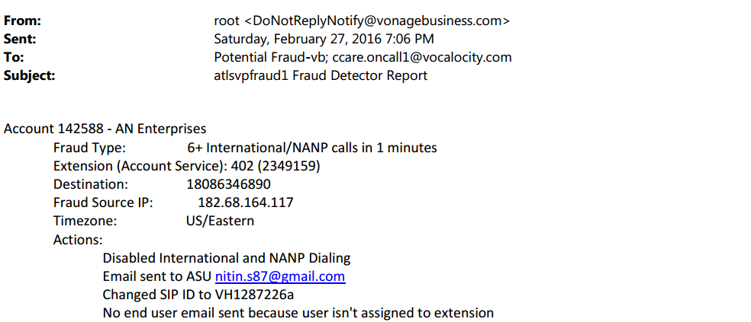
Root Alert
Root Alerts are generated by calls exceeding account thresholds or are calls that either the customer or Vonage is being charged for. Example:

Slide 5

Domestic Alert
Domestic Alerts are generated by domestic calls exceeding account thresholds and is often triggered as a result of network conditions. However, be on the lookout as autodialers and PBX’s may also be the culprit either with or without the account holders knowledge. Example:

Slide 6
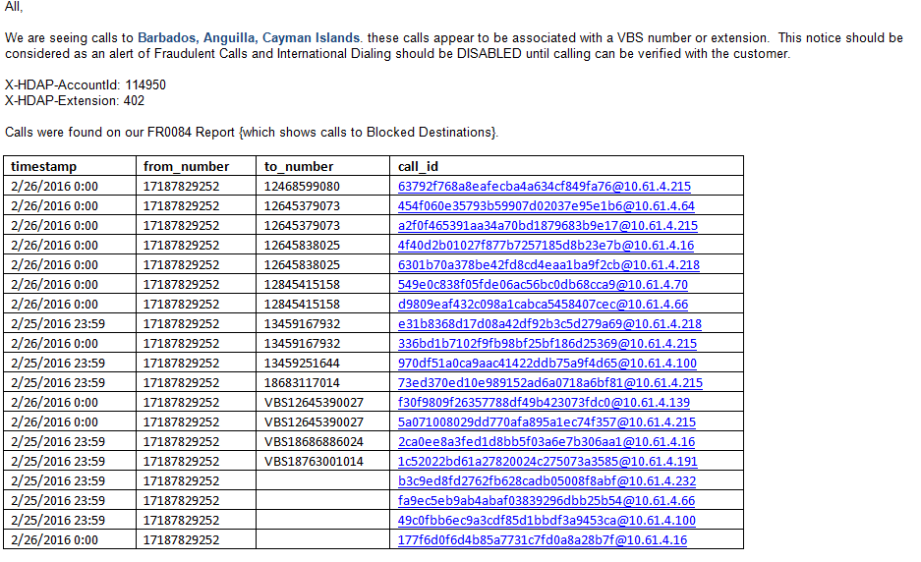
Vonage or Manual Alert
Vonage Alerts are generated upon discovery of calling patterns to undefined, blocked, or regions high in fraudulent activity. Example:

Slide 7
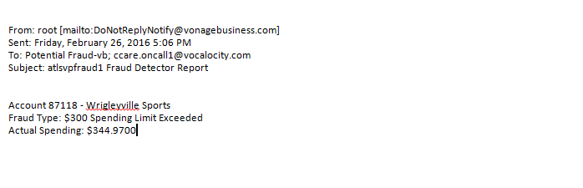
Spending Alert
Spending Alerts are generated when charges exceed an account threshold. Example:

Slide 8
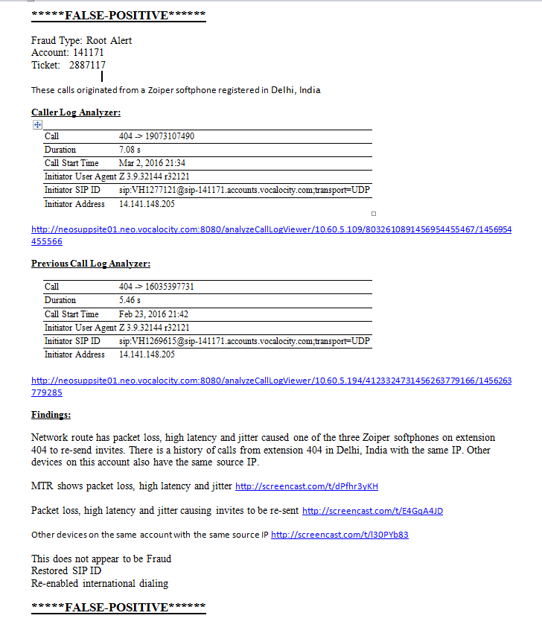
Fraud Template Example
Change the Fraud Type according to the alert you receive, i.e. Root, Domestic, Vonage, or Spending
Make sure your previous call example is at least 2 weeks prior to the current date
Provide adequate explanation and supporting screenshots within the findings section
This template can also be used for investigations that you determine to be Fraud.
Using this template will ensure that you have a thorough investigation and are more likely to identify investigations correctly.
**Please note: if you do not use this template and the information you provide is not adequate we will take ownership of your on call case to do a proper investigation. This mean you will not get paid for that case.

Slide 9
Investigation Steps
After the Fraud alert comes to the On-Call phone forward that email to yourself in Outlook.
From Outlook “Reply All” (Potential Fraud & CCare On-Call 1) with “Investigating”. Make sure your reply includes your Outlook signature.
Check the Account and see if a ticket was created in Salesforce if not create one. Insure you change case owner to On-Call and place your name in the Tier 2 Rep field.
Copy the message body of the Alert and paste them into the Salesforce Description, be sure to include the type of Fraud Alert i.e.: Root, Domestic, Vonage, or Spending.
Thoroughly investigate the potential Fraud and make your determination whether it’s a False-Positive or Fraud.
From Outlook “Reply All” to the Alert with your investigation notes. (see examples below)
Update your salesforce ticket with your investigation notes in the “Log Call” section change Problem Code to “Fraud Alert” and Problem Code II to reflect False-Positive or Fraud. Make sure case owner is set to On-Call and your name is in the Tier 2 Rep field or you will not be paid.
Close Ticket “Resolved”
Send an email to FraudandAbuseTeam-vb@vonage.com for any actual Frauds at the next day so the total charges can be calculated.

Slide 10
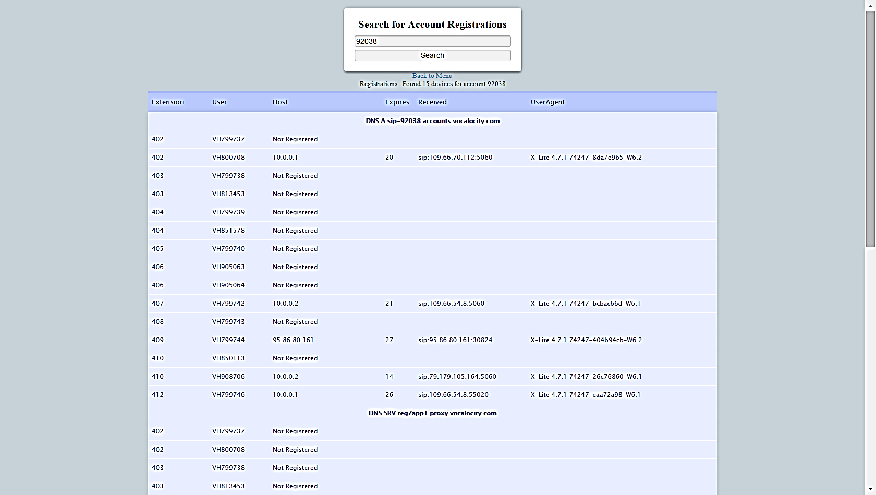
Begin Your Investigation
You will begin you investigation by looking at the account registration page.
Compare the IP addresses of the registered devices with the alert.
Look for duplicate SIP IDs and suspicious devices

Slide 11
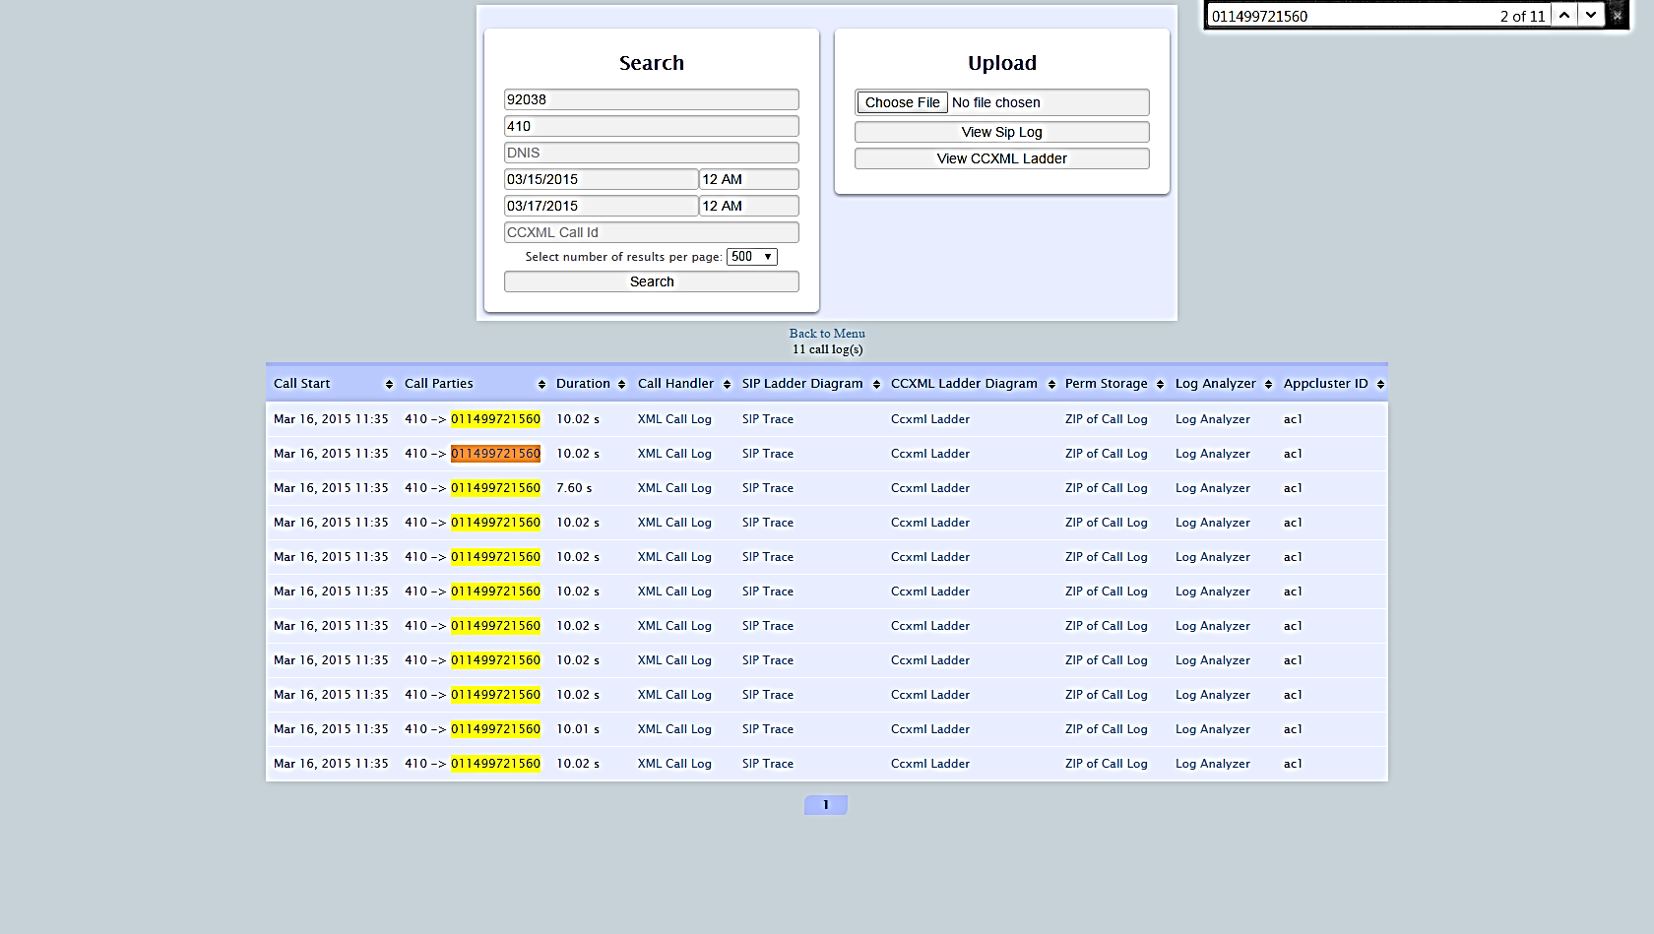
Investigation continued …
Next you will need to bring up the call logs of the extension that set off the Alert.
Search the call logs for the destination number or the terminated number.
Pay close attention to the amount of times the same number was called and the duration of those calls.

Slide 12
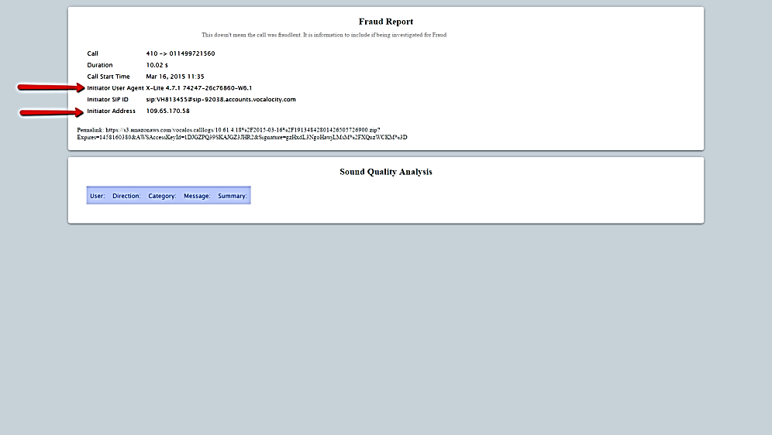
Investigation continued …
Your next step is to bring up the log analyzer for the call triggering the alert
Make note of the User Agent which will tell you the device that place the calls, and the Initiator Address which will tell you from where the device was when the calls were placed
Make sure this information is copied and pasted as per the Fraud Template

Slide 13
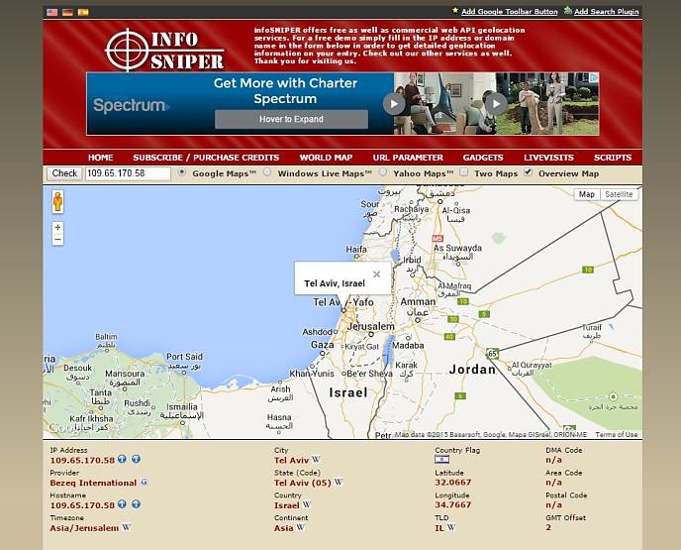
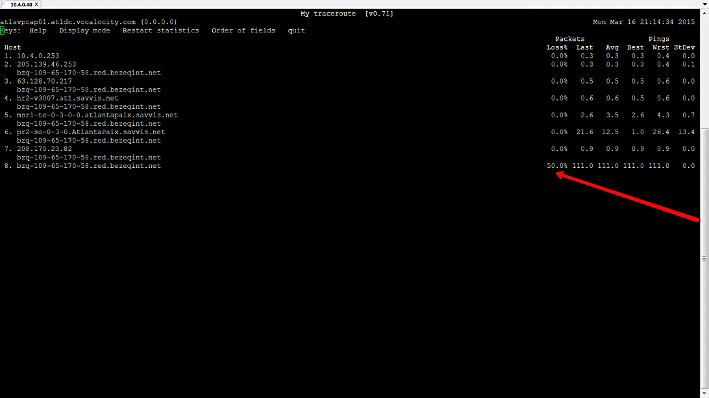
Investigation continued …
Use a IP address look up tool (like infosniper.net) to look up the IP address of the Initiator User Agent pay close attention to where these calls were place from.
You will also want to run an MTR to the Initiator User Agent IP address . Look for any signs of High latency, Jitter, or Packet Loss.

Slide 14
Investigation continued …
You will now want to look at the call logs again. This time look at calls made at least 2 weeks back from the same extension.
You will once again bring up the Log Analyzer from one of these earlier calls.
Compare the information here to the information from the Log Analyzer that set off the Alert.
Check to see if these calls were from a different device, at a different IP address.
If the Device and IP address are the same and there was high latency, jitter, or packet loss this more than likely is a False Positive Alert.
If the Device is different and the location of the IP addresses are far and seem to be suspicious then this could potentially be a Fraud.

Slide 15
Other ways to investigate.
If after your research you are unclear whether the calls were Fraudulent or not.
You can attempt to call the Account Super User to verify.
You can attempt to place a call to the user on the extension.
If the calls were international check the account to see if there is a history of making these types of calls.
Reach out to your Supervisor or a Fraud SME.

