Slide 1

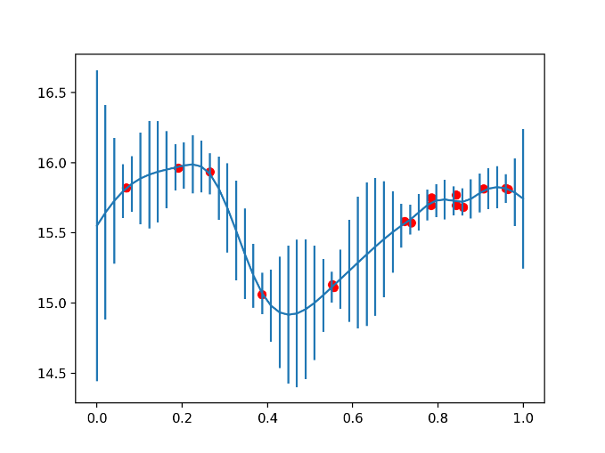

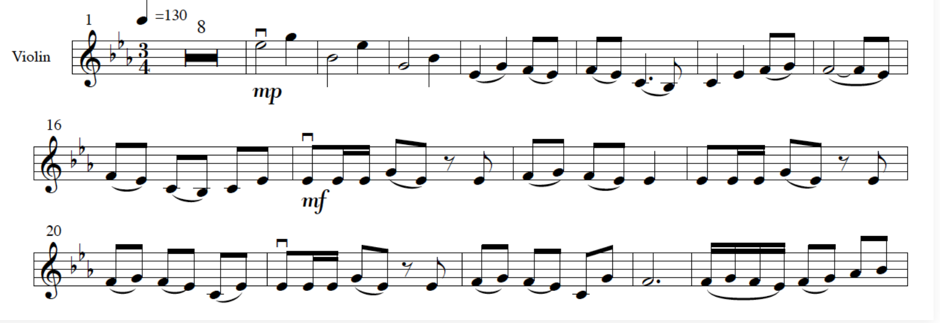
The Music of Light Curves
A hack by Siddha Mavuram,
Matthieu Baumann & Thomas Boch

Slide 2
How It Works
Light curves of variable stars are taken from VizieR data
Light curves are graphically extrapolated with machine learning techniques
Frequencies are sampled from the extrapolated data and converted to notes using Javascript
The Aladin sky atlas is used to interactively play the songs of variable stars

Slide 3
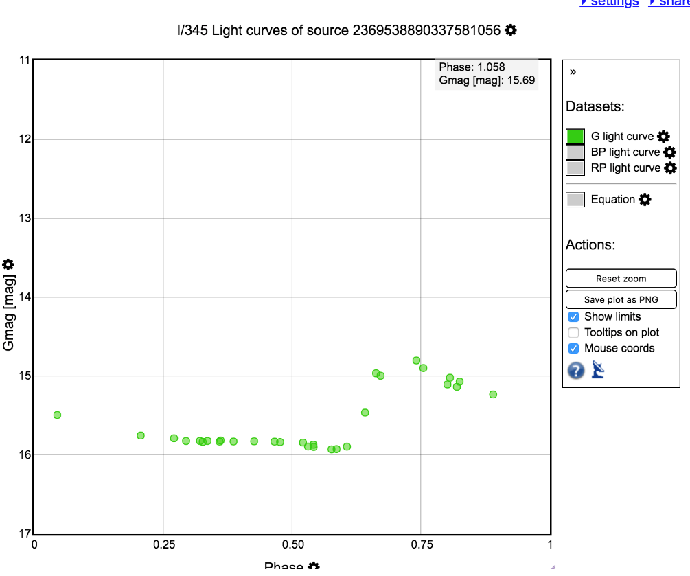
VizieR data
Data was obtained from the VizieR database – specifically from the Gaia DR2 catalogue of variable star light curves
Light curves were separated into separate wavelengths – we chose to use the G band, but any of the three could be played trivially

Slide 4
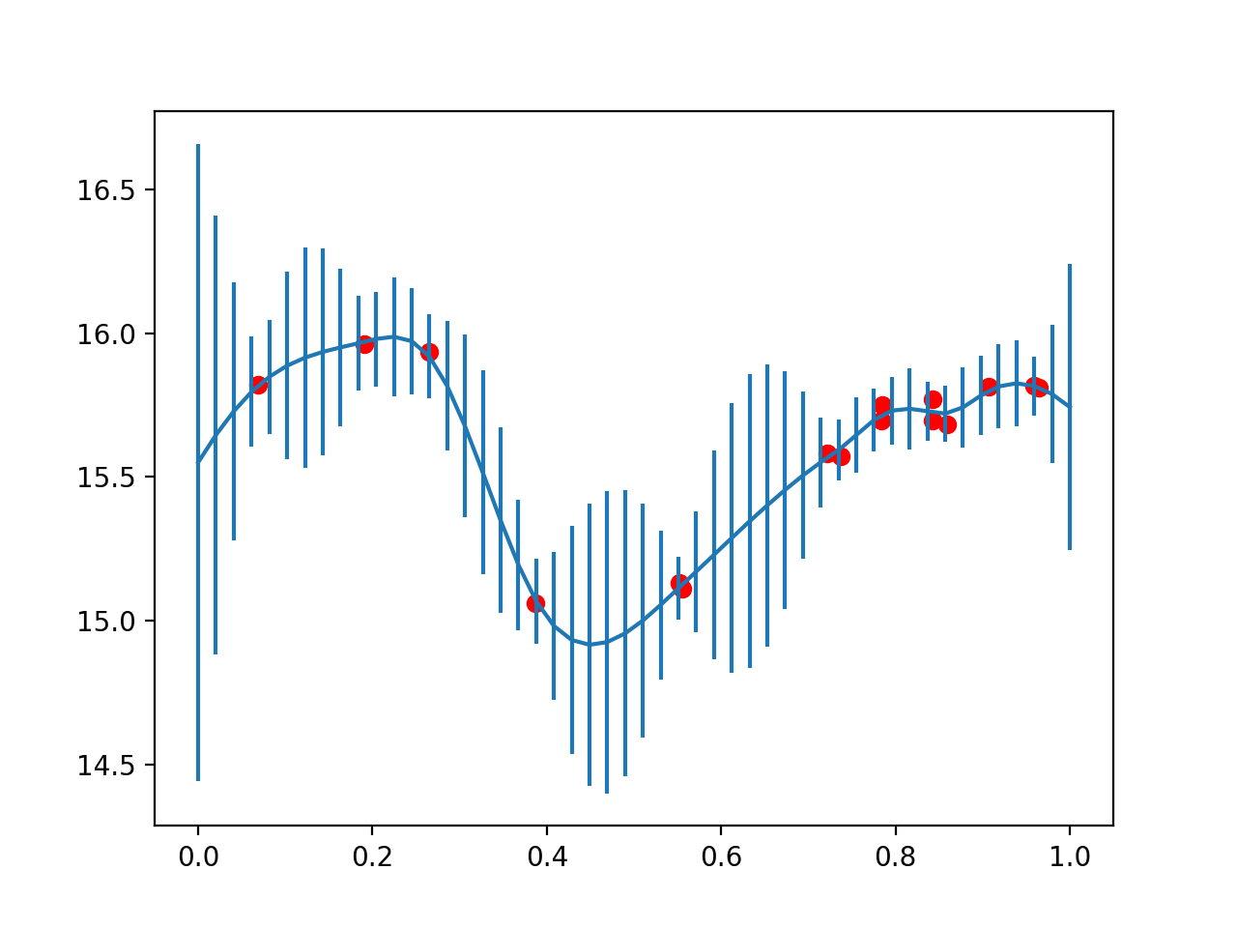
Data Extrapolation
Getting good rhythm was hard with the variable times between data points in the light curve
A Gaussian process was used to extrapolate the data and obtain a continuous function of light magnitude in the phase diagram for the 10k stars of the sample
Python : scikit-learn

Slide 5
Melody Generation
Magnitudes of light were sampled from the continuous functions at regular intervals
All periodic data was normalized to 20 seconds for consistent music
Tone.js was used to synthesize sounds from magnitudes, in an appropriate key, with an appropriate synth sound

Slide 6
Scientific Uses
Light curves can have certain “sound signatures” which can identify specific features
Data accessibility/visualization

Slide 7
Thanks
The hackathon organizers
Kai Polsterer (technical advice on gaussian processes)
Sebastien Derriere (for the initial idea: https://arxiv.org/pdf/1811.02930.pdf )
Link to Github: https://github.com/tboch/lightcurves-music

