Slide 1
EPICS Motor Support
Top-level object is the EPICS motor record
  Lots of code has been written to this object:
    spec, IDL and Python classes, etc.
Next layer is EPICS device support
  Knows about the motor record, talks to the driver
Lowest layer is EPICS driver
  Knows nothing about motor record, talks to the hardware
3 models of device and driver support have developed over time

Slide 2
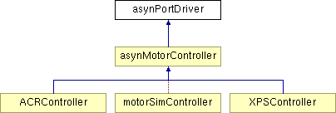

Model 3
Two base classes, asynMotorController and asynMotorAxis.
Base classes provide much functionality, only need to write device-specific implementations.
Easy to support controller-specific features
Don’t have to use motor record.
Direct support for coordinated profile moves in the driver API.

Slide 3
asynMotorController
class epicsShareFunc asynMotorController : public asynPortDriver {
asynMotorController(const char *portName, int numAxes, int numParams,
int interfaceMask, int interruptMask,
int asynFlags, int autoConnect, int priority, int stackSize);
virtual asynMotorAxis* getAxis(asynUser *pasynUser);
virtual asynMotorAxis* getAxis(int axisNo);
virtual asynStatus startPoller(double movingPollPeriod, double idlePollPeriod, int forcedFastPolls);
virtual asynStatus wakeupPoller();
virtual asynStatus poll();
void asynMotorPoller();
virtual asynStatus initializeProfile(size_t maxPoints);
virtual asynStatus buildProfile();
virtual asynStatus executeProfile();
virtual asynStatus abortProfile();
virtual asynStatus readbackProfile();

Slide 4
asynMotorAxis
class epicsShareFunc asynMotorAxis {
virtual asynStatus move(double position, int relative,
double minVelocity, double maxVelocity, double acceleration);
virtual asynStatus moveVelocity(double minVelocity, double maxVelocity,
double acceleration);
virtual asynStatus home(double minVelocity, double maxVelocity,
double acceleration, int forwards);
virtual asynStatus stop(double acceleration);
virtual asynStatus poll(bool *moving);
virtual asynStatus setPosition(double position);
virtual asynStatus initializeProfile(size_t maxPoints);
virtual asynStatus defineProfile(double *positions, size_t numPoints);
virtual asynStatus buildProfile();
virtual asynStatus executeProfile();
virtual asynStatus abortProfile();
virtual asynStatus readbackProfile();

Slide 5
Coordinated Motion
(Formerly called Trajectory Scanning)
Create arrays of target locations of each motor in a multi-axis controller
Create array of time per element
Define times/locations to output synchronization pulses to trigger detectors
Execute coordinated move
Optionally read back encoder positions when each synchronization pulse was output
Many controllers have this capability
  Newport MM4000, Newport XPS, Delta Tau PMAC, Prodex MAXv, Parker ACR series, etc.
We now have an API to take use this capability in a consistent way
Now done in same driver as for motor record, eliminates conflicts

Slide 6
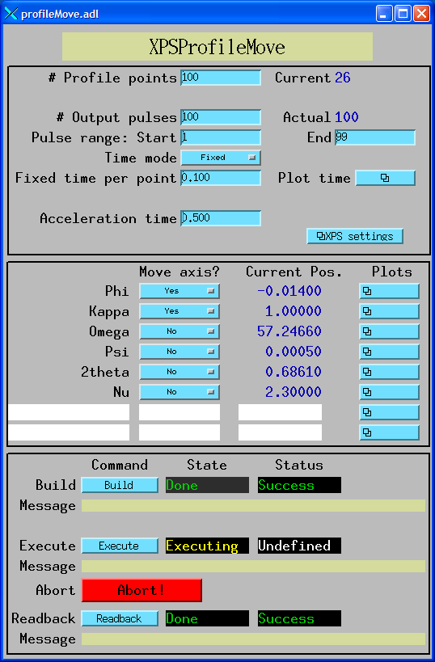
Coordinated Motion
; IDL program to build, execute and readback profile
; This program builds a profile and executes it.
nelements = 100 ; 100 elements in the profile.
npulses = 100 ; 100 pulses in the profile.
naxes=2 ; We will move the first 2 motors (Phi and Kappa)
; Define array of positions
positions = dblarr(nelements, naxes)
; The Phi profile is a sin wave with two complete periods and an
; amplitude of +-1 degrees
positions[*,0] = 1.*sin(findgen(nelements)/(nelements-1.)*4.*!pi)
; The Kappa profile is a sin wave with one complete period and an
; amplitude of +-1 degrees
positions[*,1] = 1.*sin(findgen(nelements)/(nelements-1.)*2.*!pi)
profile = 'IOC:Prof1:'
group = 'GROUP1'
time = 0.1 ; Fixed time per profile point
status = profile_move(profile, positions, group=group, maxAxes=6, $
build=1, execute=1, readback=1, time=time, $
npulses=npulses, actual=actual, errors=errors)
end

Slide 7
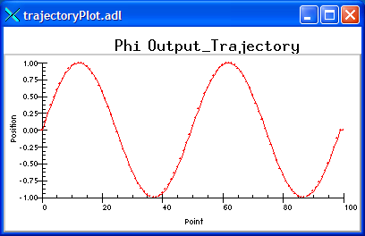
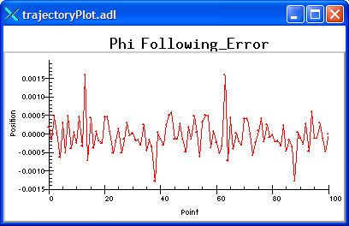
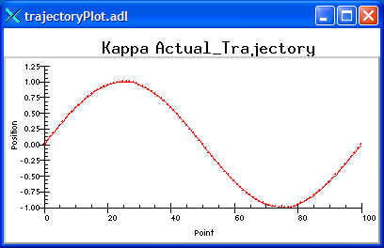
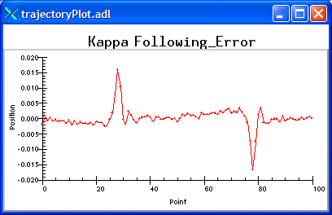
Phi output profile
Phi following error
Kappa readback profile
Kappa following error

Slide 8
SPEC Interface
SPEC macros have been written to allow SPEC to utilize profile moves via EPICS interface
Low level interface, all of SPEC's standard scans can be done "on-the-fly" with profile move software. Replacement macros for:
  _ascan # Used by all ascan and dscan macros
  Mesh
  hklscan # Used by hscan, kscan and lscan
  _hklmesh
  _hklline # Used by hkcircle, hlcircle, klcircle, hkradial, hlradial and klradial
  _scanabort resume
  _loop

