Slide 1
Theo Bohnen
@tbohnenjnr
Notes:
My Name is Theo Bohnen
And first of, just want to congratulate all the organisers for all their hard work, and just making stuff work regardless of the challenges.
Also thank you to all the other speakers, they’ve been absolutely amazing!

Slide 2


Me
@tbohnenjnr
Notes:
Christian, proud Husband and Father.
We grow coders young in our family.
Turns out, if you replace the 6v battery with a 12v battery you blow your radio but… you get a lot more speed. So after the upgrade, he promptly crashed into a wall. But now when he gets on it, he grins at me and then punches the throttle.
Building (and crashing) drones and occasionally I actually get to fly them.

Slide 3
WHAT IS FOUNDeRY’S MANDATE?
Our mandate is to research and develop innovative tech solutions that could change the way wholesale banking works in the future with an obsessive focus on client needs and experience.
1.
Future Proof Banking
(Corporate Investment Banking)
2.
Disrupt the traditional banking model through the strategic development of technology. Finding the real white space.
3.
Align the banking expectations of clients to the product output of the bank (RMB).
Notes:
Basically a bunch of cool people trying to make sense of this new FinTech world, how banks stay relevant and useful while stuck in a big machine with lots and lots of good but cumbersome regulations.

Slide 4
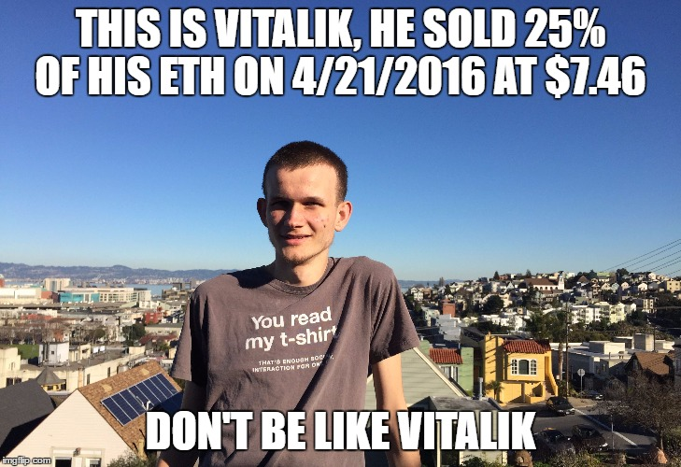
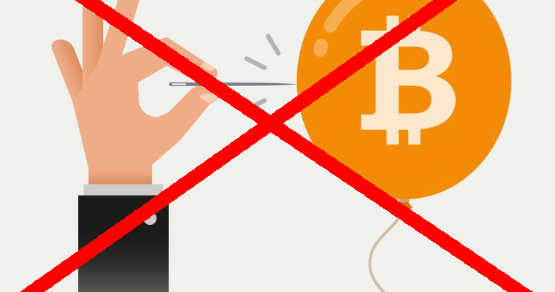
HODL
Notes:
So, because I get to go after Co-Pierre, I can now talk about how bitcoin is NOT a Bubble, and that you should HODL.
Seriously, just like any other thing that is traded and has the promise of such high returns, there is a lot of nervous money in the game and my one caution to all of you is to not put in any money you can’t afford to lose (which some of you will promptly ignore) but more importantly, don’t get so attached to the currency or technology that it becomes part of what defines you as a person. Learning is a good thing and we often learn best when there is something on the line however, make sure you’ll be okay if the price does correct. If you attach your whole being to something and that something goes wrong, it’s hard to recover from that.
Also, I don’t know if that’s true about Vitalik and I also just do not care.

Slide 5
WHAT AM I GOING TO TALK ABOUT
1.
Software Craftsmanship
2.
Continuous Improvement
3.
Testing

Slide 6
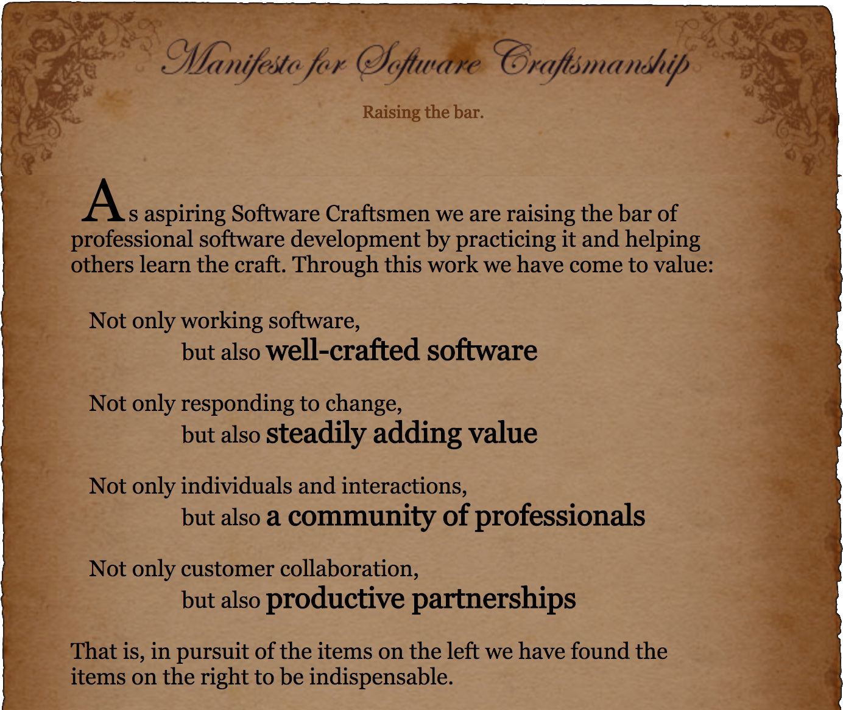
Software Craftsmanship
Notes:
Software craftsmanship was built on top of the values of the Agile Manifesto (who knows what Agile is?) and, just like I am not Bitcoin or Ethereum, I am not Software Craftsmanship but I do like the values, techniques and principles that they portray and I’ve incorporated them into how I do software development.
So while we write DApps and awesome solidity contracts, we need to make sure that we are doing it in a responsible way. This is even more important when working with live public blockchains. You are working with people’s livelihood here, a small mistake can destroy a life.

Slide 7
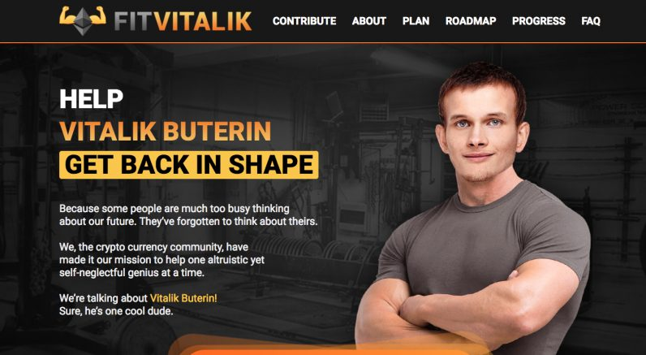
CONTINUOUS IMPROVEMENT
Notes:
When I look at all the great software developers I know the one of the things most common between all of them is that they continually improve. When we look at someone that's really great at what they do we generally think wow, they are so smart but what you don’t realize is all the effort that they put in day in and day out researching and improving.

Slide 8
CONTINUOUS IMPROVEMENT
1.
Small steps, in the right direction, over time, gives success
2.
Spend time learning the underlying technology, use the tools that work until they don’t work anymore
Notes:
Small Steps - House Metaphor I’ve found that the only way to improve is to continually work at your skills and just like a house isn’t built all the bricks at the same time, just so our knowledge is accumulated brick by brick, constantly checking that we are going in the right direction over time. One day, we wake up and realize the first section is built and we can now start building the next, while still improving the first.
Early on in my career I got stuck in frameworks a lot, spending so much time learning them and getting good at them just to find out that their being deprecated or not maintained anymore. The lesson I’ve learnt from this is to spend more time learning the fundamentals, things that can be applied regardless of the technology. One of the ways how this played out for me is learning as many languages as I can, as well as just proper software development techniques. A lot of these principles transcend a framework and even a language. Automated testing for example is applicable to most software development.
Katas - Explain. There is multiple levels of learning in this, from learning solidity using smart codes,
ShuHaRi a method I use for learning, origins. For example, start out by doing the blockchain’s recommended guide of tutorials, i.e what Andy is doing with us and then once we start to really understand it, start to kick the tires a bit more, get developing Contracts using the contract examples, DApps using truffle boxes and once you really understand them, start creating your own.
Pairing / Mobbing and why it’s good for learning and writing good quality code

Slide 9
TESTING - WHY DO WE DO IT?
No Software is perfect (Think Parity Multisig), especially not the first time. I don’t want to bet someone else’s money.
We want to continually improve our product
Every time we add a test, we make our code stronger
It’s a great coder’s manual
Regression
Good way of squashing bugs and keeping them squashed
Notes:
What testing am I talking about (explain manual and automated testing)
Why do we do testing
No Software that I know of is perfect before it’s deployed and I doubt we’ll start developing perfect code now. DAO, Parity Multisig are some of the big ones we know about but you can be sure that there are hundreds more.
Like Kent Beck says TDD gives him the comfort that when he changes something, he’s not breaking anything
We want to continually improve our product, move fast and break stuff but… We need to know about the breaks before we go to production otherwise it’s move fast and go bankrupt, get sued and go to jail.
Every time we add a new test, we make our code a little bit stronger and more importantly, protect our and our customers interests more.
It’s a great user manual for anyone else that needs to work on the code.
We can’t possible think of everything that we are affecting by the change we are making, so this prevents us from breaking stuff because we continually run all tests to make sure things
It gives us the ability to improve our code, without being scared that we’re breaking stuff.
It’s a good way to fix a bug. First figure out how to reproduce it, write a test that proves the existence of the bug and fix the code, thereby making the test pass and preventing the bug from happening in the future.

Slide 10
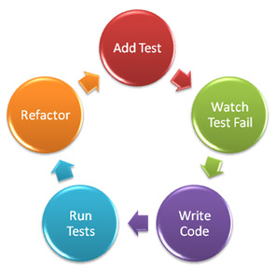
TEST DRIVEN DEVELOPMENT - TDD
Notes:
You write tests before you implement the code. This forces you to think through your features and helps you focus. It has so many hidden benefits
The basic cycle is:
Write The test
Make the test pass
Refactor (make it better, see what you can improve)
Red Green Refactor

Slide 11
WHAT KIND OF TESTS ARE THERE?
Acceptance Tests
Integration Tests
Unit Tests
UI Tests
Notes:
Caveat, these are not formal textbook definitions, simply because there are so many different definitions, words and stuff that just confuses you. I’m going to outline techniques that I would use and that I think you should consider.
Acceptance Tests: These are tests that you do at the highest level possibly, covering your entire application. You can think of it as a feature test.
Integration Tests: Normally, when you interact with Ethereum for instance, things are slow. You don’t want to write all your tests against Ropsten (an Ethereum testnet) for instance, simply because it’s slow and more importantly, tricky to manage state. It is still vitally important though. When we do integration testing, tricky things crop up that we’ve never thought about
Unit Tests: Unit tests are tests that we write to test specific pieces of code. Generally this is thought of as testing a specific function but I’ve found that it really depends on what the unit is. Sometimes it can be a very important part of the contract but a very small piece of code. You want to test as much as possible of it from every angle you can.
UI Tests:
Generally these tests don’t adhere to our formal definitions of them and sometimes a unit test becomes an integration test, or even an acceptance test. Go with it. Just always ask yourself after you’ve written a test, what did I miss.
Contract tests?

Slide 12
SO HOW DO WE TEST
Create an end to end Acceptance Test
Start writing small unit tests per task of your feature, all the while working to making your acceptance test pass
Once we’ve written all the tests, we can go back to the acceptance test and make sure it passed.
Rinse and repeat per feature
Notes:
What I normally would do is create an end to end acceptance test, that will test everything but will then comment out the test (so that the test doesn’t bother me). This helps me think of the whole design flow and potential issues.
I will then start writing the unit test that will test each part of the contract, each one slowly building towards making the acceptance test(s) pass. Remembering to do Red, Green, Refactor all the way.
It’s important to write just enough code to make these tests pass and even more important, to not forget about those good test ideas that keeps on popping up in your head as you are writing these tests. Normally what I do is to just write a test header, and then, so that I don’t forget to implement it, I make it fail in about a weeks’ time. You will forget to come add it later.
When you write a test, you want to not only write tests for the happy tests but also the unhappy ones which are normally even more important than the happy ones with regards to making sure you’ve not messed up. An example would be that you wrote a test that you can approve a transaction for your child but, you didn’t write a test to make sure that nobody else accept the owner can approve the transaction.
As we write new tests and change the existing code, we want to make sure that all our previous tests are still passing and that we haven’t broken something. This is one of
3. Once I have written all these tests, I can now go back to my acceptance test and make sure it passes. I can also go through all my tests and see any obvious ones I have missed.

Slide 13
TESTING IN ETHEREUM
Jest / browser based tests
Contract Tests
Javascript Tests
Notes:
Browser and or react native

Slide 14
TIPS
It takes practice. A lot of it. No seriously, a lot.
If you don’t know where to start, that’s okay. Start with something stupid. Is your contract deployed?
Think before you run your test. What will the output be? Reflect after you ran your test.
Don’t test that the EVM works correctly (except if you’re unsure).
Take time to name your tests
Test the right things.
If the test passes the first time and you don’t expect it, your assert is most likely wrong.
Do not change your code to make it testable.
Notes:
Think before you run your test. What will the output be? Reflect after you ran your test. This is one one those hacks to get better little by little. You train your brain to think through the problem and thereby reducing your test / fix cycle a lot.
Take time to name your tests and more importantly, always make sure that they do what they say.
When you are asserting in your tests, be specific, make sure you test everything. Make sure that you test
Do not add functions to your code to make it testable. Figure out different ways to do this. It will get easier. The more code you write, the more vulnerabilities and potential bugs you have.

Slide 15
TESTING USE CASE
https://github.com/tbohnen/solidity-test-examples/tree/master
Notes:
Let’s go through an example:
Let’s say you have a mobile App where a child can load a payment to some address or contract, and the parent needs to approve it before the funds get sent. Disclaimer: I have not spent any amount of time thinking this through, I am sure there are better ways to do it and I ask you to forget about it and think about it from a testing perspective.
The Features are the following:
You will want to initialize your contract
You want to test that your contract is payable and you can send money to it.
Now that you have money in your contract, you want to add a parent to the contract.
Then you want to add a child to the contract.
Then you want the ability for the child to create a potential transaction
Now you want the parent to approve the transaction and submit it.

Slide 16
CLOSING THOUGHTS
1.
Practice your craft
2.
Keep improving
2.
Start Testing
Notes:
I hope you can see how the practices I’ve taught you will help you to write better code but more importantly, safer, more secure code.

